Slide 1
Ilmu Ekonomi
Pertemuan 2 Prodi PIWAR Politeknik APP Jakarta

Slide 2
Today’s content
Supply and demand: a model of competitive market
Demand curve
Supply curve
The perfect equilibrium

Slide 3
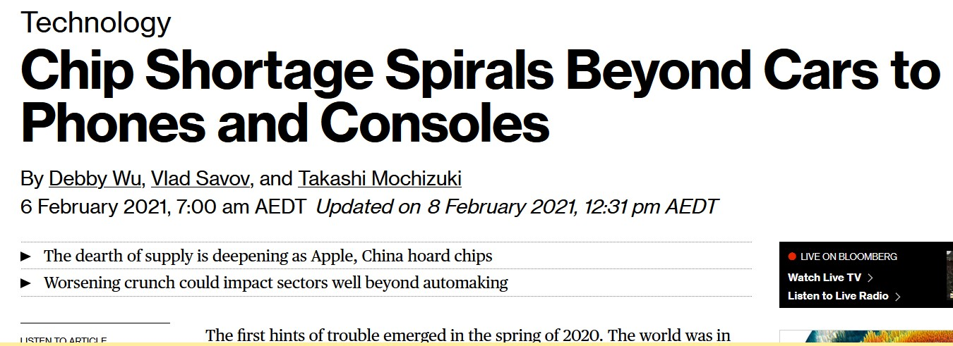
What happen to chip?
chip

Slide 4
Some problems
More stuff are smart these days
Lockdown force people to buy gadget to work and play
more servers for service provider
Lockdown forced stand-downs
US-China trade war

Slide 5
Supply and demand
COVID-19 and trade war cause demand and supply shocks
Demand for electronices rose up, while supply can hardly keep-up
Supply, demand and price are important to making decision.
high price incentivies producer to expand, hence lower price.

Slide 6
Market
Chip makers and chip users create the market for chip.
Market is a “place” where buyers and sellers meet to exchange goods and services for payment.
When there are ‘many’ buyers and ‘many’ sellers, we often say the maket is competitive.
How many is ‘many’? 100? 1.000?

Slide 7
Competitive market
The important feature of competitive market is power.
In the competitive market, buyer and seller cannot control price.
Seller trying to sell above market price won’t get any buyer, vice versa.
Competitive market is also known as perfect market or perfect competition.

Slide 8
Competitive market
Competitive market is characterised by low entry and exit cost.
It is easy to start production or file for bankruptcy.
On the other extreme, there is monopoly, where the buyer/seller have absolute power.
Most markets are somewhere in between.

Slide 9
Competitive market
As previously discussed, we analyze with model.
While no market is exactly perfect, we always start with competitive market.
Like all model, we start with something simple.
as we move forward, we will see the implication of relaxing the perfect market assumption.

Slide 10
Demand curve
Demand is the consumer side of the market, measured by quantity.
It is generally accepted that people buy less goods if it is expensive, ceteris paribus 1.
People say this is the law of demand.
economists usually measure this using the demand schedule & demand curve.

Slide 11
Intermezzo
Is ceteris paribus realistic?
What makes it hard to say exactly high price decrease demand?

Slide 12
Demand schedule
A demand schedule is a table showing how much people will want to buy a certain product given prices.
If everyone in a country face the same price, we can measure demand by adding up all demand for a given price.
Making a demand schedule is not easy, in part because ceteris paribus isn’t realistic.
prices change, but so other things.

Slide 13
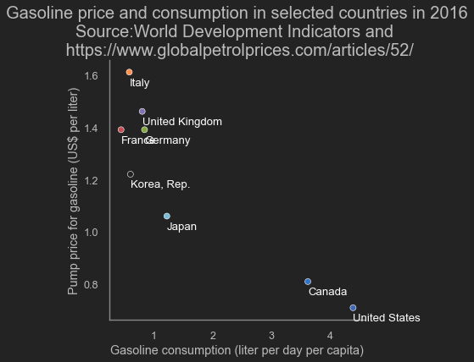
Price and demand
gas

Slide 14
Demand schedule
Price of rice | Rice Consumption
P | Q
(1.000 IDR per kg) | (kg per person per year)
12.0 | 116
11.0 | 130
10.5 | 141
10.0 | 154
9.5 | 170

Slide 16
Demand curve
We can illustrate the demand schedule in a graph.
A High school reminder of a Cartesian diagram:
Two planes, $x$ (horizontal) and $y$ (vertical).
$y=f\left(x\right)$
We plot price on the y-axis, and quantity on the x-axis.
however, perfect market implies $Q^{D}=f\left(P\right)$

Slide 17
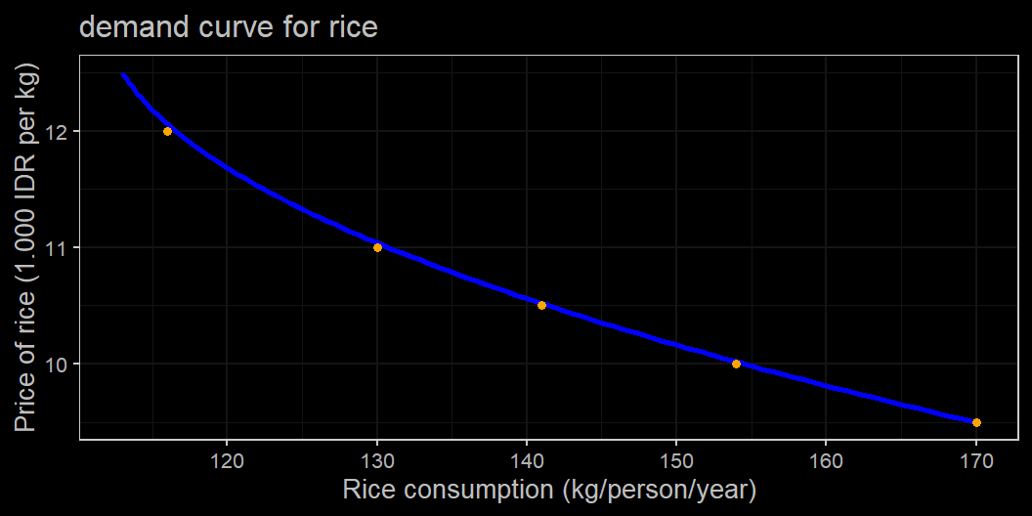

Slide 18
High school reminder
Change in price leads to change in quantity along the lines.
We say quantity is a function of price
$$Q^{D}=f\left(P\right)$$
Price is exogenous, quantity is endogenous.
quantity does not affect price.
That’s why perfect market is convinient.
if price change, Q change along the curve

Slide 19
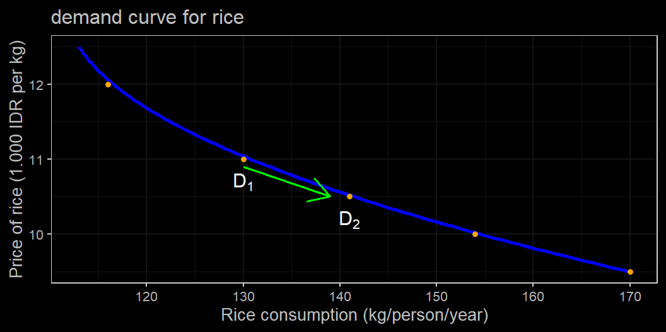
Change in price, ceteris paribus

Slide 20
Demand curve
There are plenty of things affect demand:
increased income, change of taste, influencers, etc.
Additionally, prices change too:
Technology, disaster, tax, etc.
As long as the change doesn’t cause by buyers & sellers.
When this happen, we shift the curve.

Slide 21
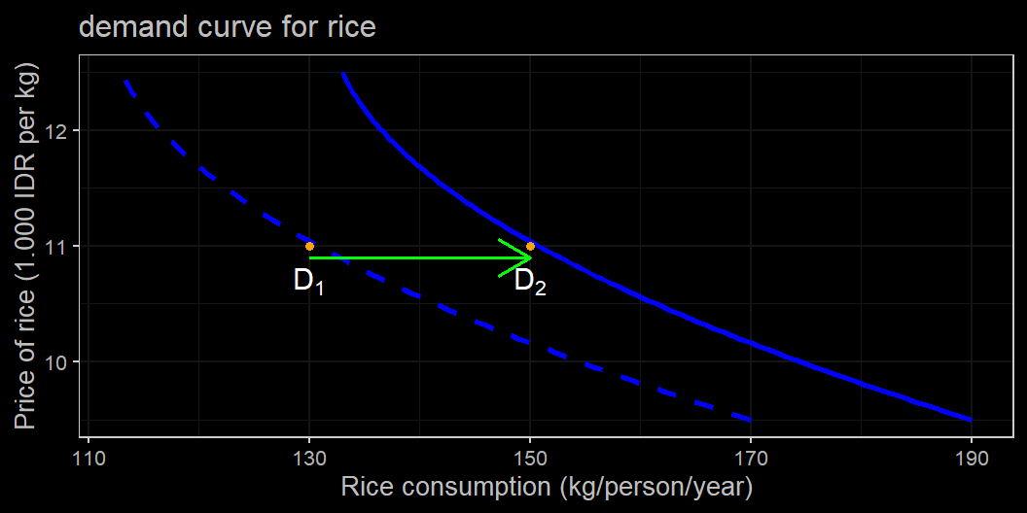
Change in something else

Slide 22
Key take away
We use graph to show relationship between price and quantity.
In perfect competitive market, buyers and sellers can’t affect price. Hence price is exogenous and quantity is endogenous.
Change in price $⇒$ movement along the curve.
Change in everything else $⇒$ shift the curve.

Slide 23
Back to demand
Shift the curve is what generally means by economist when we say increase in demand or decrease in demand.
i.e., at the same price point, demand change.
What shift the demand curve?
Changes in the prices of related goods.
Changes in income.
Changes in taste.
Changes in expectations.
Changes in the number of consumers.

Slide 24
Changes in the prices of related goods or services
Most normal goods have a substitutes.
A Substitute is another good which serve the same purpose.
you will not likely to buy it if you have your main good.
Bread, noodle, and pasta can be considered a substitute for rice. What else?
When $P_{noodle}$ goes down, you might want to switch to noodle, hence reducing demand for rice even when $P_{rice}$ doesn’t change.

Slide 25
Changes in the prices of related goods or services
The opposite of substitute is complements $​^{2}$
Demand is reduced if its complement is also reduced in demand.
Demand for combustion engine car reduced when gasoline (bensin) prices go up.
similarly, people tend to buy electric car if charging it is relatively cheaper.
.footnote[[2]: not compliment. different word]

Slide 26
Changes in income
In most goods, people buy more when their income increases.
that’s why businesses pay attention to a country’s economic growth.
Most goods are normal goods, not inferior goods.
inferior goods behave the other way around: buy less when income goes up.
you buy less of instant noodle when you’re richer.

Slide 27
Changes in tastes.
Changes in taste is straightforward.
nobody listens to K-Pop back in the 90s.
We don’t know how, but people’s taste is changing.
Marketers and advertisers would like to disagree.
If you can detect changes in tastes, or even better, influence other people’s taste, you have an advantage in business!

Slide 28
Changes in expectations.
People reacts on signal and what they expect for the future.
Some people hold back purchasing some goods because they know those goods will have a discount in the near future.
People buy more stocks when vaccine introduced cuz they expect the economy to grow in the near future.
Knowledge is an advantage
that’s why insider trading is illegal.

Slide 29
Changes in the number of buyer
Similar with income, more buyer means more demand given the same price.
This is why warteg often gets higher demand when there is a new construction site nearby.
As the number of middle-class increases, demand for things that they usually buy also increase.

Slide 30
Supply & Prices
Is the other side of the market.
Like demand but the opposite:
Supply goes up when prices goes up.
When surgical facemask’s price went up, even Polytron supplies facemasks.
We also express supply with supply schedule and supply curve.

Slide 31
Supply schedule
Price of rice | Supply of rice
P | Q
(1.000 IDR per kg) | (kg per person per year)
12.0 | 170
11.0 | 154
10.5 | 141
10.0 | 129
9.5 | 113

Slide 33
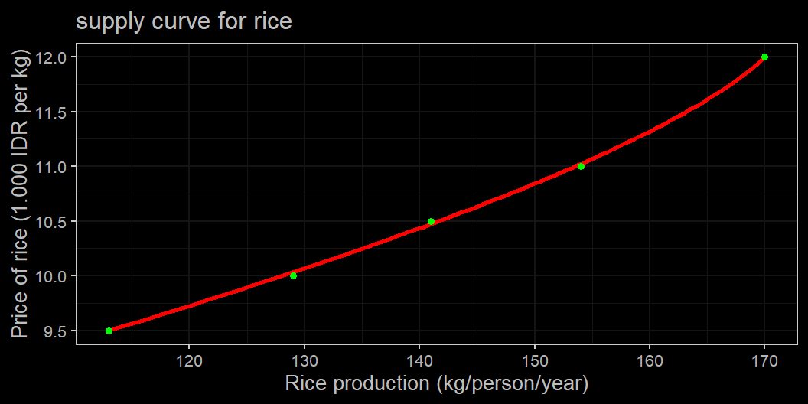
Supply curve

Slide 34
Supply Curve
When price changes, quantity supplied go up.
like demand, if sellers can’t affect the market price, they follow the market price.
$$Q^{S}=f\left(P\right)$$
- the difference is, prices positively correlated with $Q^{S}$, $i.e.,$ $\frac{dQ^{S}}{dP}>0$, $i.e.,$ upward sloping.
Hence, $P$ is exogen, $Q^{s}$ is endogen.

Slide 35
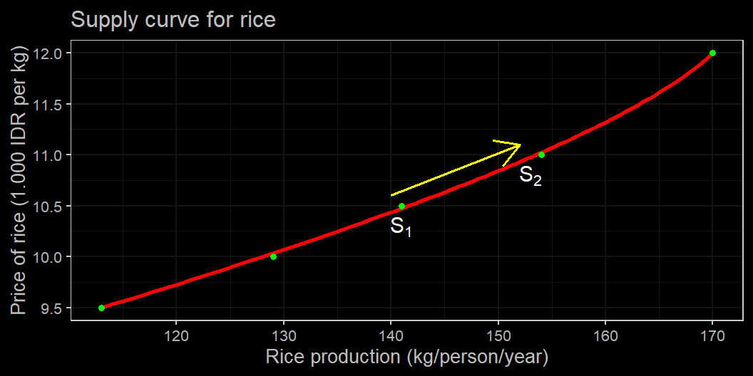
Change in price, ceteris paribus

Slide 36
Supply curve
Plenty of things that are not prices also affects the supply curve.
Affecting farmers’ decision to supply includes:
change in import price.
change in minimum wage in manufacturing.
Draught or flood.
Adoption in tech, etc.
we’ll learn more about production cost later.
When these changes, we shift the curve.

Slide 37
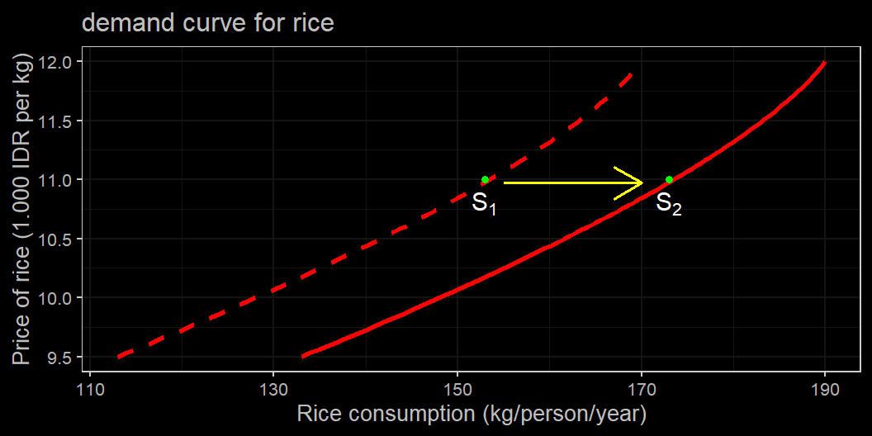
Changes in something else

Slide 38
What shifts the supply curve?
Like demand, there are several generelised factors affecting the supply curve.
They are:
Changes in input prices
Changes in the prices of related goods or services
Changes in technology
Changes in expectations
Changes in the number of producers

Slide 39
Changes in input prices
To produce, you need inputs
labour, seeds, fertilizers, price of land.
$P_{input}↑ ⇒$ Increase in production cost.
needs higher price to supply same amount of goods.
In a sense, a producer in a market may be a consumer in another market.
A Factory outlet is a producer in the shirt market, but a consumer in the fabric market.

Slide 40
Changes in the prices of related goods or services
Especially important for producers which sell many types of products with a very similar inputs.
Toyota produces a lot of Avanza in Indonesia.
taxes for sedan and utility vehicles is higher in Indonesia.
You won’t see Avanza in Australia. Instead, there’s a lot of Camries and Hiluxes.

Slide 41
Changes in expectation
Suppliers also tend to react to expectation.
When a producer think there will be increase in price of its good in the future, it will hold to sell it.
In fact, hoarding is a part of a producer’s strategy.
There’s a trade-off between selling it now vs storing it and sell it later.

Slide 42
Changes in the number of sellers
Similar with income, more seller means more supply given the same price.
The rise of Gojek and the likes leads to higher supply of transportation service.
Similarly when China started to rise up in manufacturing: more supply for cheap labour for electronic industry.

Slide 43
Market equilibrium
Now that we learn that buyer and seller react to price on a curve, it is time to unite them!
The perfect market is when quantity supplied matches quantity demanded.
$$Q^{D}=Q^{S}$$
- The price that causes this is called equilibrium price or market clearing price.
The easiest way is to graph the two Q together.

Slide 44
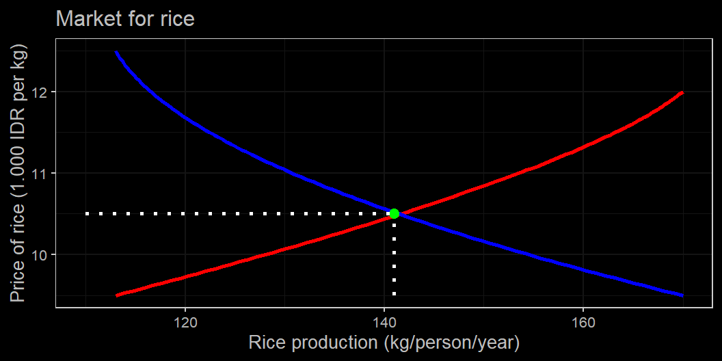
Equilibrium price

Slide 45
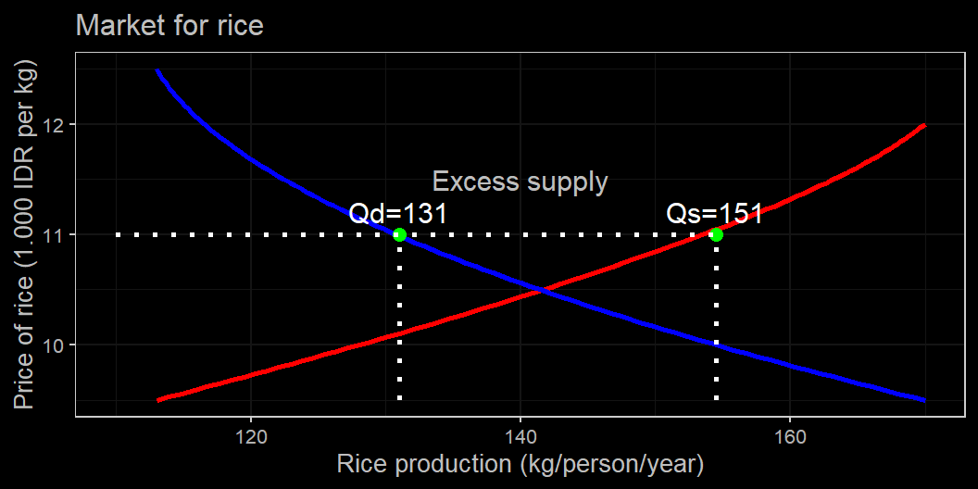
Excess Supply

Slide 46
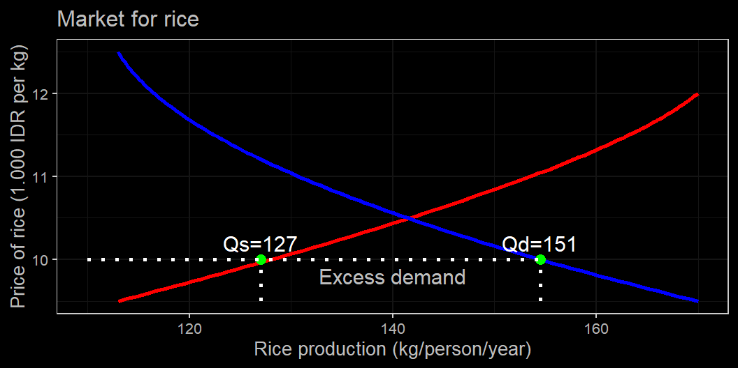
Excess Demand

Slide 47
Market equilibrium
If price is above market price, there will be excess supply. Many goods are left unsold as the price isn’t worth it for some buyers.
Some of the less competitive supplier will close, driving price down.
If price is below market price, there will be excess demand. Not enough goods are supplied and there will be scarcity in the market. People will try to sell more as producers increase production.
sometimes it is even worth it to invest. Many alcohol producer turns to making hand sanitiser. Also, Polytron.

Slide 48
Market equilibrium
Price equilibrium may take some time to adjust.
Some Markets are constantly moving (stock price is a good example)
Shocks to demand and/or supply will move market equilibrium to a new position.
New market equilibrium basically means a new equilibrium price and equilibrium quantity is formed.

Slide 49
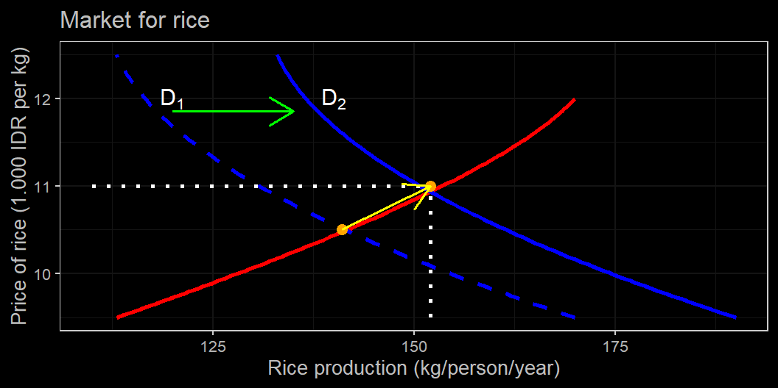
Equilibrium amid demand shock

Slide 50
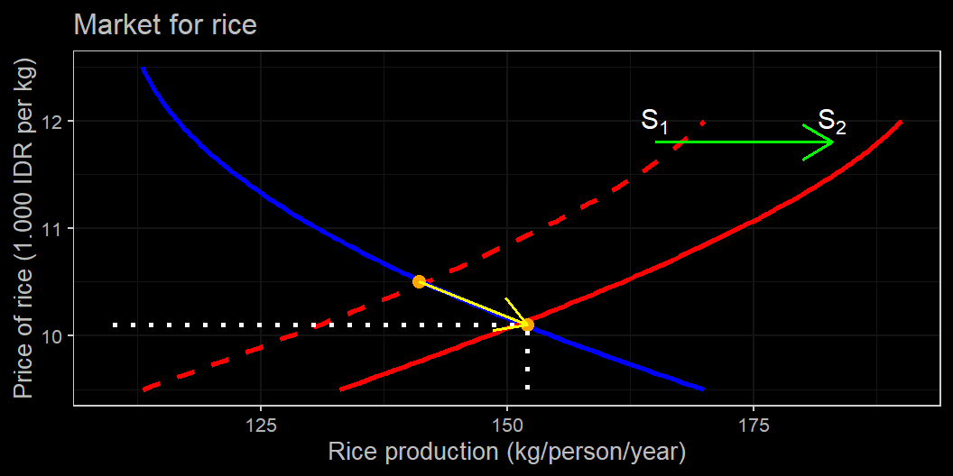
Equilibrium amid supply shock

Slide 51
Equilibrium after shock
A positive demand shock leads to a higher equilibrium quantity and price.
A positive supply shock leads to a higher equilibrium quantity but a lower price.
A negative demand shock leads to a lower equilibrium quantity and price, and lower equilibrium quantity with a higher price.

Slide 52
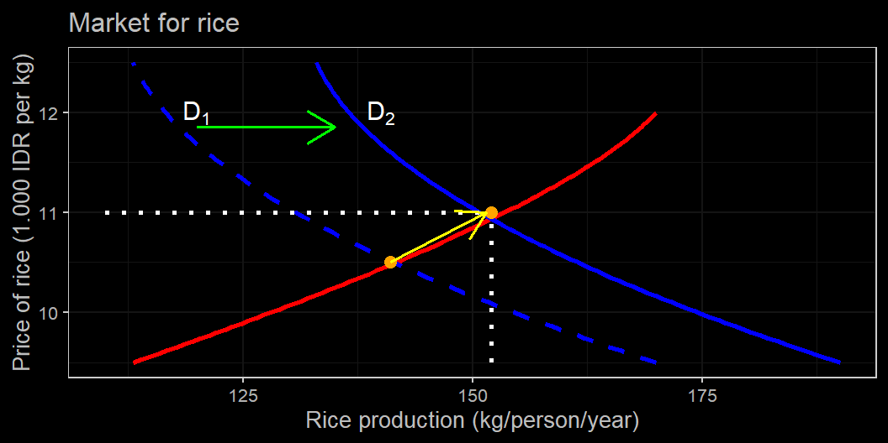
Equilibrium amid demand shock

Slide 53
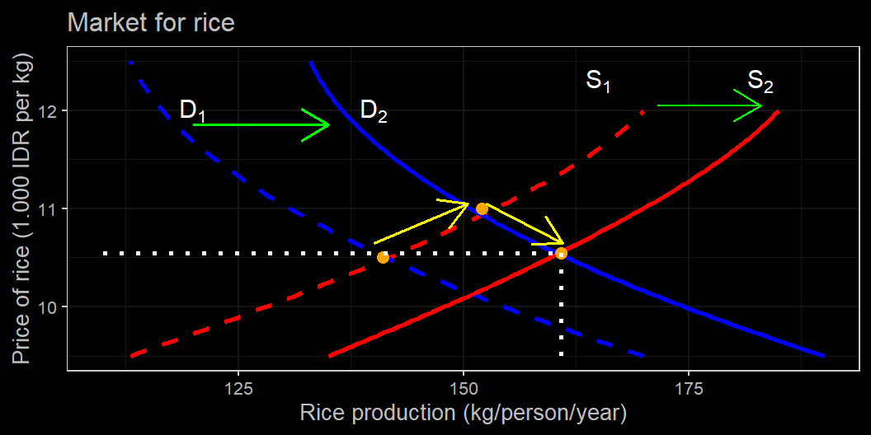
Equilibrium amid demand shock then supply shock

Slide 54
Double positive shocks
As you can see, if the positive shock is big enough, it can offset the rise in price with even higher increase in demand.
You might note as well that the slope of the curve matters.
steeper curve change quantity even more.
We will learn more later on elasticity.

Slide 55
Perfect market
So we learned a bit on how perfect market operates:
Supply and demand will eventually settle on a market clearing price.
Market clearing price adjust quickly.
No single buyer or seller can affect it.
Movement along the curve occurs when price change
while exogenous shock (non-price change) shifts the curve.

Slide 56
Next week
What happens when market prices doesn’t adjust as quickly?
What happens when the government intervene in a perfect market?
We will learn tomorrow in meddling with the market

