Slide 1
ECES805205 Trade and Industrial Economic Development Analysis
Week 9-15
Lecturer: Deasy Pane

Slide 2
Lectures
Week | Topics
9 | Tools for trade analysis
10 | Trade policy in action: tariff & non-tariff measures
11 | Firms in international trade
12 | Commodities exports & Dutch diseases
13 | Free Trade Agreement in action
14 | Global Value Chain in action
15 | Case studies on industrial policy (group presentation)
16 | Final Exam

Slide 3
Grading
Midterm exam | 35 %
Final exam | 35 %
Assignment | 30 %

Slide 4
Paper Assignment
Case study for trade and industrial analysis for a certain country.
China
Vietnam
India
Or you can choose, but discuss with me
Using various data and methods that are introduced from the class, analyze:
Trade and industrial performance, including their participation in GVCs.
Trade and industrial policies that are implemented, including their participations in FTAs.
What you can learn from them
How it will be relevant for Indonesia or developing countries
Link them with theories and do relevant literature studies
You also can use econometric analysis

Slide 5
Tools for Trade Analysis
Deasy Pane
ECES805205 Trade and Industrial Economic Development Analysis

Slide 6
The goals of this lecture
Be familiar with trade data and sources of trade data
Understand to some tools to do trade analyses
Be able to do analysis using trade data
Be ready with assignments!

Slide 7
Trade data
Who produces trade data?
Where can we get trade data?
What are included in trade data?

Slide 8
Useful links
UNCOMTRADE: https://comtradeplus.un.org/
WITS: https://wits.worldbank.org/
Trademap: https://www.trademap.org/Index.aspx
BPS: https://www.bps.go.id/subject/8/ekspor-impor.html#subjekViewTab3

Slide 9
Understanding the data on export and import
Value, volume, unit price
Time series
By country
By product category (HS code)
Industry level (SITC, ISIC, BEC, Lall Classification)
Firm level

Slide 10
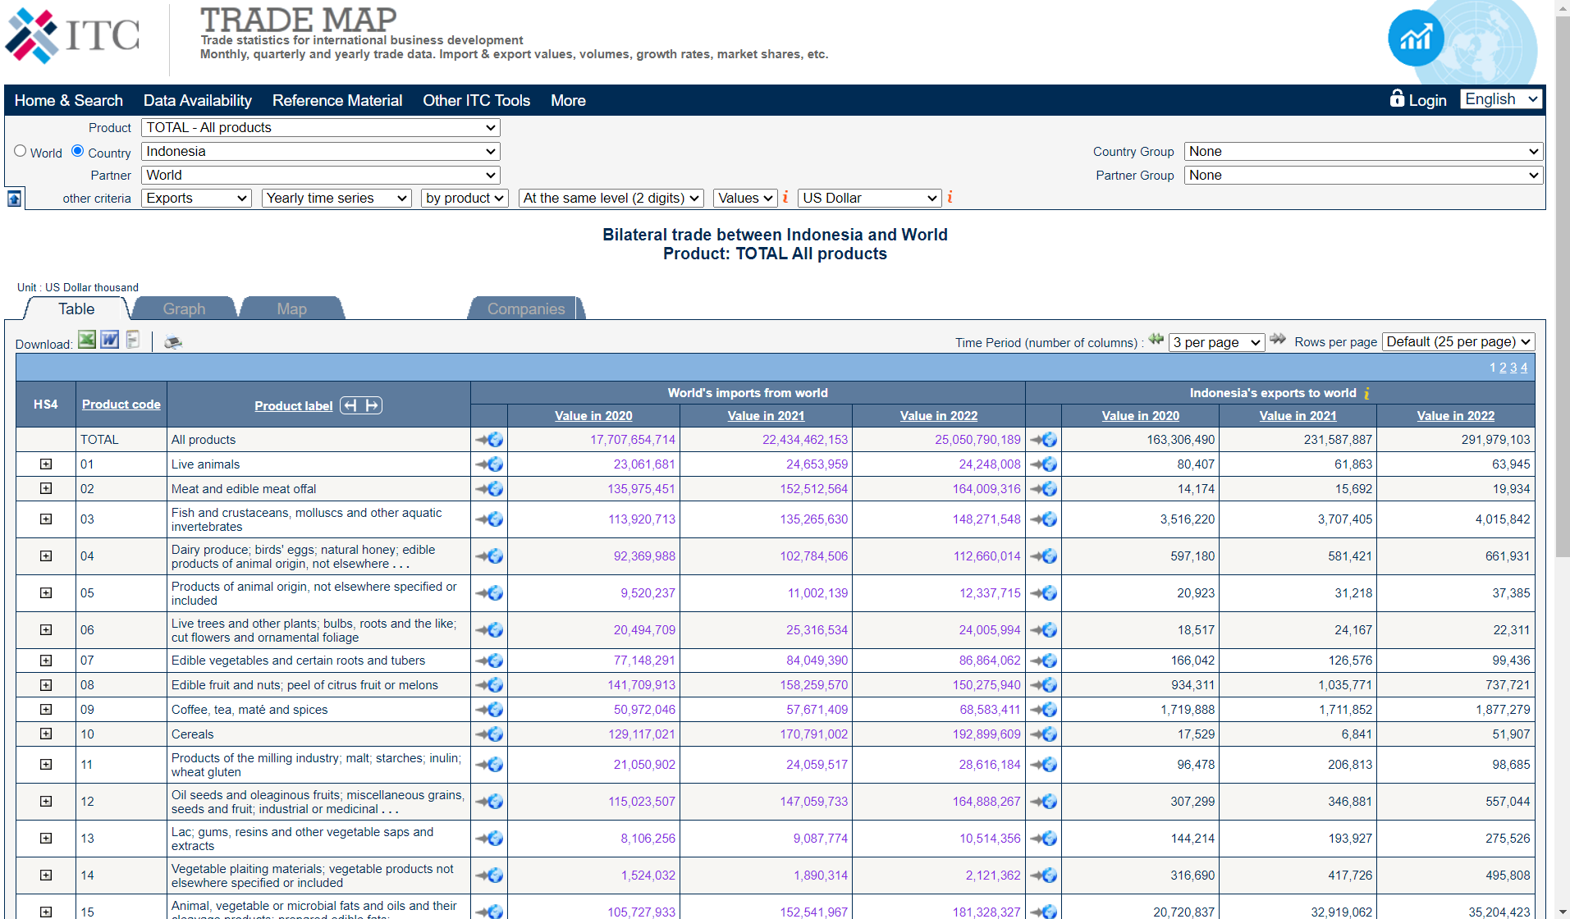

Slide 11
Basic indicators
Trade value
Trade growth
Share of specific products trade to total trade
Global demand
Market share
Share of trade to GDP (trade openness)
Trade balance

Slide 12
Measuring Comparative Advantage
Comparative advantage is an economy's ability to produce a particular good or service at a lower opportunity cost than its trading partners.
Comparative advantage is usually measured in opportunity costs, or the value of the goods that could be produced with the same resources. This is then compared with the opportunity costs of another economic actor to produce the same goods.
Relative prices and therefore costs play a crucial role in determining comparative advantage.
In the absence of sufficient data on factor costs, particularly pre-trade prices that are not observable, how does one find out the commodities in which a country has comparative advantage.
Notes:
For example, if Factory A can make 100 pairs of shoes with the same resources it takes to make 500 belts, then each pair of shoes has an opportunity cost of five belts. If competitor factory B, can make three belts with the resources it takes to make one pair of shoes, then factory A has a comparative advantage in making belts, and factory B has a comparative advantage in making shoes.

Slide 13
Revealed Comparative Advantage (RCA)
Since the analysis is based on realized observed export data, it is called ‘revealed’ comparative advantage by Balassa (1965).
RCA is the ratio of a country’s share of the commodity in the country’s total exports to the share of world exports of the commodity in total world exports.
Notes:
The revealed comparative advantage (RCA) index, introduced by Balassa (1965), can be used to discover the products in which a country has a comparative advantage.
Comparative advantage: countries, firms, or individuals should specialize in the production of goods and services in which they have a lower opportunity cost compared to others.
RCA analysis can help identify areas where the country has a competitive edge and areas that might benefit from further investment and development.

Slide 14
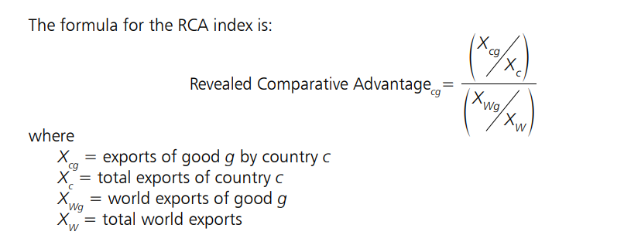
Revealed Comparative Advantage (RCA)
Notes:
Ratio of two shares

Slide 15
Revealed Comparative Advantage (RCA)
RCA > 1: If RCA is greater than 1, it suggests that the country specializes in the production and export of that particular product or industry. It implies a comparative advantage.
RCA < 1: If RCA is less than 1, it indicates that the country does not specialize in that product, suggesting a comparative disadvantage.
RCA = 1: An RCA of 1 means that the country's exports in that product are proportionate to its overall exports.
Notes:
RCA can help identify areas where the country has a competitive edge and areas that might benefit from further investment and development.

Slide 16
Symmetric Revealed Comparative Advantage
RCA is not symmetric; it usually exceeds 1 when net exports are positive and is less than 1 when there is net imports.
In 1995, Laursen and Engedal developed the SRCA index, which generates scores ranging between −1 and +1 and is symmetric around zero.
Countries with SRCA scores close to +1 have a higher revealed comparative advantage, and countries with scores close to −1 have a lower one.
SRCA_{ij} = [RCA_{ij} – 1] / [RCA_{ij} + 1]

Slide 20
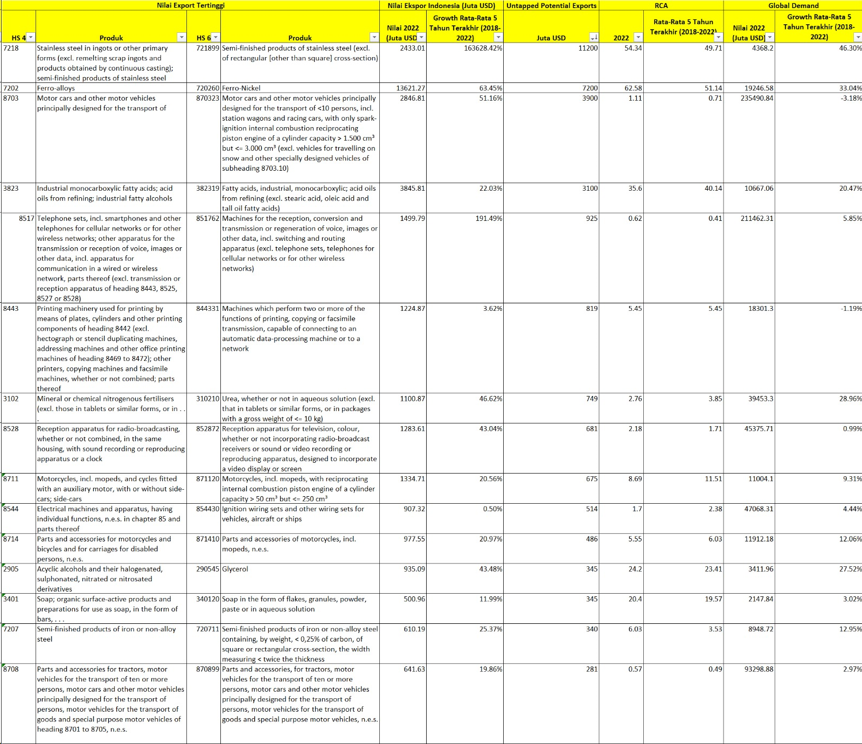

Slide 21
Intra Industry Trade (IIT)
The theory of comparative advantage suggests that countries should specialize to a degree in certain products, then trade should happen between economies with large differences in opportunity costs of production.
However, a high proportion of trade is intra-industry trade. That is, trade of goods within the same industry from one country to another.
IIT is trade where a country simultaneously exports and imports similar or related goods or services within the same industry or product category.

Slide 22
Reasons and benefits of IIT
Strong consumer preferences for variety and choice.
Countries with differences in factor endowments tend to produce different qualities which leads to intra-industry trade.
Firms in different countries work on specific stages of production or particular products and collaborate to each other in value chains. Therefore, trade encompasses not only complete finished products but also intermediate goods.
IIT leads to production cost reduction through economies of scale and more efficient resource allocation
IIT encourages the rise of intra-firm trade within multinational businesses
IIT encourages firms to specialize in particular products, fostering competition, learning, innovation, and excellence in those specific products.

Slide 23
Horizontal and Vertical IIT
Horizontal IIT: This occurs when countries trade similar products within the same quality and price range. For example, both Japan and Germany might export and import high-quality luxury cars.
Vertical IIT: In this case, countries trade goods of different quality or price levels within the same industry. For example, a country might export lower-priced, economy-class cars and import higher-priced luxury cars.

Slide 24
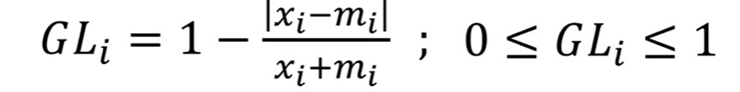
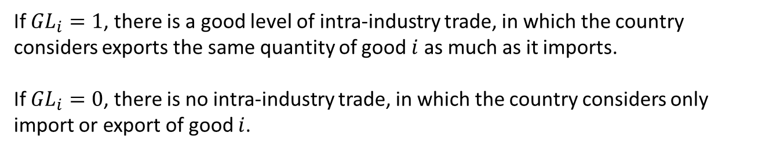
Calculating the Intra-Industry Trade
Grubel and Lloyd Index (1971)
$X_{i}$ denotes the export and $M_{i}$ the import of good $i$
If ${GL}_{i}=1$, there is a good level of intra-industry trade, in which the country considers exports the same quantity of good $i$ as much as it imports.
If ${GL}_{i}=0$, there is no intra-industry trade, in which the country considers only import or export of good $i$.

Slide 26
Trade Intensity Index
How intensively a country is trading with another?
The Trade Intensity Index can be used to assess the strength and significance of trade relationships between two countries. It provides insights into the degree of economic integration or dependency between trading partners on the basis of their importance in world trade.
A high Trade Intensity Index suggests a strong economic link or dependency. Conversely, a low index value indicates a more diversified export portfolio.
The Trade Intensity Index can be useful for various purposes, such as identifying key trading partners, evaluating the impact of trade agreements, assessing economic integration, and understanding the vulnerability of a country's economy to changes in trade with specific partners.

Slide 27
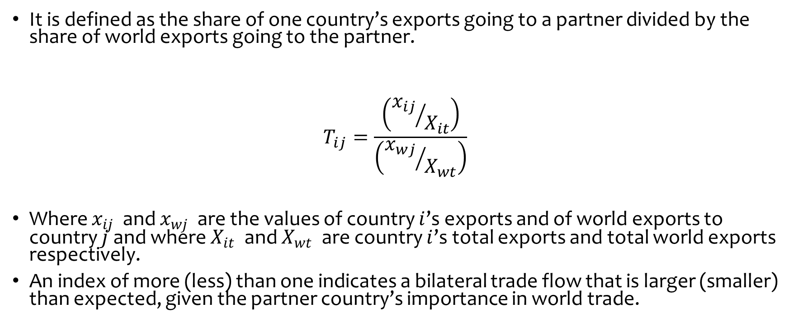
Trade intensity index
It is defined as the share of one country’s exports going to a partner divided by the share of world exports going to the partner.
$$T_{ij}=\frac{\left({x_{ij}}/{X_{it}}\right)}{\left({x_{wj}}/{X_{wt}}\right)}$$
Where $x_{ij}$ and $x_{wj}$ are the values of country $i$’s exports and of world exports to country $j$ and where $X_{it}$ and $X_{wt}$ are country $i$’s total exports and total world exports respectively.
An index of more (less) than one indicates a bilateral trade flow that is larger (smaller) than expected, given the partner country’s importance in world trade.

Slide 29
Trade Complementarity
The Trade Complementarity Index (TCI) measures to what extent the export profile of one country matches the import profile of another country.
It is defined as 1 minus the sum of the absolute value of the difference between the import category shares of a country and the export shares of the country divided in half.
The index takes a value between 0 and 1, with 0 indicating no overlap and 1 indicating a perfect match in the import–export pattern.
A strong level of complementarity could suggest a greater likelihood of achieving successful trade outcomes.

Slide 30
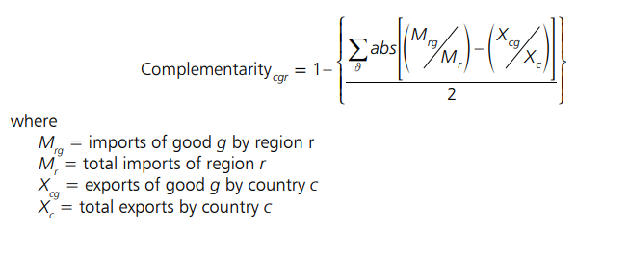
Trade Complementarity Index

Slide 31
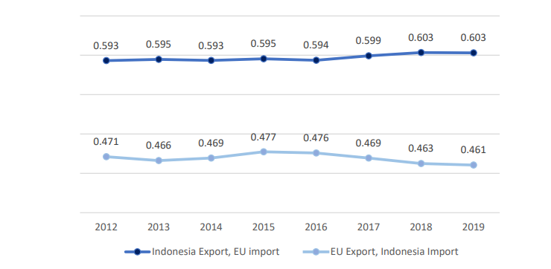
Trade Complementarity Index (TCI) between Indonesia and EU27, 2012-2019
Notes:
Trade between Indonesia and the EU is indeed complementary due to the differences in the socio-economic backgrounds of Indonesia and the EU, as well as the comparative advantages of each party. Ideally, this complementarity would create promising trade relations. Indonesia is a tropical country with diverse natural resources, making it possible to supply animal and vegetable products to the EU market. On the other hand, the EU is a group of countries with advanced technology capable of producing aircraft, engines and electrical products, which are urgently needed for the development of infrastructure and upstream industries in Indonesia.
However, Figure 2.6 above shows that the complementarity of trade between the two inclined to stagnate in recent years. This is shown by Trade Complementarity Index (TCI) figure between Indonesian exports and EU imports, with an average of around 0.6 from 2012 to 2019. Meanwhile, the complementarity between Indonesian imports and EU exports is relatively lower in the range figure of 0.4. However, TCI was not able to capture the main commodities traded between Indonesia and the European Union in more detail. Therefore, this study calculates the coverage rate in order to see a more detailed picture of types of commodities traded between Indonesia-EU.

Slide 32
Export Similarity Index
The Export Similarity Index is to assess the degree of similarity or dissimilarity in the composition of exports between two countries.
This index helps determine how closely the export profiles of two nations align and provides insights into their potential for trade cooperation or competition. It is a useful tool for policymakers, economists, and trade analysts when evaluating trade relationships and identifying potential trade partners.
It is defined as the sum over export categories of the smaller export share, comparing the export share of the country with that of other countries in the region.
The index ranges between 0 and 1, with 0 indicating no overlap in the export profiles (i.e., the country is not a competitor with other countries in the region) and 1 indicating perfect overlap.
The more similar the export profiles are, the more likely it is that there will be limited potential for gains from interindustry trade with a regional trading arrangement. This index does not consider gains from intra-industry trade.

Slide 33
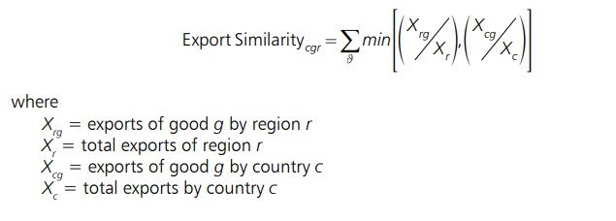
Export Similarity Index
Notes:
The main strengths of using trade indicators is that they are relatively easy to understand, their data requirements are easily satisfied, and their computation is straightforward.
However, their main limitation is that, since these indicators are atheoretical, interpretation of the results may be difficult. In addition, for the indicators presented in the trade indicators section, the results may be meaningless if the indicators are computed for trade categories that are too aggregated or unsuitably classified. To obtain more relevant information from these trade indicators, trade data could be reclassified according to a country’s production structure and the computations could be performed at a more disaggregated level. Finally, these trade indicators are able to answer only a limited number of specific questions regarding an FTA.

Slide 34
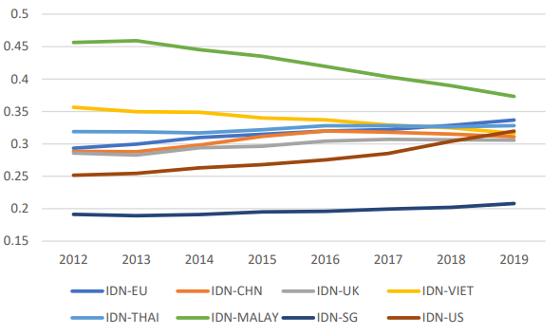
Export Similarity Index (ESI) between Indonesia and Trading Partners, 2012-2019
Notes:
Export Similarity Index (ESI) was developed by Finger and Kreinin (1979). The idea behind this index is that the more different export structure is between developed and developing countries to other (third) markets, the less developing countries will benefit from reduced tariffs which mainly cover products exported by developed countries. ESI can also measure the competitiveness between Indonesia and other EU trading partners. The index is based on the share of each product in the total exports of each country and then is calculated it as the sum of the minimum value for each product.
The ESI results ranged between 0 and 1, where 0 indicates no similarity between the two countries, and 1 indicates identical similarities. As shown in Figure 2.7 above, the Indonesian ESI and EU show increasing pattern with an average value of 0.32 over time. This indicates that the difference in commodities exported between the two countries is quite high, which may be due to differences in their socioeconomic backgrounds, as previously mentioned. The most similar products exported by the EU and Indonesia are motor vehicles and accessories, gold, insulated, wire, cables and other insulated electrical conductors, and musical instruments.
Meanwhile, the similarity index between Indonesia and the main EU importing countries, namely the US, China and the UK, shows relatively lower results compared to the indices between Indonesia and the EU. This is mainly because most of Indonesia's exports are products from the primary sector, such as coal, oil and natural gas. Meanwhile the US, China and the UK generally export high-tech products. The similarity between Indonesia and other ASEAN countries is quite high, for example the 2016 Indonesia-Malaysia index reached 0.4. This means that the two countries are very similar because they export natural gas and palm oil, or products from secondary sectors, such as clothing or shoes. The downward trend occurs because Indonesia is still dominant in exporting natural resource products. Meanwhile, Malaysia is slowly shifting away from the primary sector products to manufactured products.

Slide 35
Constant Market Share Analysis
Constant Market Share (CMS) analysis helps identify the factors responsible for changes in exports, such as changes in market share, changes in product composition, or changes in the overall growth of the global market.
The methodology is used to find out whether a country’s pace of exports growth is in line with world’s exports growth by breaking down the overall growth (or decline) in a country's exports into several components to understand what is driving the change.
It measures the contribution of geographical, product specialization and competitiveness to the growth of exports of a given country under the assumption that its share has remained in the combined exports of every product by all competing exporters.
Notes:
CMS analysis allows policymakers and researchers to understand why a country's exports have grown or declined and to identify areas where policy interventions or business strategies may be needed to enhance export performance. It's a valuable tool for assessing the competitiveness of a nation's exports in the global market.

Slide 36
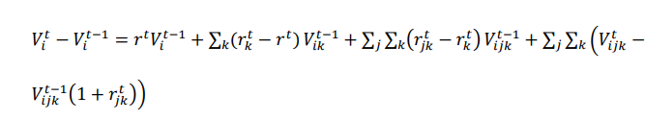
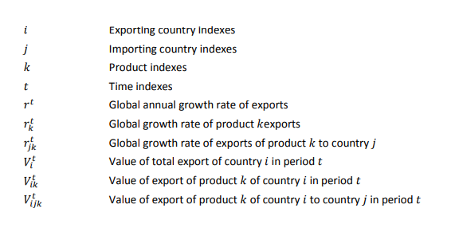
Global effect
Market effects
Competitiveness effects
Product composition effects

Slide 37
Components of CMSA
Global Market Effect is the average export growth rate of the given country 𝑖
Product Composition Effect measures the extent to which country 𝑖 exports are concentrated in commodities with growth rates more favorable than the world average. It will be positive if the country concentrated on the export of goods whose markets were growing relatively fast and negative if it concentrated in slowly growing commodity markets.
Market Effect accounts for changes in market share. It would be positive if country 𝑖 had concentrated its exports in markets that experience relatively rapid growth and negative if it concentrated in relatively stagnant regions.
Residual Effect (or Competitiveness Effects) represents any unexplained changes. A negative value means the country’s failure to maintain its market share in world trade. It may capture factors such as poor quality of products, failure to develop new products in line with changing demand pattern, inefficiencies of production and marketing, etc.

Slide 38
First level analysis
In this analysis, exports are considered as a single good to a single market. Thus, if a country maintains its export share in world market, then exports would increase by rV1.
Therefore the change in exports between two periods may be written as follows:
V2–V1 =rV1+(V2–V1–rV1) … (1)
The above identity (1) means that export growth from period 1 to period 2 (V2 – V1) is divided into components associated with general increase in world exports (rV1) and the competitiveness effects, which is measured as a residual (V2 – V1 – rV1).

Slide 39
Second level analysis
In this analysis, exports are considered for a diverse set of goods and markets. For the i^{th} good, the change in exports between two periods may be written as follows:
Vi2 – Vi1 = riVi1 + (Vi2 – Vi1 – riVi1)
V2 – V1 = Σ_{i} riVi1 + Σ_{i} (Vi2 – Vi1 – riVi1)
= Σ_{i} (r – r + ri) Vi1 + Σ_{i} (Vi2 – Vi1 – riVi1)
= Σ_{i} (rVi1) + Σ_{i} (ri – r) Vi1 + Σ_{i} (Vi2 – Vi1 – riVi1)
= (rV1) +Σ_{i} (ri – r) Vi1 + Σ_{i} (Vi2 – Vi1 – riVi1) …(2)
Notes:
The above identity (2) indicates that a country’s export is decomposed into (a) the general rise in world exports, (b) the commodity composition of the exporting country in period 1, and (c) the competitiveness effects that is measured as a residual showing the difference between actual export increase and the hypothetical increase had the exporting country maintained its share of export of each commodity group.
The commodity composition effect, Σ_{i} (ri – r) Vi1 would be positive, when the exporting country had concentrated on export of goods in which the market for the good were growing relatively faster than total world export growth.
The commodity composition effect, Σ_{i} (ri – r) Vi1 would be negative, when the exporting country had concentrated on export of goods in which the market for the good were growing relatively slower than total world export growth.

Slide 40
Third level analysis
V2 – V1 = Σ_{i}Σ_{j} rijVij1 + Σ_{i}Σ_{j} (Vij2 – Vij1 – rijVij1)
= Σ_{i}Σ_{j} (r – r + ri – ri + rij) Vij1 + Σ_{i}Σ_{j} (Vij2 – Vij1 – rijVij1)
= Σ_{i}Σ_{j} (rVij1 – r Vij1 + riVij1 – riVij1 + rijVij1) + Σ_{i}Σ_{j} (Vij2 – Vij1 – rijVij1)
= Σ_{i}Σ_{j}rVij1 + Σ_{i}Σ_{j} (ri - r) Vij1 + Σ_{i}Σ_{j} (rij – ri) Vij1 + Σ_{i}Σ_{j} (Vij2 – Vij1 – rijVij1)
= Σ_{i} r Vi1 + Σ_{i} (ri – r ) Vi1 + Σ_{i}Σ_{j} (rij – ri) Vij1 + Σ_{i}Σ_{j} (Vij2 – Vij1 – rijVij1)
= (rV1) + Σ_{i} (ri – r) Vi1 + Σ_{i}Σ_{j} (rij – ri) Vij1 + Σ_{i}Σ_{j} (Vij2 – Vij1 – rijVij1) …(3)
Notes:
The identity (3) shows that export growth can be decomposed into (a) the general rise in world export; (b) the commodity composition of the exporting in period 1; (c) the market distribution of the exporting country’s exports; and (d) the competitiveness effects that is measured as a residual indicating the differences between actual export increase and the hypothetical increase when the exporting country had maintained its share of export of each commodity group to each country.
The market distribution effect, Σ_{i}Σ_{j} (rij – ri) Vij1 would be positive when the exporting country had concentrated its exports in the market that were growing relatively faster than total world export growth.
The market distribution effect, Σ_{i}Σ_{j} (rij – ri) Vij1 would be negative when the exporting country had concentrated its exports more in the stagnant region of the world.

Slide 41
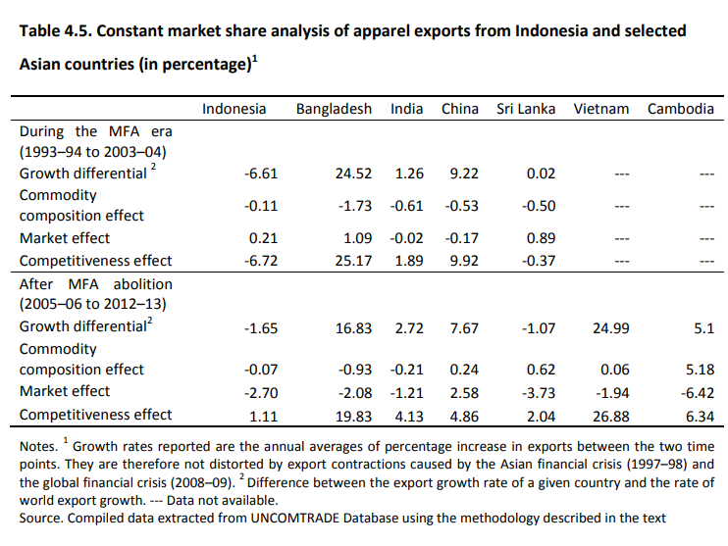

Slide 42
Limitations of CMSA
Competitiveness is measured as a residual, which may include many things including competitiveness.
The magnitude of each effect is influenced by the level of aggregation of the commodities, which is usually chosen subjectively, depending on the availability of data.
The magnitude of effects do not indicate anything about the possible causes of those effects.

Slide 43
Gravity Model
The gravity trade flow model is one of the most used empirical trade flow equation.
This model provides an empirically tractable general equilibrium framework for bilateral trade flow analysis.
The gravity model states that the volume of trade between two countries is proportional to their economic mass and a measure of their relative trade frictions.
The basic formulation of the gravity flow model has bilateral trade between two countries as the dependent variable, while income, population and distances between trading partners as the independent variables.
Notes:
Prices are excluded from the model, as the approach studies equilibrium trade flows that result from the interaction of supply and demand adjusting price as an endogenous variable.

Slide 44
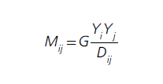
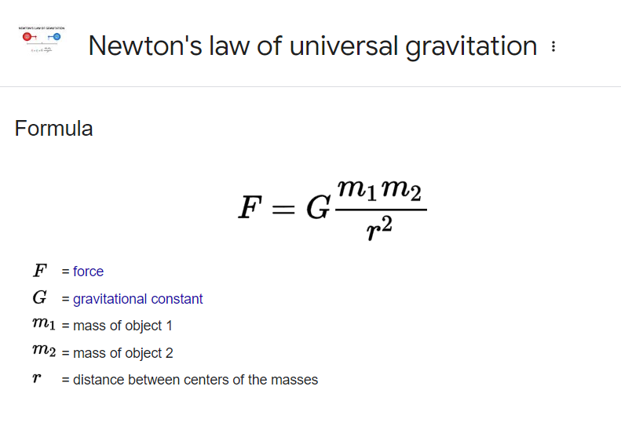
Gravity Model
Mij is the value of trade between country i and country j.
Yi denotes for importer-specific factors that make up the total importer’s demand (usually the importing country’s GDP).
Yj comprises exporter-specific factors (such as the exporter’s GDP) that represent the total amount exporters are willing to supply.
Dij is represents the trade costs of exporter i to access of market j (distances, tariffs, other costs).
G is a variable that does not depend on i or j such as the level of world liberalization.
The basic gravity model is derived from the Newton’s law of gravity

Slide 45

Gravity Model
In log term:
In the gravity equation, geographical distance between the importing and exporting countries is actually a proxy for trade costs, which impede bilateral trade.
Other variables that capture trade costs can be also added, such as tariffs, NTMs, FTAs, common language, colonial links, common currency, or whether the importing or exporting countries are islands or landlocked.
Gravity equations can be estimated using cross-section, time-series, and panel data.

Slide 46
Multilateral trade-resistance in gravity model
Anderson and van Wincoop’s (2003) shows that controlling for relative trade costs is crucial for a well-specified gravity model.
The propensity of country j to import from country i is determined by country j’s trade cost toward i relative to its overall “resistance” to imports (weighted average trade costs) and to the average “resistance” facing exporters in country i; not simply by the absolute trade costs between countries i and j.
Two countries surrounded by other large trading economies, say Belgium and the Netherlands bordered by France and Germany respectively as well as by each other, will trade less between themselves than if they were surrounded by oceans (such as Australia and New Zealand) or by vast stretches of deserts and mountains (such as the Kyrgyz Republic and Kazakhstan).

Slide 49
Thank You

