Slide 1
Ilmu Ekonomi
Pertemuan 12 Prodi PIWAR Politeknik APP Jakarta

Slide 2
Last week-ish
AD-AS see movement of real sector / goods market:
Relationship between real GDP and prices
Unemployment gets affected:
employment follows GDP: moves in short-run, neutral in long-run.
In long-run, wage rate follows prices.
Government can interfere:
prices doesn’t change in long-run.

Slide 3
This week
We have yet the third market: Money market.
Money market completes the macroeconomics relationship: growth, unemployment and inflation.
We will learn supply and demand of money, with interest rate as its price.
We covered how financial system works.
We will then see how central bank fits in.

Slide 4
The money market
via GIPHY

Slide 5
Demand for money
We have learned that money is the most liquid form of asset.
Easy to use for transaction
However, there’s opportunity cost of holding money
money bears little to no return compared to other asset classes.
While there are many returns to asset, we use interest rate as the main opportunity cost of holding money.
therefore, interest rate is the ‘cost’ we have to pay to get the convinience of ease of transaction.

Slide 6
Demand for money
We can say that interest rate is the price of money.
As interest rate increase, the opportunity cost of holding money increases.
if interest rate is high, it is better to hold less money and put them in the deposit account.
remember the lesson last week about money creation:
when interest rate is high, borrowing becomes expensive while saving becomes more profitable.
This situation leads to hence less money being created.

Slide 7
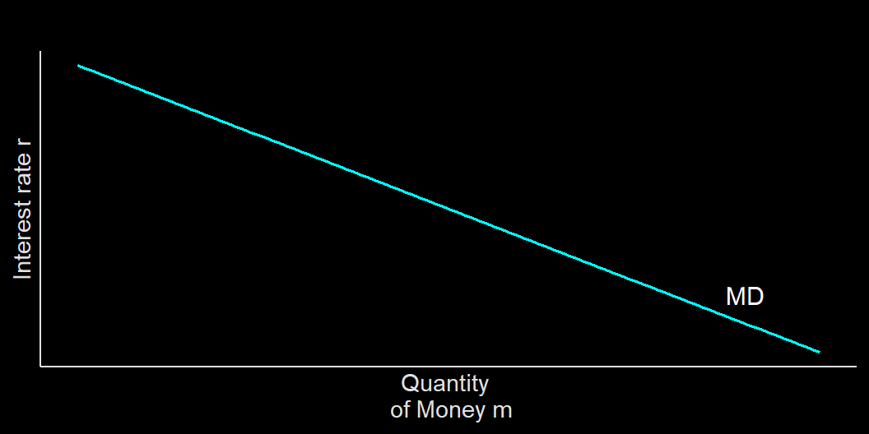
Money demand curve
money demand is downward sloping
changes in interest rate leads to movement along the curve:
r $⇑$, M $⇓$
vice versa
Other changes leads to a shift in the money market

Slide 8
What shifts the MD curve?
Changes in aggregate price level. When price is high, you need more cash in hand to purchase them. When I was young, going out with Rp100k in hand is enough to buy dinner and movie tickets. Now?
Changes in real GDP. As money is used to buy things, when there are more things to buy, there are more money demanded in the economy.
Changes in institution. Rules such as reserve requirements matter: higher reserve means less flexibility in creating money.

Slide 9
Money supply
We have learned that money is created by the banking system.
However, the main driver of money creation is the central bank.
in Indonesia its Bank Indonesia (BI).
Bank Indonesia controls money supply in three ways:
Open-market operations via buying and selling treasury bills
Discount windows
Change reserve requirements.

Slide 10
Money supply
Three main tools for BI to control money supply:
Open-market operations is buying and selling treasury bill (eg Sertifikat Bank Indonesia, SukBI, etc). BI sells t-bill when they want to reduce money supply, and buys them when otherwise.
Discount windows is opened when banks needed liquidity and BI provide them with interest rate. The interest rate BI charge to banks is called Repo rate (BI 7DRR). Low repo rate allows banks to expand money supply.
Reserve requirements. When liquidity is needed, BI will reduce reserve requirements so banks have more money to lend to people. This is the case during COVID-19 recession.

Slide 11
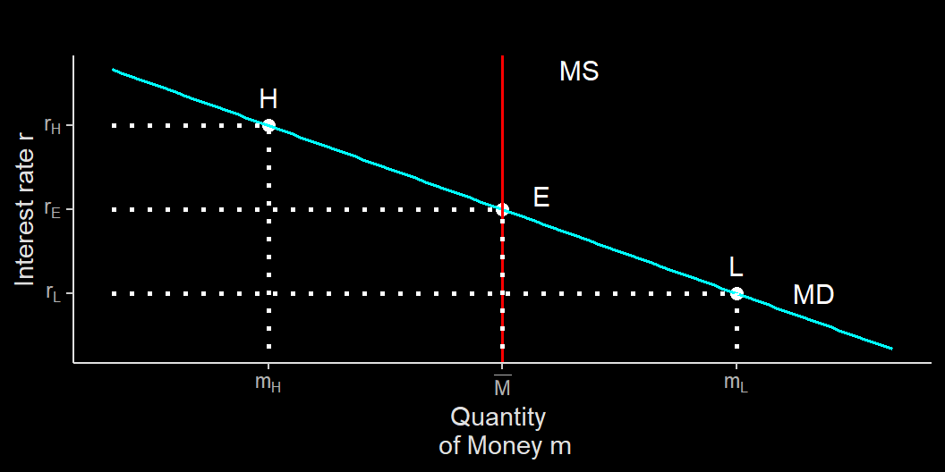
Money market equilibrium
This is called liquidity preference model of interest rate.
BI sets how much money in the market by setting interest rate. Effectively, BI controls the movement of MS.
When BI wants less money circulated, they crank-up interest rate by using its three tools.

Slide 12
Money market equilibrium
Suppose economy booms and demand for money at $L$, but BI keeps MS at $\overline{M}$.
At $L$, money demand is $M_{L}$ and interest rate is at $r_{L}$
For those who want to sell non-money asset, they has to offer higher interest rate.
Which cranks up general interest rate and reduce money demand back to $\overline{M}$

Slide 13
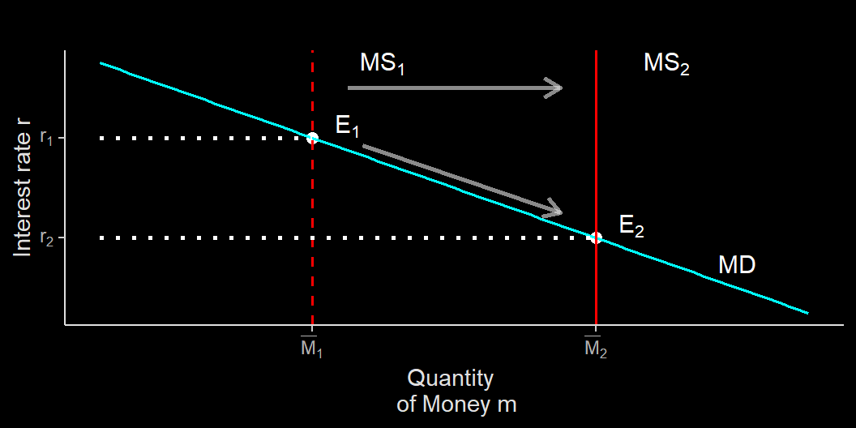
Changing money supply
Suppose the cenral bank issue expansionary monetary policy either by purchasing t-bill or reducing repo rate.
The policy pushes money to the banking system, which leads banks to reduce their interest rate.
Lower interest rate lower borrowing costs, create more money in circulation.

Slide 14
Monetary policy and Aggregate Demand
In the previous week, we touched a bit on what moves AD curves.
When BI increase money supply:
interest rate drops
low interest rate = low borrowing costs:
investment and consumption increases.
leads to AD shifts to the right.
When BI decrease money supply:
interest rate increases
high interest rate = high borrowing costs:
people saves; industries halt investment.
leads to AD shifts to the left.

Slide 15
Monetary policy
Central bank should only reduce interest rate when output is below potential output.
The reason is the same as the government:
during normal times, boosting AD will results in inflation.
In fact, inflation is the main mandate of BI, NOT output nor unemployment.
The main mandate of BI is to maintain the value of IDR:
controlled inflation
controlled exchange rate

Slide 16
Inflation targeting Framework
Inflation targeting framework (ITF) is a framework where the basis of BI’s monetary policy is inflation.
BI announce its inflation target (together with Ministry of Finance), and vows to use monetary policy to get that inflation rate.
as of today, the target is 3$$1%
When inflation is below target, BI will be expansive, whereas high inflation will leads BI to rise interest rate.
Indonesia is an open economy: inflation can happen due to cheap IDR. This is why BI also intervene in the exchange rate market.

Slide 17
Year | Actual Inflation | Target Inflation | End of Year BI Rate
2006 | 6.60 | 8.0 | 9.75
2007 | 6.59 | 6.0 | 8.00
2008 | 11.06 | 5.0 | 9.25
2009 | 2.78 | 4.5 | 6.50
2010 | 6.96 | 5.0 | 6.50
2011 | 3.79 | 5.0 | 6.00
2012 | 4.30 | 4.5 | 5.75
2013 | 8.38 | 4.5 | 7.50
2014 | 8.36 | 4.5 | 7.75
2015 | 3.35 | 4.0 | 7.50
2016 | 3.02 | 4.0 | 4.75
2017 | 3.61 | 4.0 | 4.25
2018 | 3.13 | 3.5 | 6.00
2019 | 2.72 | 3.5 | 5.00
ª Source: BI

Slide 18
When inflation was high, BI rate is also high. High BI rate is supposed to have money absorption effect.

Slide 19
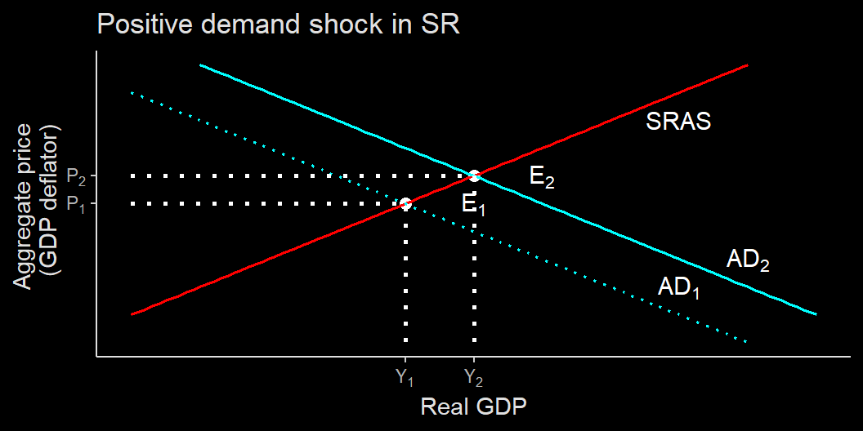
Expansionary monetary policy
When the central bank increase money supply, interest rate goes down, leads to inrease investment and consumption.
AD shifts to the right, output go up to $Y_{2}$ while aggregate price level increases to $P_{2}$

Slide 20
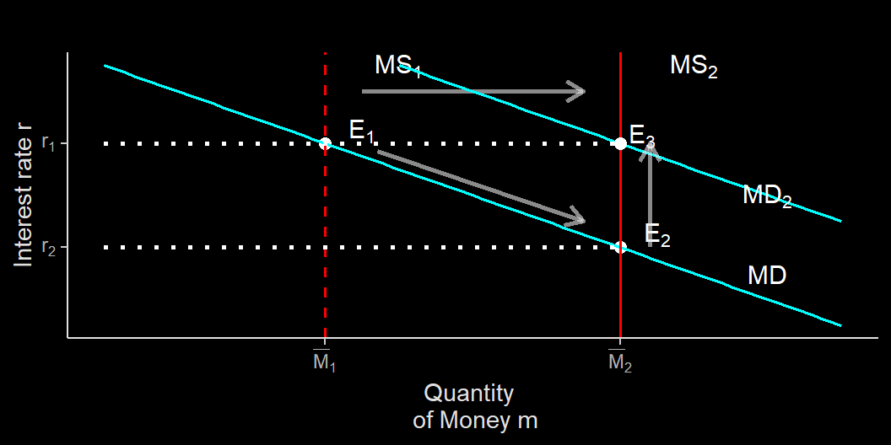
Inflation shifts MD…
The central bank can either pull money supply back, or keep money supply high.
If money supply stay high, because aggregate demand and aggregate price both go up, MD shifts to the right, increasing money demand.
In the long-run, this push interest rate back up to the original position.

Slide 21
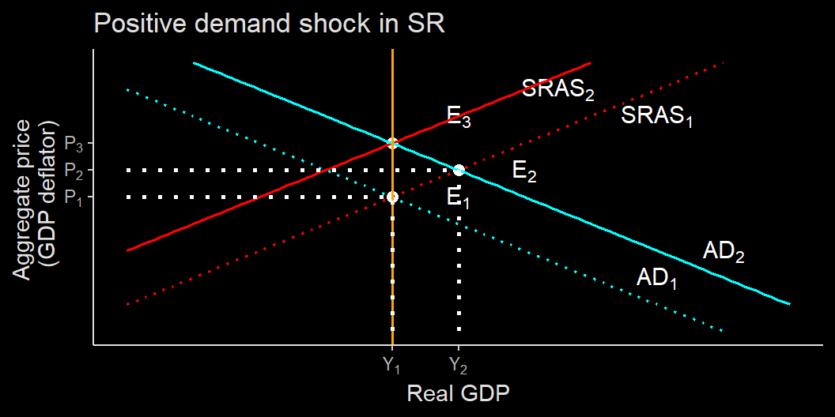
Long run impact
Increase of interest rate and wage rate in the long run leads to lower supply (SRAS shifts to the left)
In the end, output level is back to normal, but prices go up (inflation)
The central bank failed to keep GDP and employment high, sacrifices its main target which is inflation.

Slide 22
Long-run neutrality of money
Often, many government asks the central bank to finance their expansive program instead of stabilizing prices.
But when the economy is in its normal state, expansionary monetary policy will only leads to higher inflation.
This is called neutrality of money, that is, during normal times, you can’t boost real GDP because increased prices will neutralize the higher amount of money.

Slide 23
Importance of ITF
The central bank (and the government) have very important job in mitigating recession and stabilizing the economy.
It is not easy, however:
Tightening monetary and fiscal policy too soon risks economy return to recession.
Tightening monetary and fiscal policy too late, and the economy may overheat, inflate, and bursting bubbles.
That is why inflation targeting is important, as inflation is the sign of overheating economy.

Slide 24
In short…
During a recession:
Self-correcting mechanism:
Short-run: AD shifts to left, prices go down, output/GDP go down.
Long-run, self-correcting mechanism: AS shifts to right, prices go even lower but output returns to normal.
In the end, output stays the same, prices level is very low.
Government intervention:
Short-run: AD shifts to left, prices go down, output/GDP go down.
Government interventions: AD shifts to the right, prices and output go back to normal.
In the end, output and prices is the same.

Slide 25
Does monetary policy work?
Note that the central bank does not dictate interest rate charged by private banks.
BI set repo rate to increase incentive for banks to expand their lending.
However, there are possibilities that consumer banks do not follow the rate set by BI rate.

Slide 26
Does monetary policy work?
One reason is high risk premia. Some countries has terrible investing condition. In this situation, default rate may be too big for banks to lower their interest rate and forego their reserves.

Slide 27
Does monetary policy work?
Second reason is oligopolistic banking market. Remember that interest rate is basically the price of lending service. Banks can hold high interest rate to maximize profit the same way normal monopoly and oligopoly works.

Slide 28
Does monetary policy work?
Banking sector can become oligopolistic when there are high barriers to entry.
When barriers to entry to banking is high but demand for lending exist, illegal lending pops-up, e.g.:
lintah darat
illegal Fin-tech
Third problem is what plague advance countries: zero-lower bound. In advance countries, interest rate is so low, it has to go negative to be lowered.
De facto wise, interest rate is already negative in some countries if you consider admin fee. But we still use banks amid convenience.

Slide 29
What to do?
When monetary policy isn’t effective, the central bank can turn to the government.
Instead of selling t-bill to banks, BI can sell t-bill straight to the government to finance $G$
This effectively turns monetary policy to fiscal policy.
However, this method risks hyper-inflation as in 1966. In fact, since it is in the government’s interest to grow GDP, it can ask central bank to purchase t-bill even during normal times.

Slide 30
Next-up
Macroeconomics essentially discussing relationship between aggregate demand, aggregate supply, aggregate prices, unemployment, interest rate and money supply.
These understandings are important to make sense of macroeconomic news.
However, we have not discuss one crucial thing: international economics.
Next-week we will learn one more important indicator: balance of trade and balance of payment.
Further, we will see how exchange rate and international credit market plays a role in the economy.

Slide 31
The end

