Slide 1
Ilmu Ekonomi
Pertemuan 11 Prodi PIWAR Politeknik APP Jakarta

Slide 2
Recap on last week
shock type | shifts | P | Y | U
Positive demand | $\vec{AD}$ | $⇑$ | $⇑$ | $⇓$
Negative demand | $\overset{⃖}{AD}$ | $⇓$ | $⇓$ | $⇑$
Positive supply | $\vec{SRAS}$ | $⇓$ | $⇑$ | $⇓$
Negative supply | $\overset{⃖}{SRAS}$ | $⇑$ | $⇓$ | $⇑$
Short run impact of shocks:

Slide 3
Recap on last week
In the short-run, wage does not change (sticky wage):
when economy expand (ie, when Y $⇑$), unemployment go down (more jobs created).
In the long-run, wage follows prices:
when price went up, wage goes up in the long-run.
when price went down, wage goes down in the long-run.
These mechanisms returns $Y$ and unemployment back to their potential/natural level.

Slide 4
This week
The effect of fiscal policy
Financial system
the central bank

Slide 5
Fiscal policy
Basically related to government expenditure (APBN+APBD)
The government gets its revenue from (mostly) taxes
Disburse the money through government projects and subsidy transfers
What we consider fiscal policy are:
increase/decrease government expenditure.
changes in taxes.
changes in government debt.

Slide 6
Fiscal policy
Recall the basic equation of GDP:
$$GDP=C+I+G+X−IM$$
Increasing government expenditure $=G⇑$
Decreasing income taxes:
More money for people to consume $=C⇑$
More money for business to invest $=I⇑$

Slide 7
Expansionary fiscal policy
When there’s negative demand shock, the economy enters a recession ($Y⇓$)
Unemployment $⇑$ as the economy works under-capacity.
Government can speed up returns to the potential output level $Y_{P}$ by using expansionary fiscal policy such as:
Increase government spending
tax cuts.
Increase in government transfers (bansos,subsidi).

Slide 8
Contractionary fiscal policy
On the contrary, an overheat economy causes a big increase in prices.
$Y⇑$ in the short run but inflation can be uncontrollable and a bubble may burst.
Government can reduce the speed of price hike by using contractionary fiscal policy like:
Reduce government spending.
Increase taxes.
Reduce government transfers.

Slide 9
Does it work?
Expansionary fiscal policy should be done during a recession:
During a recession, economy runs below capacity.
Only the government can spend without fear of the future.
In general, Indonesian economists are agree to high spending during a recession.
It may not work to offset a supply shock, but most recessions are caused by demand shock.

Slide 10
Government spending vs tax cut
We have learned that taxes distort perfect markets.
lowering taxes reduce DWL.
However, some arguments can be made for government spending:
Some will only spend some, but not all (saving instead).
Government spending can be 100% purchases.
(Income) Tax cut can be ineffective in a country where most people doesn’t pay tax.

Slide 11
Ricardian equivalence
Without altering tax, increased government spending must come from debt which creates government deficit.
Those debt needs to be paid in the future by rising taxes.
Forward looking people knows this. They might reduce consumption and save to pay the future taxes.
This is called Ricardian Equivalent: income from government consumption will be saved to pay future taxes, eliminating effects of expansionary policy.

Slide 12
Ricardian equivalent
In the short-run, people will not save equals to the future tax.
They can spread their saving in to a longer time-span.
Most people will not even aware about how to calculate the debt and the tax needed to pay them in the future.
Therefore, Ricardian equivalent is not a big problem.

Slide 13
Lags in fiscal policy
Expansionary fiscal policy is also a race against time.
There are reasons why government disbursement is slow:
Lack of data on who to transfers
Inefficient bureaucracy
Disbursement that is too slow risks overheating and inflation if the economy already returned to the optimal output.

Slide 14
Long-run implication of Fiscal Policy
Without proper tax revenue, government needs to run a fiscal deficit which is financed by debt.
Running a deficit and accumulating debt often leads to a more political debate than economics.
Too much debt is problematic because it erodes trust from borrower.
This is the case for Greece and Argentina.
What about Indonesia?

Slide 15
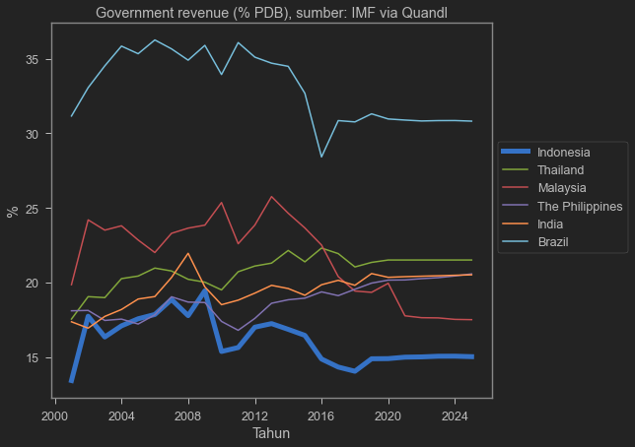
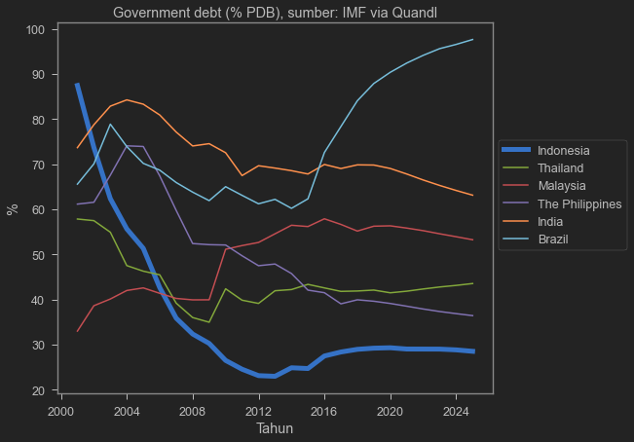
What about Indonesia?
image
image

Slide 16
However…
image

Slide 17
Indonesian bond is expensive. at around 6-7% interest rate, this potentially crowds out private investment!

Slide 18
COVID recession
Growth in % (except stated otherwise) | 2019 | 2020 | 2021 | 2022
GDP | 5.0 | -2.1 | 4.9 | 5.4
private consumption $C$ | 5.2 | -2.7 | 3.6 | 7.1
Government expenditure $G$ | 3.3 | 1.9 | -0.3 | 1.0
CPI (inflation) | 3.0 | 1.9 | 2.1 | 3.0
Fiscal balance (% GDP) | -2.2 | -6.5 | -5.7 | -4.1

Slide 19
COVID crushes demand. $G$ helps, and it was financed by debt.
Source: OECD (2021), OECD Economic Surveys: Indonesia 2021, OECD Publishing, Paris, https://doi.org/10.1787/fd7e6249-en.

Slide 20
Fiscal policy during normal times?
During normal times, economy runs at 100% capacity:
government spending will only crowds out private spending.
risks inflation.
Private firms borrows and invest normally.
government’s debt rises interest rate which is not good for business.

Slide 21
What about negative supply shock?
For example, oil price increase:
We can’t just make oil or quickly change our technology
Fukushima shock: can’t just find/make replacement firms.
Negative supply shock leads to stagflation:
government has to pick a lesser evil:
reduce inflation or reduce unemployment.

Slide 22
The Financial System
So far we have talking about AD-AS, also known as real sector (sektor riil).
The other side of the coin is financial sector:
We do not consume what it produces.
But we use it for transaction.
We use it to measure everything we do in the real sector.
This time we will learn about money, banking, and the central bank.

Slide 23
Money
Before we use money, we barter.
This is inefficient as some goods are:
hard to carry around.
hard to divide.
hard to match.
perishable (decreased in value over time)

Slide 24
Money
Probably the oldest “money”
This is inefficient as some goods are:
hard to carry around.
hard to divide.
hard to match.
perishable (decreased in value over time)
At some point, people used gold and silver to facilitate barter.

Slide 25
Money
However, even gold is hard to carry around especially if you are rich.
People stash their gold in a place called bank, and received “bank note” as a proof that they own the gold.
Normally, one needed to go to bank, take the gold, and transact.
But in the end, people use the bank note itself. This bank note is our today’s currency.
Nowadays, banks can create money without having to have a gold in their stash.

Slide 26
Money
Money is any asset that can easily be used to purchase goods and services.
An asset is called liquid if we can easily convert it to cash.
We generally consider cash, bank cheques, and saving account as money because they are liquid.
What are considered non-liquid asset?
house, cars, stocks, firms, what else?

Slide 27
Main roles of money
Medium of exchange. Everyone has to believe in its value. We normally use IDR. Sometimes, foreign money is used. Goods can also be used under certain circumstances.
Store of value. It has consistent value (not perishable over time)
Unit of account: the commonly accepted measure individuals use to set prices and make economic calculation.

Slide 28
Types of money
Commodity money is goods that is valuable to many people. Gold and silver, cigarettes, alcohol.
Commodity-backed money is a “paper money” that we can use to redeem a commodity (usually gold). Holders of these bank notes are guaranteed the gold (or other commodity) stated in the notes.
Fiat money is the money we know today. It only backed by the government’s word.

Slide 29
Advantages
Commodity-backed money makes transaction quicker than commodity money because a bank can generate more notes than it has gold.
In normal times, people won’t redeem 100% of the gold. Banks just need to keep gold enough to satisfy daily demand.
Fiat money is even faster because banks do not need to hold anything. Some problems tho:
It’s easier for counterfeit money to exists.
Some central banks print too much money which leads to the money losing its value.

Slide 30
Measuring money supply
M1 is the narrow definition:
consists of cash, traveler’s checks, and other checkable bank deposits.
M2 is a broader definition. It is M1 plus:
saving account and time deposit (deposito).
How much M1 and M2 circulate in the economy is largely controlled by the Central Bank
Bank of Indonesia in our case.

Slide 31
Bank roles
Bank uses liquid assets in the form of deposit to finance illiquid investments of borrowers.
Banks cannot lend all of its assets: it has to store a small fraction in their own vault or in the central bank.
These stored asset is called bank reserves.
Bank reserves is not circulated in the market, hence not counted in M1 and M2.
In Indonesia, bank needs to have a reserve equals to 3.5% of its total loan.
Also called reserve requirement ratio.

Slide 32
Bank Runs
In normal times, people usually don’t do anything with their saving account.
This way, banks can lend most of the money and reserve some for liquidity.
But if many lenders suddenly would like to withdraw money, bank would not have enough money.
they might have to sell some asset.
When many people wants to withdraw money at the same time, we call it bank run.

Slide 33
Bank Runs
Bank runs happen when borrowers hear Bank is near collapsing.
However, just a rumour could create a real collapse if lenders decided to withdraw money together at the same time.
This can be contagious: a lost of faith in one bank could lead to lost of faith to the entire system.
This happened in 1998 when several banks were closed.

Slide 34
Bank regulations
Deposit insurance. Indonesian depositors is insured (partially) by Lembaga Penjamin Simpanan (LPS)
Capital requirements. Bank is required to have a minimum capital or asset to be able to operate in Indonesia.
Reserve requirements. Currently is 3.5% but it used to be higher. It was lowered due to COVID-19 recession.
Discount window, where the central bank can lend money to private banks so they don’t have to sell their asset.

Slide 35
Money Creation
Bank control how much money circulated in the market by moving deposits between loanable funds and its reserves
Suppose Panca has a Rp1 million in his pocket. He decided to deposit it to Bank BeCAk.
Panca give Bank BeCAk his Rp1 million which reduces money supply
But Bank BeCAk credits Panca’s account by Rp1 million which increases money supply
Hence no change in money supply

Slide 36
Money Creation
But then Joy come to Bank BeCAk to borrow Rp900k to buy shoes.
Bank BeCAk use its reserve it get from Panca:
Bank BeCAk keep Rp 100k of its reserve, which comes from Panca
Bank BeCAk credits Joy’s account Rp900k.
This leads to increased Rp900k in money supply: now there are Rp1.900k of money supply in the market!

Slide 37
Money multiplier
Suppose Joy buy the shoes from Liv.
Liv then deposit the money to another bank named Bank Madara.
Bank Madara adds Rp900k to its reserve.
Also credit Liv’s account Rp900k.
But like Bank BeCAk, Bank Madara can loan some of the fund and reducing its reserve!
The more money is circulated, the more expansionary the monetary condition is.

Slide 38
Next week
Money supply is reduced when:
People keep their money out of the financial system
Banks increase its reserves
These are usually happening in an uncertain time: a recession or even worse, a crisis.
Next week, we will learn how money supply and money demand interact with the real sector
We will also learn how Bank Indonesia plays a role in the economy.

