Slide 1
Ilmu Ekonomi
Pertemuan 4 Prodi PIWAR Politeknik APP Jakarta

Slide 2
Recap on last week
We use consumer and producer surplus to measure the efficiency of the economy. We want the combination of both to be generally bigger.
The two face a constant political battle: consumer wants small prices, producers like high prices.
When market is perfect, intervention often leads to various types of inefficiency

Slide 3
Today
We will learn about one more intervention: tax.
before we go there, it is best to understand elasticity first.

Slide 4
What’s an elasticity?
If you are a business owner, understanding elasticity is important aspect to get maximized profit.
Price elasticity of demand of a good is a concept of how much the demand of that good change its price changes.
we usually just say elasticity in short.
Maximizing profit requires this knowledge:
sometimes it is better to sell cheap to gain huge market share, or sell high if niche.

Slide 5
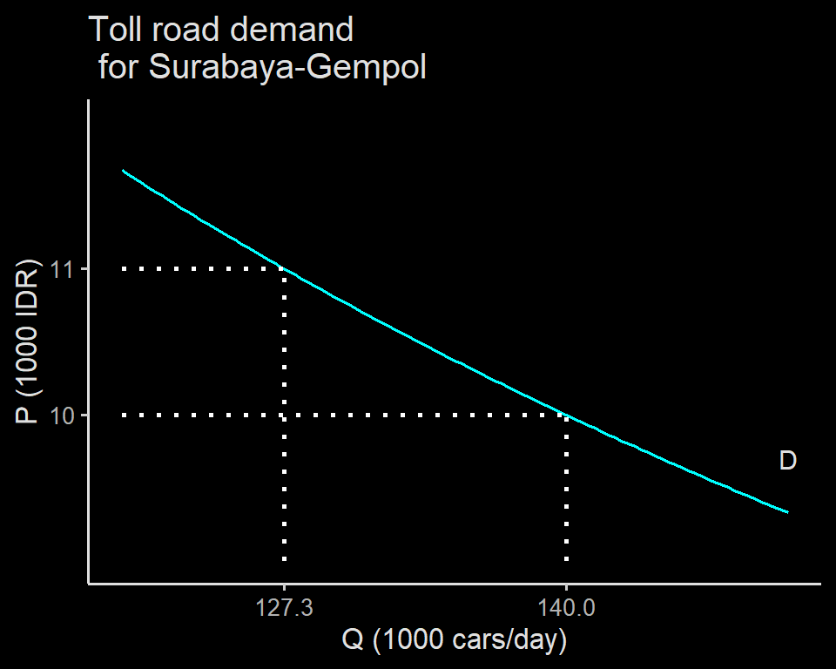
Calculating elasticity
Consider the demand curve on the right.
At $P_{1}=10$, the daily traffic is $Q_{1}=140$
When $P_{2}=11$, daily traffic drops to $Q_{2}=127.3$

Slide 6
Calculating elasticity
To calculate elasticity of demand, we first calculate:
percent change in the quantity demanded
percent change in the price
Formula for no.1:
$$\text{\% change in }Q^{D}=\frac{Q_{2}^{D}−Q_{1}^{D}}{Q_{1}^{D}}×100$$
Formula for no.2:
$$\text{\% change in P}=\frac{P_{2}−P_{1}}{P_{1}}×100$$

Slide 7
Calculating elasticity
for our case, we have:
$$\begin{matrix}Q_{1}^{D} & =140 & Q_{2}^{D} & =127.3 \\ P_{1} & =10 & P_{2} & =11\end{matrix}$$
Thus:
$$\begin{matrix}\text{\% change in }Q^{D} & =\frac{127.3−140}{127.3}×100 \\ & =−10\%\end{matrix}$$
$$\begin{matrix}\text{\% change in P} & =\frac{11−10}{10}×100 \\ & =10\%\end{matrix}$$

Slide 8
Calculating elasticity
After we get the numbers from {1} and {2}, we use this formula:
$$\text{Price elasticity of demand}=\frac{\text{\% change in }Q^{D}}{\text{\% change in P}}$$
in our case, we have:
$$\begin{matrix}\text{Price elasticity of demand} & =\frac{−10\%}{10\%} \\ & =−1\end{matrix}$$

Slide 9
Calculating elasticity
Economists are also lazy in writing the minus sign.
Usually we report demand elasticity in absolute term.
i.e., we drop the minus sign.
However, since most demand curves are downward sloping, it must be negative
hence we automatically knows what it means even when we report in absolute term.

Slide 10
About percent change
Using percent changes is more useful than absolute changes - Things are usually move on proportion - A wealthy person will feel casual getting 1 million IDR because it’s probably just a small % of her total wealth.
Quantity and prices have many metrics
kgs, litres, units, pairs, units/day, etc
IDR, USD, btc, etc.

Slide 11
interpreting elasticity
via GIPHY

Slide 12
Interpreting elasticity
We have seen the elasticity of our toll road case is around 1, but what does this mean?
Note that the elasticity formula has % change in Q at the top, and % change in P at the bottom.
In a sense, the number shows how much quantity change given the price change.
that means, the bigger the number of the price elasticity, the more elastic it is

Slide 13
A market is elastic. So what?
Let’s have a look at different ‘kind’ of elasticities and what they mean
We’ll begin with two extreme cases of elasticity: zero (0) and infinity ( $∞$ )

Slide 14
Two extreme cases
Suppose the toll road is the only way to go to work.
No matter how high the price, people will still need to use it.
Hence, change in the demand of toll road is zero for any change in price.
Suppose shuttlecocks are priced 10.000 IDR
If people don’t care about the shuttlecocks’ color, everyone will buy the pink one if the price drop to 9.900
Everyone won’t buy a single one if the price go up only to 10.100 IDR

Slide 15
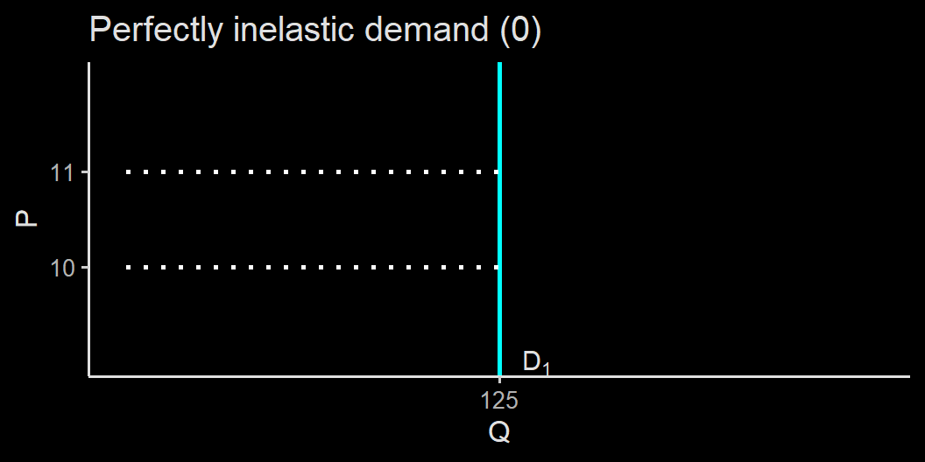
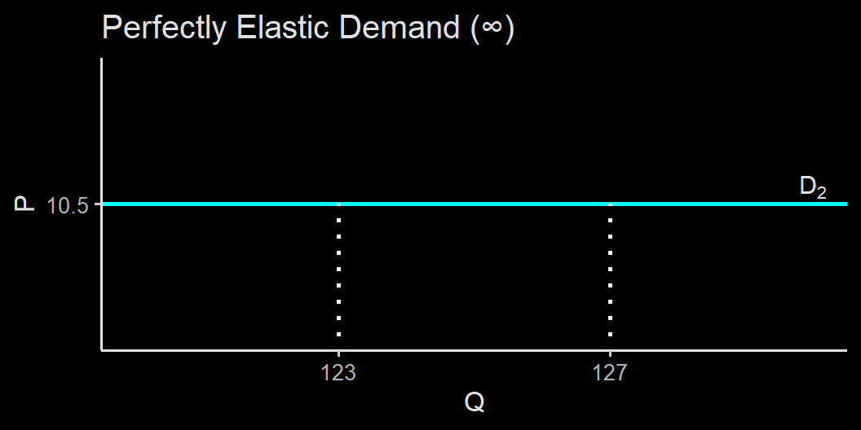
Two extreme cases of elasticity

Slide 16
Types of elasticities
Most goods are somewhere in between.
We usually use elasticity=1 as another important division point.
1 is a useful barrier because when elasticity=1, that means a change in price by 1 % leads to a change in quantity demanded by 1 %
elasticity < 1 means the quantity response less than a change in prices, while elasticity > 1 means the quantity is highly responsive, more than the change in price.

Slide 17
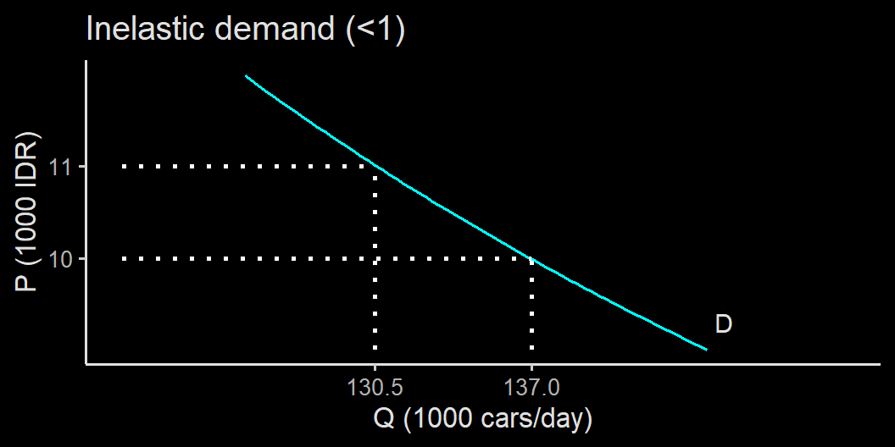
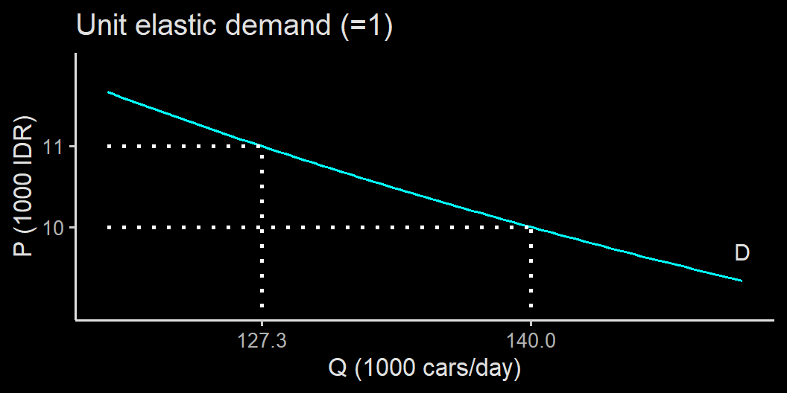

Slide 18
Types of demand elasticities
Elasticity | meaning
0 | perfectly inelastic. Price doesn’t matter
< 1 | inelastic. Quantity is less responsive to price changes
1 | unit elastic. Quantity change exactly the same as the price change in % terms
>1 | elastic. Quantity response heavily to price changes
$∞$ | perfectly elastic. A slight increase of price reduces demand to zero

Slide 19
Elasticities vary. So what?
Suppose you wan’t to increase the revenue from the toll road operation, what price will you set?
It is intuitive to think that the higher the price, the better.
High price $⇒$ more revenue
Is there a problem with this logic?
Remember, demand respond to price. High price $⇒$ lower demand $⇒$ less revenue
The maximum price depends on the demand elasticity

Slide 20
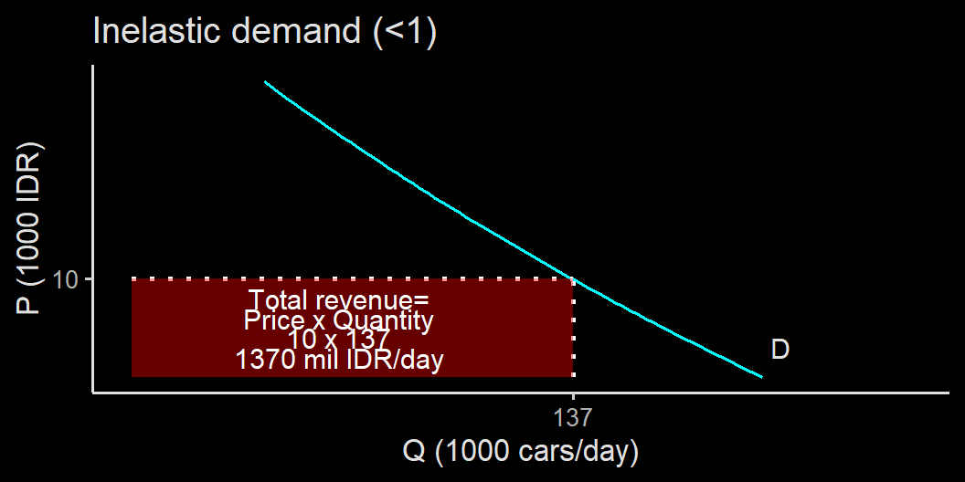

Slide 21
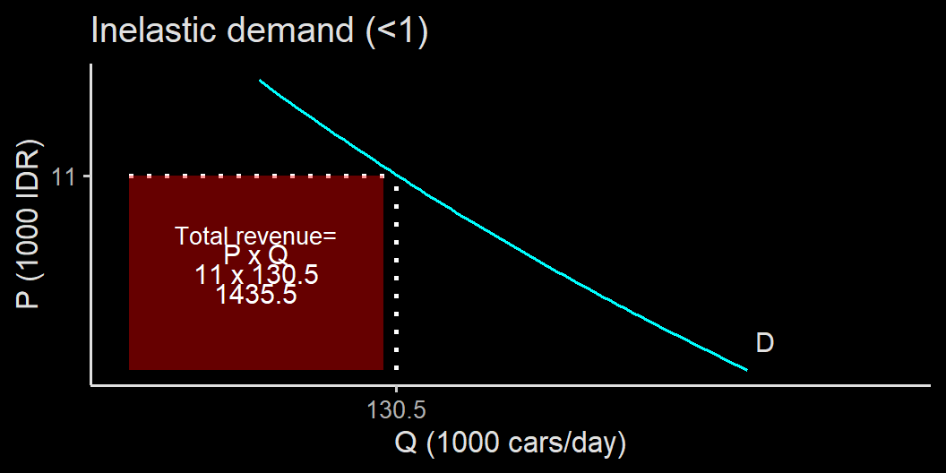

Slide 22
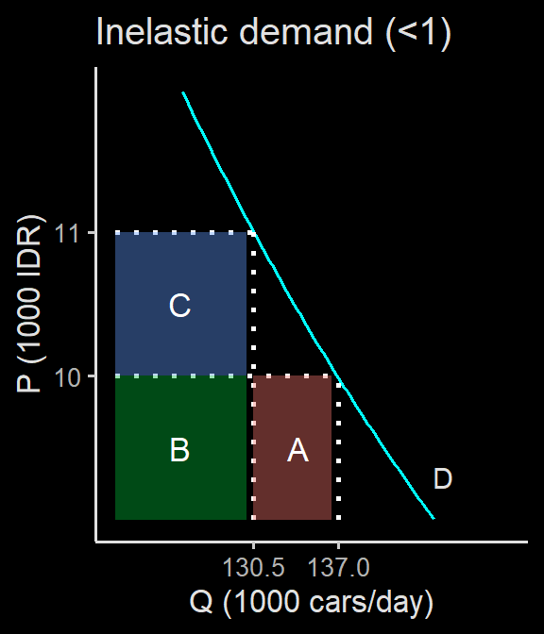
Impact of price increase
Segment A is the Quantity effect of price increase
Negative effect since fewer units sold
Segment C is the Price effect of price increase
positive effect since higher price for each unit sold

Slide 23
Impact of price increase
If you are profit oriented, Increasing the price is a good idea if:
$$B+C>B+A$$
$$C>A$$

Slide 24
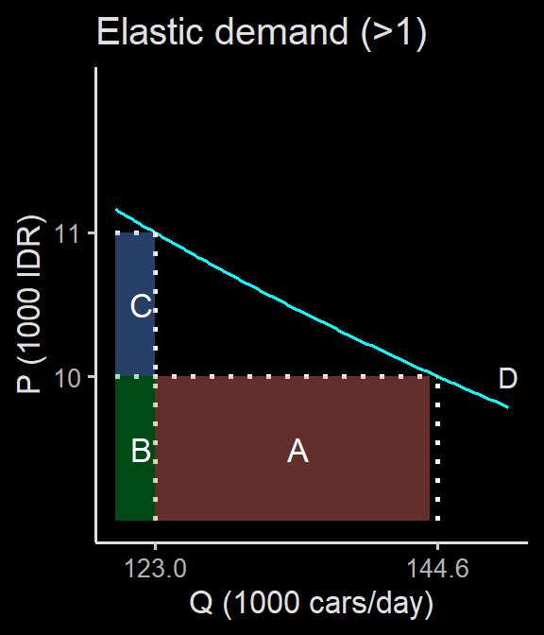
Impact of price increase
In a market with high demand elasticity, the quantity effect outweighs the price effect.
Increasing the price is not so clever if the market’s demand is highly elastic.

Slide 25
Last point on demand elasticity
When elasticity = 1, then $A=C$
hence changing price has no impact on sales revenue.
Profit oriented in the real life may not very realistic
Governments may want to serve as much people as possible
In the short run, growth and market cap may be more important than profit.

Slide 26
Last point on demand elasticity
We usually tied elasticity on a price point.
on our toll road case, our price point is 10.000 IDR
Elasticity may differ in different price point.
Changing price from 10 to 11 may have different impact compared to changing price from 20 to 21.
the first one is an increase of 10%.
the second one is an increase of 5%.
in absolute term, both are a 1.000 IDR increase.

Slide 27
Last point on demand elasticity
Estimating elasticity is very hard
There are many things also at play:
different condition in different time
different buyer with different characteristics behave differently
Income, taste, etc matters (remember what shifts the demand curve?)

Slide 28
Factors determine demand elasticity
A necessity good tend to have lower elasticity compared to a luxury good.
The availability of close substitutes, like the case with pertamax and shell.
Share of income spent on the good. Rich people may not care with toll road price.
Time. Cigarettes may have low elasticity in the short run because it is so addictive, and adapt later in the long run.

Slide 29
Other types of demand elasticity
Cross price elasticity of demand is how the price of good $B$ affects a demand of good $A$.
$${\text{Cross-Price elasticity}}_{A,B}=\frac{\text{\% change in }Q_{A}}{\text{\% change in }P_{B}}$$
When good A and good B are subtitutes, then the effect is negative.
e.g., Samsung and Xiaomi
When good A and good B are complements, the effect is positive.
e.g., Samsung and Telkomsel

Slide 30
Other types of demand elasticity
Income elasticity of demand is how the chanage on income affects your demand of good $A$
$${\text{Income elasticity of Demand}}_{A}=\frac{\text{\% change in }Q_{A}}{\text{\% change in Income}}$$
It is usually positive if good $A$ is a normal good.
It is negative if good $A$ is an inferior good.
you buy less instant noodle when you’re richer.

Slide 31
Other types of demand elasticity
Income elasticity of demand is how the chanage on income affects your demand of good $A$
$${\text{Income elasticity of Demand}}_{A}=\frac{\text{\% change in }Q_{A}}{\text{\% change in Income}}$$
A necessity good is usually income inelastic because you need to buy it no matter what.
A luxury good can be income elastic. You only buy it if your main needs are covered so you can wait for a discount.

Slide 32
Price elasticity of Supply

Slide 33
Price elasticity of Supply
Supply also have elasticities. As a supplier, you can’t afford to sell expensive if there are high competition.
However, in many cases (such as toll road), entering the market is very hard.
How easy it is to expand (or for new supplier to enter the market) matters to how responsive can supply react to the change in price.
$$\text{Price elasticity of supply}=\frac{\text{\% change in }Q^{s}}{\text{\% change in }P}$$

Slide 34
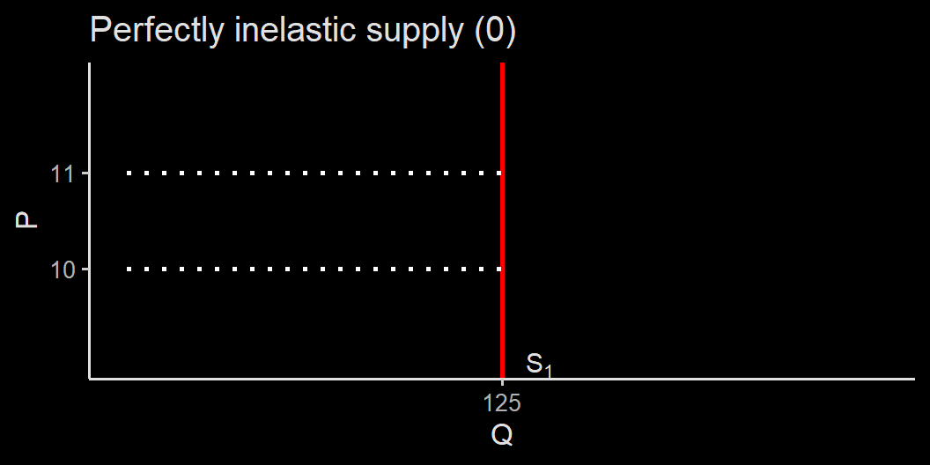
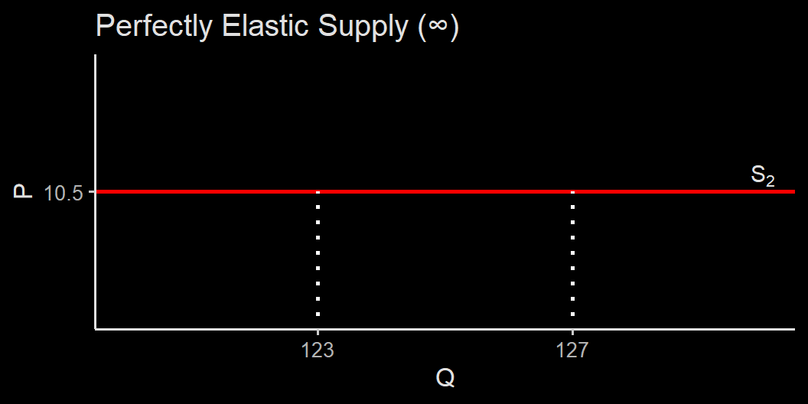
Two extreme cases of elasticity

Slide 35
Two extreme cases of elasticity
In a perfectly inelastic supply case, the market can’t supply more even if the price increase. Toll road is like this: Building more toll road is expensive and takes time. Most times this is monopolized by the government.
In a perfectly elastic supply, the market supply exactly zero when the price go up just by a little. A highly competitive market where all firms operate at the margin may behave this way.
Again, most times, the supply curve is somewhere in between.

Slide 36
What changes supply elasticity?
A market tend to have a highly elastic price elasticity of supply when inputs are abundant and can be converted in and out of producion at a very low cost.
Matters, as price elasticity of supply tend to be higher in the long run. Increasing production capacity may takes time since investing in a new land, building or machine requires time.
Some goods are even impossible to be increased, hence have zero elasticity. Radio spectrum is one example.

Slide 37
European farm surplus
European Union subsidised their farmers heavily. They probably knew that subsidies create huge surplus (remember last week), but they thought the surplus would not be as big since farming land is limited.
However, EU farmers were able to expand production using things like fertilizers and pesticides, which are readily available inputs.

Slide 38
The benefits and costs of taxation

Slide 39
Excise Tax (cukai)
The government often tax goods in the form of an excise tax.
In Indonesia, some goods have an excise to its purchase:
Cigarettes & alcohol
Luxury goods (PPnBM)
You can say that a value-added tax is another form of an excise tax.

Slide 40
How tax works
Tax acts like a price ceiling plus plus floor:
The government set a higher price for consumers to pay
At the same time, the producers are forced to produced at a lower price.
A reminder: in a price floor scenario, surplus from consumer transferred to the producer, while in a price ceiling, surplus transferred from producers to consumers.
in tax case, CS and PS are transferred to the government.

Slide 41
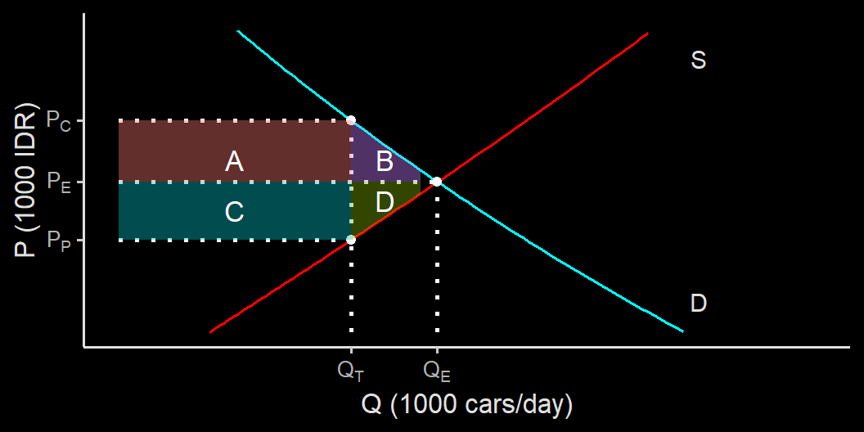
The impact of tax

Slide 42
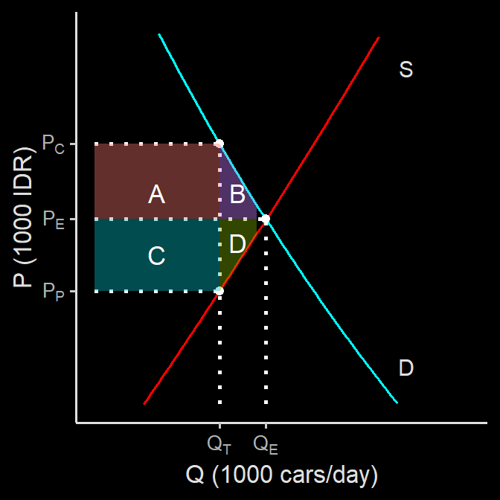
The impact of taxation
The market price is $P=P_{E}$
The price paid by consumers is $P=P_{C}$
Producer receive payment at $P=P_{P}$
The tax per purchased good paid to the government is $t=P_{C}−P_{P}$

Slide 43
The impact of taxation
Consumer lose $A+B$
Producer lose $C+D$
The government collects tax revenue $TR=T×Q_{T}$
This is equals to $TR=A+C$
$B+D=DWL$

Slide 44
The impact of taxation
As we learn, the tax revenue and the size of DWL depends highly in demand elasticity and supply elasticity of the good.
The less elastic the demand and supply of a good, the higher revenue gained from taxing the good.
i.e., price effect > quantity effect.
DWL also lower when the demand and/or supply of the good is highly inelastic.

Slide 45
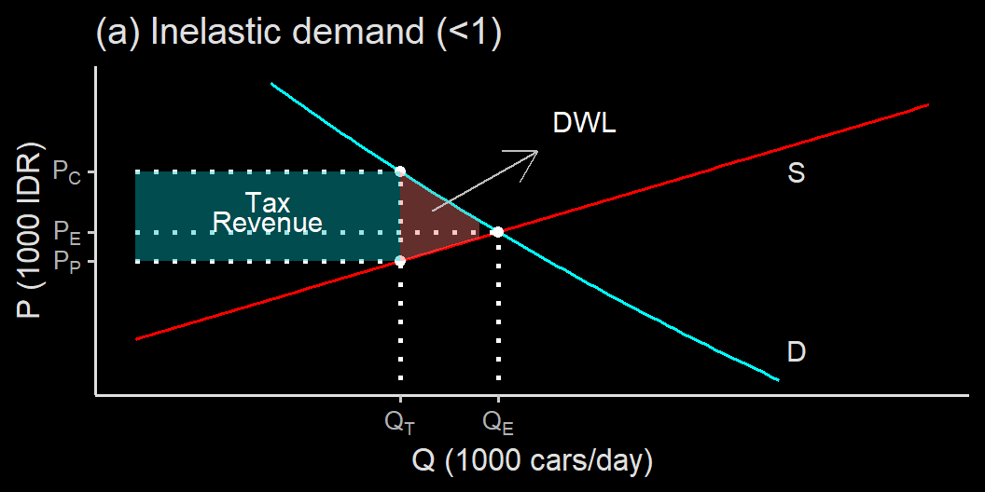
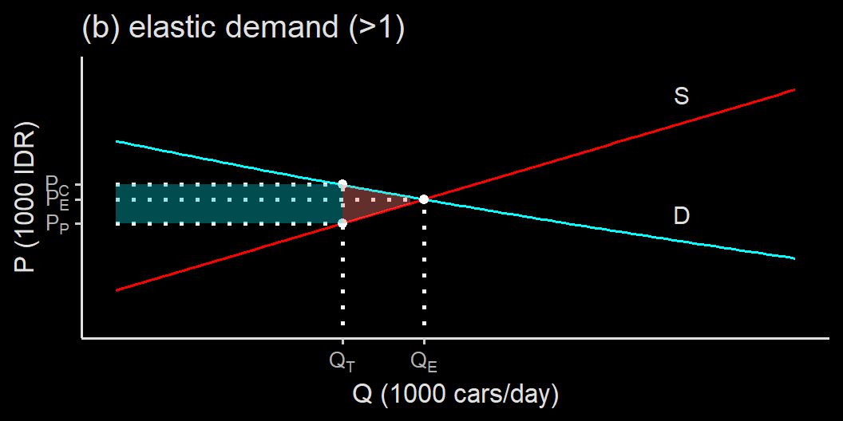

Slide 46
Implication
If the government wants to collect revenue, its best to impose a tax on a good with low elasticities.
If the government wants to change behaviour, tax a good with high elasticities.
Taxing cigarettes to discourage smoking maybe ineffective
however, it can be used to gain revenue.
Highly inelastic goods may suggest it’s a necessity: people may be unhappy with the tax.

Slide 47
Implication
Same goes with the business people: be careful in increasing price if your product is highly elastically demanded.
Next week, we will have a look a bit more detailed on the supply curve:
what drives the elasticity of supply.
Different types of cost.

Slide 48
Some recap before da quiz
Elasticities is very important in determining surpluses: CS, PS, revenues.
Elasticities can be estimated (albeit hard).
Elasticities vary: $0≤1≤∞$ .
Many factors influence elasticities.
You should be able to use elasticity formula and can draw how tax is calculated and drawn.

Slide 49
Thank You
via GIPHY

