Slide 1
Unemployment and inflation
Pertemuan 9 Prodi PIWAR Politeknik APP Jakarta

Slide 2
Last Week
Various Indicators

Slide 3
This week and next week
Unemployment rate
Inflation
Long run growth

Slide 4
Unemployment rate: Definition
Unemployment rate is NOT simply the rate of how many people without a job in a country.
The important part is the divider: instead of dividing unemployed people with total population, we divide it with a labour force
$$\text{unemployment rate}=\frac{\text{Number of unemployed workers}}{\text{Labour Force}}×100\%$$

Slide 5
Labour Force
labour force is the sum of people who are currently working and people who are looking for work.
Unemployment rate in Indonesia is calculated by BPS. You can read the definition on their website.
You need to be above 15 years old to be included in the labour force.
Currently working: doing activities which receive payment or profit for at least 1 hour in 1 week.

Slide 6
More definition
looking for work is someone who are not working but reporting as looking for work in the last one week.
part-time employed is someone who are doing work less than 35 hours a week and is not looking for a full-time work.
underemployed is someone who are doing work less than 35 hours a week and is looking for a full-time work but unable to find one (mostly due to economic condition).

Slide 7
labour force & participation rate
Labour force excludes:
15 years old or younger.
School and university goers.
Retiree.
stay-at-home mum/dad.
Labour participation rate is defined as:
$$\text{Labour Participation Rate}=\frac{\text{Labour Force}}{\text{Population over 15 years old}}$$

Slide 8
Labour Force Participation
Even when population growth is small, it is possible to increase labour force participation.
for example by having more working women: East Asian Miracle in the 1990s was partly because increased women’s participation in the economy.
More people going to the universities can also reduce labour participation rate for a while.
Migration changes population and labour force participation in both source region and receiving region.

Slide 9
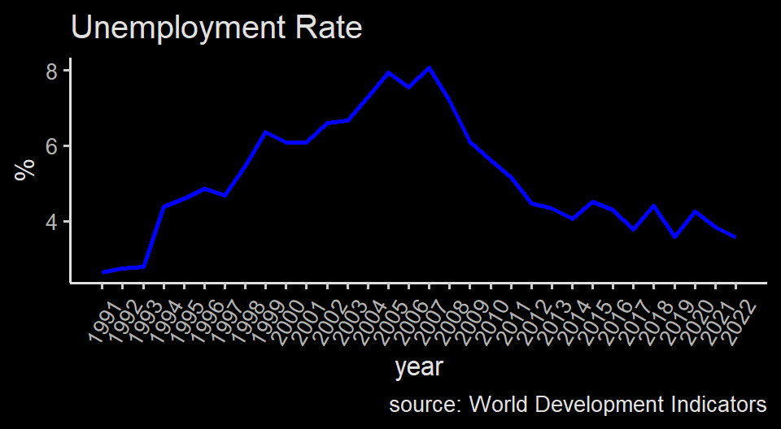
Indonesia’s unemployment rate

Slide 10
Indonesia’s Unemployment rate
Indonesia had a very low unemployment rate during the 90s amid industrial expansion
The 1998 Asian Financial Crisis (AFC) took a big hit on unemployment rate
2008 Global Financial Crisis (GFC) brings a lot of foreign investment, expanding the economy.

Slide 11
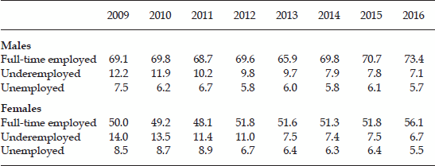
Indonesia’s employment conditions
gambar1

Slide 12
Source: Data from Sakernas, 2009–16. Taken from Sarah Xua Dong and Chris Manning (2017) Labour-Market Developments at a Time of Heightened Uncertainty. Bulletin of Indonesian Economic Studies, 53:1, 1-25, DOI: 10.1080/00074918.2017.1326201

Slide 13
Regional unemployment rate
Province | Feb 2020 | Aug 2020
DKI Jakarta | 5.15 | 10.95
Kep. Riau | 5.98 | 10.34
Jawa Barat | 7.71 | 10.46
Bali | 1.25 | 5.63
Maluku | 6.71 | 7.57
Papua Barat | 6.78 | 6.80
Kalimantan Utara | 5.71 | 4.97
A quick, negative shock (like COVID-19) is stronger in a place where jobs are normally abundant. Source: BPS

Slide 14
Unemployment rate & Growth
It is intuitive to think that economic growth leads to lower unemployment rate.
When business cycle is peaking, more jobs are available. Thus lowering unemployment rate.
That is why you can name a law that improve business climate as “job creation law”.
But can we have a booming economy to a point where unemployment rate = 0?
The answer is no

Slide 15
Natural rate of unemployment
Indonesia’s lowest unemployment was during the manufacturing boom in the early 1991 at 2.62%.
There are some reasons why we will never get unemployment to 0:
Structural change
Frictional unemployment
Structural unemployment

Slide 16
Structural change
When the economy booms, usually only a certain jobs become available.
For example, the manufacturing boom in the 90s brought a lot of labour-intensive and engineering jobs.

Slide 17
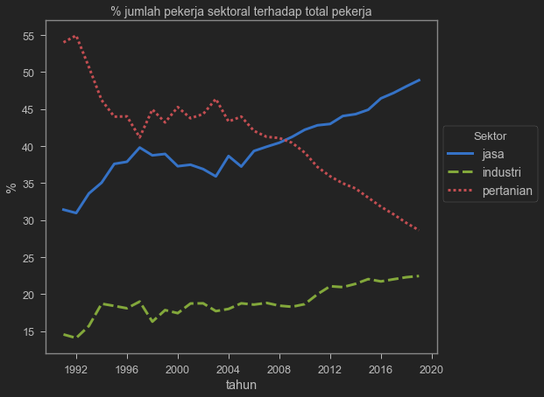
Indonesia’s structural change
a

Slide 18
source: World Development Indicators

Slide 19
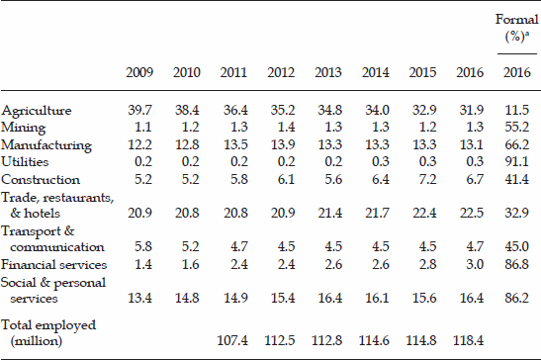
Indonesia’s structural change
gambar2

Slide 20
Source: Data from Sakernas, 2009–16. Taken from Sarah Xua Dong and Chris Manning (2017) Labour-Market Developments at a Time of Heightened Uncertainty. Bulletin of Indonesian Economic Studies, 53:1, 1-25, DOI: 10.1080/00074918.2017.1326201

Slide 21
Structural change
In the 2008, many investment goes to developing countries such as Indonesia.
These investments are coming to many services-related sectors, not so much on agricultural sector.
You might heard how many Indonesia’s agricultural engineering graduates goes to the financial sectors.
A person who are already a farmer can not easily jump to non-farming jobs.

Slide 22
Frictional unemployment
The graduates might take some times to do job search, and during this time, if that graduates is being surveyed, BPS will classify him/her as unemployed.
This is called frictional unemployment.
for example, an engineer graduates can easily join the online taxi wave, but one might skip that opportunity and keep searching for engineering jobs.

Slide 23
Frictional unemployment
It is not bad, in fact it is actually good because it shows that people look for jobs best suited to them.
Good job matching is good for economy because it leads to efficiency.
Problem arise when it takes too long and too costly for a job search to match.

Slide 24
Structural unemployment
Is when labour supply is persistently higher than available jobs.
Structural unemployment happens when the job market cannot clear.
This is due to a price floor-like effect which prevent wage to hit a market clearing wage rate.
this is not great as it introduces inefficiency.

Slide 25
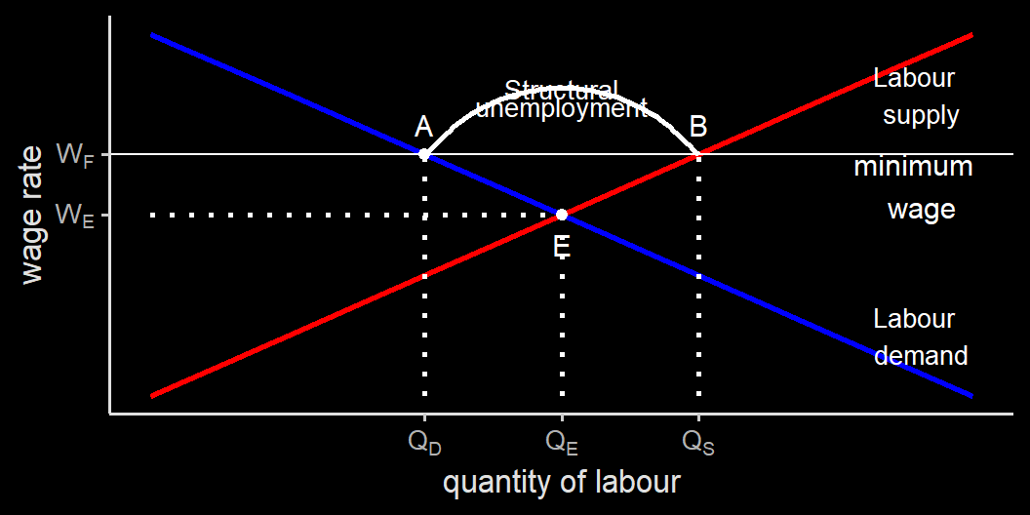
Structural unemployment

Slide 26
Minimum wages
Minimum wage is mandated by the government to ensure a decent wage for all worker.
It has an opportunity cost:
potentially reduces work opportunity (Suryahadi et al 2010)
people who are willing to work in a lower wage can’t participate
it helps only people who are already working
Minimum wage can help in the situation where labour demand is concentrated on a small number of firms (employer has market power).

Slide 27
Labour union
Labour union can have a similar effect to a minimum wage
Labour union allows for labours to act collectively, and negotiate a higher wage for the union members. (collective bargaining)
Collective bargaining gives labour market power, and can potentially be harmful for unemployed people.

Slide 28
Efficiency wages
Firms may choose to pay efficiency wage, a wage that employers set above the equilibrium wage rate so employee has insentive to perform better.
For employers, sometimes having a smaller number of employee is better as long as they are perform.
This higher wage creates structural unemployment.

Slide 29
The natural rate of unemployment
Is the level of unemployment that is rendered “natural” (since it won’t get to zero)
Natural unemployment = frictional unemployment + structural unemployment.
Actual unemployment = natural unemployment + cyclical unemployment.
Cyclical unemployment is the deviation of the actual rate of unemployment from the natural rate because of economic cycle.

Slide 30
The natural rate of unemployment
Knowing the level of the natural rate of unemployment is important to determine the state of the economy.
However, it is not always straight-forward: we don’t always know what the natural rate of unemployment is and is always up to a debate.
Moreover, just because someone has a job does not mean the job is decent or secure.
A minimum wage too high can also incentivies informal jobs which has worse working condition compared to formal jobs.

Slide 31
Inflation
A rise in price level is not necessarily bad, especially if wage level is also rises.
Economists often use the term ‘real’ to negates the impact of price level and wage level.
real wage is the level of wage divided by a price level, while real income is the level of income divided by a price level.
They show the most important things: how much goods and services you can get from working and earning money.

Slide 32
Inflation
The rate at how fast the price increase can be a problem: that is, inflation.
remember the definition of inflation:
$$\text{inflation rate}=\frac{\text{Price index year 2 - Price index year 1}}{\text{Price index year 1}}×100\%$$
There are problems with inflation that is too high.

Slide 33
Cost associated with inflation
menu cost, is when firms need to change printed price on their menus or displays.
During the Brazilian inflation of the early 1990s, supermarket workers are reportedly spent half their time for changing price stickers.
Unit-of-account cost is a cost associated with unreliability of money. During a hyperinflation, it is common to ditch local currency and use US Dollar instead to buy and sell goods, like in Zimbabwe and Venezuela.
In the worst-case scenario, barter can even be an option.

Slide 34
Winner and losers from inflation
The reason why inflation creates winners and losers is long term contract.
Many transactions are not made in a single day: for example, a loan.
In the case of loan, a borrower received a fixed amount of money today while having to return it with interest at a later time.
The contract is usually written in a nominal interest rate term. High inflation can reduces the actual real interest rate.
real interest rate = nominal interest rate - inflation.

Slide 35
Winner and losers
Suppose Ann borrow 200.000.000 IDR from Bob with 10% interest rate: Ann will return 220.000.000 to Bob in a year time. Ann use the money to buy a car.
However, inflation is high: the next year’s price of a car is actually 230.000.000 IDR, which is a 15% increase.
In this case, real interest rate = 10% - 15% = -5%: it is better for Bob to buy car instead of lending the money to Ann.
in other words, borrowers gain from inflation at the expense of lenders.

Slide 36
Which inflation?
It is common to calculate inflation using local currency.
As an economic agent, we have expectation of the future and of the value of IDR.
If we expect an inflation, perhaps it is better to save in terms of other asset: real estate, stock, foreign exchange, gold, cryptos etc.
In the end, how much IDR we have is not the most important. The most important is how much things we can buy with thata amount of IDR.

Slide 37
Inflation is hard
Inflation can be problematic because it is hard to bring down once it reach a high number.
Inflation can make a currency become too volatile and worthless as a unit of transaction.
especially if import is very high.
In general, a central bank and the government target inflation to be at 2%.

Slide 38
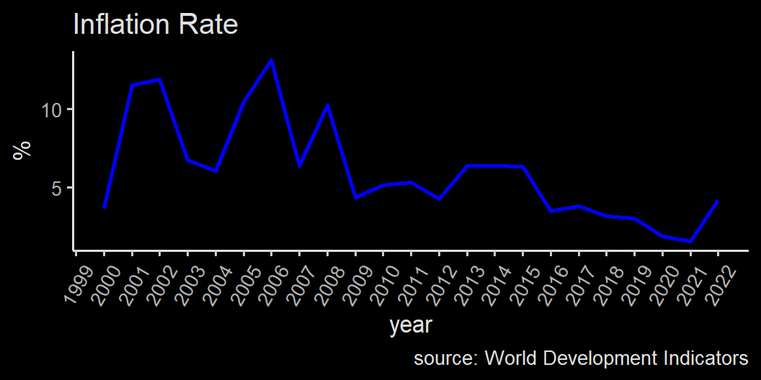
Inflation

Slide 39
Next week
We will learn more on economic growth.
We will look at the relationship between inflation, unemployment rate and economic growth.

