Slide 1
Ilmu Ekonomi
Pertemuan 13 Prodi PIWAR Politeknik APP Jakarta

Slide 2
Quick recap
So far we’ve learned:
how to measure economic variables:
GDP, inflation, unemployment
How they interact:
AD-AS framework
Long run vs short run
fiscal policy
How financial market matters:
(central) banks and interest rate

Slide 3
This week
So far, we assume highly domestic market situation.
It is highly not realistic especially for Indonesia, a small(-ish) country where international economies matter:
Indonesia relies a lot of international help from escaping 1966 and 1998 crises.
Exchange rate is highly depending on global capital market situation.
Two booms (1970s oil boom and 2000s commodity boom) elevate Indonesian economy hugely

Slide 4
This week & next week
Balance of Payment
Current account, capital account and financial account.
Trade in goods and services:
Comparative advantage theory
Global Value Chain
International finance:
exchange rate and international capital
International / External policy

Slide 5
International economics
Indonesia is largely an open economy:
It buys and sells goods and services to the rest of the world.
Also trade saving and investment abroad (stocks, currencies, debts, direct investment)
Being an open economy offers advantage:
help building domestic capital (remember convergence theory?).
Enjoys spillover economic benefits.

Slide 6
International economics
However, anything bad happens to the global market, will affect Indonesia as well.
Indonesian policy tool may be less effective.
meanwhile, big economy’s policy may be stronger:
When the US’ central bank rise interest rate, lots of foreign capital fled Indonesia, tilting IDR valuation.
We will learn more about these effect later on.

Slide 7
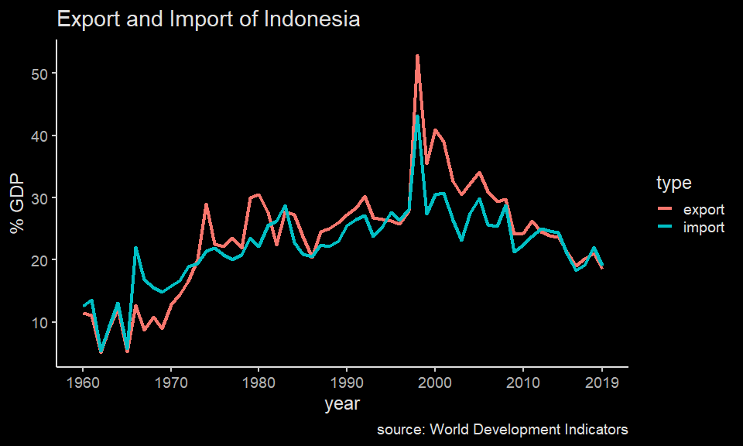
Trade in goods

Slide 8
Indonesia’s export jumps since the 1970s thanks to oil boom. Since then, Indonesia is generally running trade surplus.
The importance of trade is generally the same throughout.

Slide 9
ww source: OEM
Exported commodities
Indonesia’s main exports are natural resources: minerals, coal, palm oil, wood products, rubber.
Also a bit on manufactures: iron and steel, vehicles, machine and electronics, food products.

Slide 10
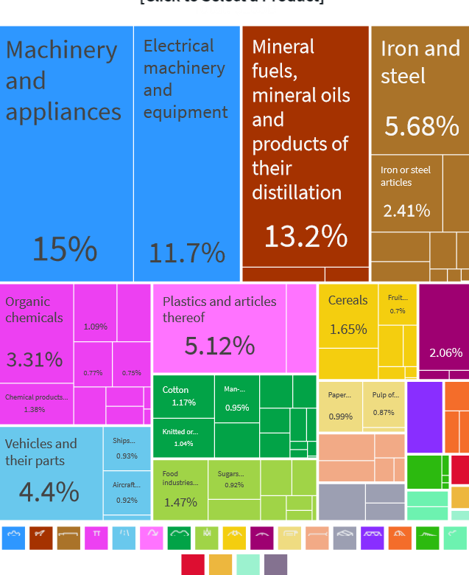
Imported commodities
Indonesia’s main imports are manufacturing inputs: capital goods, fuels, iron and steel, plastics and chemicals. Also a bit of food.
ww

Slide 11
Why nations trade
You might have seen the news about what Indonesia trades with the world:
We imports many food stuff: beef, rice, wheat, soybeans
We also export many plantation and natural resources such as CPO and coal.
But you might also hear that trade is like a competition: export is good, import is bad, and trade deficit means a country is “lost”.
Truthfully, it’s much more complex than that.
Generally, economists believe that international trade is better for both parties.

Slide 12
Comparative advantage
Comparative advantage is the reason why trade is good for both parties.
A country has a comparative advantage in producing a good or service if the opportunity cost of producing the good or service is lower for that country than for other countries.
This concept relies heavily on opportunity cost, that is, when a country produce good $x$, it has to forgo resources capable of producing good $y$
Think of it like this: if you spent 2 hours studying for economics, that means you forgo 2 hours you could have spent studying statistics.
How do you make decision on what to study?

Slide 13
Production possibility frontier
To understand this term better, we will use some simplified examples.
Suppose there are two economies, Indonesia and United States (US), and two goods, textiles and soybean.
Textiles and soybean requires different tech and labour / capital intensity.
Let’s say Indonesia can either produce 200 ton of textiles and 0 soybean, 0 textile and 50 ton of soybean, or anything in between.
US can either produce 100 ton of textiles and 0 soybean, 0 textile and 100 ton of soybean, or anything in between.
What if the two countries do not trade?

Slide 14
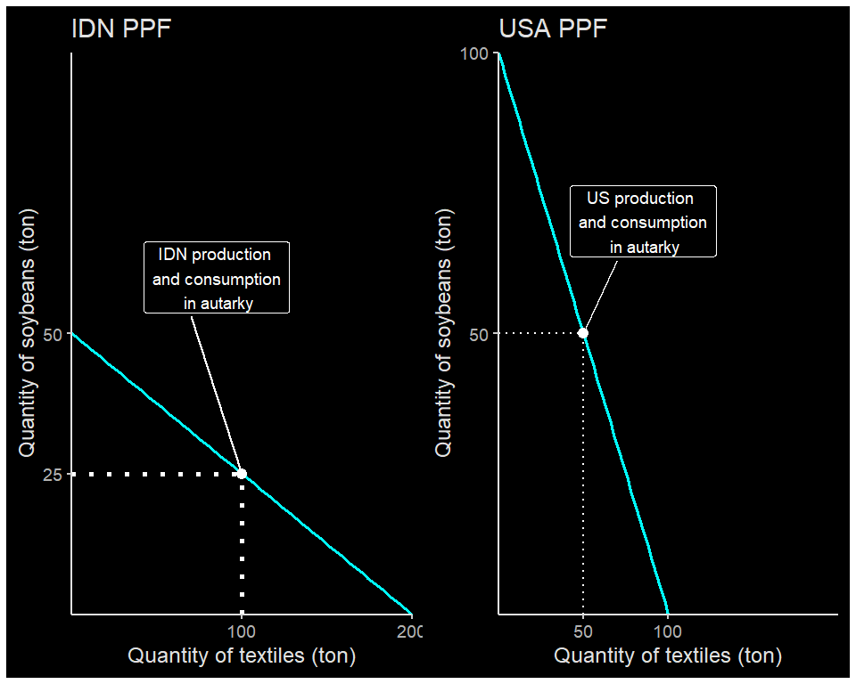

Slide 15
2 countries in autarky
Produce | US opportunity cost | IDN opportunity cost
1 ton of textiles | 1 ton of soybean | 250 kg of soybean
1 ton of soybean | 1 ton of textiles | 4 ton of soybean
Suppose the two countries does not trade. Indonesia’s production is (200,50), While in the US, it’s (50,50).

Slide 16
Indonesia is comparatively better at making textiles, while US is better at producing soybean:
To make 1 ton of textiles, US needs to gave up resources which can be used to make 1 ton soybean, while Indonesians need only to give up 250 kg soybean.
To make 1 ton of soybean, US needs to gave up resources which can be used to make 1 ton textiles, while Indonesians need only to give up 4 ton of textiles.

Slide 17
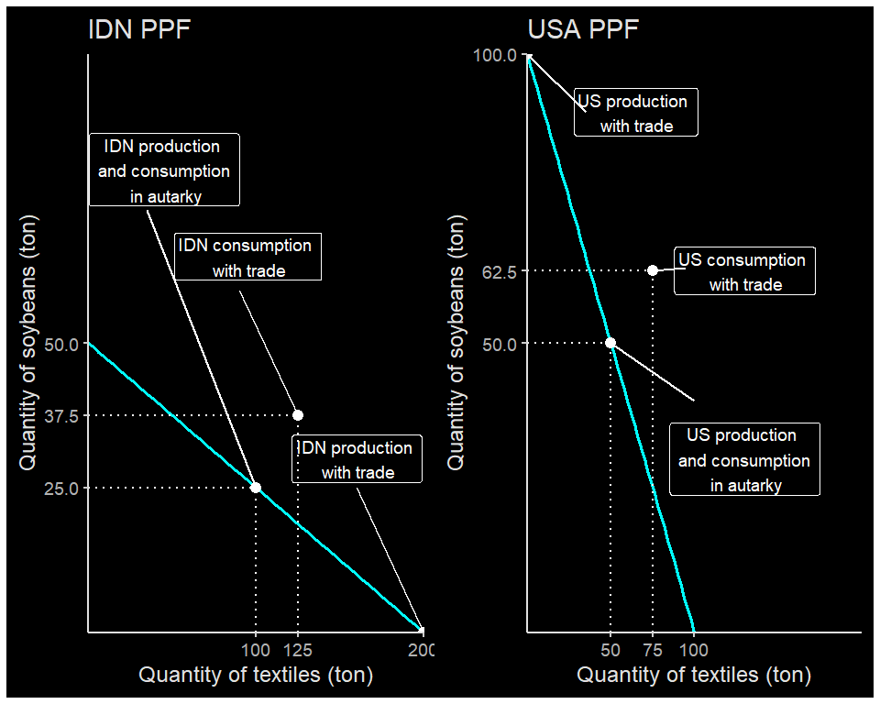

Slide 18
Gains from trade
 |  | in autarky |  | with trade
 |  | production | consumption | production | consumption | Gains from trade
USA | textiles (ton) | 50 | 50 | 0 | 75.0 | +25
USA | soybean (ton) | 50 | 50 | 100 | 62.5 | +12.5
IDN | textiles (ton) | 100 | 100 | 200 | 125.0 | +25
IDN | soybean (ton) | 25 | 25 | 0 | 37.5 | +12.5

Slide 19
By concentrating production on one good and then trade, you can see that both ended up better-off:
with autarky, total production {textiles,soybean} $=\{150,75\}$
consumption=production, and $C_{USA}=\{50,50\},C_{IDN}=\{100,25\}$

Slide 20
Gains from trade
 |  | in autarky |  | with trade
 |  | production | consumption | production | consumption | Gains from trade
USA | textiles (ton) | 50 | 50 | 0 | 75.0 | +25
USA | soybean (ton) | 50 | 50 | 100 | 62.5 | +12.5
IDN | textiles (ton) | 100 | 100 | 200 | 125.0 | +25
IDN | soybean (ton) | 25 | 25 | 0 | 37.5 | +12.5

Slide 21
with trade, total production {textiles,soybean} $=\{200,100\}$
Production $⇒P_{USA}=\{0,100\},P_{IDN}=\{200,0\}$
Consumption $⇒C_{USA}=\{75,62.5\},C_{IDN}=\{125,37.5\}$

Slide 22
Comparative advantage
In reality, we will need country’s preferences to establish proper equilibrium quantity and prices.
In this model, we have no price. But from the opportunity cost, we can calculate the relative prices:
In the US, opportunity cost to produce 1 soybean is 1 textile. That means, $P_{USA}^{soybean}=P_{USA}^{textile}$
In Indonesia, opportunity cost to make 1 soybean is 4 textiles. That means, the price of soybean must be four times price of textile.
Since in Indonesia, it is comparatively cheaper to produce textile, it’s better for US to source its textile from Indonesia.

Slide 23
What determines comparative advantage?
Differences in climate is the reason why we’re so good at producing CPO and rubber, but sucks at producing soybean and wheat.
Differences in Factor Endowment. Some countries are endowed with natural resource, some with cheap labour. Countries which has no both has to find something else, such as:
Differences in technology. Japan, South Korea and Taiwan are one good example. While technology can be transferred, opportunity cost of investing in high-tech things is more production of CPOs.

Slide 24
Global Value Chain
These days, trade have been moving to an even more extreme point. Hence hyperglobalization: countries rely on each other to produce one particular goods.
The main enabler is advances in communications:
human-human: the internet.
human-machine: production software, production dashboard.
machine-machine: CAD-CAM.
Countries able to specialize not only in a production of particular goods, but a particular process of production.
This is called Global Value Chain (GVC)

Slide 25
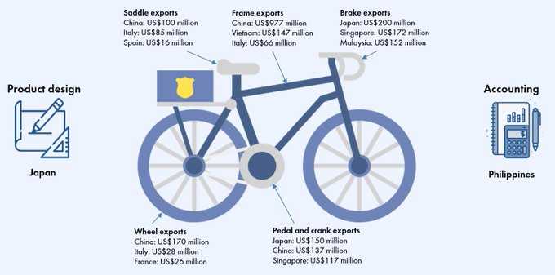
Many products these days do not made by just 1 country
image

Slide 26
source: World Bank

Slide 27
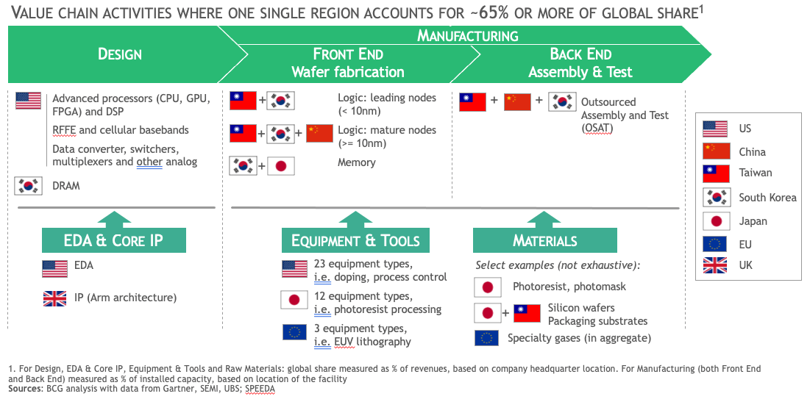
Global Value Chain
Many products these days do not made by just 1 country
image

Slide 28
source: Semiconductor Industry Association

Slide 29
Global Value Chain
GVC allows for a country that has very low technological prowess become one of the dominant exporter of high-tech goods like smartphone and laptops.
In GVC situation, trade policy becomes very important: a poorly designed trade policy will leads to zero production in both.
Imagine if Indonesia has to build its own semiconductor fab in order to produce a smartphone.
With GVC, Indonesia can import semiconductor and assemble a PCB and smartphone domestically.
Indonesia also able to export textiles in varying qualities of raw materials.

Slide 30
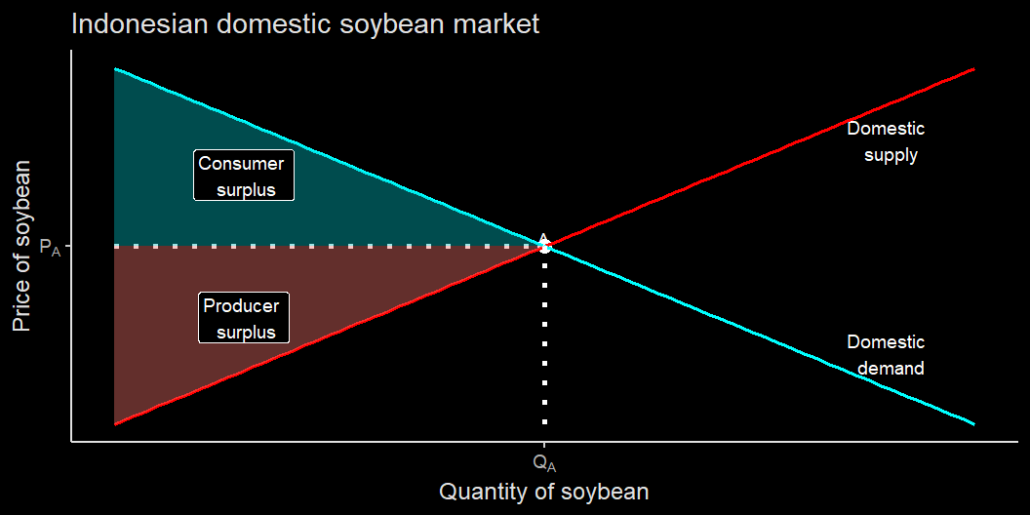
Indonesian soybean market in autarky

Slide 31
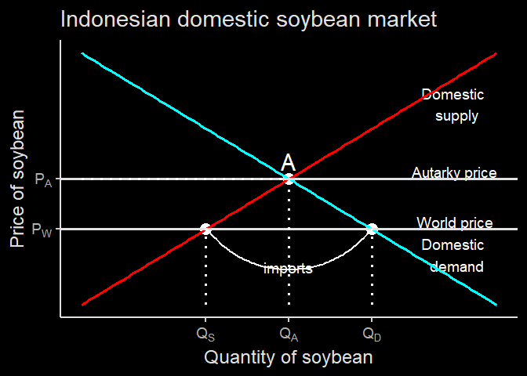
Indonesian soybean market with trade
With trade, the soybean market is exposed to a lower world price $P_{W}$
at $P_{W}$, demand increases $Q_{A}→Q_{D}$, while supply reduces $Q_{A}→Q_{S}$
This imbalance is solved via imports. Domestically produced soybean is $Q_{S}$, while imported soybean is $Q_{D}−Q_{S}$

Slide 32
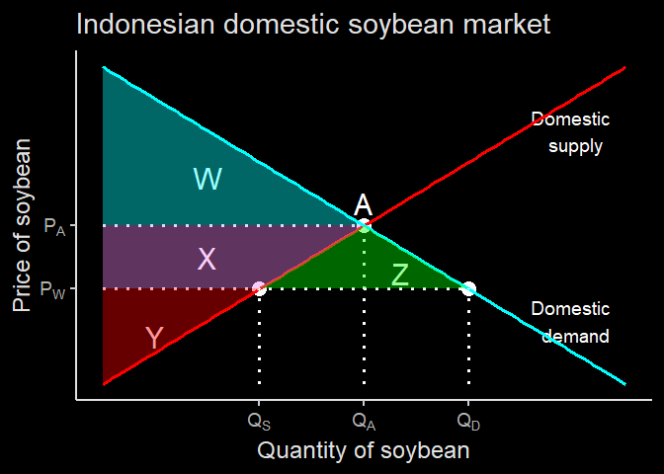
Change in surplus
In autarky:
PS = Y + X
CS = W
TS = Y + X + W
In trade:
PS = Y
CS = W + X + Z
TS = Y + W + X + Z
CS is much higher, and trade gains area Z in total.
However, domestic soybean producer lose area X.

Slide 33
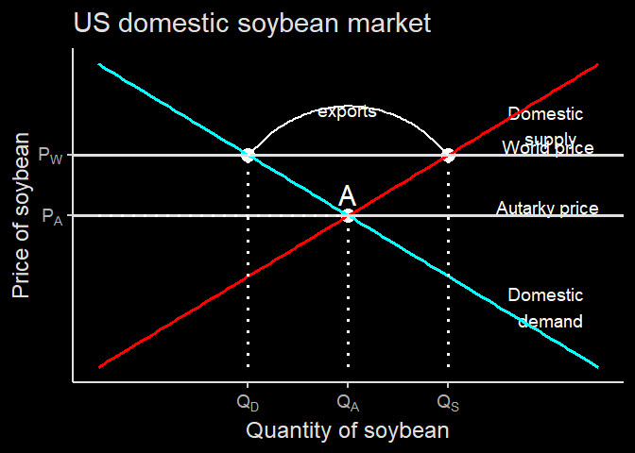
US soybean market with trade
With trade, the soybean market is exposed to a higher world price $P_{W}$
at $P_{W}$, demand reduces $Q_{A}→Q_{D}$, while supply increases $Q_{A}→Q_{S}$
This imbalance is solved via exports. Domestically consumed soybean is $Q_{D}$, while imported soybean is $Q_{S}−Q_{D}$

Slide 34
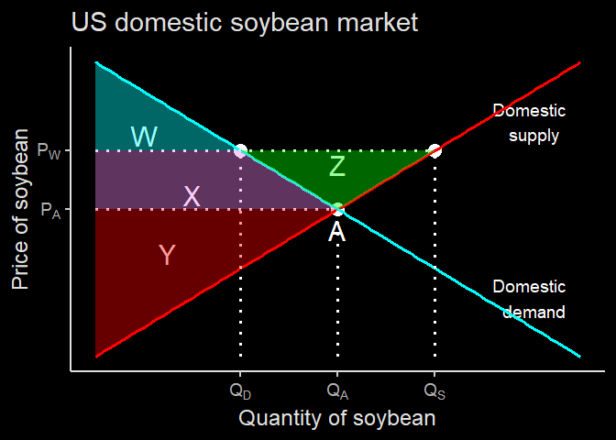
Change in surplus
In autarky:
PS = Y
CS = W + X
TS = Y + X + W
In trade:
PS = Y + X + Z
CS = W
TS = Y + W + X + Z
PS is much higher, and trade gains area Z in total which goes to producer.
However, domestic soybean producer lose area X.

Slide 35
Effect of trade
Trade benefits exporting industries while hurting import competing industries.
Factor of productions used for export sectors will have high demand, and priced highly:
Firms in natural resources exporting countries will compete to gain access to lands
Farmers move to manufacturing because Indonesia export a bit of manufactures, while net importing agricultural goods.
If factors can’t easily move, it will leads to inequality.

Slide 36
Trade policy
Trade leads to winner and losers:
import benefits consumers while hurt producers
export benefits producers while hurt consumers
In the case of soybean:
import helps chicken breeders who benefit from cheap soybean, but hurt soybean farmers.
If soybean farmers are more politically influencial, they can ask for protection from the government by using import tariff or import quota.

Slide 37
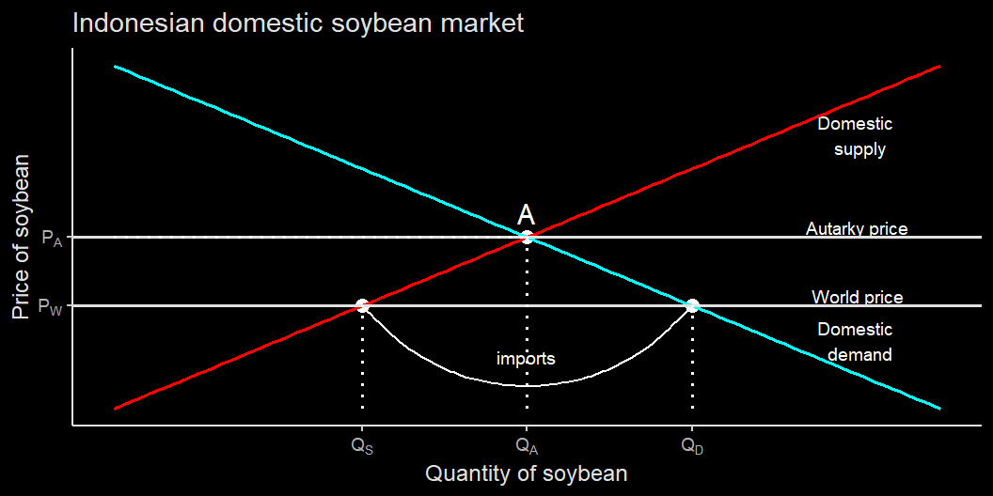
Recall soybean import

Slide 38
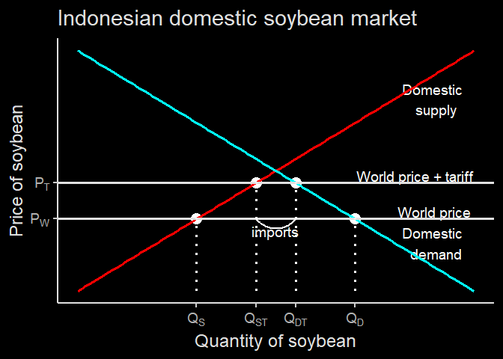
The effect of import tariff
When the government impose tariff, the import price become more expensive. Local producer doesn’t experience tariff so they become more competitive.
Domestic parket becomes world price + tariff
This push demand down to $Q_{DT}$ and increase domestic supply to $Q_{ST}$
Imports are lower $Q_{DT}−Q_{ST}$

Slide 39
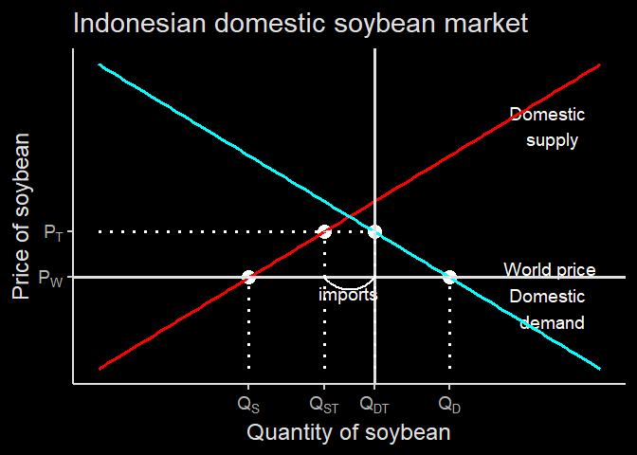
The effect of import quota
When the government impose quota restriction at $Q_{DT}$, the effect is similar.
buyers want to buy up to $Q_{D}$ but cannot.
This push price up to $P_{T}$.

Slide 40
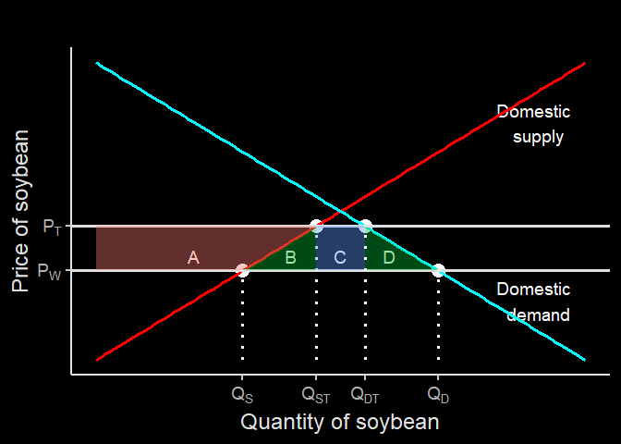
Surplus changes from trade policy
Tariff leads to lower imports, and more domestically produced goods.
In total, CS lost A+B+C+D
PS gains = A
Government gets tariff revenue, which is number of imports $×$ per-unit tariff, which is C
B+D is DWL.

Slide 41
Effect of trade policy
in case of quota, B goes to quota rent.
When quota rent is sold with a competitive auction, the rent can go to government, and thus have the same effect as tariff.
However, when appointed quota is not transparent this can lead to a corruption.
Beef and garlic are the examples of import quota, while lobster was the example of export quota corruption.

Slide 42
Conclusion
In conclusion, trade is generally good for everyone
Unfortunately, the gain from trade is not shared equally, and could potentially lead to higher inequality.
Donald Trump rust belt
Indonesian manufacturing suffer from commodity boom during the 2000s.
Trade creates winners and losers, and the battle between winners and losers determine trade policy.

Slide 43
Next up
Next week we will see how international capital plays out.
The role of exchange rate
Balance of Payment.

