Slide 1

Validating Cell Tower Clustering For Mobility Prediction
Pedro d'Aquino
Mehrdad Moradi
Dec. 13, 2012

Slide 2
Cellular Mobility Prediction is in Operators’ Interest
Network Optimizations:
Resource Pre-allocation
Prefetching
Handover Optimization
Personalized Services
Location Based Offline Advertisement

Slide 3
Current Approaches
Instrumentation of User devices for Collecting:
GPS/WiFi/GSM
Application
Using General Performance Event Handling(GPEH) Data:
Radio Measurement
Cell Information
Calls

Slide 4
GSM Data Sets
 | Cells | Area Codes | Country IDs | Cell Transitions | Status
Nokia Challenge | 23378 | 966 | 32 | 3308612 | Sampled
Reality Mobility | 32787 | 1052 | 2 | 619693 | Transition based

Slide 5
Our Approach
Mobility Path Extraction
Oscillating Pair Detection
Oscillation Graph Generation
Oscillation Graph Clustering
Clustering Efficiency Evaluation

Slide 6
Mobility Path Extraction
Input: GSM Logs
Output: Mobility Paths
Person Id | T start | T end | T duration | Cell Id
1 | 0 | 4 | 4 | C1
1 | 6 | 9 | 3 | C4
1 | 9 | 13 | 4 | C3
1 | 15 | 24 | 9 | C7
1 | 24 | 28 | 4 | C5
[ C1 C4 C3 C7]
[C7 C5]

Slide 7
Oscillating Pair Detection
Goal:
Retrieve sets of towers that overlap each other in all mobility paths:
Soft Handover: The user is in a stationary state but there is transition between overlapping towers.
Solution:
Switching: a handover from one tower to another inside of a mobility path
Ex[ x, y, x, w, v, w, y], minimum switching count= 3
(x,y) has 3 switches
It is an oscillating pair

Slide 8
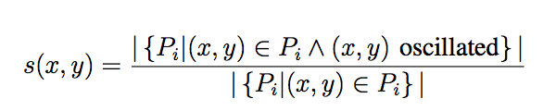
Oscillation Graph Generation
G(V, E):
V: All cell towers in oscillating pairs
E: Weighted edges with weight:
connecting oscillating pairs.
Intuition:
s(x,y) is the ratio of how many times the cell towers x and y oscillated over the number of mobility paths in which x and y appear.
Example: [ x, y, x, w, v, w, y], [x f y], [x y g]: s(x,y)=1/3

Slide 9
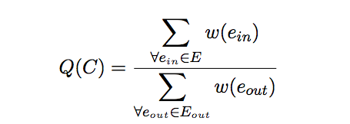
Oscillation Graph Clustering
Approach:
Greedy Algorithm:
Removing edge with minimum weight
Finding cluster C:
Quality Metric(Q(C) ) >threshold

Slide 10
Oscillation Graph Clustering(2)
Intuition:
0.9
0.8
0.6
0.9
0.1
0.9
0.9
0.8
0.75
0.9
0.8
Removing lowest weight edge
0.6
0.9
0.9
0.9
0.8
0.75
0.9
0.8
0.6
0.9
0.9
0.9
0.8
0.75

Slide 11
Questions
How much clustering is accurate?
Are clustered cells are near enough to overlap?
Does sampling cause high rate of loss in mobility paths?

Slide 12
Clustering Efficiency Evaluation
Sampling Effect:
Comparing the effect of sampling on Reality Mining dataset
Metric Measurements:
Comparing the results of the clustering in datasets.
Cluster Distance
Cluster Incompleteness
Cross Validation:
Validating cluster characteristic using GPS data sets:
OpenCelld
OpenBMap

Slide 13
Clustering: Sampling Effect (1)
Reality Mining dataset logs every cell transition
We have many soft handovers in one minutes.
Question: Do we really need such precision?
Nokia Mobile Data Challenge the active cell tower connection is sampled every minute.
We lose many hard handovers in one minutes.
Question: Are we really ignoring many mobilities?

Slide 14
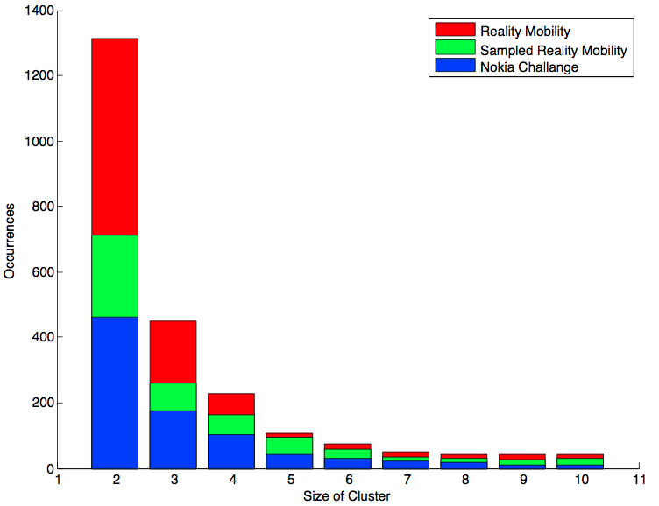
Clustering: Sampling Effect
Sampling every one minute doesn’t change distribution of size and quality.

Slide 15
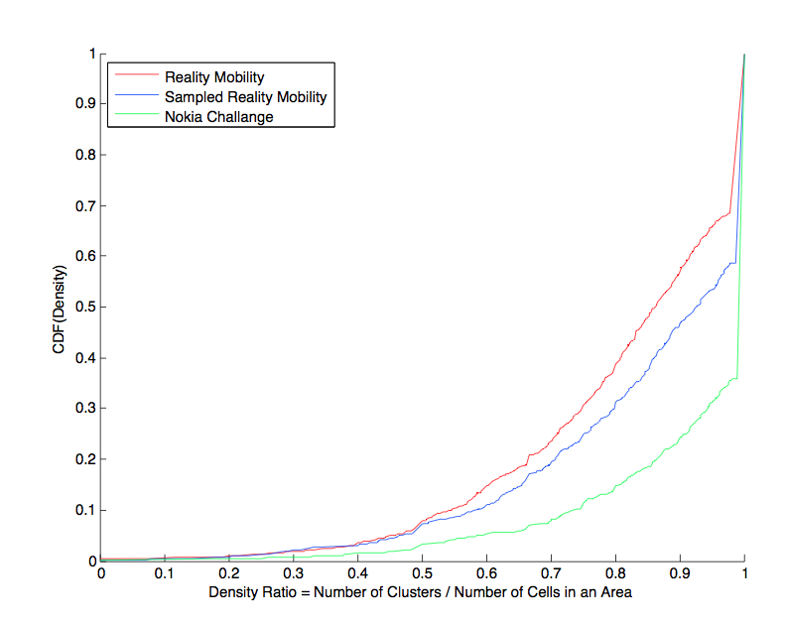
Clustering: Density Ratio
Sampling every one minutes doesn’t change density ratio:
Density Ratio= (# Clusters/ # Cells) in an area

Slide 16

GPS Data Sets(1)
Nokia Mobile Data Challenge – GPS
GSM and GPS entries do not necessarily have the same timestamp
Intuition: Average of all GPS positions that were associated with that tower
How much accurate the GPS estimate of a particular tower is?
Standard deviation
Haversine formula

Slide 17

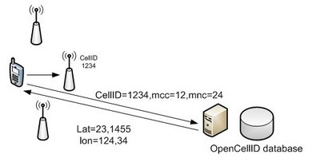
GPS Data Sets (2)
Cost:
k: is the number of users in the dataset
m,n: upper bounds on the number of GPS
and GSM records per user
OpenCellId and OpenBMap:
keeps track of the position and associates it with a cell tower

Slide 18
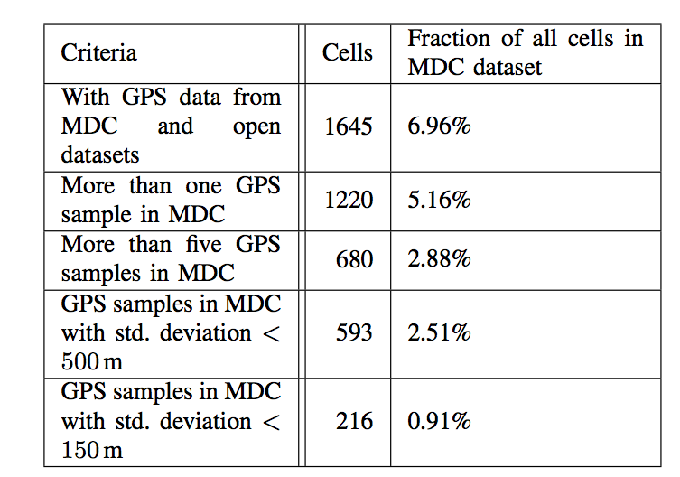
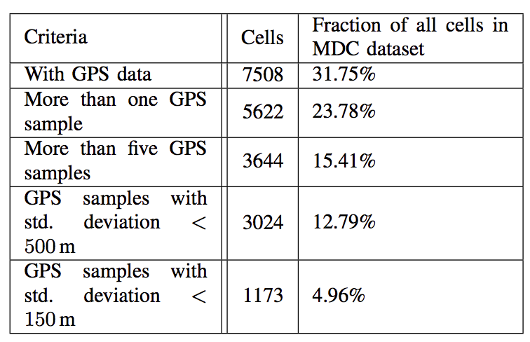
GPS Data Sets (3)
Combine OpenBMap and OpenCellId measures and use an average
Summary:

Slide 19
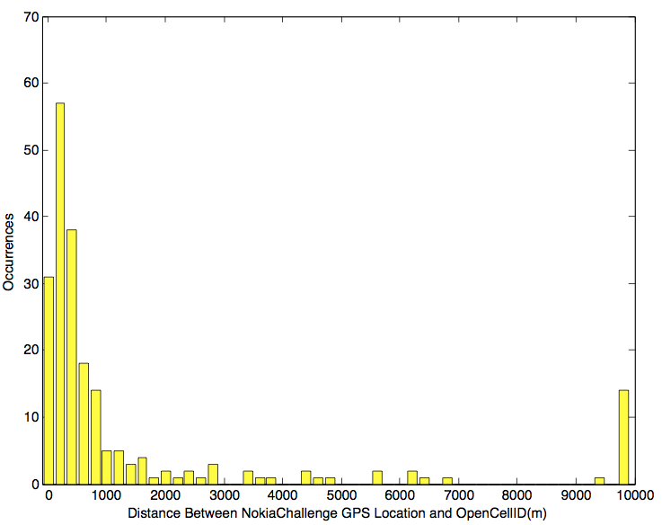
MDC GPS VS OpenCellID
Distance is usually small…
confidence in the MDC GPS logs

Slide 20
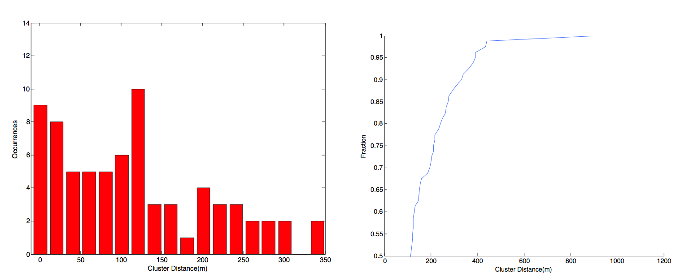
Metric Measurements: Cluster Distance
Cluster Distance:
The average distance between cells in a cluster
Closeness: group together towers that are geographically close

Slide 21
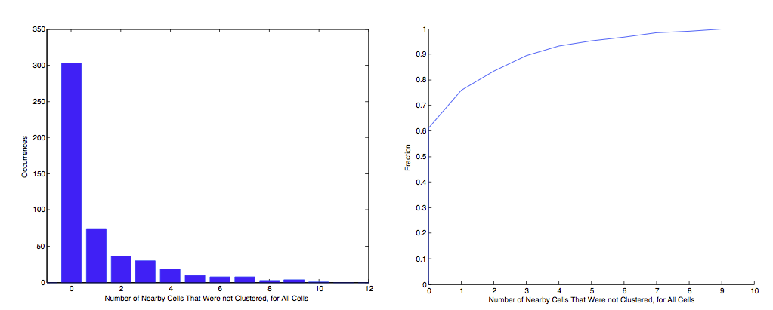
Metric Measurements: Incompleteness

Slide 22
Conclusion

Slide 23
Future Works

