Slide 1

Validating Cell Tower Clustering For Mobility Prediction
Pedro d'Aquino
Mehrdad Moradi
Dec. 13, 2012

Slide 2
Cellular Mobility Prediction is Operators’ Interest
Network Optimizations:
Resource Pre-allocation
Prefetching
Handover Optimization
Personalized Services
Location Based Offline Advertisement

Slide 3
Current Approaches
Instrumentation of User devices for Collecting:
GPS/WiFi/GSM
Application
Using General Performance Event Handling(GPEH) Data:
Radio Measurement
Cell Information
Calls

Slide 4
Data Sets
 | Cells | Area Codes | Countries | Cell Transitions
Nokia Challenge | 23378 | 966 | 32 | 3308612
Reality Mobility | 32787 | 1052 | 2 | 619693

Slide 5
Our Approach
Mobility Path Extraction
Oscillating Pair Detection
Oscillation Graph Generation
Oscillation Graph Clustering
Validating Graph Clustering

Slide 6
Mobility Path Extraction
Input:
Person Id | T start | T end | T duration | Cell Id
1 | 0 | 4 | 4 | C1
1 | 6 | 9 | 3 | C4
1 | 9 | 13 | 4 | C3
1 | 15 | 24 | 9 | C7
1 | 24 | 28 | 4 | C5
[ C1 C4 C3 C7]
[C7 C5]

Slide 7
Oscillating Pair Detection
Goal:
Retrieve sets of towers that overlap each other:
Soft Handover: The user is in a stationary state but there is transition between overlaping towers.
Solution:
Switching means a handover from one tower to another inside of a mobility path
[ x, y, x, w, v, w, y], minimum switching count= 3
(x,y) has 3 switches
It is oscillating pair

Slide 8
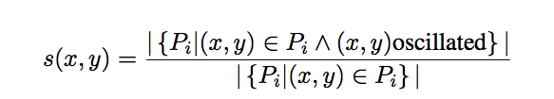
Oscillation Graph Generation
G(V, E):
V: All cell towers in oscillating pairs
E: Weighted edges with weight:
connecting oscillating pairs.
Intuition:
s(x,y) is the ratio of how many times the cell towers x and y oscillated over the number of mobility paths in which x and y appear.
[ x, y, x, w, v, w, y], [x f y], [x y g]: s(x,y)=2/3

Slide 9
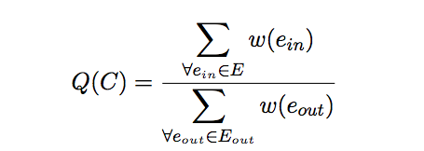
Oscillation Graph Clustering
Approach:
Greedy Algorithm
Finding Cluster C:
Quality Metric(Q(C) ) >threshold

Slide 10
Oscillation Graph Clustering(2)
0.9
0.8
0.6
0.9
0.1
0.9
0.9
0.8
0.75
0.9
Removing lowest weight edge
0.8
0.6
0.9
0.9
0.9
0.9
0.8
0.75
0.8
0.6
0.9
0.9
0.9
0.8
0.75

