Slide 1

Validating Cell Tower Clustering For Mobility Prediction
Pedro d'Aquino
Mehrdad Moradi
Dec. 13, 2012

Slide 2
Cellular Mobility Prediction is Operators’ Interest
Network Optimizations:
Resource Pre-allocation
Prefetching
Handover Optimization
Personalized Services
Location Based Offline Advertisement

Slide 3
Current Approaches
Instrumentation of User devices for Collecting:
GPS/WiFi/GSM
Application
Using General Performance Event Handling(GPEH) Data:
Radio Measurement
Cell Information
Calls

Slide 4
Data Sets
 | Cells | Area Codes | Country IDs | Cell Transitions | Status
Nokia Challenge | 23378 | 966 | 32 | 3308612 | Sampled
Reality Mobility | 32787 | 1052 | 2 | 619693 | Transition based

Slide 5
Our Approach
Mobility Path Extraction
Oscillating Pair Detection
Oscillation Graph Generation
Oscillation Graph Clustering
Clustering Efficiency Evaluation

Slide 6
Mobility Path Extraction
Input: GSM Logs
Output: Mobility Paths
Person Id | T start | T end | T duration | Cell Id
1 | 0 | 4 | 4 | C1
1 | 6 | 9 | 3 | C4
1 | 9 | 13 | 4 | C3
1 | 15 | 24 | 9 | C7
1 | 24 | 28 | 4 | C5
[ C1 C4 C3 C7]
[C7 C5]

Slide 7
Oscillating Pair Detection
Goal:
Retrieve sets of towers that overlap each other in all mobility paths:
Soft Handover: The user is in a stationary state but there is transition between overlaping towers.
Solution:
Switching: a handover from one tower to another inside of a mobility path
Ex[ x, y, x, w, v, w, y], minimum switching count= 3
(x,y) has 3 switches
It is oscillating pair

Slide 8
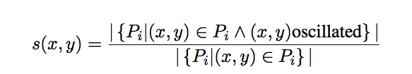
Oscillation Graph Generation
G(V, E):
V: All cell towers in oscillating pairs
E: Weighted edges with weight:
connecting oscillating pairs.
Intuition:
s(x,y) is the ratio of how many times the cell towers x and y oscillated over the number of mobility paths in which x and y appear.
Example: [ x, y, x, w, v, w, y], [x f y], [x y g]: s(x,y)=2/3

Slide 9
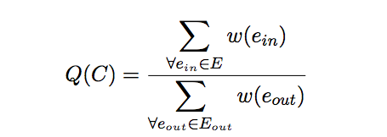
Oscillation Graph Clustering
Approach:
Greedy Algorithm:
Removing edge with minimum weight
Finding cluster C:
Quality Metric(Q(C) ) >threshold

Slide 10
Oscillation Graph Clustering(2)
0.9
0.8
0.6
0.9
0.1
0.9
0.9
0.8
0.75
0.9
Removing lowest weight edge
0.8
0.6
0.9
0.9
0.9
0.9
0.8
0.75
0.8
0.6
0.9
0.9
0.9
0.8
0.75

Slide 11
Questions
How much clustering is accurate?
Are clustered cells are near enough to overlap?
Does sampling cause high rate of loss in mobility paths?

Slide 12
Clustering Efficiency Evaluation
Comparing the effect of sampling on Reality Mining dataset
Comparing the results of the clustering in datasets.
Cluster Distance
Cluster Incompleteness
Validating cluster characteristic using GPS data sets:
OpenCelld
OpenBMap

Slide 13
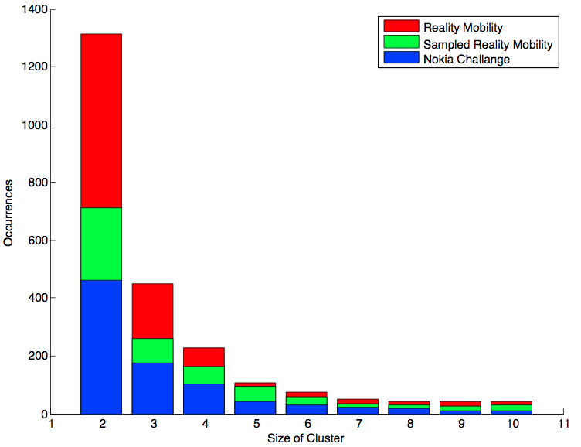
Clustering: Sampling Effect
Sampling every one minute doesn’t change distribution of size and quality.

Slide 14
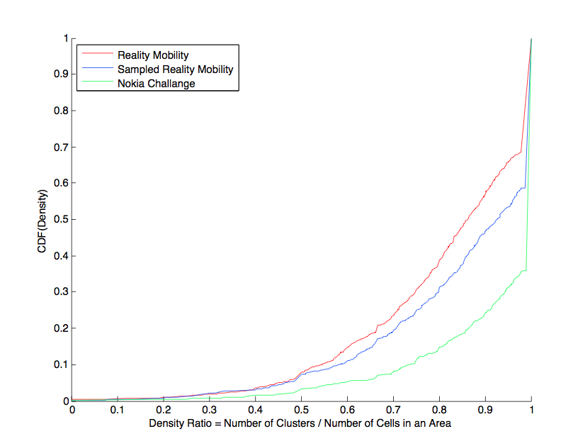
Clustering: Ratio
Sampling every one minutes doesn’t change density ratio:
Density Ratio= (# Clusters/ # Cells) in an area

Slide 15
Clustering: Density Ratio
Sampling every one minutes doesn’t change density ratio:
Density Ratio= (# Clusters/ # Cells) in an area

Slide 16
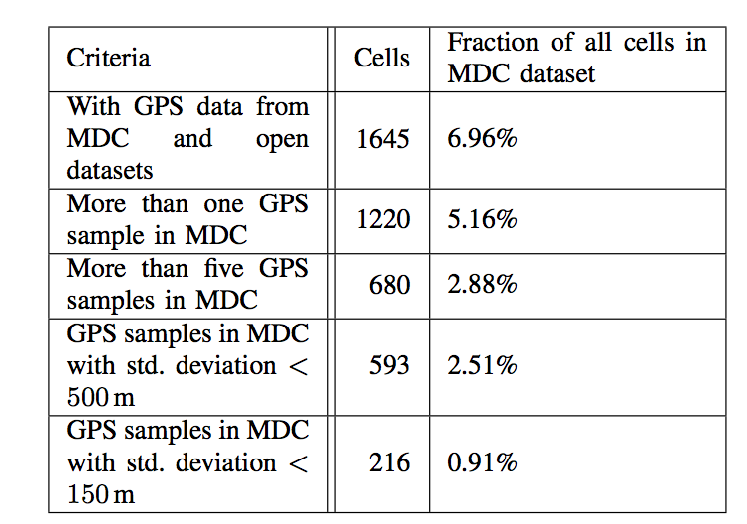
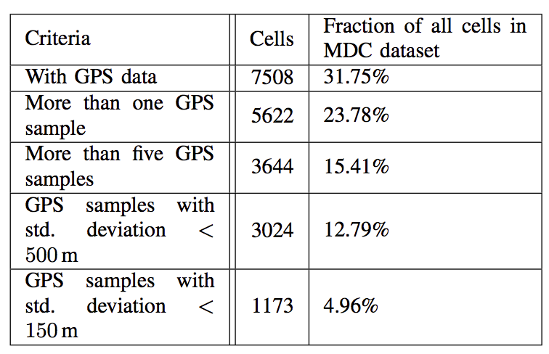
GPS Data From MDC

Slide 17
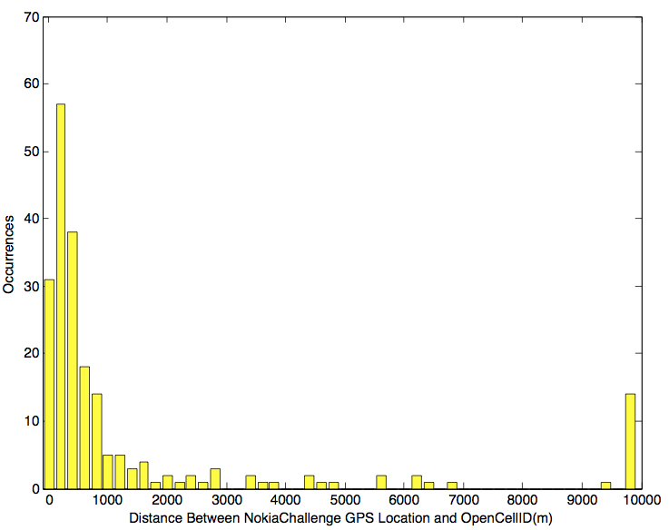
MDC GPS VS OpenCellID

Slide 18
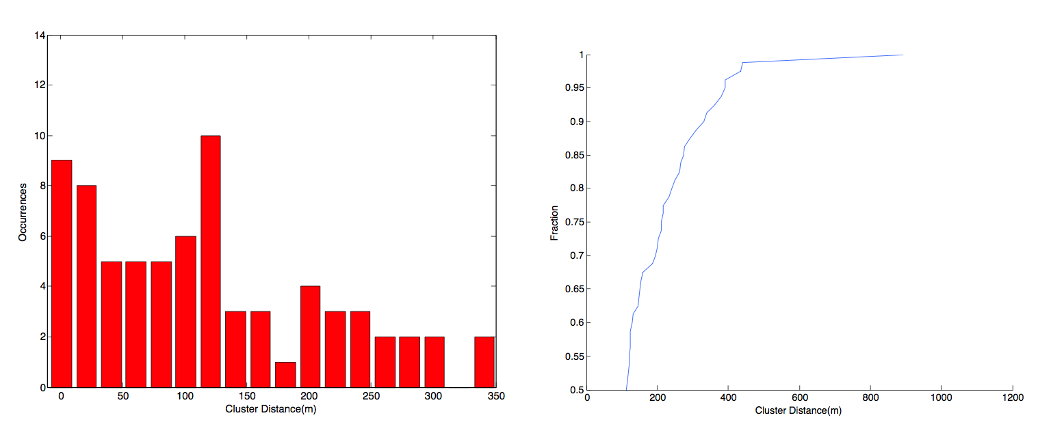
Cluster Distance

Slide 19
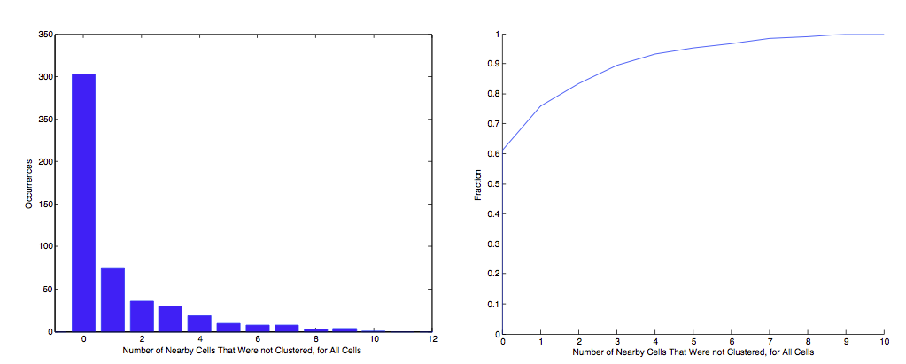
Cluster Incompleteness

Slide 20
Conclusion

Slide 21
Future Works

