Slide 1
Decision-making under a sequential multiple-option choice frame
Chen Hu
(lab meeting 11/10/2017)

Slide 2
Introduction
Understand how options are compared during decision making process is crucial.
Former studies have identified that:
People’s prior preference can shift the value comparison frame. Choice are based on the value comparison between the default option vs the alternative (Lopez-Persem, eLife, 2016).
People’s preference might be shifted by their actions (e.g. choice). (Vinckier, submitted)
People demonstrate a bias towards the most recent presented options in sequential presentation (results reported by S. Ballesta in C. Padoa-Schioppa’s lab ; results in P. Domenech’s lab) .

Slide 3
Questions of interest
In sequential multiple-choice frame, is there a default option (temporary defied as the best option the subject encounters so far ) serve as the reference option?
Will there be interactions between option values and option sequences?
How potential pre-commitment might modify people’s preference and confidence report?

Slide 4
Hypothesis
In sequential multiple option choice, instead of registering the value of each option and compare them at the end step base on Softmax rule, people will implement the value comparison in multiple steps (i.e. for n items, do (n – 1) pairwise comparison).
Each time a new option emerges, people will compare the new option with the current best option. Whichever option wins will get a bonus of pre-committed (implicit, compare to explicit choice action), and enters into the next round with augmented value.
Therefore the final choice is based on the modified value after multiple pairwise comparisons instead of the initial reported ratings.
The same advantages are predicted by response time and confidence report.

Slide 5

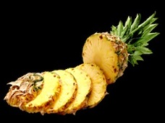
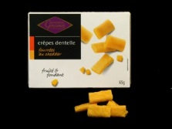



Task Structure
Practice
Rating
Practice
Choice
Cate1
Rating
Cate1
Choice
Cate2
Rating
Cate2
Choice
Cate3
Rating
Cate3
Choice
Cate4
Rating
Cate4
Choice
Cate5
Rating
Cate5
Choice

Slide 6

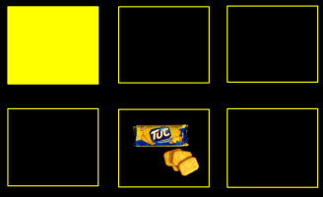



Task Structure
Practice
Rating
Practice
Choice
Cate1
Rating
Cate1
Choice
Cate2
Rating
Cate2
Choice
Cate3
Rating
Cate3
Choice
Cate4
Rating
Cate4
Choice
Cate5
Rating
Cate5
Choice
Per choice trial:
+ confidence
rating
Self-paced, > 500ms
1s
< 5s
Feedback 1s

Slide 7
Task Structure
Practice
Rating
Practice
Choice
Cate1
Rating
Cate1
Choice
Cate2
Rating
Cate2
Choice
Cate3
Rating
Cate3
Choice
Cate4
Rating
Cate4
Choice
Cate5
Rating
Cate5
Choice
Per choice trial:
+ confidence
rating
Self-paced, > 500ms
1s
< 5s
Feedback 1s
In each blocks:
Ratings: 3*3 + 4*4 + 5*5 +6*6 = 86 items per block
Choice: 3 + 4 + 5 + 6 = 18 trials * 4 repetition = 72 per block

Slide 8
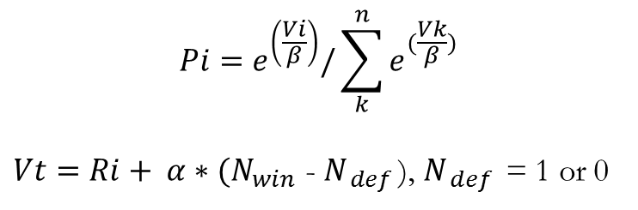

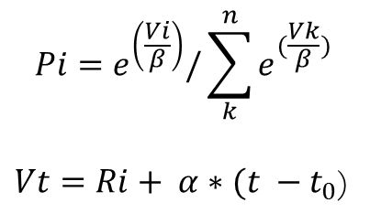
Hypothesis testing
$$Pi=e^{\left(\frac{Vi}{β}\right)}/\sum_{k}^{n}{e^{(\frac{Vk}{β})}}$$
$$Vi=Ri$$
H0
H1- default:
H2- recency:
$$Pi=e^{\left(\frac{Vi}{β}\right)}/\sum_{k}^{n}{e^{(\frac{Vk}{β})}}$$
$Vt=Ri+ α∗{(N}_{win }$- $N_{ def }$), $N_{ def }$ = 1 or 0
$$Pi=e^{\left(\frac{Vi}{β}\right)}/\sum_{k}^{n}{e^{(\frac{Vk}{β})}}$$
$Vt=Ri+ α∗(t −t_{0}$)

Slide 9
Task simulation
Based on previous tasks using similar items, the ratings are simulated as uniformly distributed random integers from 0 to 100, with 10% attracted to the 0 point.
Result set: 86 ratings *10 categories, 18 trials* 10 categories (24 subjects)
Simulate the choice:
Using the inverse temperature from the previous study of DV on choice
Simulate a range of possible ‘bonus for winning a comparison’, ranging from 0.51 to 10,02), to verify the extent to which the predicted effects sustain.

Slide 10
Simulation results

Slide 11
Pilot results: rating and confidence rating across categories

Slide 12
Pilot results: choice probability

Slide 13
Discussion
Whether we should mask the options?
Whether we should constraint a time out if no mask?
Alternative models?

Slide 14
Appendix

Slide 15
Food (144 items*24 subjects, AL, def task)

Slide 16
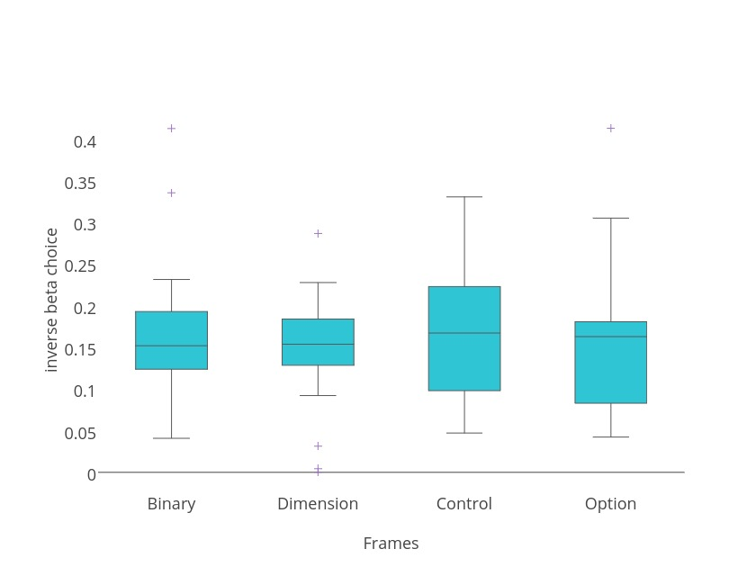
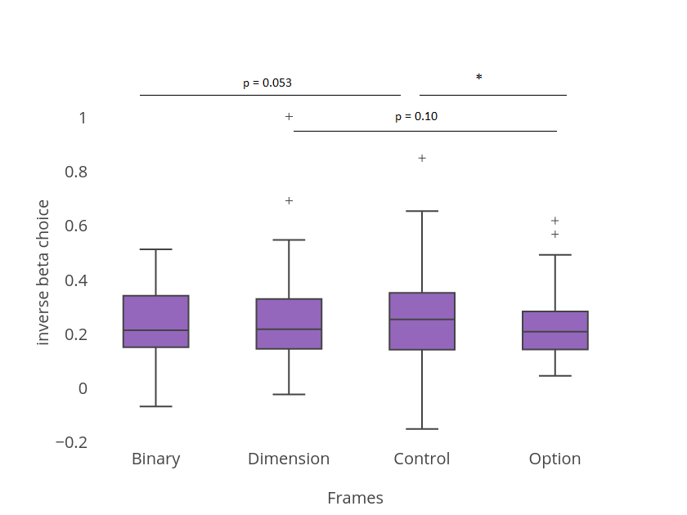
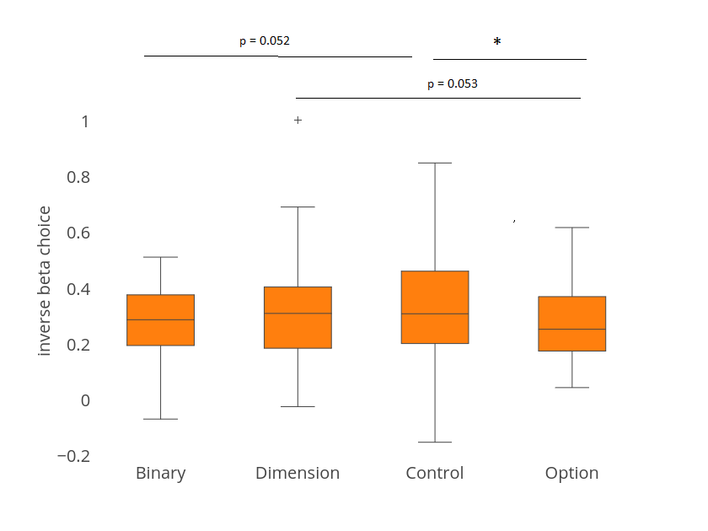
Glm analysis with model free DV → choice
Notes:
Inverse choice beta is calculated as:
Choice = sigmoidal (betaDV + constant)
DV = RatingR *(quantity_left – quantity_right) - RatingE *(quantity_left – quantity_right)
Blue plot: fMRI data, n = 24, ANOVA, p = 0.8, no significant difference. Mean [0.1638 0.1473 0.1675 0.1546]
Orange plot: pilot data, n = 41, ANOVA, p = 0.36 mean [0.2617 0.2878 0.2952 0.2500]
Purple data: pulled together two datasets, n = 65, ANOVA, p = 0.44
Mean [0.2255 0.2359 0.2480 0.2147]
Mean of all session putting together two data sets = 0.231
This is the inversed temperature *beta

Slide 17
Simulation results

