Slide 1
Simulation of new task

Slide 2
Rating simulation
Get the distribution from prior studies
144 items * 3 categories (food, music, reading)
24 subjects rated

Slide 3
Food (144 items, AL, def task)

Slide 4
Food (144 items*24 subjects, AL, def task)

Slide 5
Music (144 items, AL, def task)

Slide 6
Music (144 items*24 subjects, AL, def task)

Slide 7
Reading (144 items, AL, def task)

Slide 8
Reading (144 items*24 subjects, AL, def task)

Slide 9
Simulate the rating as uniformly distributed random integers from 0 to 100.
Do it for 10 categories * 86 items
24 subjects
Then assign the ratings to each trial.
Simulate the choice, need to know:
ratings with orders in each trial
Compute the probability of choosing each of the option
Using the beta from the previous study of DV on choice (weight = 0.231)
Calculate the choices according to the probability

Slide 10
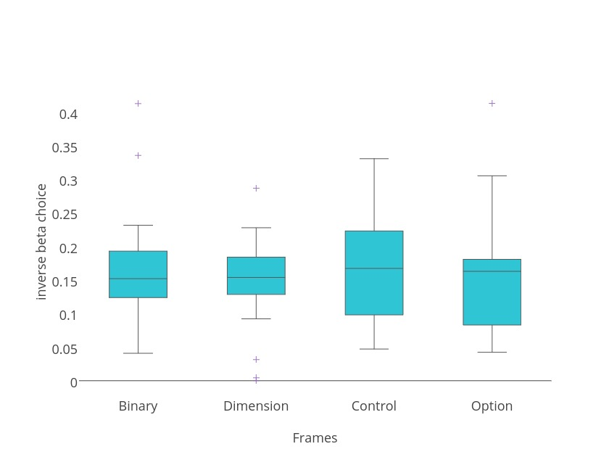
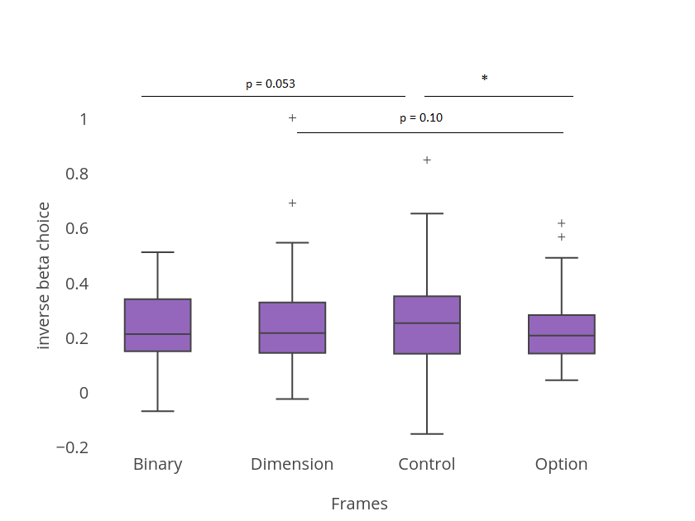
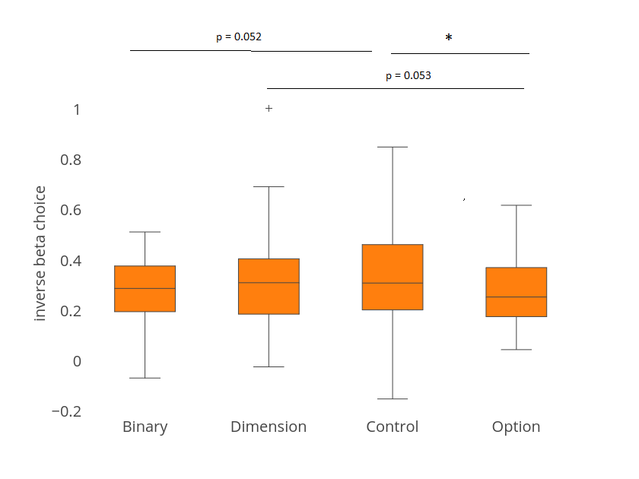
Glm analysis with model free DV → choice
Notes:
Inverse choice beta is calculated as:
Choice = sigmoidal (betaDV + constant)
DV = RatingR *(quantity_left – quantity_right) - RatingE *(quantity_left – quantity_right)
Blue plot: fMRI data, n = 24, ANOVA, p = 0.8, no significant difference. Mean [0.1638 0.1473 0.1675 0.1546]
Orange plot: pilot data, n = 41, ANOVA, p = 0.36 mean [0.2617 0.2878 0.2952 0.2500]
Purple data: pulled together two datasets, n = 65, ANOVA, p = 0.44
Mean [0.2255 0.2359 0.2480 0.2147]
Mean of all session putting together two data sets = 0.231
This is the inversed temperature *beta

