Slide 1
Decision-making under a sequential multiple-option choice frame
Chen Hu
(lab meeting 11/10/2017)

Slide 2
Introduction
Former results in the lab has established:
Choice are based on the value comparison between the default option vs the alternative (Lopez-Persem, eLife, 2017).
Preference might be shifted by people’s actions (choice etc). (Vinckier, submitted)
So we are interested in investigating:
The existence of the reference option in sequential multiple-choice frame.
How step-by-step pre- commitment might shape people’s preferences and confidence report.

Slide 3



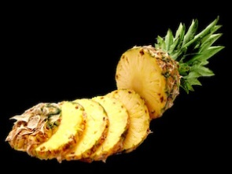

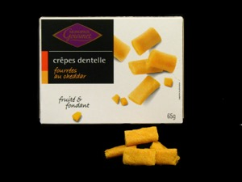
Task Structure
Practice
Rating
Practice
Choice
Cate3
Rating
Cate3
Choice
Cate1
Rating
Cate1
Choice
Cate4
Rating
Cate4
Choice
Cate2
Rating
Cate2
Choice
Cate5
Rating
Cate5
Choice
Ratings: 3*3 + 4*4 + 5*5 +6*6 = 86 items per block
Choice: 3 + 4 + 5 + 6 = 18 trials * 4 repetition = 72 per block

Slide 4
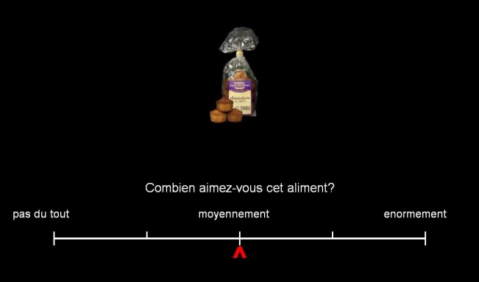
Zoom in trial
Rating
Choice

Slide 5
Hypothesis testing
H0
Pk = exp(Vk/beta)/sum(exp(Vi/beta))
People calculate the choice probability of each option base on their initial rating. People register all the values of the items during value comparison and work out final decision based on the probability computing.
H1:
Pk = exp(Vk/beta)/sum(exp(Vi/beta))
Vk(t) = Vko + betaC* (winning_record(t-1) – defeat_record(t-1));
Each time a new option emerges, people will compare the new option with the current best option. Whichever option wins will get a bonus (i.e. indicating a bias towards this pre-committed option), and enters into the next round with augmented value. The options that had been defeated will downgrade the value (due to degraded value representation) and never be compared with other option again. So the final choice is based on the regulated value after several pairwise comparison.

Slide 6
Task simulation
Based on previous tasks using similar items, the ratings are simulated as uniformly distributed random integers from 0 to 100, with 10% attracted to the 0 point.
Result set: 86 ratings *10 categories, 18 trials* 10 categories (24 subjects)
Simulate the choice:
Using the inverse temperature (beta) from the previous study of DV on choice
Simulate a range of possible ‘bonus for winning a comparison’ (denoted as betaC, ranging from 0.51 to 10,02), to verify the extent to which the predicted effect sustain.

Slide 7
Simulation results

Slide 8
Pilot results

Slide 9
Appendix

Slide 10
Food (144 items*24 subjects, AL, def task)

Slide 11
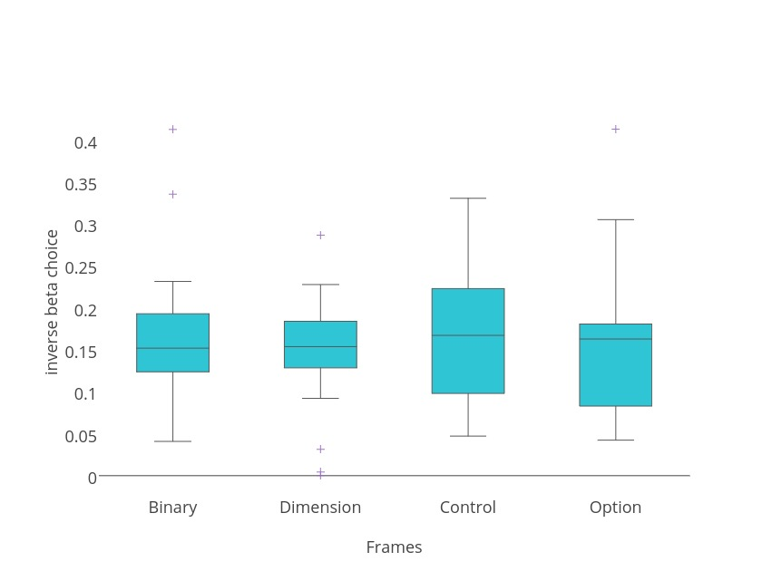
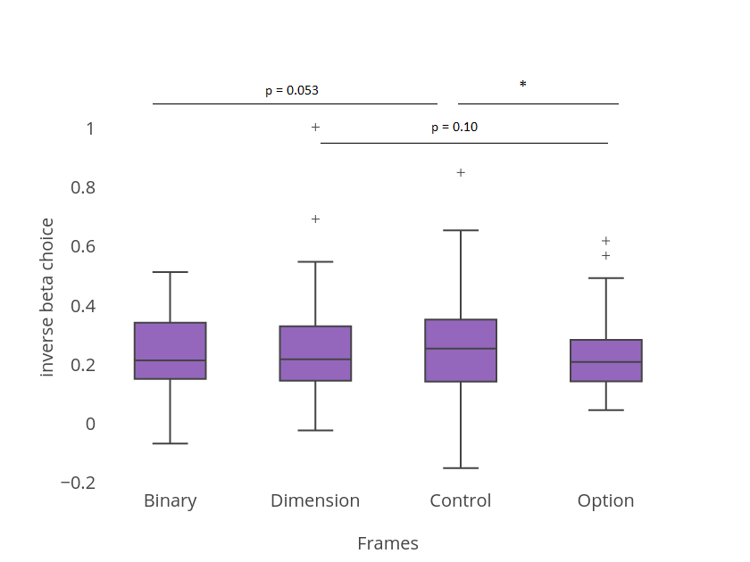
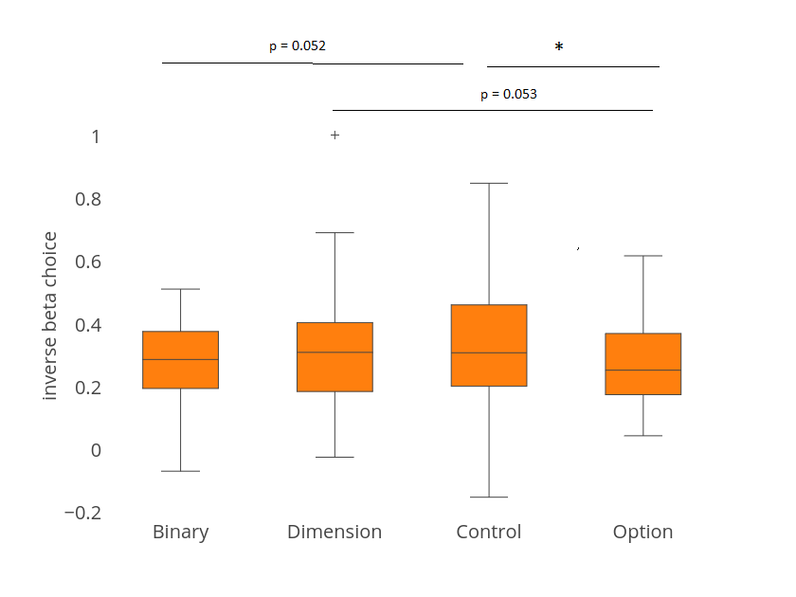
Glm analysis with model free DV → choice
Notes:
Inverse choice beta is calculated as:
Choice = sigmoidal (betaDV + constant)
DV = RatingR *(quantity_left – quantity_right) - RatingE *(quantity_left – quantity_right)
Blue plot: fMRI data, n = 24, ANOVA, p = 0.8, no significant difference. Mean [0.1638 0.1473 0.1675 0.1546]
Orange plot: pilot data, n = 41, ANOVA, p = 0.36 mean [0.2617 0.2878 0.2952 0.2500]
Purple data: pulled together two datasets, n = 65, ANOVA, p = 0.44
Mean [0.2255 0.2359 0.2480 0.2147]
Mean of all session putting together two data sets = 0.231
This is the inversed temperature *beta

