Slide 1
Decision-making under a sequential multiple-option choice frame
Chen Hu
(lab meeting 11/10/2017)

Slide 2
Introduction

Slide 3
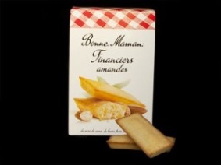

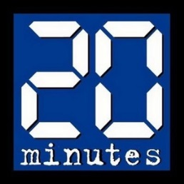
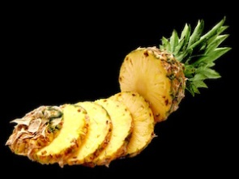

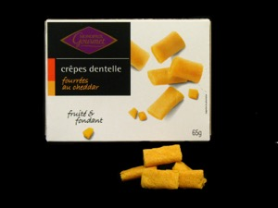
Task Structure
Practice
Rating
Practice
Choice
Cate3
Rating
Cate3
Choice
Cate1
Rating
Cate1
Choice
Cate4
Rating
Cate4
Choice
Cate2
Rating
Cate2
Choice
Cate5
Rating
Cate5
Choice
Ratings: 3*3 + 4*4 + 5*5 +6*6 = 86 items per block
Choice: 3 + 4 + 5 + 6 = 18 trials * 4 repetition = 72 per block

Slide 4
Zoom in trial

Slide 5
Simulation of the task

Slide 6
Rating simulation
Get the distribution from prior studies
144 items * 3 categories (food, music, reading)
24 subjects rated

Slide 7
Food (144 items, AL, def task)

Slide 8
Food (144 items*24 subjects, AL, def task)

Slide 9
Music (144 items, AL, def task)

Slide 10
Music (144 items*24 subjects, AL, def task)

Slide 11
Reading (144 items, AL, def task)

Slide 12
Reading (144 items*24 subjects, AL, def task)

Slide 13
Simulate the rating as uniformly distributed random integers from 0 to 100, with 10% attracted to the 0 point.
10 categories * 86 items
24 subjects
Simulate the choice:
Using the inverse temperature from the previous study of DV on choice
Simulate a range of

Slide 14
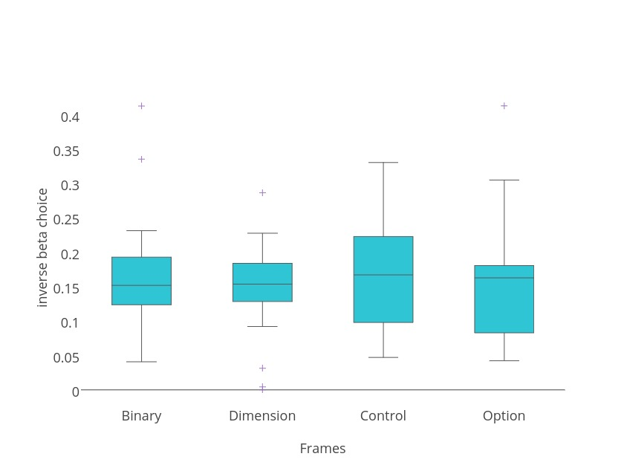
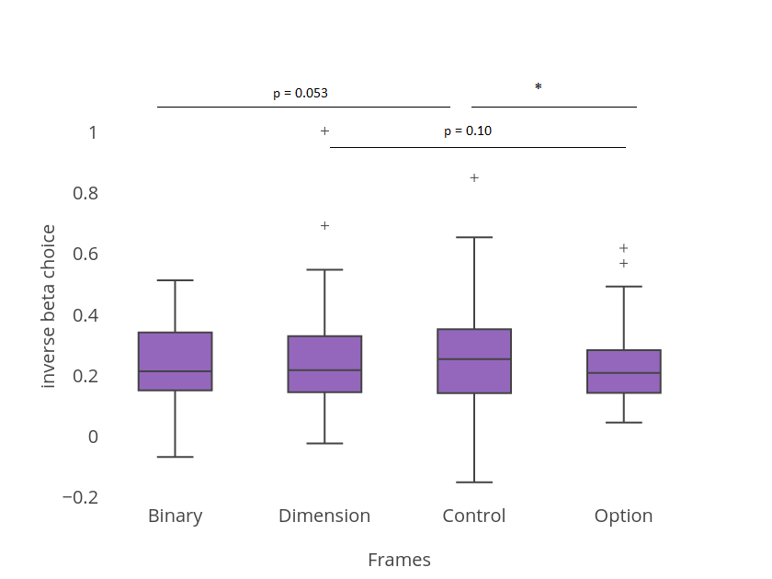
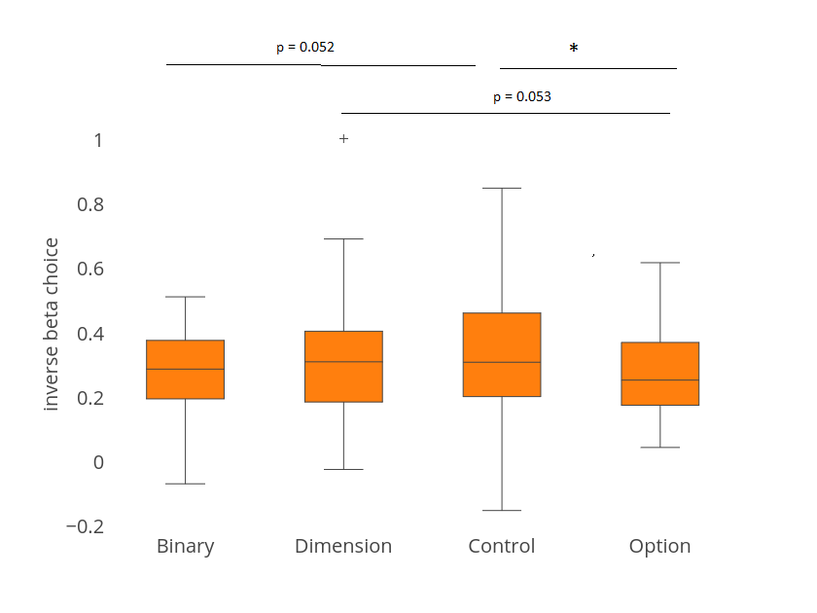
Glm analysis with model free DV → choice
Notes:
Inverse choice beta is calculated as:
Choice = sigmoidal (betaDV + constant)
DV = RatingR *(quantity_left – quantity_right) - RatingE *(quantity_left – quantity_right)
Blue plot: fMRI data, n = 24, ANOVA, p = 0.8, no significant difference. Mean [0.1638 0.1473 0.1675 0.1546]
Orange plot: pilot data, n = 41, ANOVA, p = 0.36 mean [0.2617 0.2878 0.2952 0.2500]
Purple data: pulled together two datasets, n = 65, ANOVA, p = 0.44
Mean [0.2255 0.2359 0.2480 0.2147]
Mean of all session putting together two data sets = 0.231
This is the inversed temperature *beta

