Slide 1
Web
The Web is a collection of pages linked togother and uploaded to a web server.
Anyone can read these pages by typing its address into a web browser.
Web servers and web browsers communicate via HTTP.

Slide 2
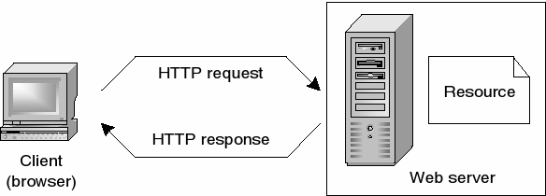
HTTP ensures that all parts of the web page are delivered

Slide 3
Web developement
there are no formal or specific qualifications required to become a web developer, a numerate degree in a subject such as maths or science will be useful.
You should also ideally have an aptitude for - or experience of - elements such as :
User experience (UX)
User interface (UI)
Coding languages including HTML and CSS
Frontend web programing languages and skills such as JavaScript, Ajax and web
Backend web programing languages such as C# or Java, PHP and Ruby
animation techniques
Design software like Photoshop and Illustrator and Sketch
Web servers and how they function

Slide 4
The role of a web developer is to :
Design, create, and modify Web sites by using standard HTML/CSS.
Analyze user needs to implement Web site content, graphics, performance, and capacity

