Slide 1
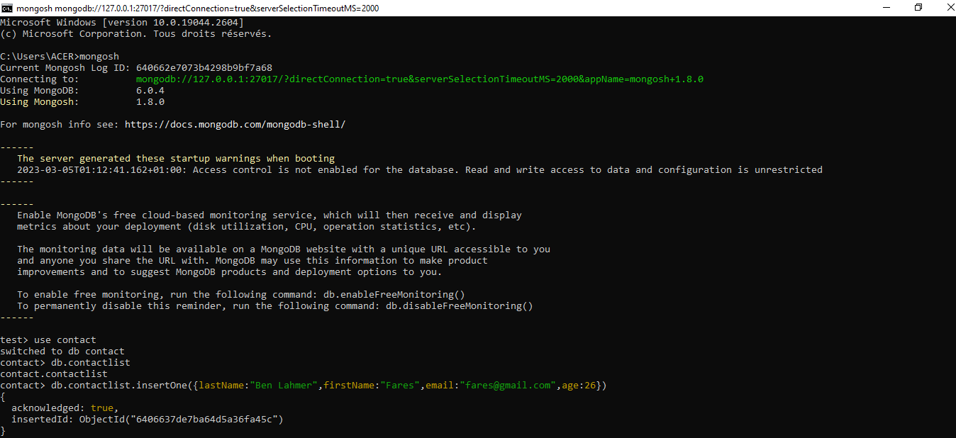
1-Creation of a database called "contact"
2-Creation of a collection called "contactlist"
3-Insertion of documents in "contactlist"

Slide 2
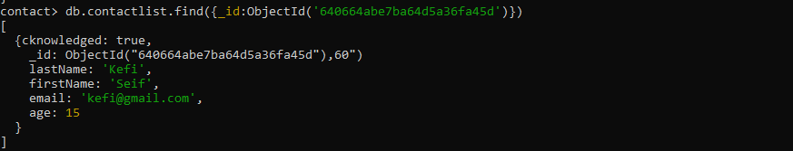
Display all the information about only one person using his ID.

Slide 3
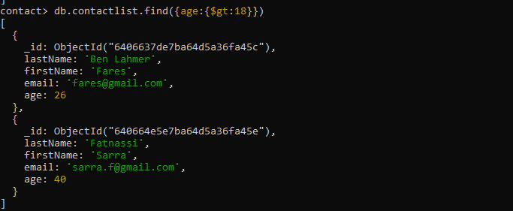
Display all the contacts with an age >18.

Slide 4
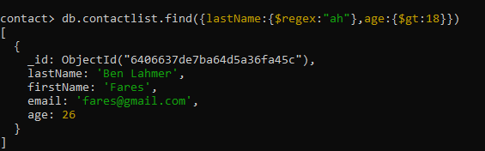
Display all the contacts with an age>18 and name containing "ah"

Slide 5
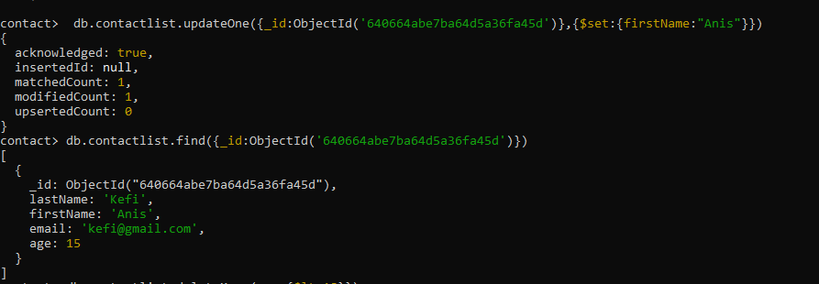
Change the contact's first name from"Kefi Seif" to "Kefi Anis".

Slide 6
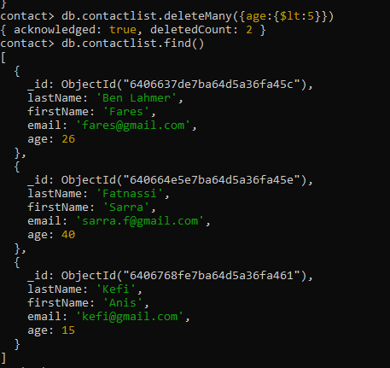
-Delete the contacts that are aged under <5. -Display all of the contacts list.

