Slide 1
M05 - Mini project
Students:
Imen Ben Mahmoud
Teodora Glamocanin
Supervisors:
André Anjos
Flavio Tarsetti

Slide 2

Introduction
Project goal:
Application of reproducible research principles to the problems of Linear Regression and Regression Trees on features of various datasets.
Evaluation of success: Mean Absolute Error (MAE)
Datasets:
Dataset 1: Wine quality
Instances: (red wine – 1599, white - 4898)
Attributes: 11
Dataset 2: Boston Housing Data
Instances: 506
Attributes: 13

Slide 3
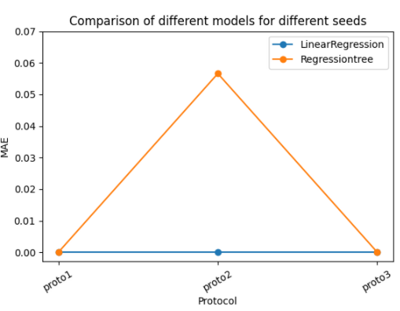
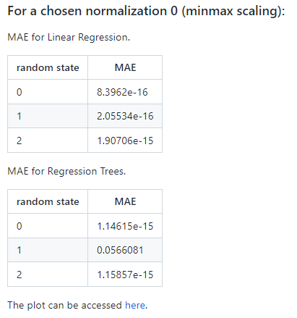
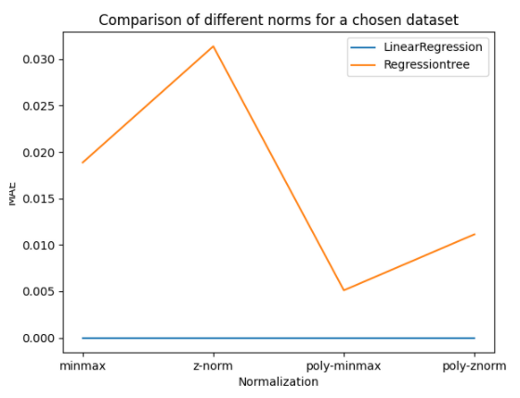
Methods
Data split:
3 different splits per dataset (train_test_split, 3 random seeds)
Train (50%)
Model training
Test (50%)
Performance evaluation
Modelling:
Linear Regression algorithm
Regression Trees algorithm

Slide 4
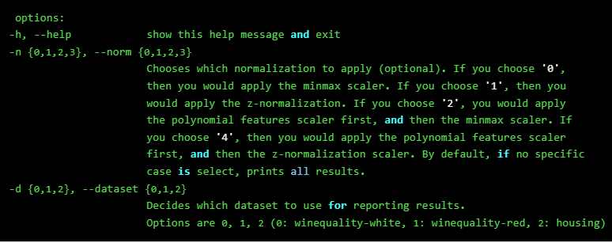
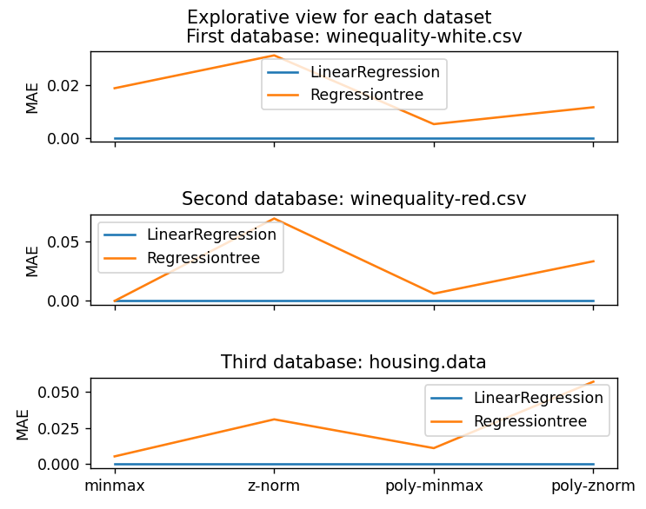

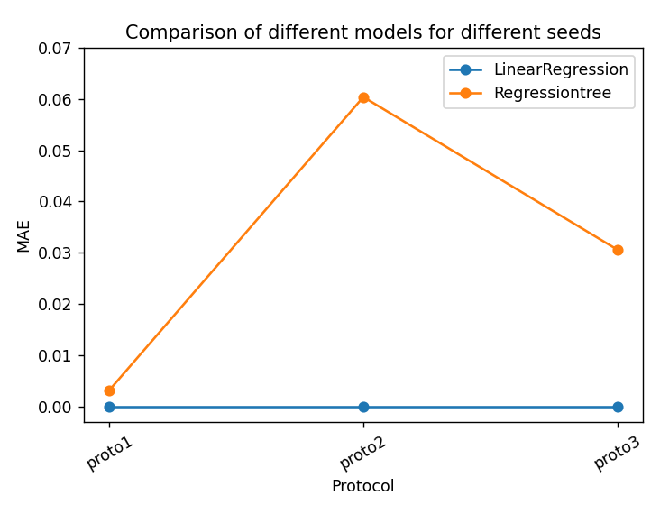
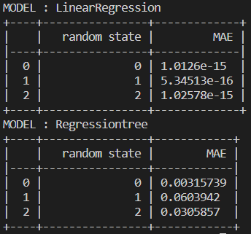
Methods
Program execution:
Ask user to specify which dataset to analyze, and (optionally) which normalization method to use
Example of output when choosing the white wine dataset and Z-normalization method:

Slide 5
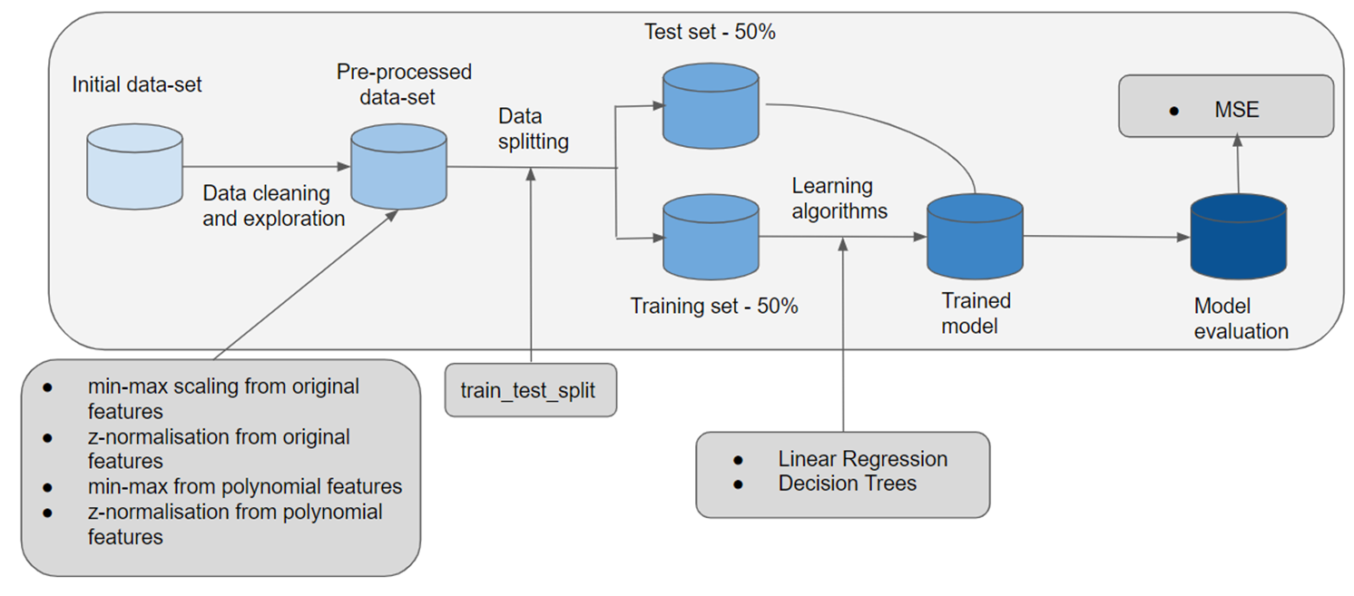
Workflow

Slide 6

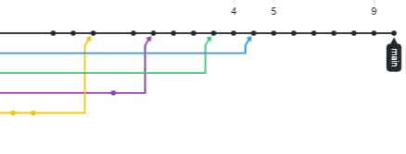
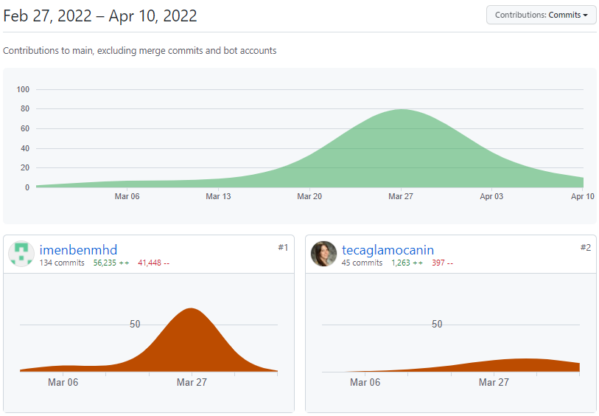
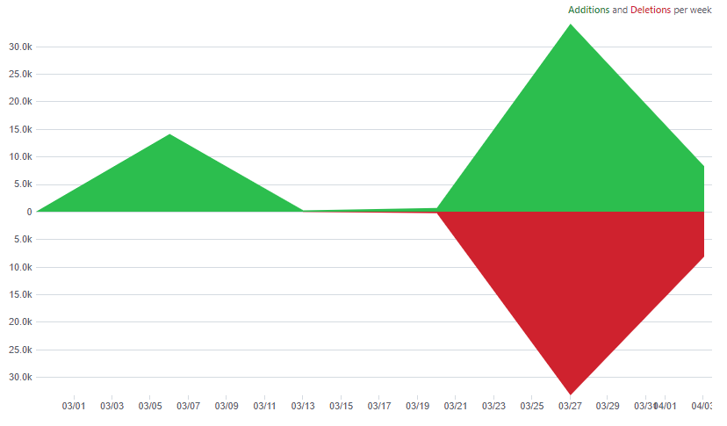
Version Control - Git
Git:
Frequent commits and merging
Different branch for different parts of the project
Git stash – stash changes made on one branch and afterwards pop them on another

Slide 7
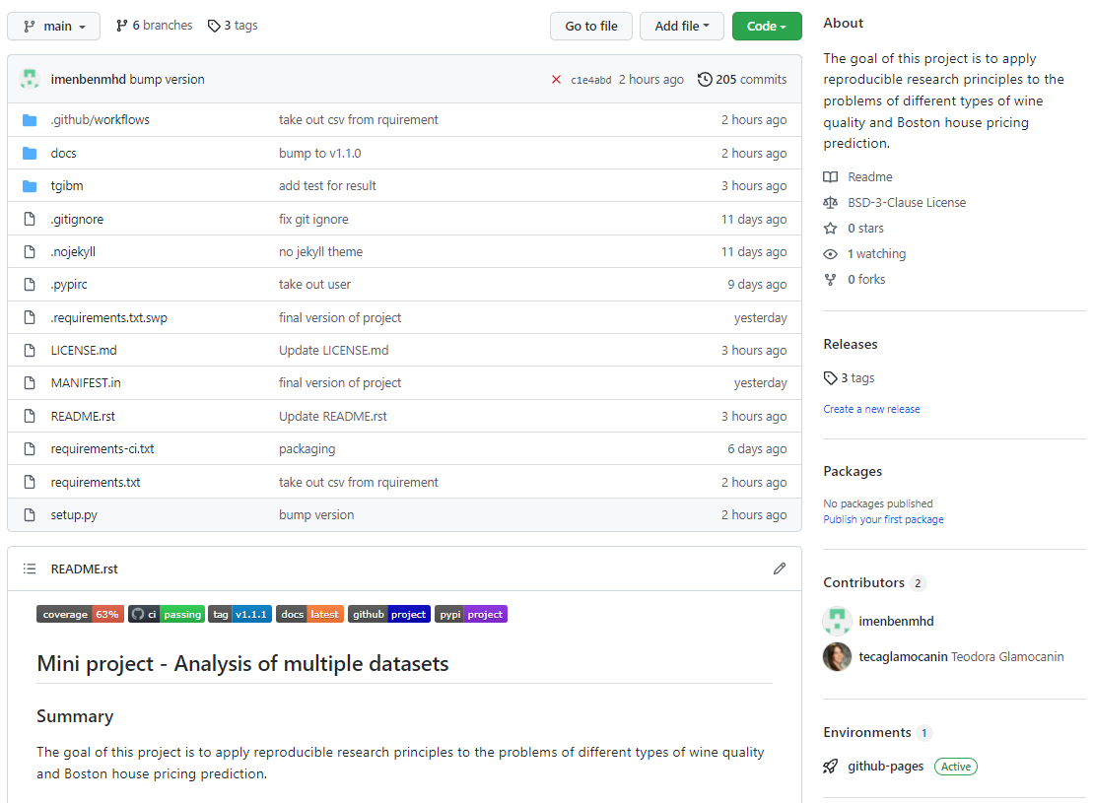
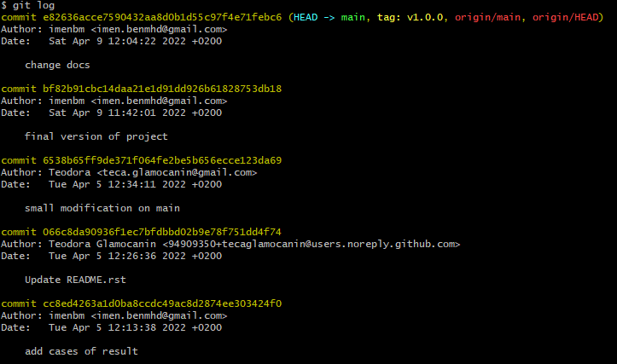
Code Sharing - GitHub
GitHub:
Hosting and sharing the repository of this project

Slide 8
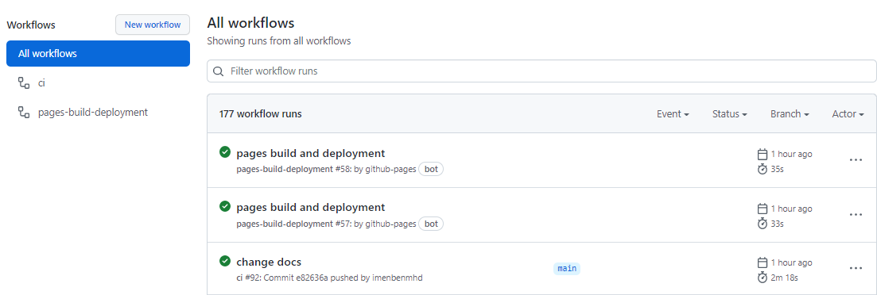
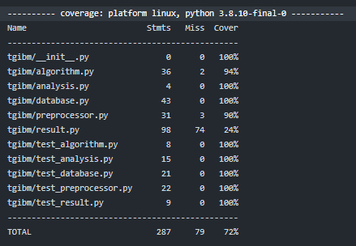

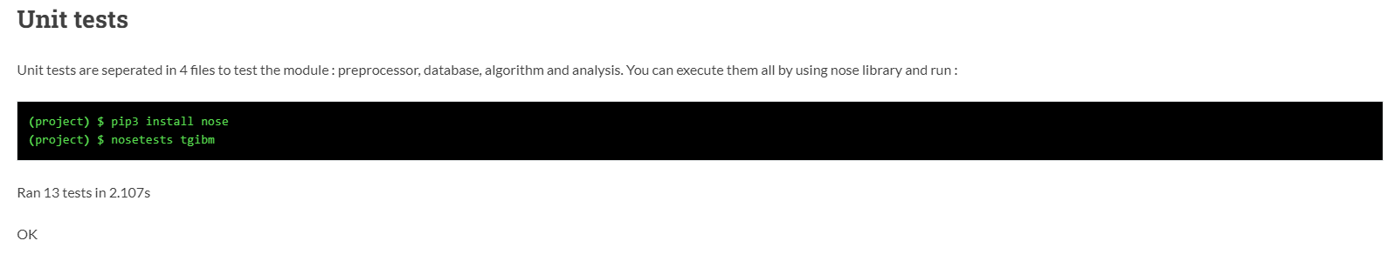
Unit Testing and Continuous Integration
Continuous Integration on GitHub actions:
Test on python 3.9 and 3.10
Steps:
Install dependencies
Test with pytest
Build documentation and deploy it to GitHub pages
Upload coverage

Slide 9
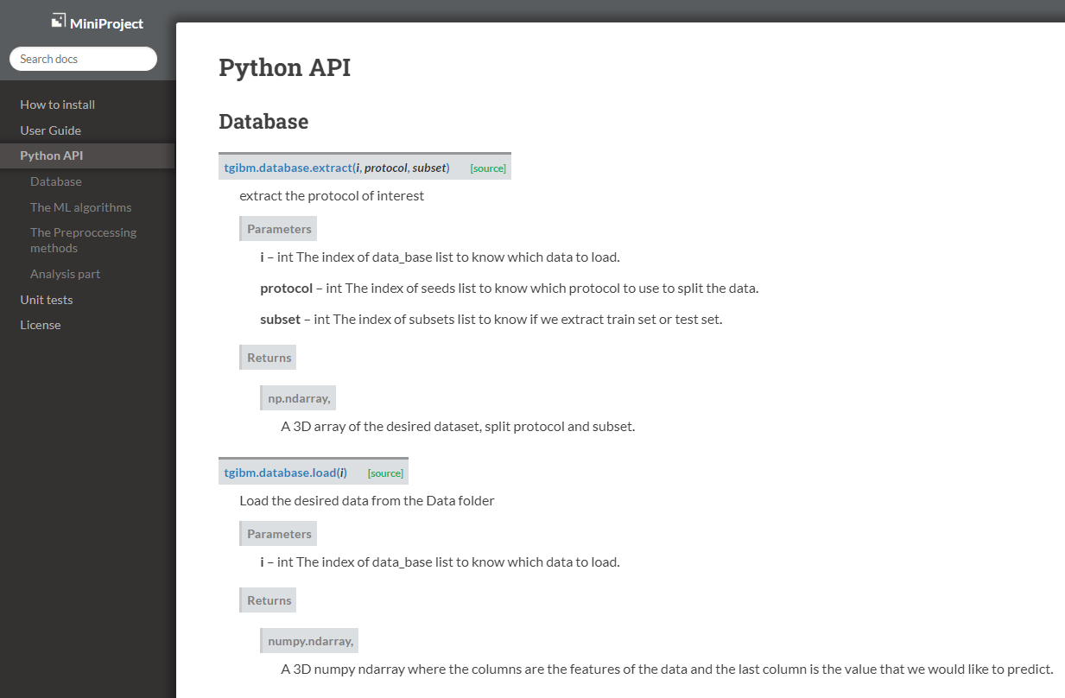

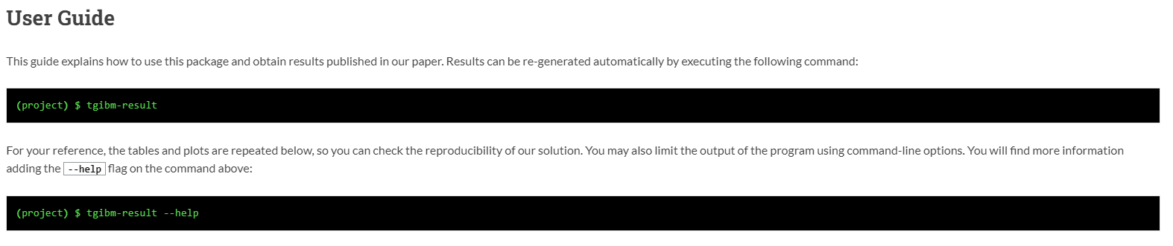
Documentation
Build with Sphinx:
Files in .rst format
Include docstrings in Python API
Updated with GitHub actions after new push

Slide 10
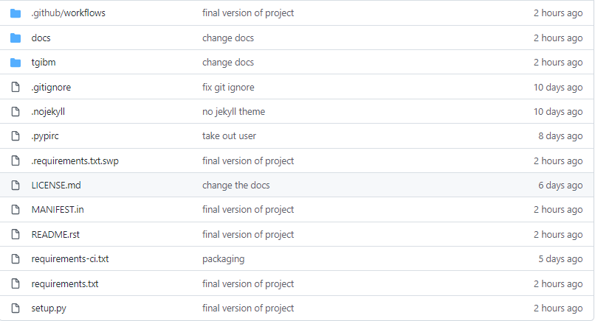
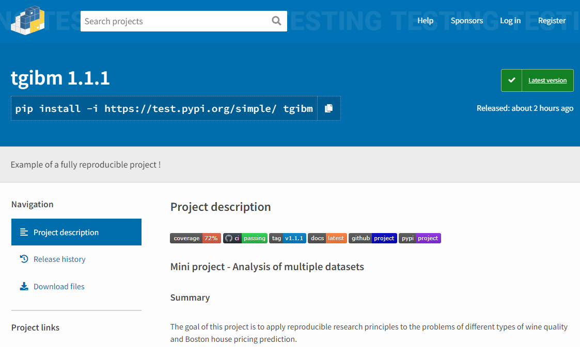
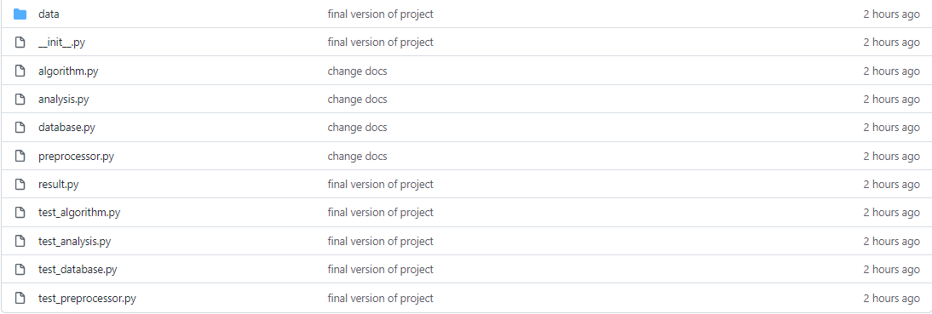
Packaging, Deployment, Licensing
BSD-3-Clause License
Use of Python Packaging

