Slide 1
Fraud Detection from Transactional Data
Transnational data
Data set of ~120K transactions, 0.7% are fraudulent
Certain account are data rich
Two approaches are proposed:
Global: one model for all the transactions
Local: one model for each account
Feature engineering to enrich the data set
Transforming provided data
Creating new features
Multiple ML model evaluated
Logistic Regression, Random Forest, SVM, Adaboost
The best model is selected based on Recall and Precision metrics
Data cleaning
And Features Engineering
Model selection
Testing and Validation

Slide 2
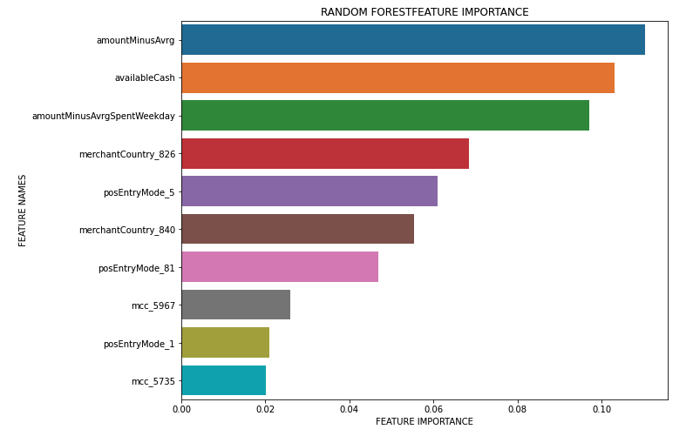
Observations and Interesting Facts
Top 10 Features
Features derived from purchase amounts are critical for fraud detection
Certain merchant's country codes and PoS entry mode are more susceptible to fraud
Model performance
Precision and recall graph to support fixing the cut-off threshold
Probability threshold 20% seems to be the sweet spot (P= 54%, R=50%)

