Slide 1

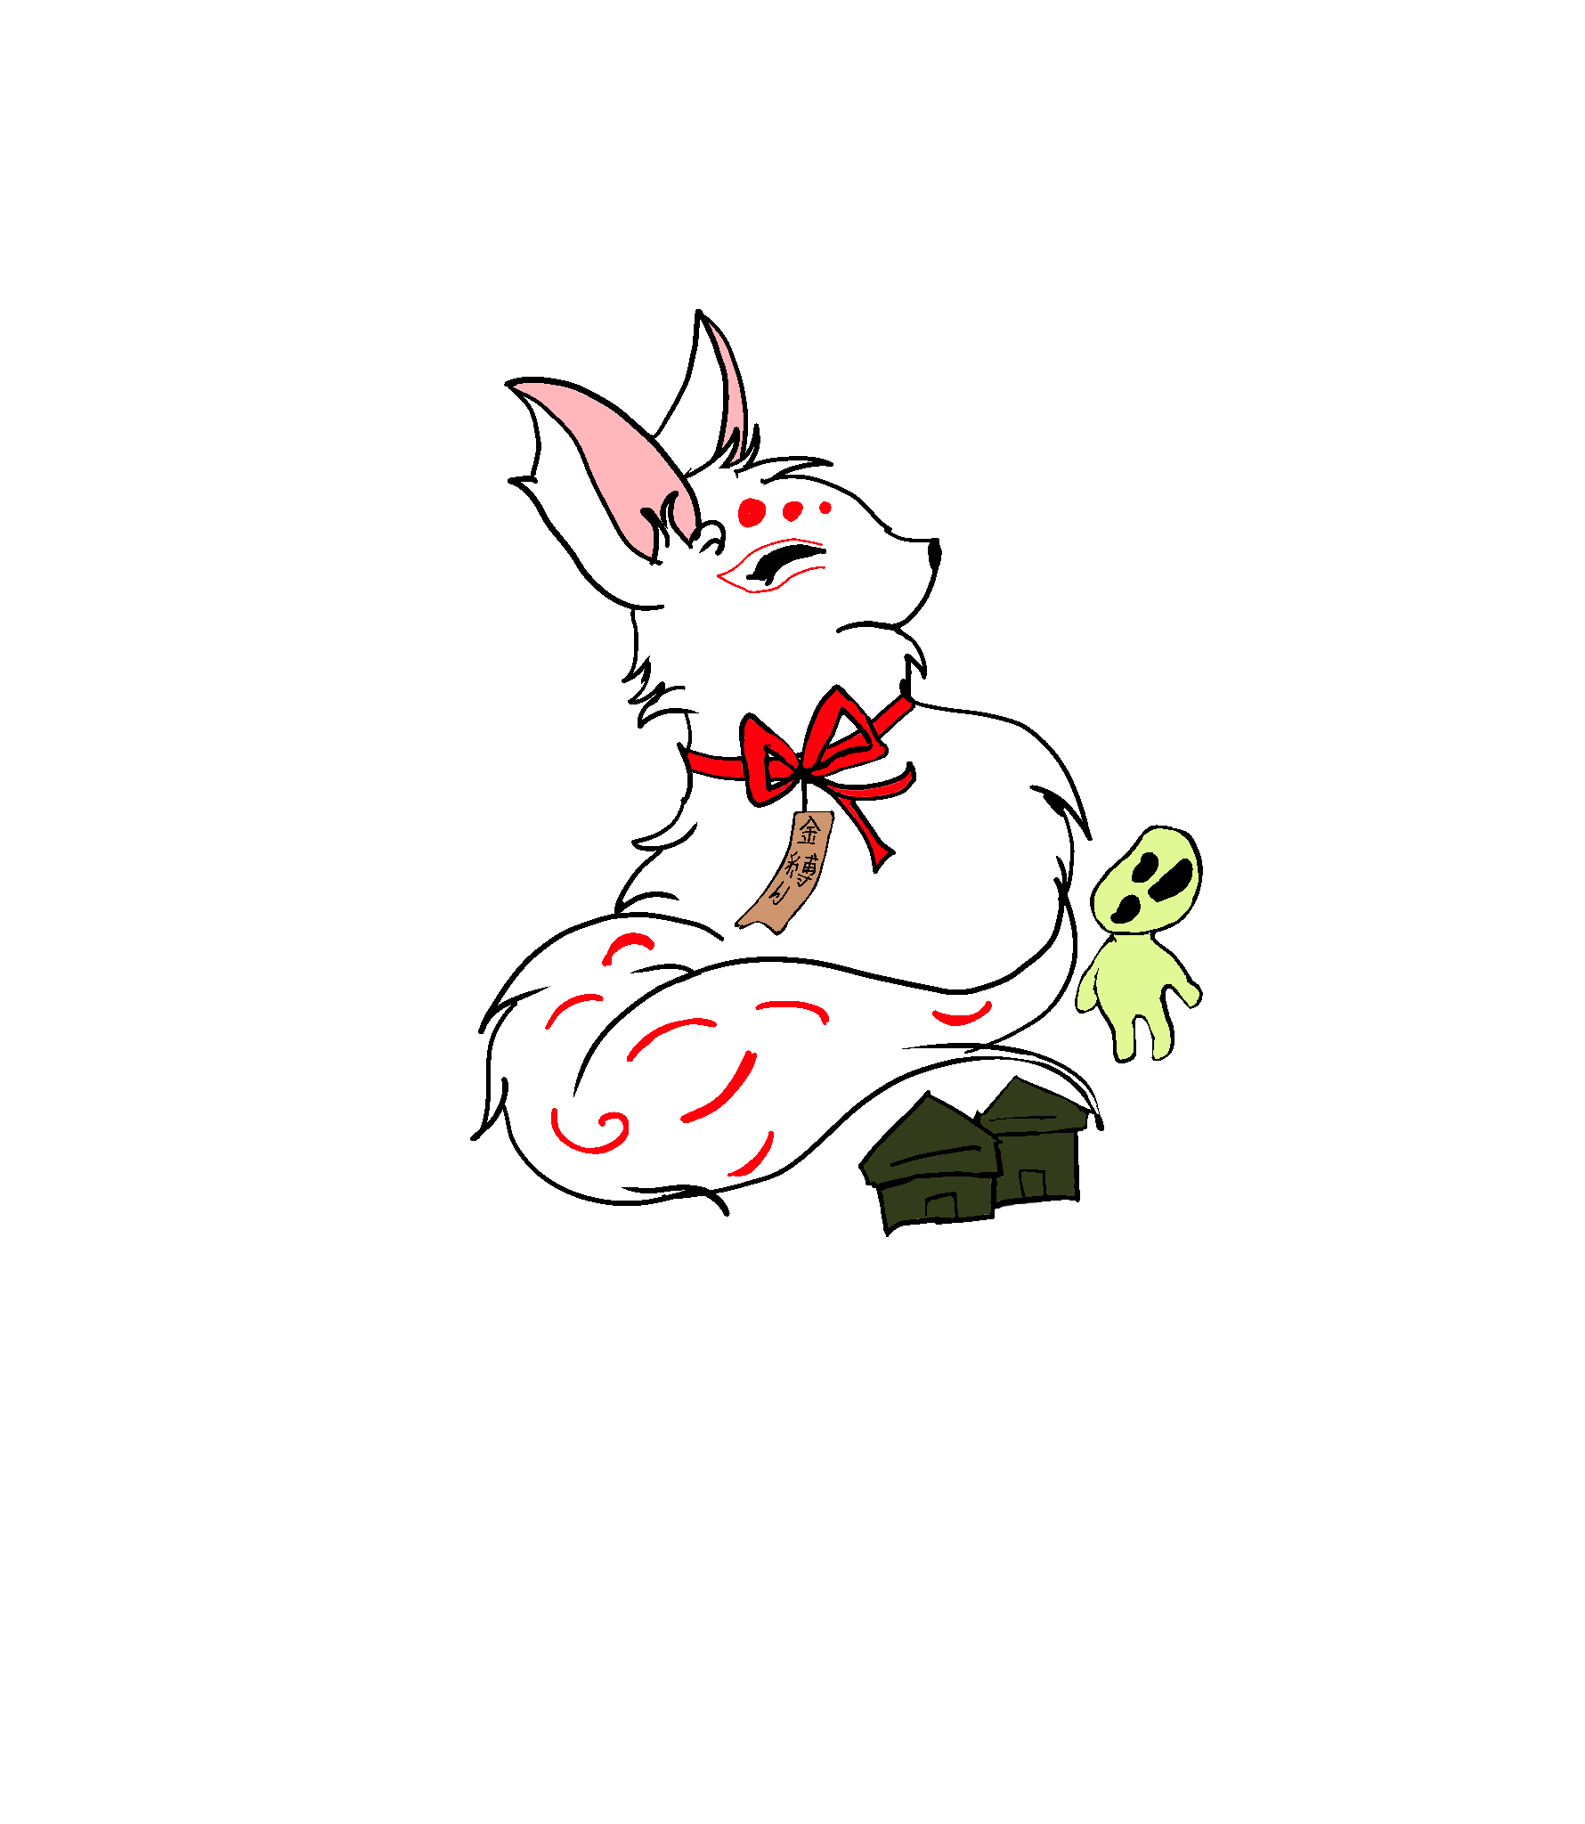
Kanashibari 金縛り
Can you escape your sleep paralysis?
金縛りから脱出て？
Kanashibari kara dasshutsute?
Imen Hellali 2020/2021

Slide 2
Game genre
A VR? atmospheric escape-room game, that will teach you about Japanese heritage and mythology with an interactive and exciting experience.
Imen Hellali 2023/2024

Slide 3
Game Goal
Solve all the puzzles of each level to enhance cognitive ability.
Collect items from riddles to escape the sleep paralysis, while developing the player’s attention, perception and logical reasoning.
Learn about Japanese folk tales, mythology and art by listening to the narrated stories.
(Escape → Resurrect and revive the god)
Imen Hellali 2020/2021

Slide 4
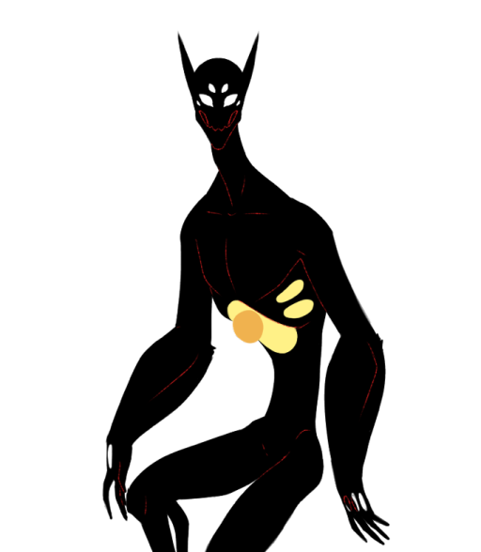
Game Idea
One night when you are in deep dreams, you fall into sleep paralysis.
You will be taken to the world of spirits, and there you will have to solve puzzles and consequently collect items that will serve the development of the story.
You will discover the truth about the spirit world you have been taken into while advancing into the different levels.
Imen Hellali 2020/2021, Sleep Paralysis Demon by dimorphodon-x from tumblr

Slide 5

Game Idea
Hints can be in many forms, but most of them will be a narrative exciting story, where you must pay attention to understand the clues presented within the lines of the speech.
Each level will introduce a different aspect of the Japanese folklore mythology, believes and traditions especially concerning art in terms of Musical instruments and old portraits.
Imen Hellali 2020/2021, Sleep Paralysis Demon Riding a Nightmare, by Marcus Tegtmeier from artstation.com

Slide 6
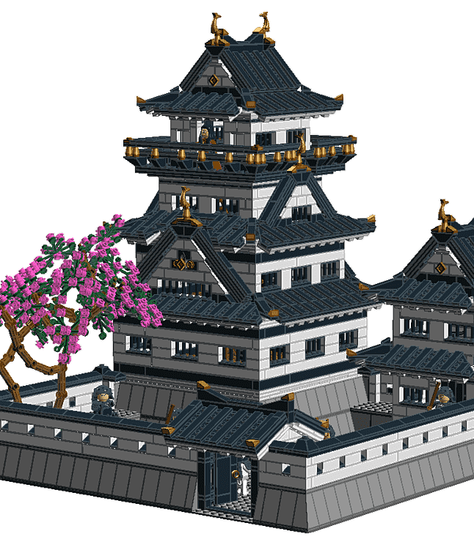
Game World
The game world is situated in a parallel world (dream world).
The world is inhabited by spirits, taking the form of humans and mythological creatures.
The world is built as one of traditional old Japanese alleys, houses and nearby shrine.
The world depicts the little characteristics you find in a Japanese heritage books.
Imen Hellali 2020/2021, Matsumoto Castle from dlpng.com

Slide 7
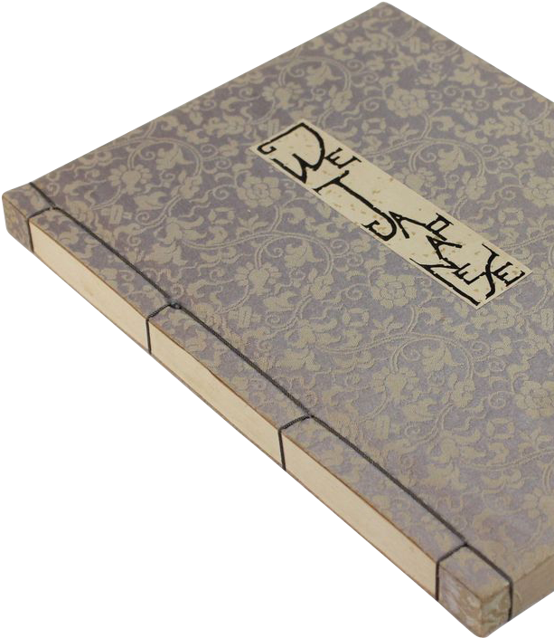
Game Mechanics
First you will enter through an intro level.
Then with each solved level, you unlock new rooms and spaces, you can explore more of the world and the surroundings.
You should be able to understand and know your next steps accordingly.
Imen Hellali 2020/2021, Japanese books by Fabio Arcangeli from pngitem.com

Slide 8

Level 0: Intro
Consists of a path that you must follow, which will introduce you to the inhabitants of the parallel world, with a narrating introductory story.
Imen Hellali 2020/2021, Sosuke Aizen by Sofiane Tiet from pngitem.com

Slide 9
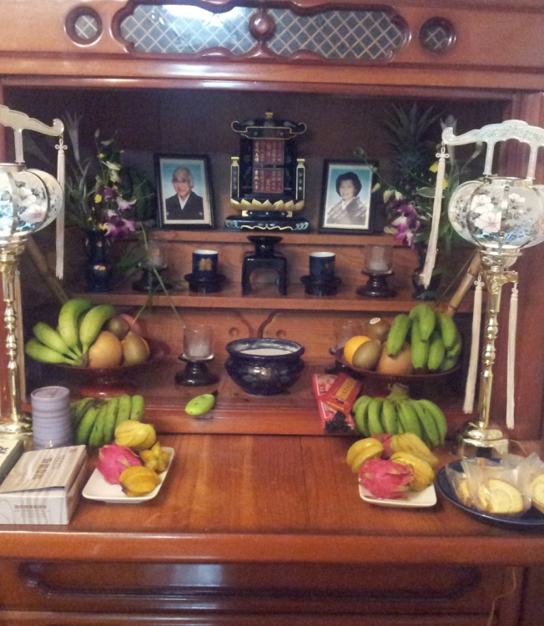
Level 1: Butsudan
In this level you will learn about one of the most practiced religion (Shinto religion) and how the Japanese people deliver their respects to the ancestors.
An introductory level to familiarize with the type of puzzles awaiting for the player.
Imen Hellali 2020/2021, 日本文化の愛 Nipponbunka no ai by MU from japanaibunka.wordpress.com

Slide 10

Puzzles in Level 1
1. collect chopsticks and rice bowl from dining table and place them accordingly on the butsudan
2. collect fire from the stove and light up the incense
3. collect plate and fruits and place them on the butsudan
4. collect a pillow, place it in front of the butsudan and kneel
Imen Hellali 2020/2021, Puzzle jigsaw from pngall.com

Slide 11

Story in Level 1
TODO
Imen Hellali 2020/2021, Books from pngall.com

Slide 12
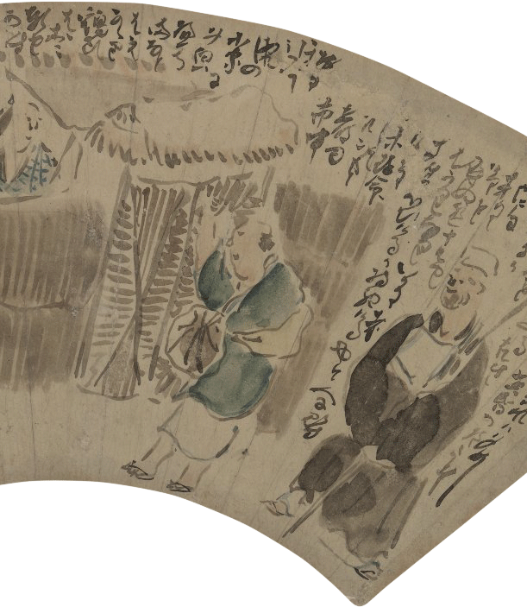
Level 2: Japanese Portraits and Interior design
In this level you will learn about paintings and drawings of famous Japanese illustrators, how they got inspired and development to modern Japanese art.
At the end of this level you will collect a color palette.
Imen Hellali 2020/2021, Yosa Buson by Nigel Huddleston from pngitem.com

Slide 13
Puzzles in Level 2
1. organize parts of a drawing to create a complete one
2. collect sakura flower and hair pins to finish a drawing
3. turn the clock needles to 18: the year “the painter name” died
4. the curtains will drop a color palette to collect
Imen Hellali 2020/2021, Puzzle jigsaw from pngall.com

Slide 14
Story in Level 2
TODO
Imen Hellali 2020/2021, Books from pngall.com

Slide 15
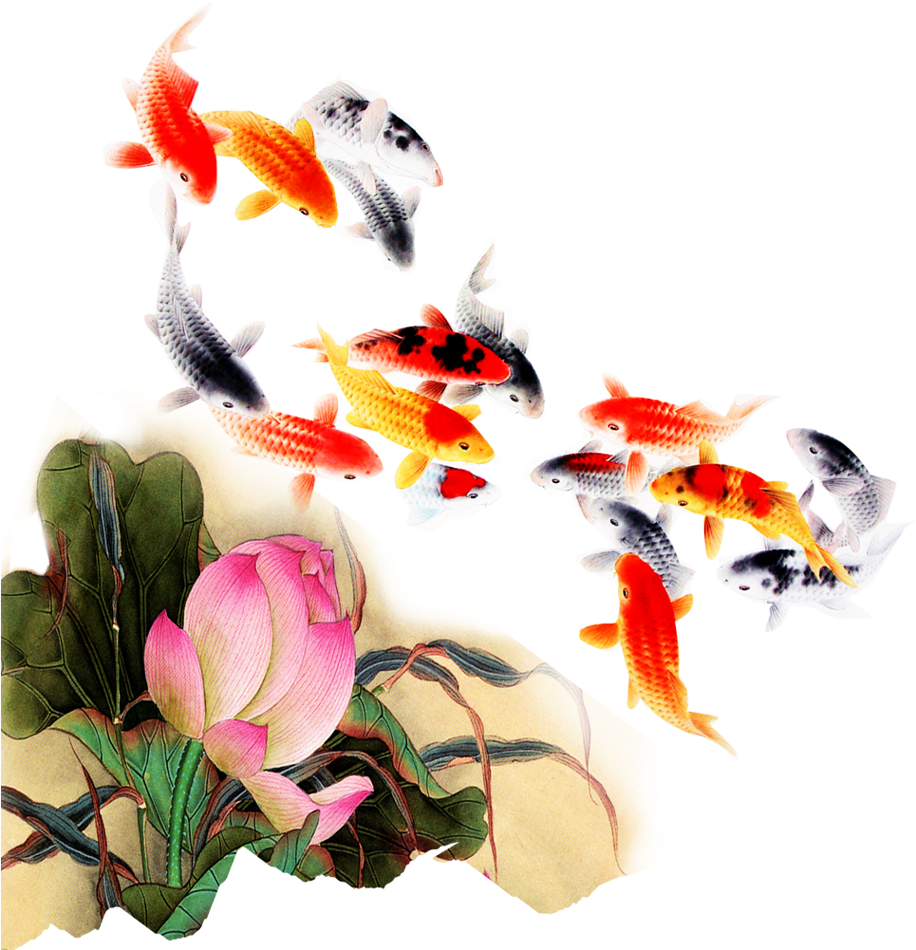
Level 3: Japanese Traditional Garden and exterior design
In this stage you experience the characteristics of a traditional Japanese garden and exterior architecture of a traditional Japanese house.
At the end of this level you will collect a koi fish.
Imen Hellali 2020/2021, Koi Fish by Harzverliebt from pngitem.com

Slide 16
Puzzles in Level 3
1. collect bamboo from bamboo tree
2. collect water from the kitchen
3. collect stones
4. collect flowers
5. place the collected items in the corresponding fountain space
6. fountain will show up and water will start flowing
7. collect worms from the dirt and throw it in the water
8. koi will appear to collect
Imen Hellali 2020/2021, Puzzle jigsaw from pngall.com

Slide 17
Story in Level 3
Imen Hellali 2020/2021, Books from pngall.com

Slide 18
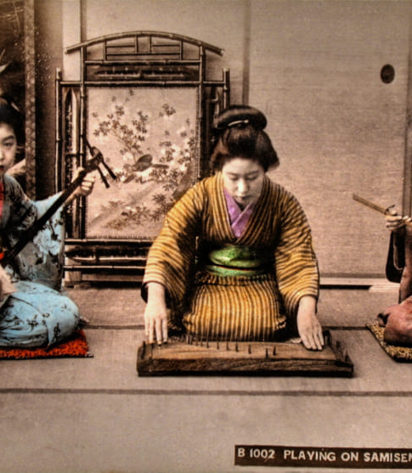
Level 4: Musical Instruments
In this level, you would have unlocked the house’s gate door and are able to visit the neighborhood and narrow alleys.
You can visit the showroom, enjoy many music peace of famous traditional Japanese musicians alive and learn about the used instruments and the history behind it.
At the end of this level you will collect strings.
Imen Hellali 2020/2021

Slide 19
Puzzles in Level 4
1. fetch the music instruments from paintings and put them on top of the corresponding podiums
2. follow the lead of the paintings and play the same notes played in them.
3. after playing the different music peace, podiums can be moved, and strings are to be found under one of them.
Imen Hellali 2020/2021, Puzzle jigsaw from pngall.com

Slide 20
Story in Level 4
1. koto
2. shamisen
3. kotosuzumi
Imen Hellali 2020/2021, Books from pngall.com

Slide 21
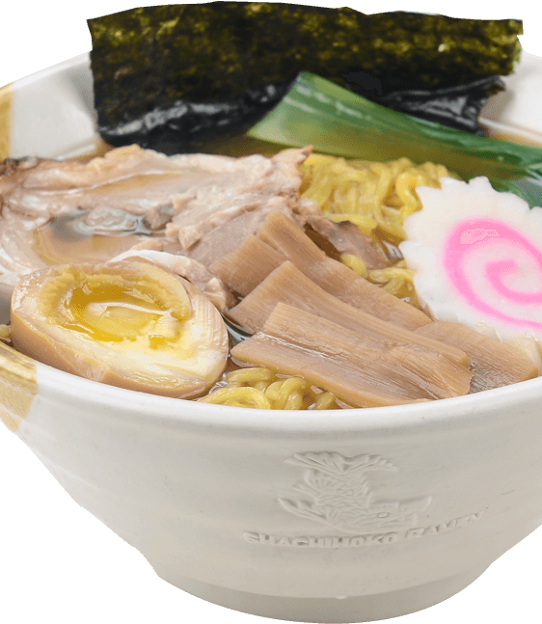
Level 5: Food
You can unlock the food stands, after finishing the showroom stage (before hand you could see the stands from outside but never enter, you must pay attention to your changing environment)
In this level you will be introduced to many must-try Japanese signature foods.
Imen Hellali 2020/2021, Ramen by Blogkultur from pngall.com

Slide 22
Puzzles in Level 5
Different customers roaming the street craving different foods, shouting the name of their food/ the ingredients of the dish.
You must bring each different person their desired dish.
Imen Hellali 2020/2021, Puzzle jigsaw from pngall.com

Slide 23
Story in Level 5
1. Miso ramen
2. Okonomiyaki
3. Takoyaki
Imen Hellali 2020/2021, Books from pngall.com

Slide 24
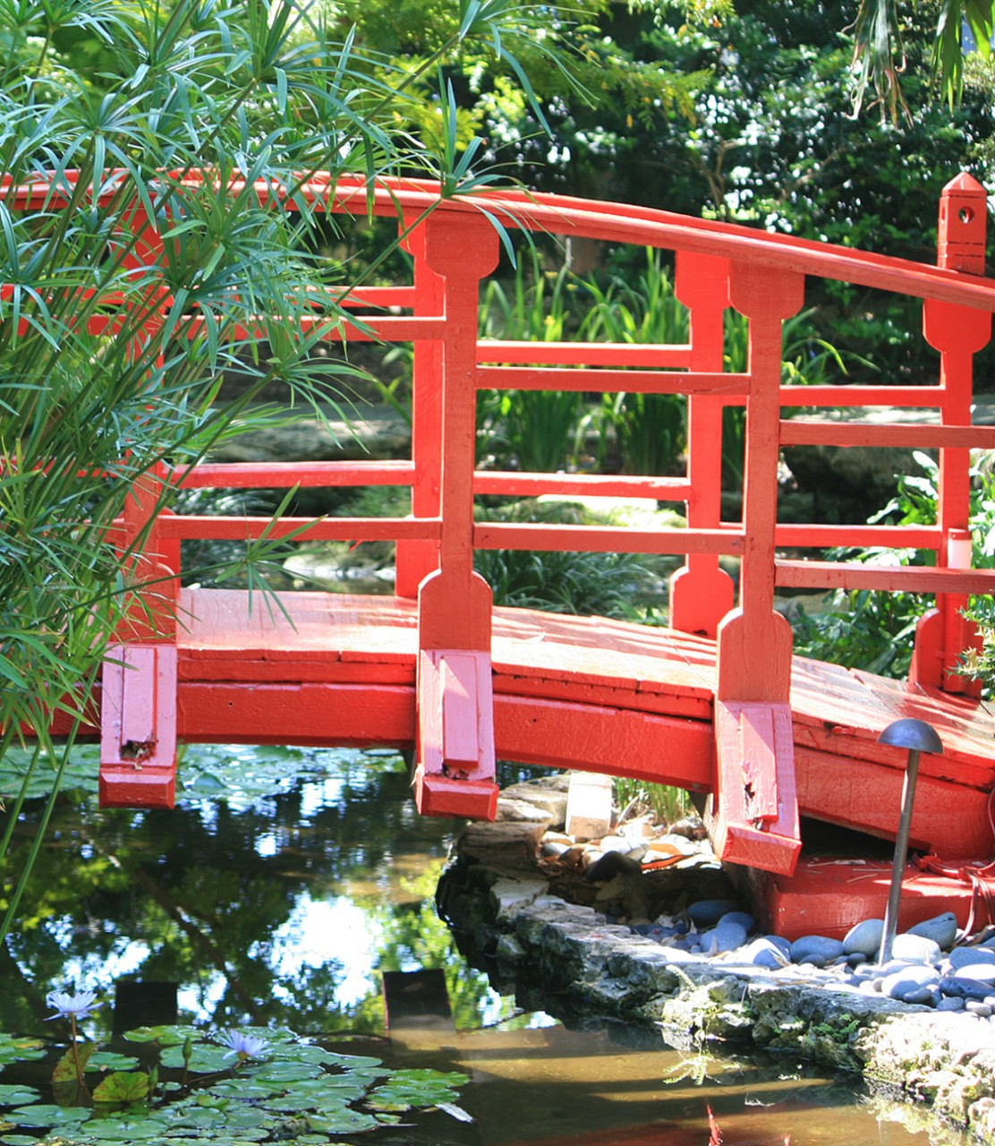
Level 6: Path to the temple
In this level you will cross the bridge leading you to the spirit realm (temple) and hear exciting stories along the way.
There will be no puzzles while crossing the bridge, this will serve as a breather and cool off level for the player while building up the story.
Imen Hellali 2020/2021, Fabyan Japanese Garden by Rick Beato from homedesignlover.com

Slide 25
Story in Level 6
todo
Imen Hellali 2020/2021, Books from pngall.com

Slide 26
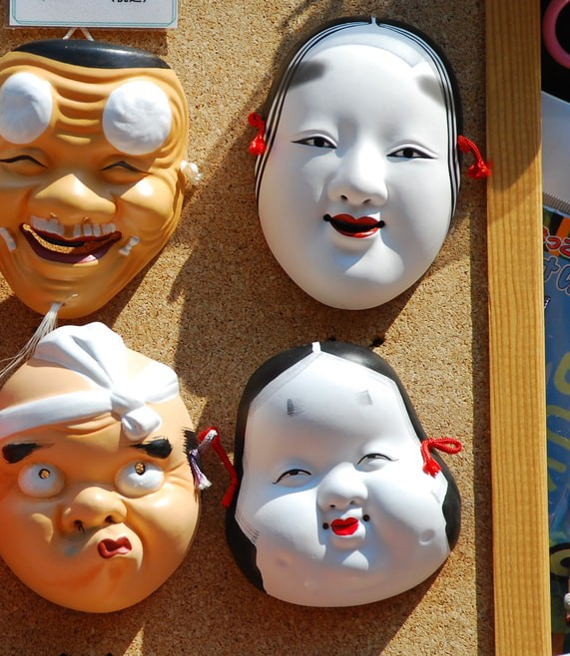
Level 7: Merchants and stands
In this stage, there will be no order to which you solve the different puzzles before reaching the temple gate.
Each merchant stand holds a different story and exciting tale.
After this level you will collect spirit fetus.
Imen Hellali 2020/2021, Otafuku and Hyottoko by bluehand from Shutterstock

Slide 27
Puzzles in Level 7
1. Mask merchant:
Oni:
Onna:
Kitsune:
2. Kokeshi merchant:
3. Kimono merchant:
4. Koi merchant:
Imen Hellali 2020/2021, Puzzle jigsaw from pngall.com

Slide 28
Story in Level 7
1. Oni masks:
2. Onna masks:
3. Kitsune masks:
4. Kokeshi doll:
5. Kimonos: kimono cloth wrapping people folktale
6. Koi: kappa folktale
Imen Hellali 2020/2021, Books from pngall.com

Slide 29
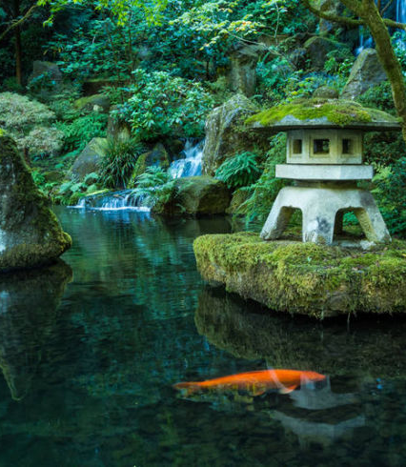
Level 8: Spirit Houses
This is last stage that will lead you to the temple.
You will understand the different Japanese architectural objects you always see in front of the temple and story behind them.
In this Level you will collect a spirit house.
Imen Hellali 2020/2021, Photos of a Shinto Shrine in Nakasato by darby sawchuk

Slide 30
Puzzles in Level 8
1. You must collect rocks and stack them as a wish tower
2. You must kneel and make a wish
3. Different Omikuji will appear that you must pull down following a certain pattern (instant feedback to indicate correctly pulled Omikuji by saying the meaning behind the written fortune/curse, or wrong move by a buzzer beep. With each wrong pull you must start the sequence from the start. No other indications will be handed)
4. Afterwards these different Omikuji are added to your inventory and you must place them in front of the corresponding spirit house.
Imen Hellali 2020/2021, Puzzle jigsaw from pngall.com

Slide 31
Story in Level 8
Omikuji おみくじ : fortunes written on paper stripes that belong to the Shinto religion. Each Omikuji will connect to a certain spirit.
1. Kodama 木霊 :
2. Yamabiko 山彦:
3. Noderabō 野寺坊:
4. Jorōgumo 絡新婦:
Imen Hellali 2020/2021, Books from pngall.com

Slide 32
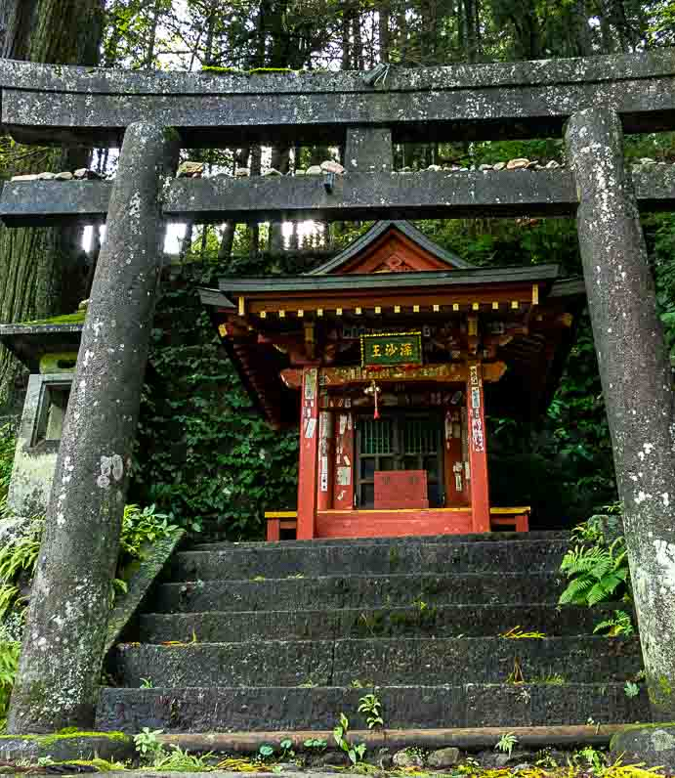
Level 9: Temple
The temple is your gateway to buddha’s world, where you will be resurrected as a human in the human world.
In this stage you will understand the message and the story behind why you were brought to the spirit world.
You will use you collected objects from each level and feed it to the spirit (the forgotten god).
This level will guide you back to the main menu and finish up the game.
Imen Hellali 2020/2021, Roadside Shinto Shrine, Nikko, Japan September 16, 2013 by Tom Bartel

Slide 33
Story in Level 9
Spirit will eat koi to start glowing and show its true shape.
Spirit will eat strings to start talking.
Spirit will eat spirit fetus to gain energy and power to bring you out of the spirit world.
Spirit will eat colors to display its true nature.
Spirit will reside in the shrine to keep its name alive.
Imen Hellali 2020/2021, Books from pngall.com

Slide 34
Characters:
1. Yume 夢 : meaning dream, the person who will guide you and narrate some of the stories.
2. Kamiumi 神産み: meaning god born, the god (kami) you are trying to bring back to life to bring you back to the living realm.
Imen Hellali 2020/2021

Slide 35
Bonus ?
Some objects when clicked will add a book to your inventory.
Each book will contain a narrative story about a folktale with illustrative pictures.
Imen Hellali 2020/2021

Slide 36
End : Escape Kanashibari 金縛り
Imen Hellali 2020/2021

