Slide 1

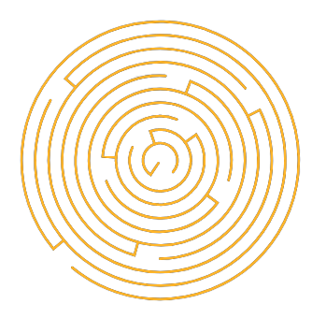
Light of Daedalus
Games Lab summer 2022
Tobias Mesmer, Tim Simecek, Imen Hellali

Slide 2
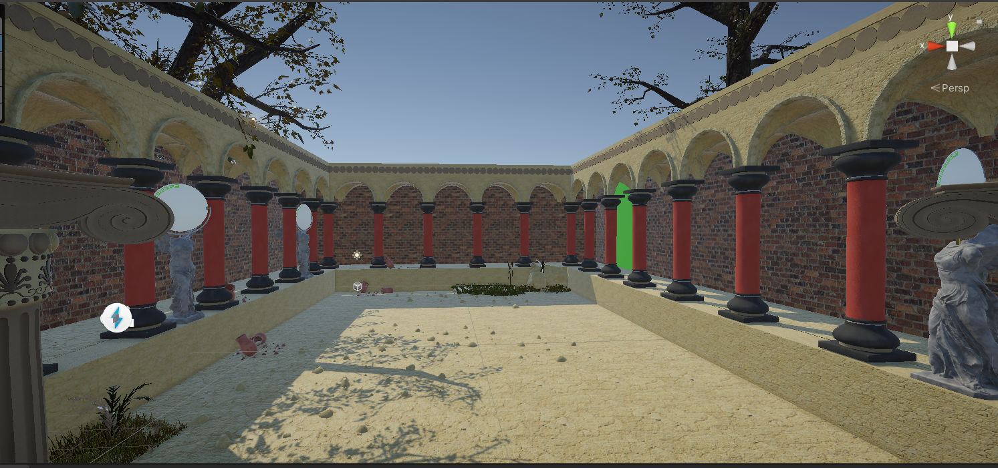
Design Progress - L1
Games Lab summer 2022: Tobias Mesmer, Tim Simecek, Imen Hellali
Notes:
Learning about current color that you have and possibility of unlocking new ones that you can use in next levels….
how reflective surface work and how they change the outgoing color

Slide 3
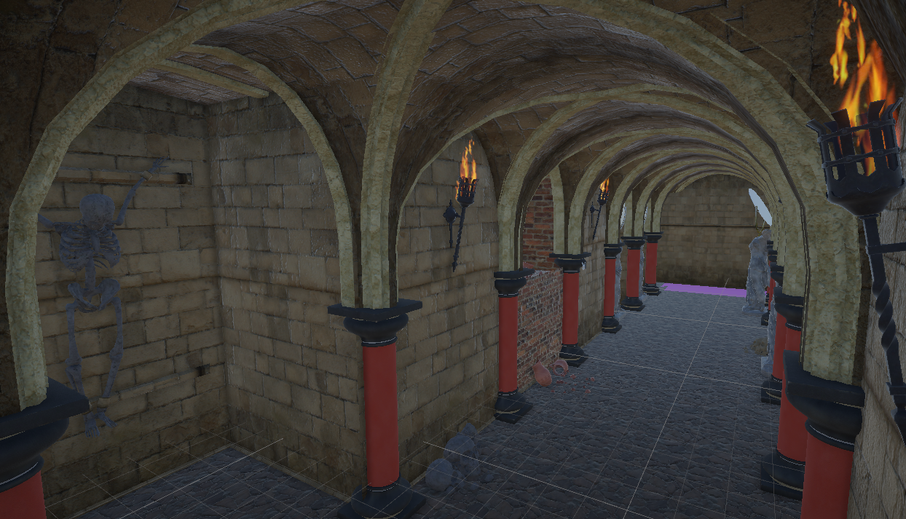
Design Progress - L2
Games Lab summer 2022: Tobias Mesmer, Tim Simecek, Imen Hellali
Notes:
You will just play around and explore the freedom the VR HMD can deliver even when the position of player is static …
By introducing a more challenging and harder puzzle…

Slide 4
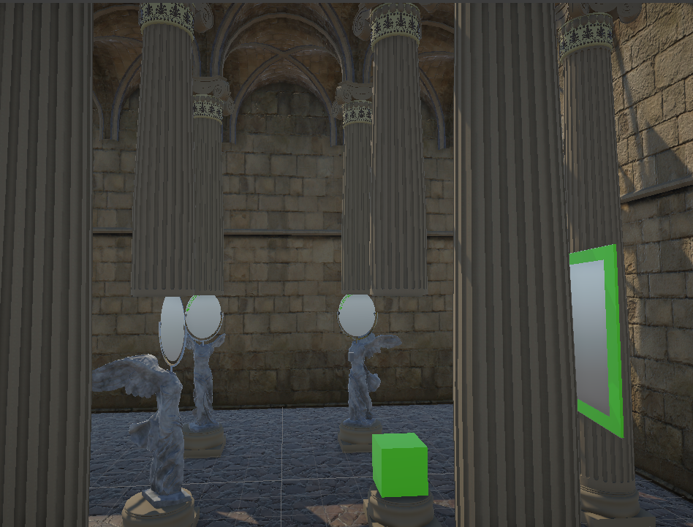
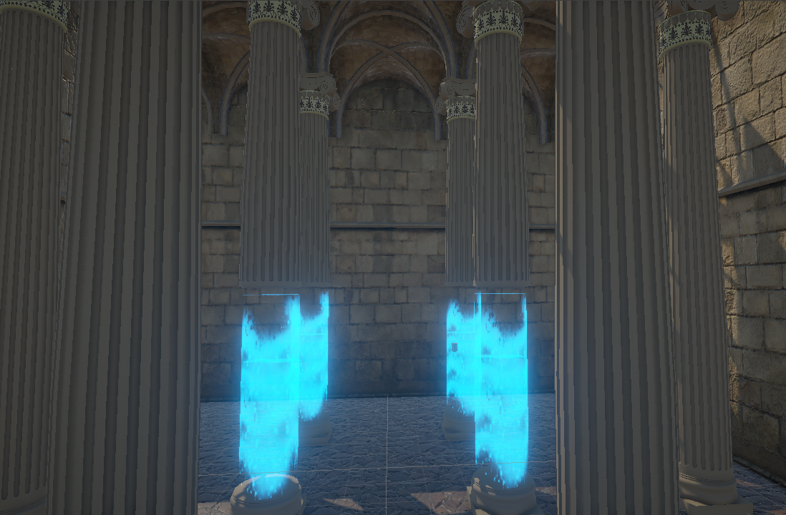
Design Progress - MainMenu
Games Lab summer 2022: Tobias Mesmer, Tim Simecek, Imen Hellali
Notes:
After each level where you unlock new obstacle you can navigate to our main menu where you can testout and play with these unlocked features as much as you want

Slide 5
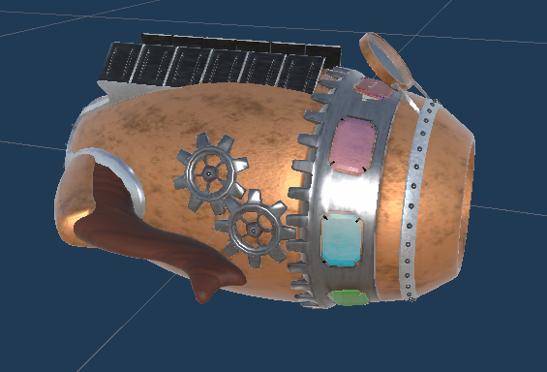
Technical Challenges - Modeling
Games Lab summer 2022: Tobias Mesmer, Tim Simecek, Imen Hellali
Notes:
movement (add teleportation to specific anchors if desired in play testing)

Slide 6
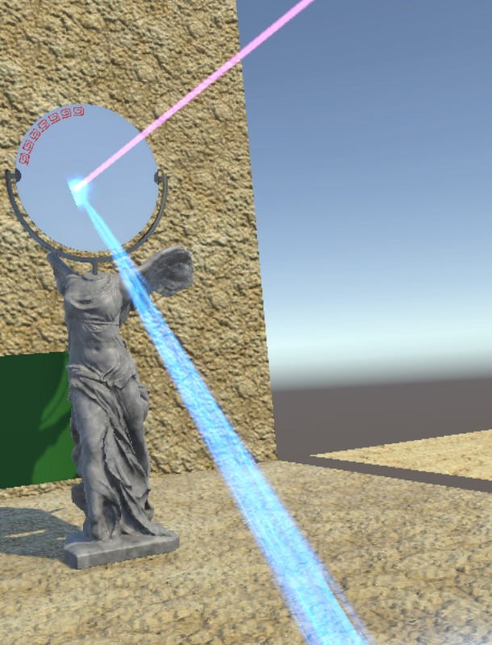
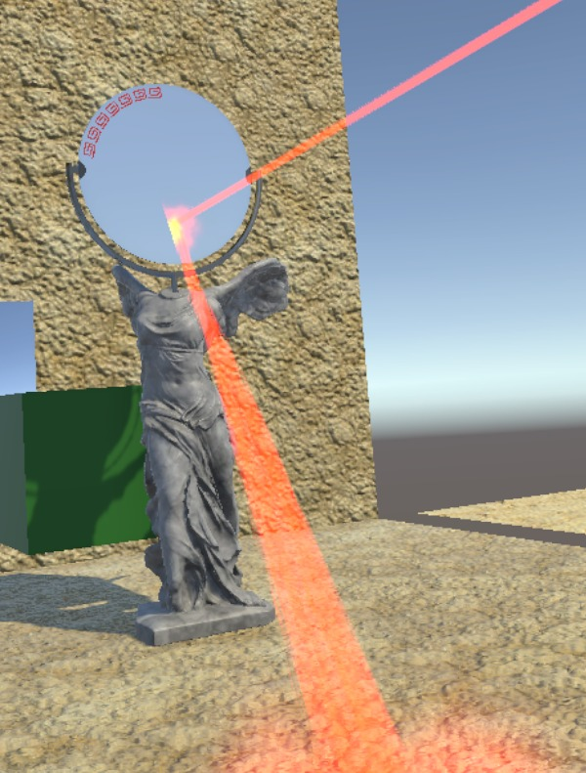
Technical Challenges - Reflectors
Games Lab summer 2022: Tobias Mesmer, Tim Simecek, Imen Hellali
Notes:
movement (add teleportation to specific anchors if desired in play testing)

Slide 7
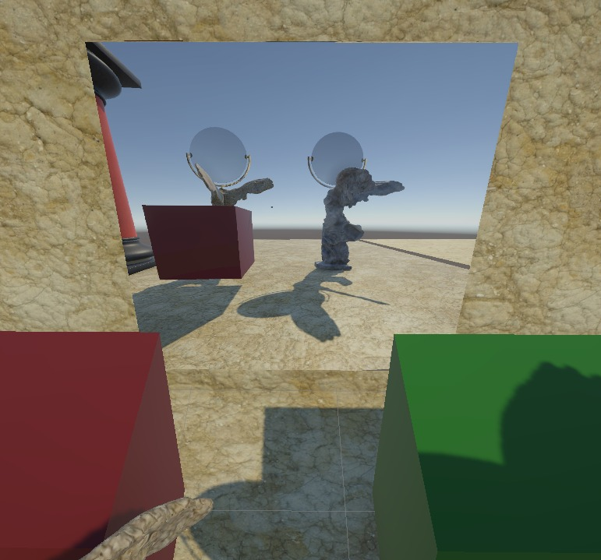
Technical Challenges - Cloaked Obstacles
Games Lab summer 2022: Tobias Mesmer, Tim Simecek, Imen Hellali
Notes:
movement (add teleportation to specific anchors if desired in play testing)

Slide 8
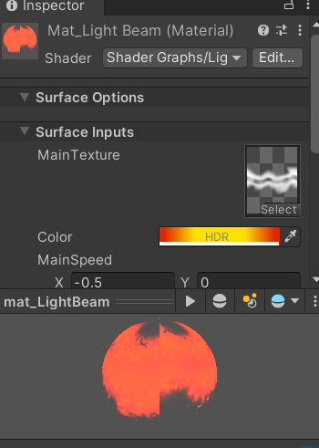
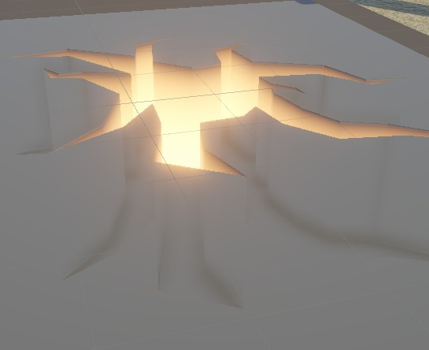
Technical Challenges - Custom Shaders
Games Lab summer 2022: Tobias Mesmer, Tim Simecek, Imen Hellali
Notes:
movement (add teleportation to specific anchors if desired in play testing)

Slide 9
Thanks!
Games Lab summer 2022
Tobias Mesmer, Tim Simecek, Imen Hellali
Maze: Example Generated maze from Leoche/Svg-Circular-Maze-Generator: Svg Circular Maze Generator (github.com) Minotaur image by bapabst Minotaur by bapabst on DeviantArt

