Slide 1
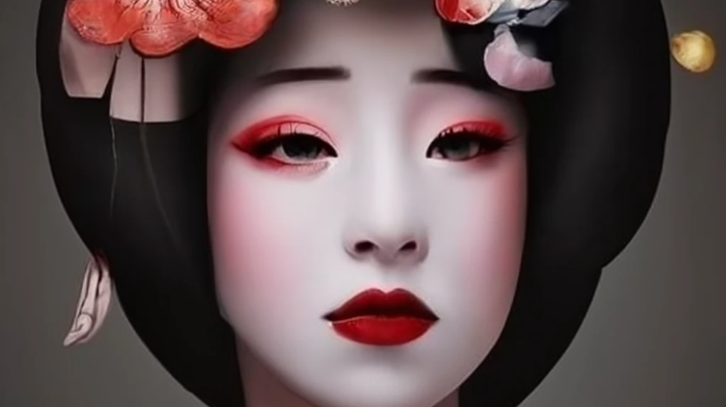
Takao’s Diary
Daily life of a high-ranking Yoshiwara Oiran

Slide 2
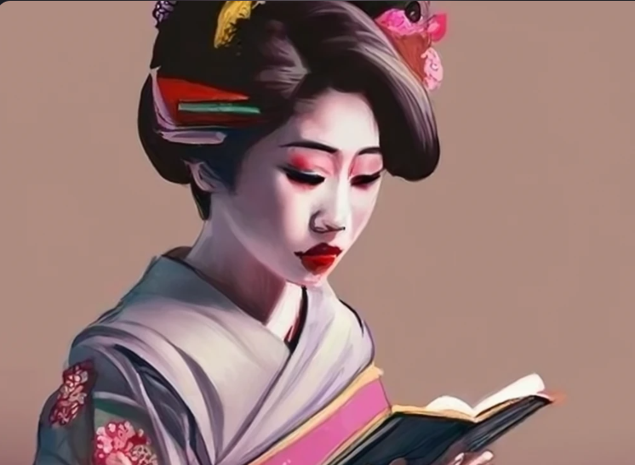
Learning Goal:
Teach how courtesans during the Edo period were drafted (real history).
Teach the lifecycle of the Edo period courtesans within a Yukaku House (real history).
Teach about Edo period pleasure district common activities, practices and stories (real history with added drama).
Experience art, religion, politics and aesthetics during the Edo period.

Slide 3
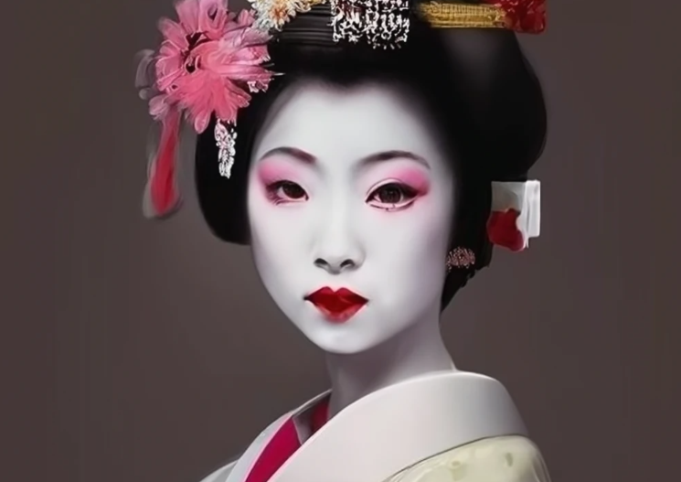
Game Goal:
Live through all the pages of Takao’s diary, from her childhood to her death. (Fill the missing pages of the diary by performing actions within the game)
Learn about her life, inspired by real life events and common practices during the Edo period Japan.

Slide 4
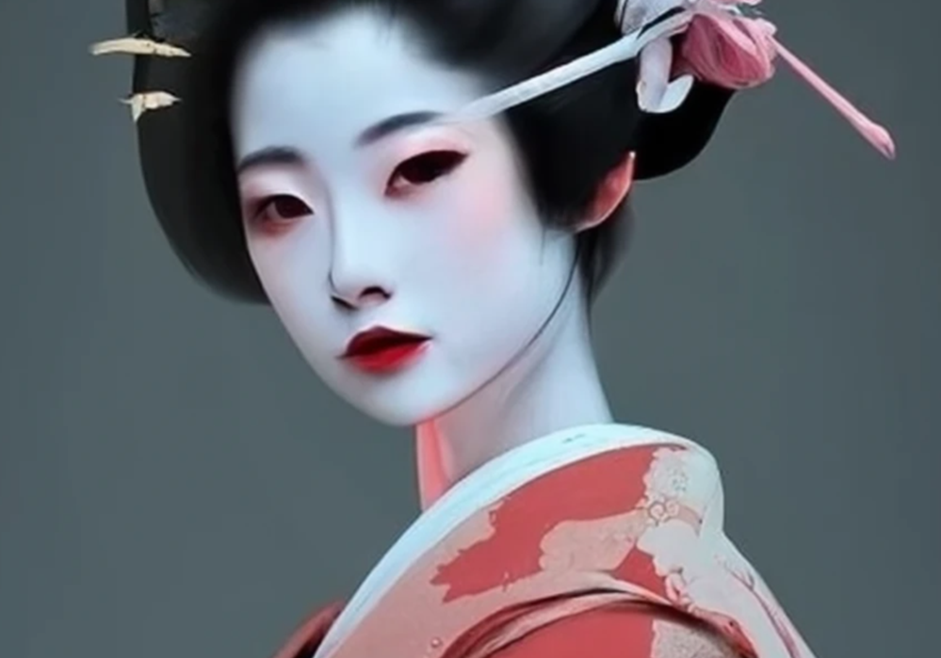
Game Genre:
Story telling (in speech mostly)
Guided puzzle game
RPG
Serious game.
VR?

Slide 5
Game Story:
The story follows the daily life of a tayū (highest ranking Yoshiwara Oiran) from her childhood, usual routine during her prime, her most insane activities and rituals practiced by Oirans during the Edo period, followed by her last days.
Takao is a tayū that was taken prisoner at an early age into a Yukaku House.
While conducting her daily life she meets Tsunamune as her primary client.
She captivates Tsunamune and seduces him to pay her debt to escape her faith.
Yet their relationship takes on a tragic road.

Slide 6
Inspired by:
Manji Takao (高尾, 1640 – December 5, 1659),a tayū (highest-ranking courtesan) of the Yoshiwara red light district of Edo, under contract to the Great Miura.
Date Tsunamune (伊達 綱宗, 23 September 1640 – 19 July 1711), Edo period Japanese samurai, and the 3rd daimyō of Sendai Domain in northern Japan from 1658 to 1660.

Slide 7
Verify Teaching:
Conduct a quantitative and qualitative survey
Quantitative: contains knowledge questions of elements in game
Qualitative: Suggestions on how to improve the learning factor

Slide 8
Timeline:
No steps yet (as I still didn’t think of the mechanics nor the detailed story itself) but I will make extension for sure later to participate in demo-day during summer and finish the whole diary not just a part of it.
Start 15 December

