Slide 1
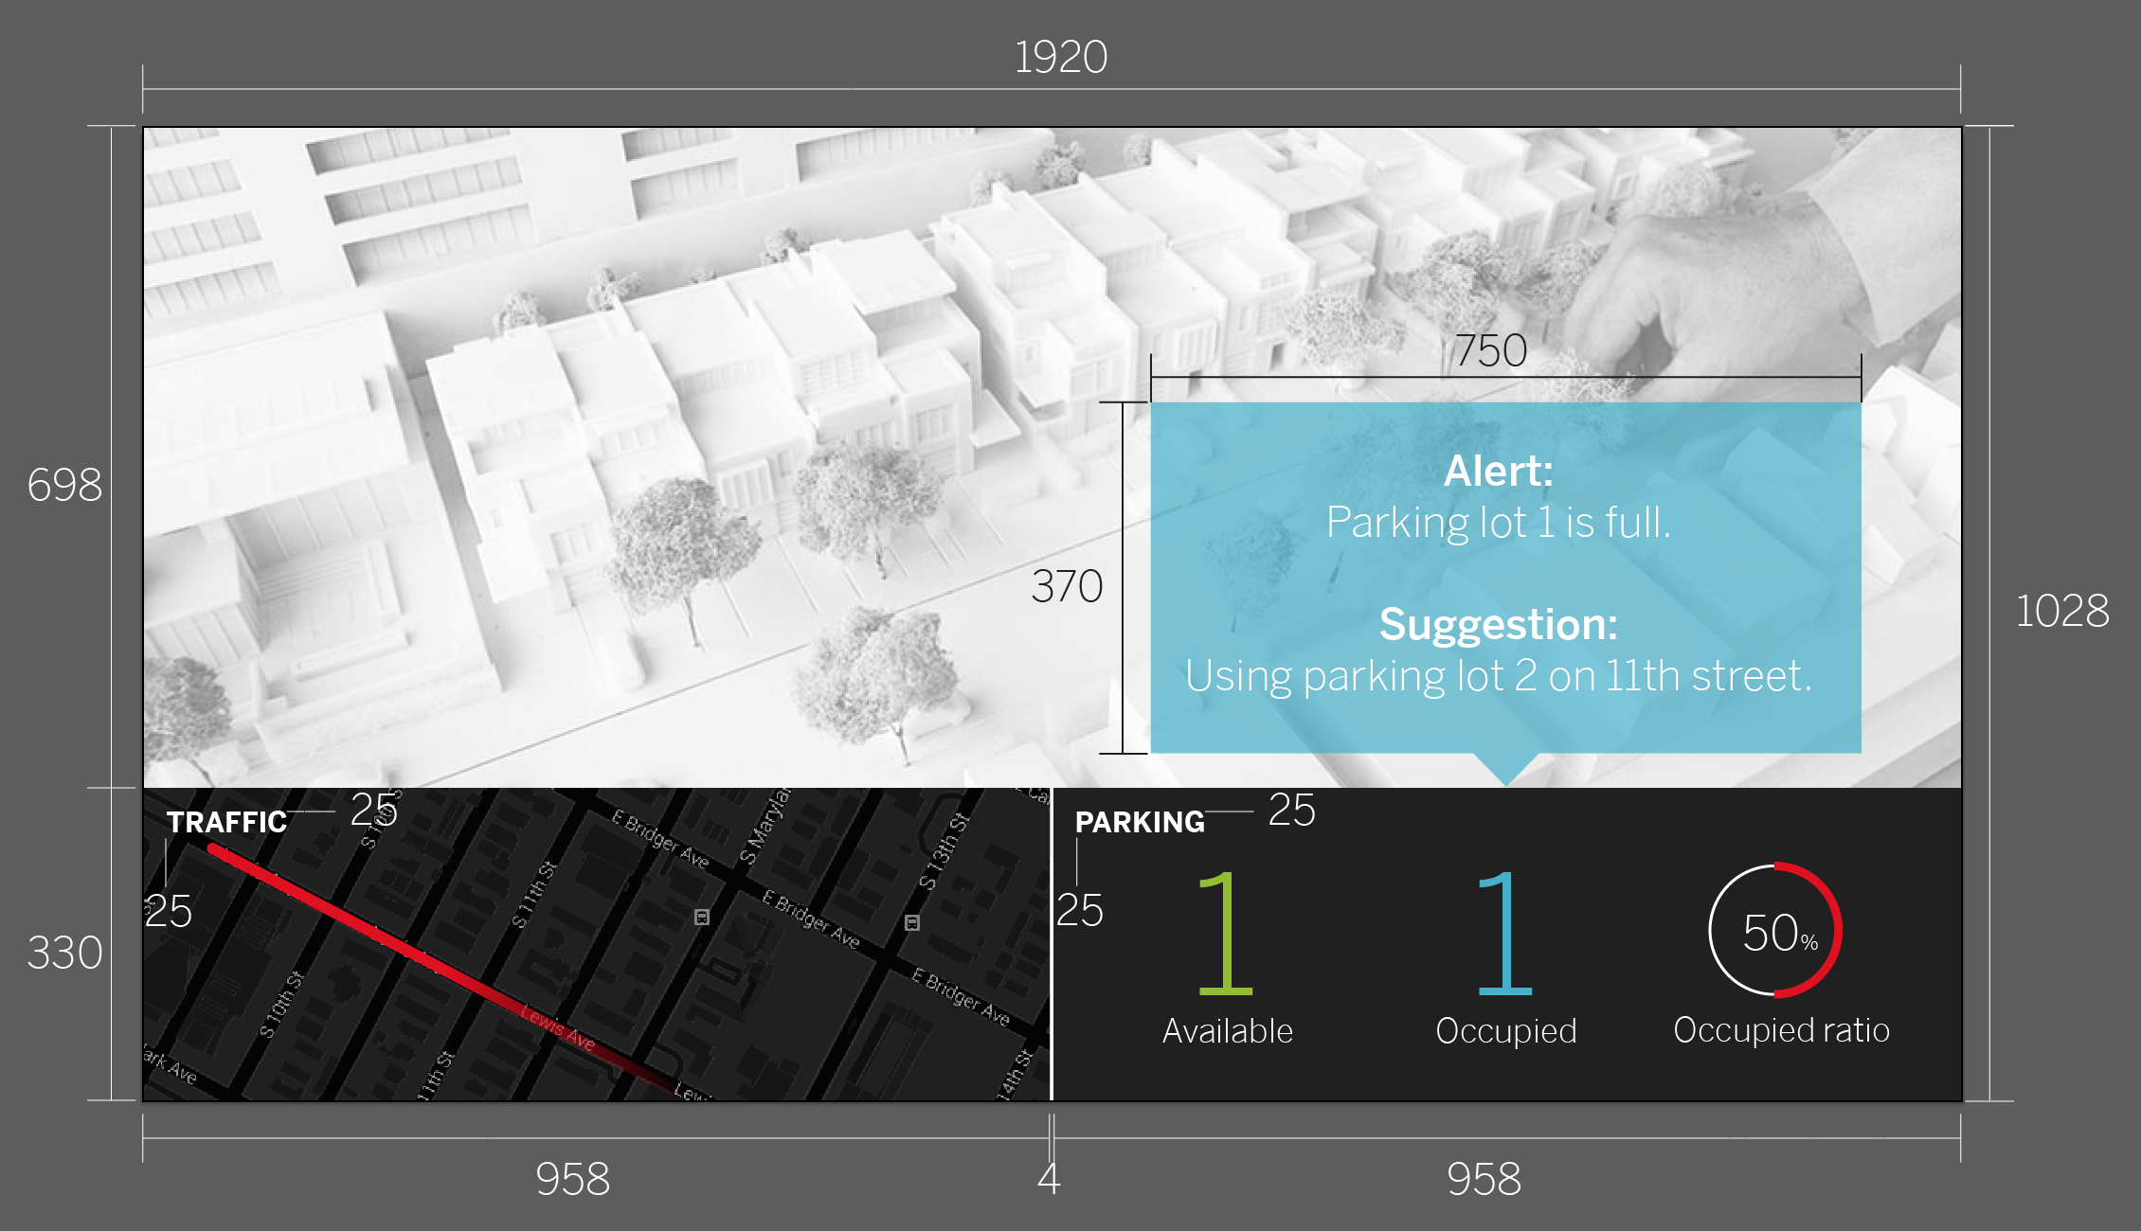

Slide 2
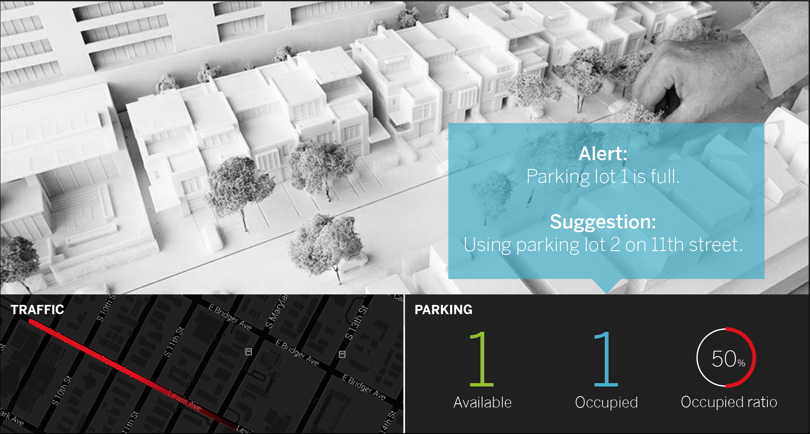
Note 1: All white lines/texts are using #FFFFFF.
Note 2: The camera view shows grayscale image.
#40AFCB
70% trans
#202020
#E20613
#E20613 (Gradient trans: 0% ~100%)
#93C01F
#E20613

Slide 3
Bentonsans Medium for “Alert”, 45
Bentonsans Light for “Parking lot is…”, 45
Bentonsans Light
50 for”50”, 20 for”%”
Bentonsans Medium, 35
Bentonsans Light, 175
Bentonsans Light, 35

