Slide 1
Reactive Programming – Session 1 (Theory)
Mohammad Merajul Islam Molla
Sr. Architect
Monstar Lab Bangladesh (MLBD)

Slide 2
Assumptions
You are familiar with multi-threading
You are familiar with Lambda expression/closure
Familiar with Observer Pattern

Slide 3
Reactive Programming – Why is it difficult?
It requires different mindset
Its vast
Lack of proper documentation
No standard/Implementation varies from language to language
Documentation is vague
Even experts make mistakes

Slide 4
History
.NET was there first!
Reactive extensions of JS released - 17.03.2010
RxJava -> ported from .NET to JVM by Netflix
Stable API release - Nov 2014
After nearly two years of development
Other languages followed…

Slide 5
Reactive Extensions
Reactive Extensions (Rx) is a library for composing asynchronous and event-based programs using observable sequences and LINQ(Language Integrated Query)-style query operators. [https://msdn.microsoft.com/library/hh242985.aspx]

Slide 6
What Does it Mean?
Rx.Observable.prototype.flatMapLatest(selector, [thisArg])
From library documentation:
“Projects each element of an observable sequence into a new sequence of observable sequences by incorporating the element's index and then transforms an observable sequence of observable sequences into an observable sequence producing values only from the most recent observable sequence.”

Slide 7
What is Reactive Programming?
Reactive Programming is programming with asynchronous data streams
A stream is a sequence of ongoing events ordered in time
It can emit three different things:
a value (of some type)
an error
a "completed" signal

Slide 8
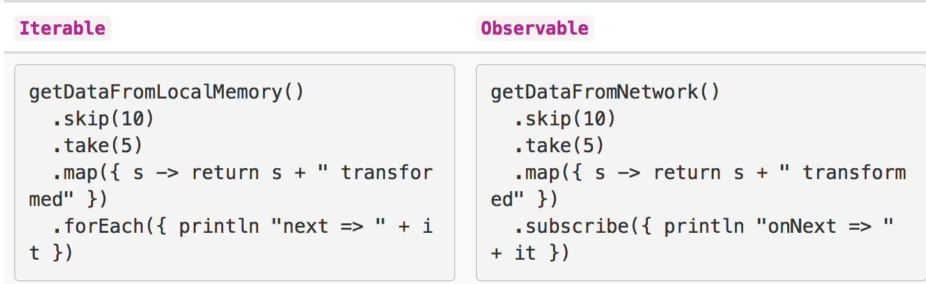
What is Reactive Programming?
The "listening" to the stream is called subscribing
The functions we are defining are observers
The stream is observable being observed
Operators - filter, select, transform, combine, and compose observables.
Synchronous - Asynchronous
Pull - Push

Slide 9
What is Reactive Programming?
It extends the observer pattern to support sequences of data and/or events
Reactive Programming vs. Functional Reactive Programming:
Functional Reactive Programming operates on values that change continuously over time
Reactive Programming operates on discrete values that are emitted over time. Although it is functional and reactive in nature

Slide 10
Reactive Manifesto
Reactive Systems are –
Responsive – The system responds in a timely manner if at all possible
Resilient – The system stays responsive in the face of failure
Elastic - The system stays responsive under varying workload
Message Driven (or event driven?) - Reactive Systems rely on asynchronous message passing

Slide 11
Observable Contract
Observable Contract
onNext* (onCompleted|onError)?

Slide 12
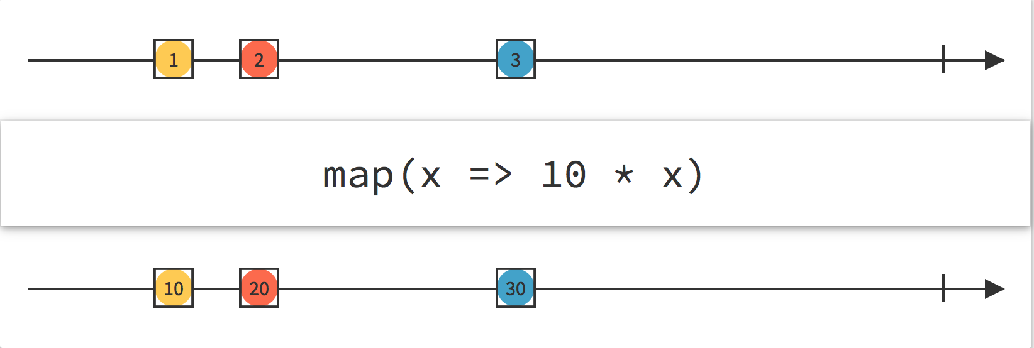
Reading Marble Diagrams

Slide 13
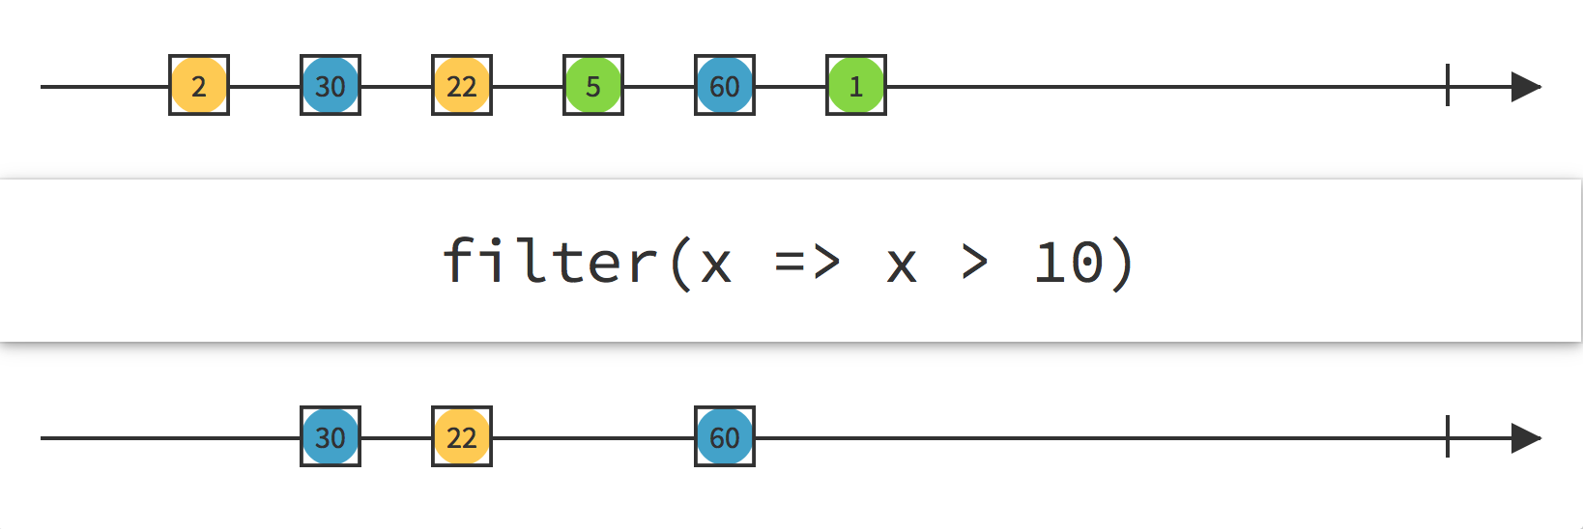
Reading Marble Diagrams

Slide 14
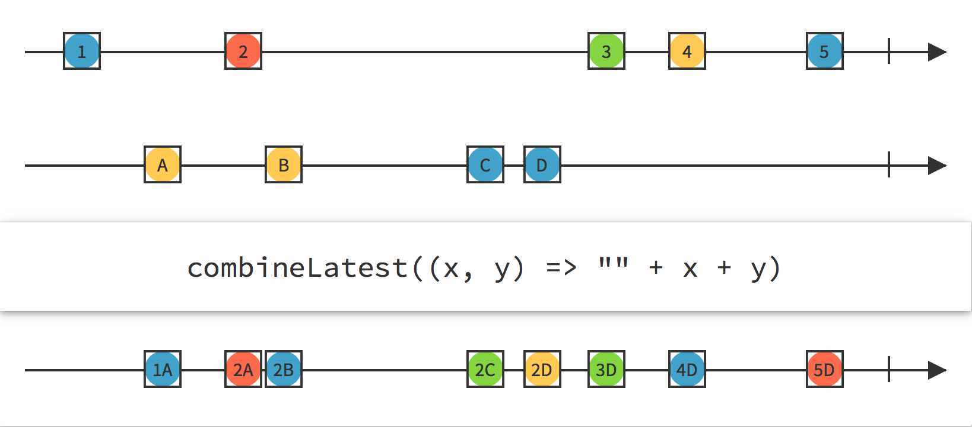
Reading Marble Diagrams

Slide 15
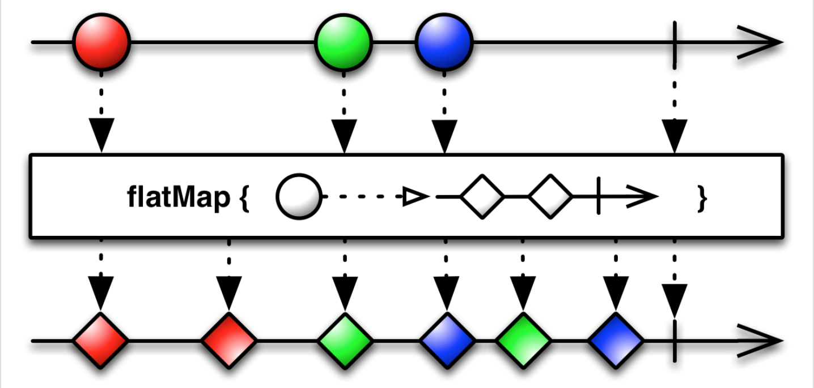
Reading Marble Diagrams

Slide 16
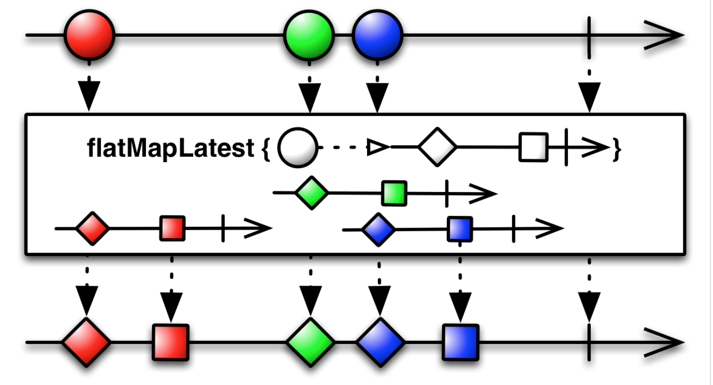
Reading Marble Diagrams

Slide 17
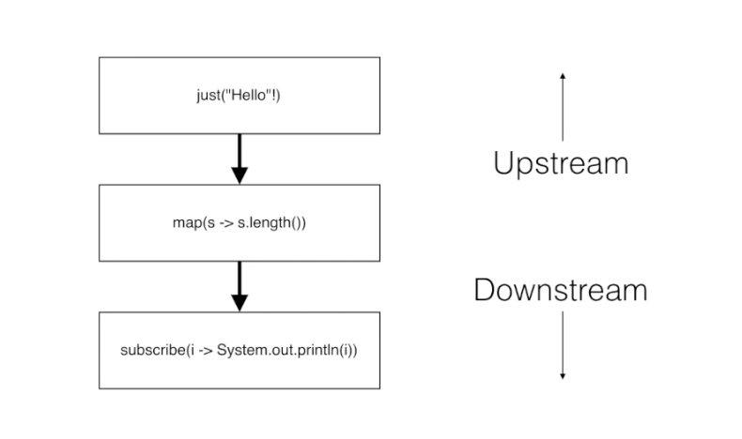
Scheduler – subscribeOn vs. observeOn

Slide 18
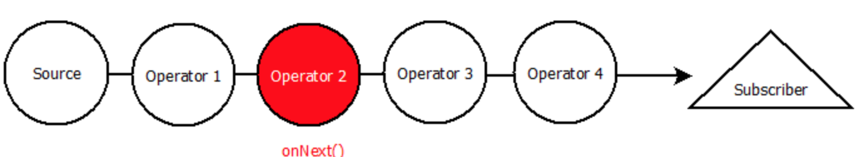
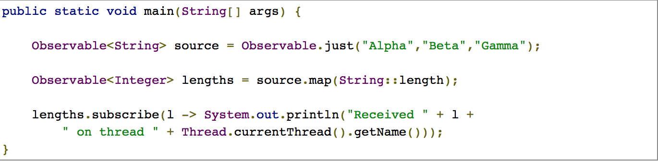
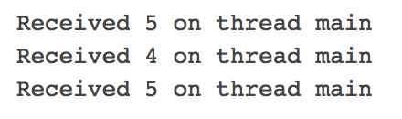
Scheduler – subscribeOn vs. observeOn
Rx by default single threaded
subscribeOn and observeOn operators can be used to introduce concurrency

Slide 19
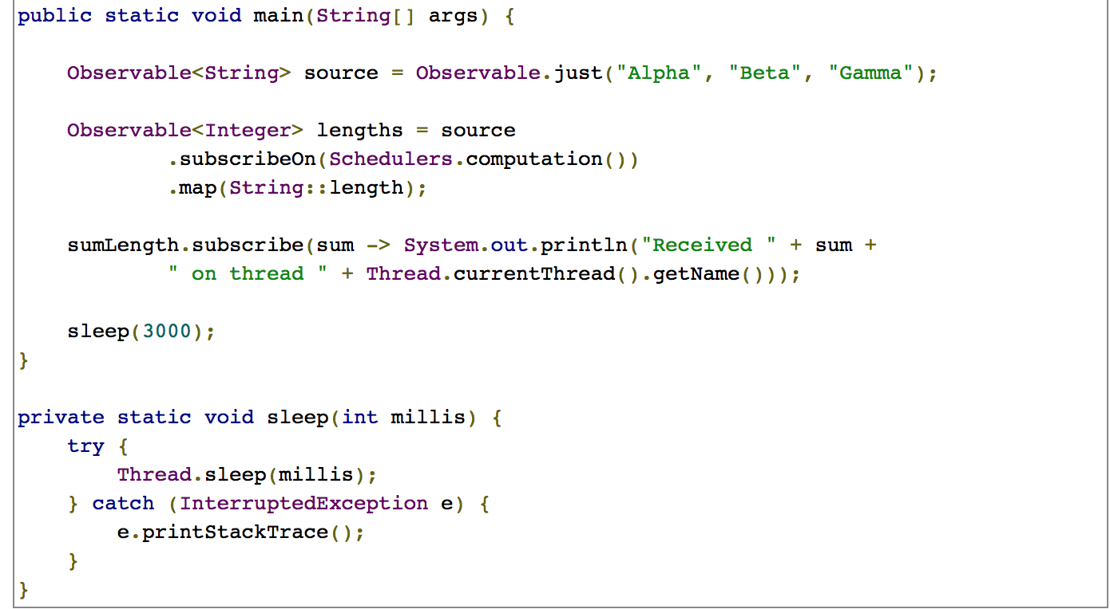
Scheduler – subscribeOn vs. observeOn

Slide 20
Scheduler – subscribeOn vs. observeOn
- subscribeOn() instructs the source Observable which thread to emit items on, and this thread will push items all the way to the Subscriber.
However, if it encounters an observeOn() somewhere in the chain it will then pass emissions to another thread for the remaining operations at that point.
subscribeOn multiple call does not work. Only the first call will work.

Slide 21
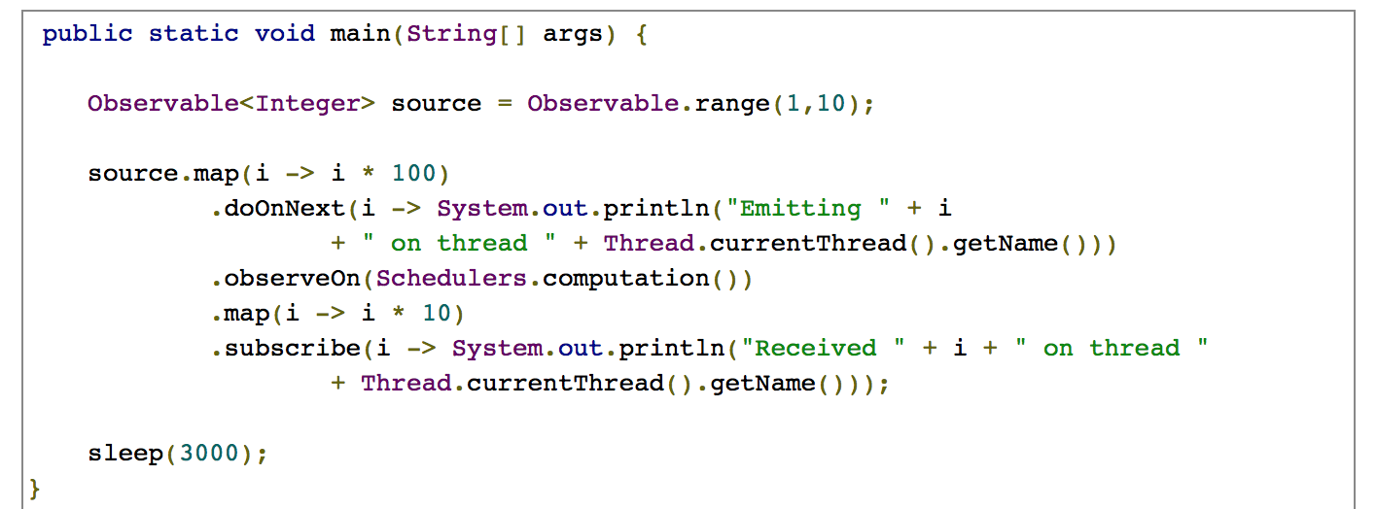
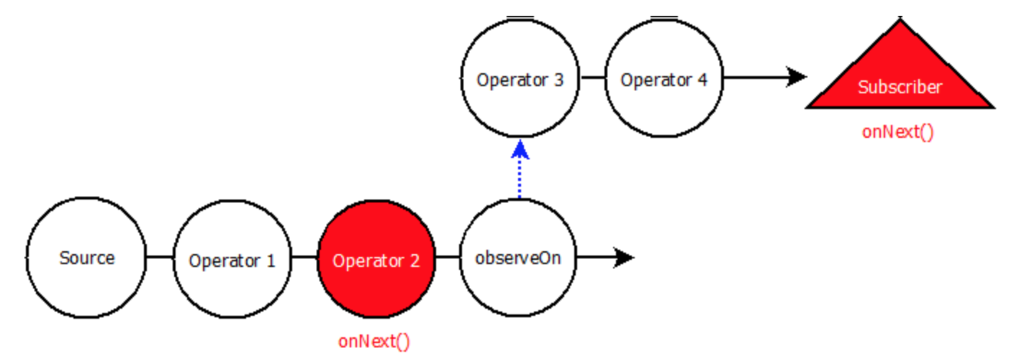
Scheduler – subscribeOn vs. observeOn

Slide 22
Scheduler – subscribeOn vs. observeOn
Tips/Notes:-
You can only direct emissions of an Observable from one single thread to another single thread (subscribeOn)
No matter where you put it, it will tell the source Observable which thread to emit items on (subscribeOn)
If you specify multiple subscribeOn() operators, the one closest to the source (the left-most), will be the one used (subscribeOn)
observeOn() only works downstream (observeOn)
A few source Observable factories, like Observable.interval(), will already specify a subscribeOn() internally. Observable.interval() will already emit on the computation scheduler, and any subscribeOn() you specify on it will do nothing.

Slide 23
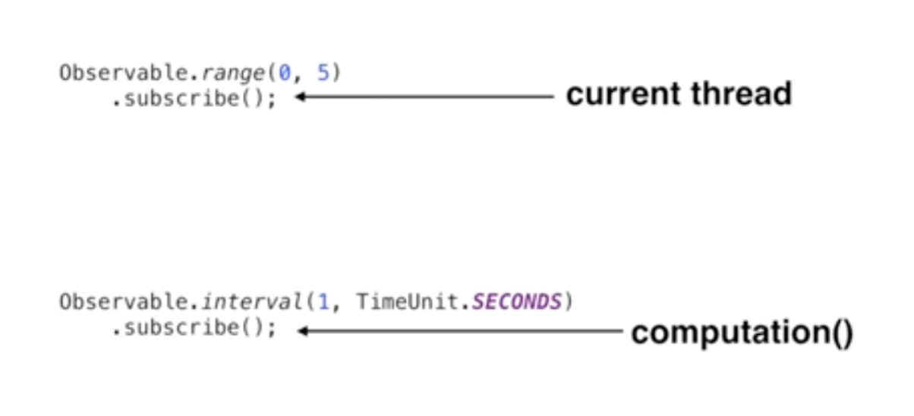
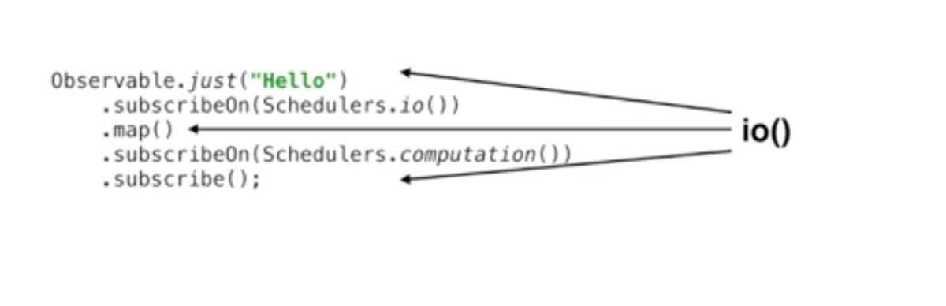
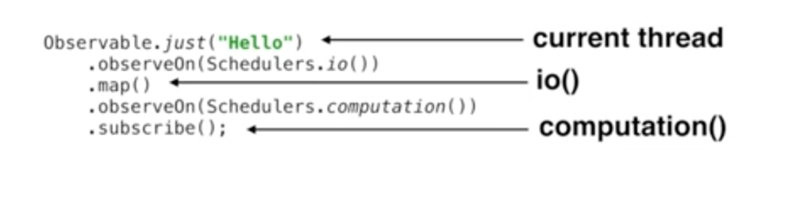
Operators
Understand your operators

Slide 24
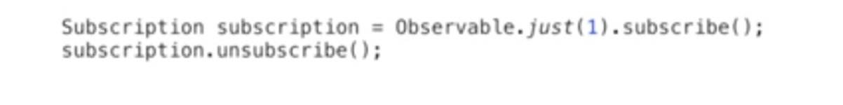
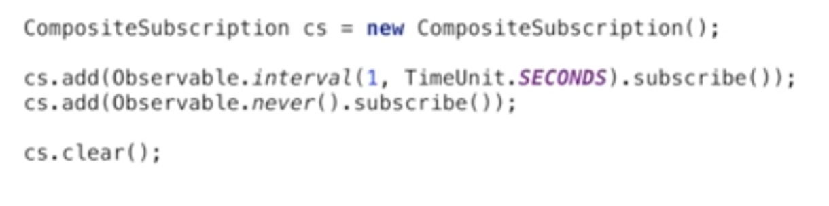
Unsubscription
Subscription may result in memory leaks
Ex – App leave to another Activity in Android

Slide 25
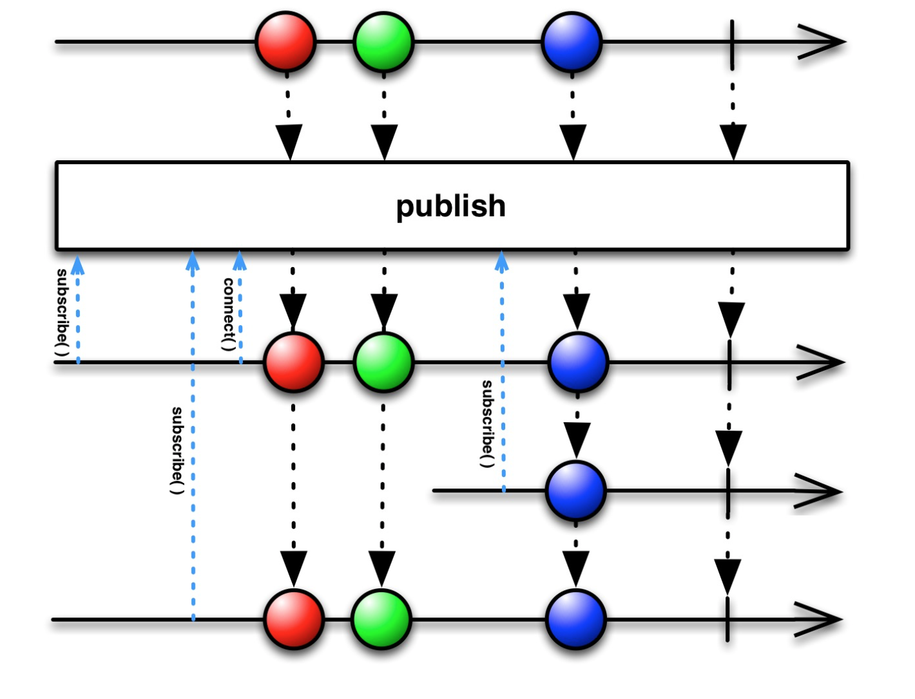
Multiple Subscribers
- Use connectable observers
https://stackoverflow.com/questions/35951942/single-observable-with-multiple-subscribers/35952390#35952390

Slide 26
Error Handling
swallow the error and switch over to a backup Observable to continue the sequence
swallow the error and emit a default item
swallow the error and immediately try to restart the failed Observable
swallow the error and try to restart the failed Observable after some back-off interval
Operators:
onErrorResumeNext() - instructs an Observable to emit a sequence of items if it encounters an error
onErrorReturn() - instructs an Observable to emit a particular item when it encounters an error
onExceptionResumeNext() - instructs an Observable to emit a sequence of items if it encounters an exception
retry() - if a source Observable emits an error, re-subscribe to it in the hopes that it will complete without error
retryWhen() - if a source Observable emits an error, pass that error to another Observable to determine whether to re-subscribe to the source

Slide 27
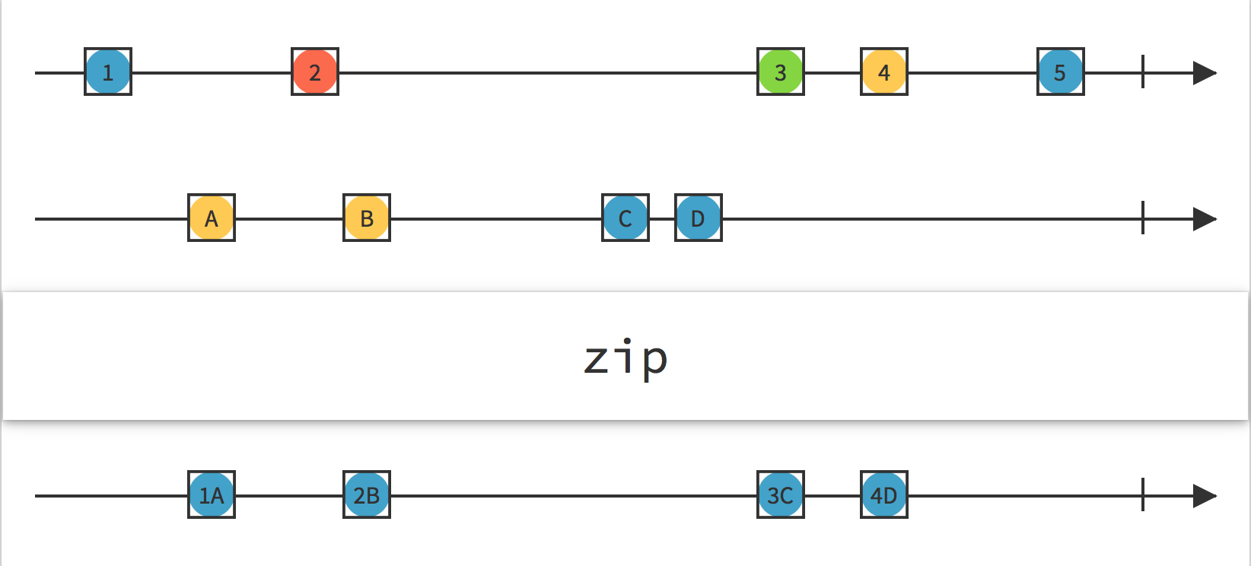
Backpressure
Observable is emitting items more rapidly than an operator or subscriber can consume them.
This presents the problem of what to do with such a growing backlog of unconsumed items.

Slide 28
Hot and Cold Observables
A cold Observable emits a particular sequence of items, but can begin emitting this sequence when its Observer finds it to be convenient, and at whatever rate the Observer desires.
database query, file retrieval, or web request
A hot Observable begins generating items to emit immediately when it is created. Such an Observable emits items at its own pace, and it is up to its observers to keep up
mouse & keyboard events, system events, or stock prices

Slide 29
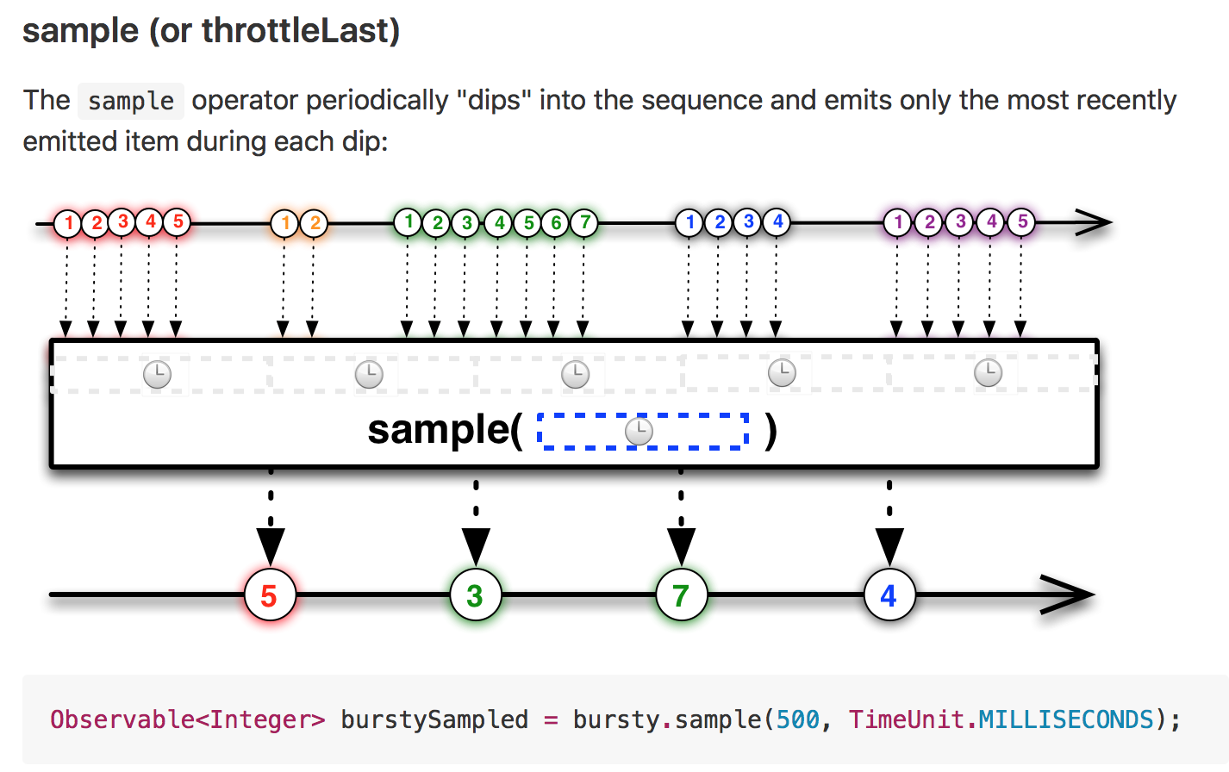
Solution to Backpressure
Use certain operators – sample, throttleLast, throttleFirst, throttleWithTimeout, debounce

Slide 30
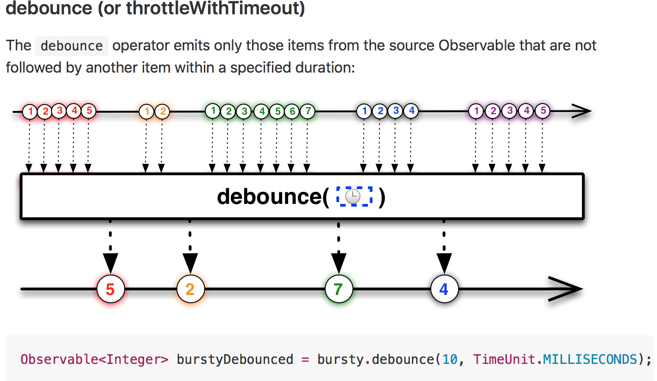
Solution to Backpressure

Slide 31
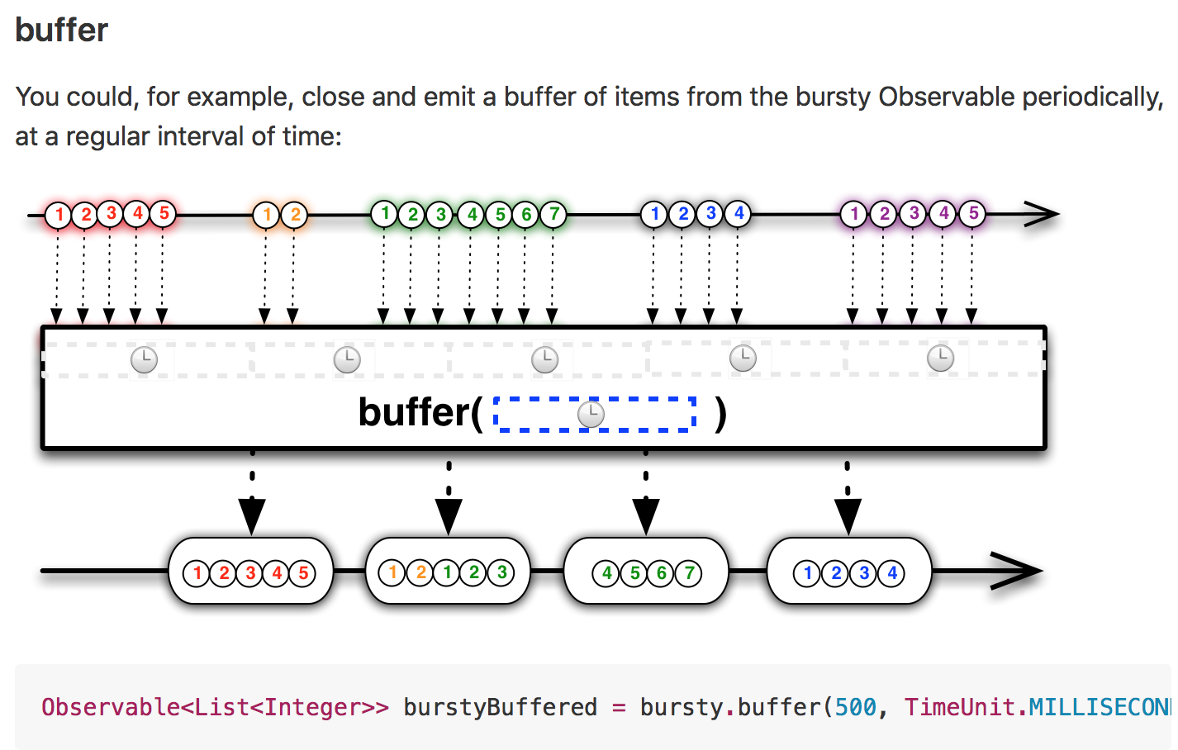
Solution to Backpressure
Buffers and Windows

Slide 32
Subjects
Self study

Slide 33
References
Reactive Manifesto - http://www.reactivemanifesto.org
ReactiveX - http://reactivex.io
Tutorials - http://reactivex.io/tutorials.html
RxMarbles - http://rxmarbles.com
RxSwift - https://github.com/ReactiveX/RxSwift
RxCocoa - https://github.com/ReactiveX/RxSwift/tree/master/RxCocoa
RxJava - https://github.com/ReactiveX/RxJava
RxBinding - https://github.com/JakeWharton/RxBinding
RxAndroid - https://github.com/ReactiveX/RxAndroid
RxJS - https://github.com/Reactive-Extensions/RxJS
RxPHP - https://github.com/ReactiveX/RxPHP

Slide 34
References
Common RxJava Mistakes - https://www.youtube.com/watch?v=QdmkXL7XikQ
Introduction to Reactive Programming (RxJS) - https://egghead.io/courses/introduction-to-reactive-programming
subscribeOn vs observeOn - http://tomstechnicalblog.blogspot.com/2016/02/rxjava-understanding-observeon-and.html
RxJava: Achieving Parallelization - http://tomstechnicalblog.blogspot.com/2015/11/rxjava-achieving-parallelization.html
RxJava — One Observable, Multiple Subscribers, Same Data - https://medium.com/@p.tournaris/rxjava-one-observable-multiple-subscribers-7bf497646675#.8f7wdrvld

Slide 35
Example Projects
Android (RxJava, RxAndroid) - https://github.com/imeraj/RxJava-Demo-App1
iOS (RxSwift, RxCocoa) - https://github.com/imeraj/RxSwift-Demo-App1

Slide 36
Q/A

