Slide 1
Ensemble Message(消息)
Health Connect和Ensemble系统培训
Notes:
11_Messages消息章节，我有一些修改建议：
1. 增加消息持久化的细节（10_EnsSystemManagement里有，可以参考那里的信息）
2. 把进程池部分的内容去掉，这需要有后面章节（业务组件部分）的知识
3. 有很多页面没有翻译
4. "queue" and "inProc"，建议放在后面章节（业务组件章节）
5. “消息的创建”有歧义，这里是指消息体的定义，不是消息创建的过程
6. “消息发送机制”里面内容基本是空的
7. 里面应该提到默认消息持久化，并提到消息可以不持久化，为后面Louis的passthrough做个铺垫

Slide 2
业务组件与消息
消息
数据
数据
Ensemble
外部应用
输入型适配器
业务服务
业务操作
输出型适配器
外部应用
业务流程
Web
SOAP
Java
复合应用
数据库
Notes:
Composite Apps: 通过CSP GW与外界Apps建立与BS的直接访问
Business Operation负责将Ensemble内传递的请求发到外部的数据源、应用或系统
BO可以调用BP, with alarm, not something user would code
Messages are the communication method between components within an Ensemble application.
Messages are used between Business Services, Business Processes and Business Operations.

Slide 3
提纲
Message基本概念
Message的创建
Message的查看，trace
Message的删除
队列管理和Pool Size
同步发送还是异步发送?
Pass-through

Slide 4
消息基本概念
消息是Ensemble内部协调业务步骤所需要传递的数据.
例如为从医保系统取得病人基本信息,要传递含有病人医保号的消息.
HL7消息
消息是持久化存储的.
Ensemble定义了两个基类，分别处理请求消息和响应消息.
Ens.Request 和Ens.Response

Slide 5
消息基本概念
Class Ens.MessageHeader Extends (%Persistent, Ens.MessageHeaderBase, %XML.Adaptor)
Class Ens.MessageBody Extends (%Persistent, Ens.Util.MessageBodyMethods, %XML.Adaptor)
Same properties
Type: Request or
Response
IsError: 0 or non-0
Application-specific
properties
ID: number
Name: string
消息头
消息体
Notes:
Ensemble messages are not used as the communication mechanism between:
A Business Service and a client application.
A Business Operation and an external application.
Each Ensemble message has a header and a body.
Header properties are the same for all messages.
Body properties are application specific for each message type.

Slide 6
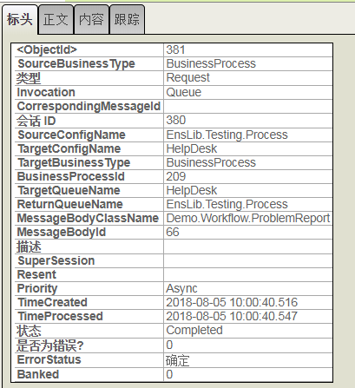
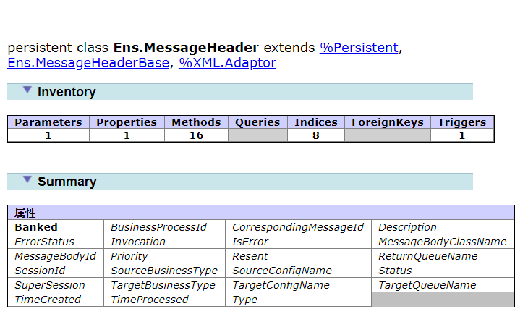
Message Header

Slide 7
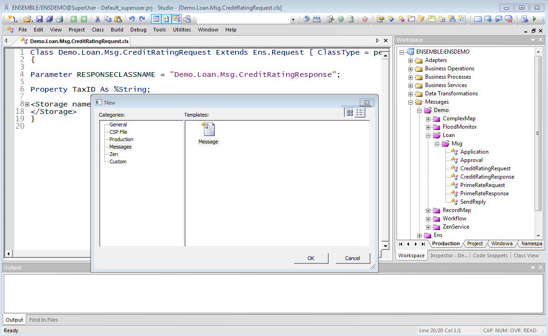
消息的创建
在Studio里创建消息，需要选择类型：Request, Response, 分别继承于Ens.Request和Ens.Response类
(实际是消息体)

Slide 8
消息的产生
消息头是消息在业务组件间传递时，由后台自动创建的
例如： Set tSC=..SendRequestAsync(“MyTarget”,myObject)
把消息放入队列的过程：
１. 保存消息，自动创建消息头 (消息优先级用户不能设置或者修改)
2. 把消息头放入队列
^Ens.Queue
3. signal(唤醒)目标组件，处理消息队列
消息一直存在消息队列(Queue)，直到被接收方组件处理。
队列不仅处理请求消息，还处理异步返回消息
Notes:
Business Processes and Business Operations have queues. Business Services do not have queues since they bring in non-Ensemble messages.
Putting a message on a queue 1) saves the message and creates a message header 2) adds entry to queue – just the message header id 3) signals recipient to wake up (no polling of queue).
消息被从队列里拿出处理的方式一定是FIFO(First In First Out)
组件disable后消息仍然会放到队列， 除非停服务

Slide 9
消息优先级
消息引擎自动决定消息的优先级：
高同步HighSync (1) — 用于ACK消息和警告.
同步Sync (2) — 用于需要比普通同步消息更高优先级的同步消息.
普通Normal (3) — 用于大多数同步消息.
半同步SimSync (4) — 用于由BPL 同步 <call>产生的异步调用. 这确保请求和响应消息在排队的一步消息前被处理.
异步Async (6) —用于异步消息.
消息优先级无法人工修改
Notes:
http://localhost:57773/csp/docbook/DocBook.UI.Page.cls?KEY=EMONITOR_concepts#EMONITOR_concepts_msg_priority

Slide 10
消息体(Message Body)可以是什么类型
消息体的对象可以是下列类型:
Ens.Request or Ens.Response的子类
Persistent class.
Serial class.
虚拟文档(Virtual document).
用于处理HL7.
Notes:
以下来自learning service的ppt, 但实际测试发现Serial Class不行， 必须是Persistent,, 各种vdoc消息实际也是集成的%Persistent
Messages are often a subclass of Ens.Request or Ens.Response.
A message body can be any of the following:
Ensemble request.
Subclass of Ens.Request.
Ensemble response.
Subclass of Ens.Response.
Any persistent object.
Any serial object.
A virtual document (used with HL7 processing).
Refer to Ensemble Virtual Documents for details.

Slide 11
消息发送机制（1）
同步发送
异步发送
延迟发送

Slide 12
消息发送机制（2）
同步方式：
method SendRequestSync(pTargetDispatchName As %String, pRequest As %Library.Persistent, ByRef pResponse As %Library.Persistent, pTimeout As %Numeric = -1, pDescription As %String = "") as %Status
异步方式：
method SendRequestAsync(pTargetDispatchName As %String, pRequest As %Library.Persistent, pDescription As %String = "")as %Status
Notes:
method SendRequestAsync(pTargetDispatchName As %String, pRequest As %Library.Persistent, pDescription As %String = "")as %Status

Slide 13
消息发送机制（3）
同步调用
应该设置超时。超时后收到的响应会丢弃
Set tSc= ..SendRequestSync("Route and Transform Message", tRequest, .tResponse)
异步调用
不等待返回消息
无法设置超时
如果后面用Sync等待返回消息，收不到消息将永远等待
Set tSC=..SendRequestAsync("Demo.Loan.FindRateFileOperation",tSendReply,0)
Notes:
Most calls from a Business Process are asynchronous calls.
For synchronous calls, a timeout setting is used. Once the timeout setting expires, any further responses to that request are discarded.
In BPL, if you forget to a sync activity for an asynchronous call, the Business Process will not wait.
In custom code, if you forget to an amount of time to wait for responses for an asynchronous call, the Business Process will wait forever.
Instead of one asynchronous call activity followed directly by a sync activity, use a synchronous call activity. Underneath the covers, synchronous calls are handled asynchronously. This will allow the actor to work on another Business Processes while waiting for the one synchronous call to return.
With more than one asynchronous call, you must use the sync activity to wait for the responses.

Slide 14
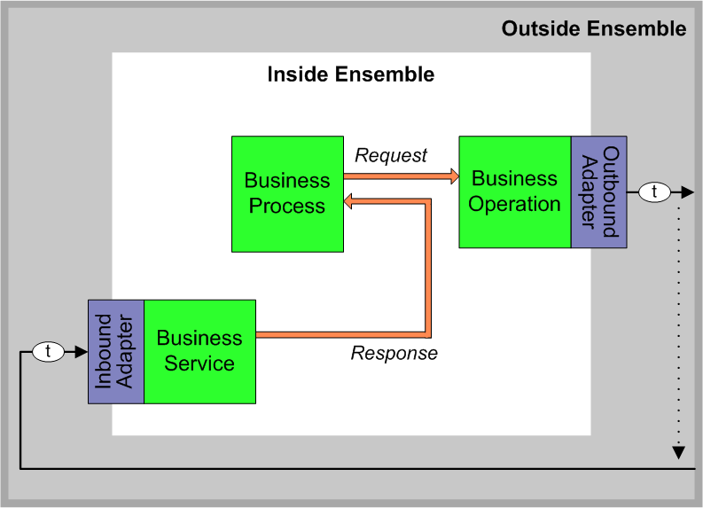
消息发送机制（4）
延迟发送(Deferred Sending)
SendDeferredResponse()为前面标示为延时的消息发送的response消息
Set sc = ..SendDeferredResponse(token, pResponseBody)
//EnsLib.Workflow.Engine.cls
http://localhost:57779/csp/docbook/DocBook.UI.Page.cls?KEY=EGDV_prog_deferred
Notes:
Where:
token — A string that identifies the deferred response so that the caller can match it to the original request. The business service obtains the token string through some mechanism unique to the production.
For example, if the external destination is email, when sending a request for which it is willing to receive a deferred response, a business operation can include the token string in the subject line of the outgoing email. The entity receiving this email can extract this token from the request subject line and use it in the response subject line. This preserves the token so that the business service receiving the response email can use it in a subsequent call to SendDeferredResponse().
pResponseBody — A response message. This object receives the data returned by the response. See “Defining Ensemble Messages.”
This method returns a status, an instance of %Status.

Slide 15
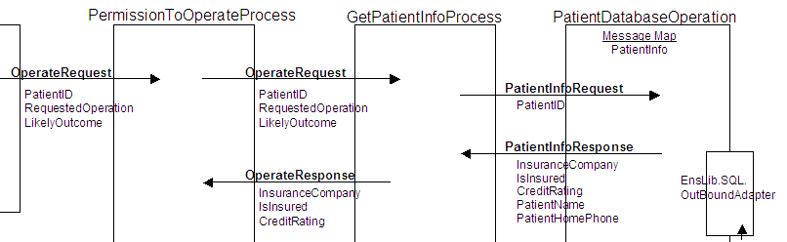
消息发送机制（5）
定义每个业务组件之前先定义发送和接收消息.
有些组件需要首先知道消息类型
可以避免输入错误typo
设计消息发送的类型
Notes:
When building business components, some properties require a message type. Having the messages already built, allows you to pick the message instead of typing the messages name. This will reduce errors.

Slide 16
公有池和私有池（Actors and Pools）
Business
Service
Business
Process
Business
Operation
Business
Process
Business
Process
Business
Operation
Business
Service
Actors
Business
Process
Notes:
When Production starts up, a director process reads the Production definition and creates the necessary jobs:
Business Services based on Pool Size setting.
Business Processes private jobs based on Pool Size setting.
Actors for Business Processes based on Actor Pool Size setting.
Business Operations based on Pool Size setting.
A Business Process should typically have its own private jobs, also known as a private pool. However, Business Processes can share one common pool of allocated jobs. Each job in the common pool is referred to as an “actor”. An actor has no affiliation with or knowledge of a specific Business Process. This is what makes actors different from jobs in a private pool.
A general rule is that the actor pool should only be used for Business Processes that do not have a large responsibility in the Production, or Business Processes that experience very low message volume. If you decide that 2 or more Business Processes are going to use the actor pool, then the actor pool size should be low at first, and increased incrementally only if testing confirms that an increase is needed for better performance.
Each Business Service and Business Operation always has its own pool of allocated jobs because communicating outside of Production may place special requirements. For this reason, the number of jobs for a particular Business Service or Business Operation needs to be configurable.
The pool size can be changed while a Production is running. For example, there may be times when an unusually large number of requests are received for a component. To handle these, the manager could increase Pool Size until the load returns to normal.
Synchronous requests from a Business Service or Business Operation are actively waiting and tying up a process from the pool. Asynchronous requests are not tying up a process while waiting for a response.
If messages are not being handled quickly enough, increasing the pool size can help. But if it is a computational bottleneck then there is no point in having the pool size larger than the number of CPUs.

Slide 17
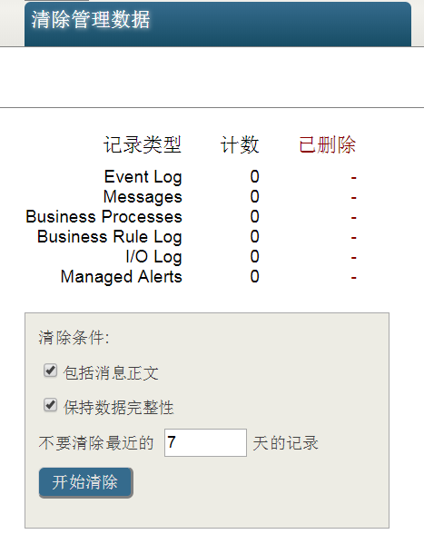
消息的清除
设置保留天数
设置任务清除消息
手工清除消息
包括消息正文
不是默认选项，但很多场景下需要选中，否则会大量保留没有消息头的消息体，长时间后会占用磁盘空间。
保持数据完整性
^Ens.MessageBodyD
^Ens.MessageHeaderD

Slide 18
消息的非持久化
业务组件的Parameter:ＩＮＶＯＣＡＴＩＯＮ
"queue" and "inProc"
每个消息有个INVOCATION
Queue: 一个消息在一个job里创建，然后放到队列，同时原job释放。（默认处理方式)
Inproc: 一个消息创建，发送，接收都是一个job.
消息有2种处理方式
排队(Queue): 消息由一个后台进程产生，并放入队列。之后由其它后台进程处理、发送
直接处理(Inproc):消息由一个后台进程产生、处理、发送
此时消息不会放入队列
Notes:
Queue means the message is created in one job, then placed on a queue, at which time the original job is released. Later, when the message is processed, a different job will be allocated for the task.
Inproc means the message will be formulated, sent, and delivered in the same job in which it was created. The job will not be available again in the sender’s pool until the message is delivered to the target.

Slide 19
删除消息体
删除消息（Purging)自动删除消息体中嵌入的各个对象
删除消息（Purging) 不自动删除嵌入对象属性引用的持久化对象（Purging does not automatically purge persistent objects referenced by properties.）
Options to purge persistent objects referenced by message properties that extend %Persistent:
Create custom purge routine.
Add delete triggers.
Add %OnDelete() callbacks.

Slide 20
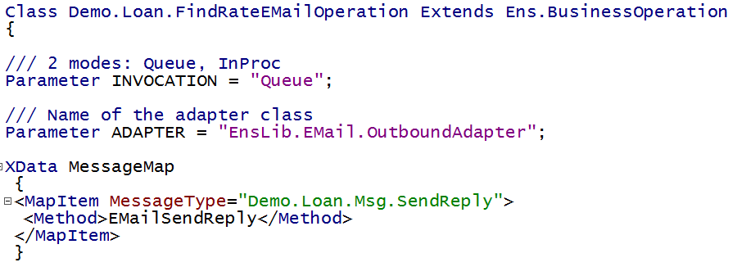
业务操作的调用模式-Queue与InProc
Notes:
问题： Inproc时， caller怎么知道要建一个bo的instance? answer: 见Ens.host的SendRequestSyncMultiple(), inproc时不建session, 不建message, 直接调用
INVOCATION parameter:
Queue – 请求消息在一个job内创建，并在该job被释放的时候被置入队列. 其他的job可以从该对垒中获取并处理这个消息。如果INVOCATION参数被置为 Queue，该Business Operation会有一个或多个关联的背景进程，并且拥有独立的消息队列.
这是Business Operation的默认行为.
InProc – 当请求消息被发给Business Operation时, 该Business Operation的实例将在其调用者的进程中被创建，并在同一进程中被执行.
这意味着请求消息将在同一进程中被创建、传递和对外发布. 这样的Business Operation没有独立的消息队列.
除非有特别的原因，Business Operation 不应被设为InProc.

Slide 21
Enterprise Tools (v2010.1+)
在一个界面(Portal)管理多个产品
Enterprise Monitor page.
监控多个产品的状态
Enterprise Message Viewer. (v2013.1+)
允许查看和搜索多个产品的消息
访问各产品中的原始消息
Message Bank Viewer.
允许查看，搜索和重发 Enterprise Message Bank中的消息
Enterprise Message Bank contains copies of original messages.
Message Bank Event Log.
允许查看，搜索Event Log entries in Enterprise Message Bank.

Slide 22
Enterprise Message Bank (v2010.1+)
Live Production
Message
Bank
Business
Operation
Enterprise Message Bank Production
Messages
and
Event Log
items
Message
Bank
Business
Service
Message
and
Event Log
repository
Live Production
Message
Bank
Business
Operation
Monitor
Business
Service
Status
repository
Notes:
The Enterprise Message Bank is a separate Production usually installed on a machine not running any live Productions.
To send messages and Event Log entries to the Enterprise Message Bank, the client Productions only requires the Message Bank Business Operation be added and configured.
Messages and Event Log entries are automatically sent to the Enterprise Message Bank. The messages and Event Log entries are not removed from the client system.

Slide 23
Enterprise Message Viewer (v2013.1+)
 | Enterprise Message Viewer | Enterprise Message Bank
Source of Message | Original message in client namespace. | Copy of original message stored locally in Enterprise namespace.
Resend Message | Not possible. | Possible.
View Message | Displays basic information about message. | Shows complete message.
Access Message | Follow link to open Message Viewer in client namespace. | Shows complete message.
Client Production | Need not modify client Production to access messages. | Add Business Operation to client Production.

Slide 24
私有池Sizes
For FIFO:
Set Pool Size = 1 for each component processing FIFO messages:
If FIFO not required:
Start with Pool Size=1.
Can increase incrementally if need better performance.
Testing needed to investigate if performance improved.
Business Process:
Non-0 value uses private pool. (Typical.)
0 uses actor pool.
All actors stopped when Business Process using actor pool disabled.
Notes:
Be careful not to disable a Business Process with Pool Size = 0. This stops all actors and as a result this causes all Business Processes using the actor pool to stop processing messages. If a Business Process using the actor queue needs to be disabled, change its Pool Size to be greater than zero before disabling the Business Process.

Slide 25
Message Facts (cont.)
持久化（Persistent）
同步发送和异步发送
Primary request.
Primary
Request
Business
Process
Primary
Request
Business
Operation
Notes:
All messages are persistent. This allows them to be searchable and viewable.
Request messages can be sent synchronously or asynchronously.
Asynchronous messages do not require a response.
The original request that causes a Business Process or Business Operation to instantiate and perform work is known as the “primary request” for that Business Process or Business Operation.

