Slide 1

Moca «Accessible Mockups»
Repo: github/imesut/Moca
App: bit.ly/mocacc

Slide 2
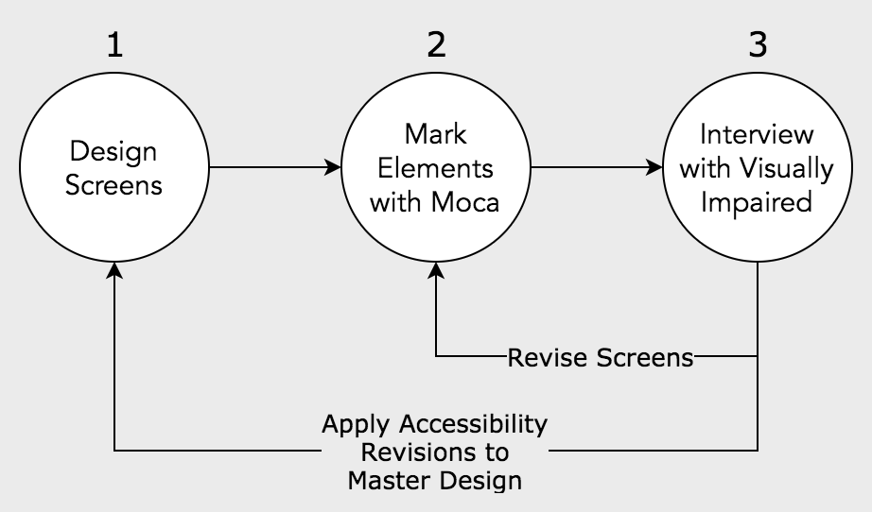
Accessibility Design & Interview Process with Moca

Slide 3
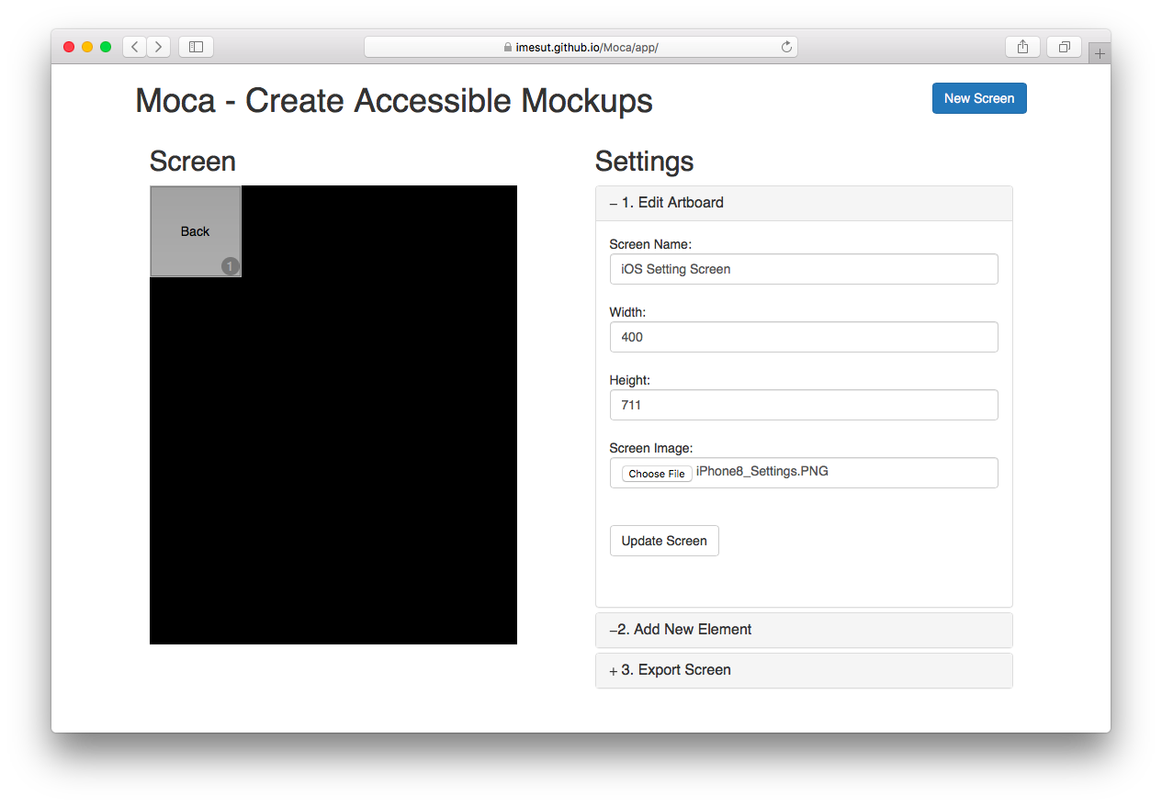
Step 1
Enter screen name
Set width and height *
Upload screen image
Press «Update Screen» button
* Size should be proportionally right, you can enter scaled width and height

Slide 4
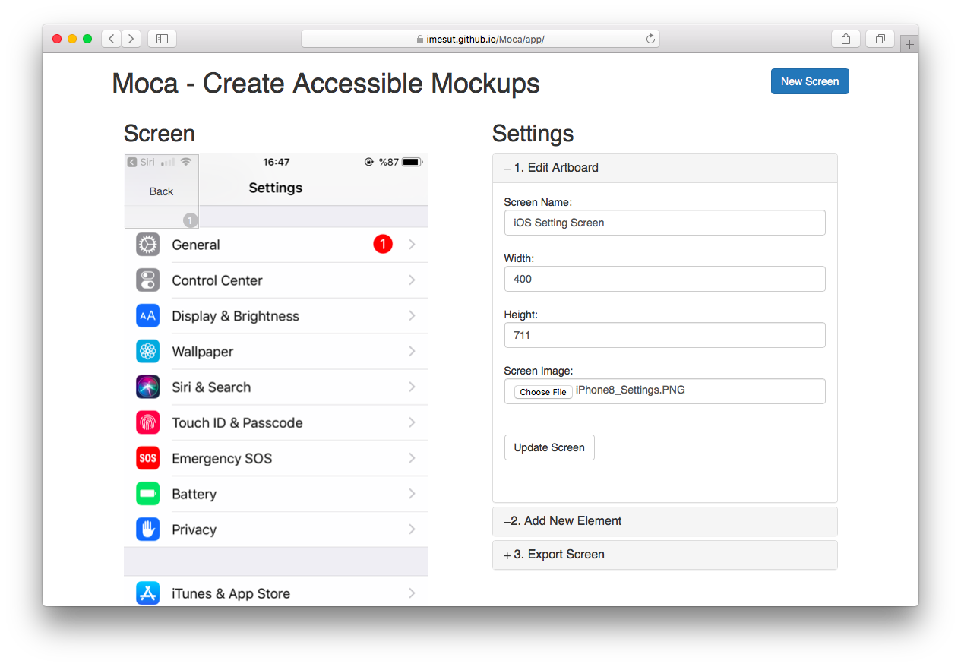
Step 2
Image has applied to canvas.
Resize first element by handling edges by mouse.

Slide 5
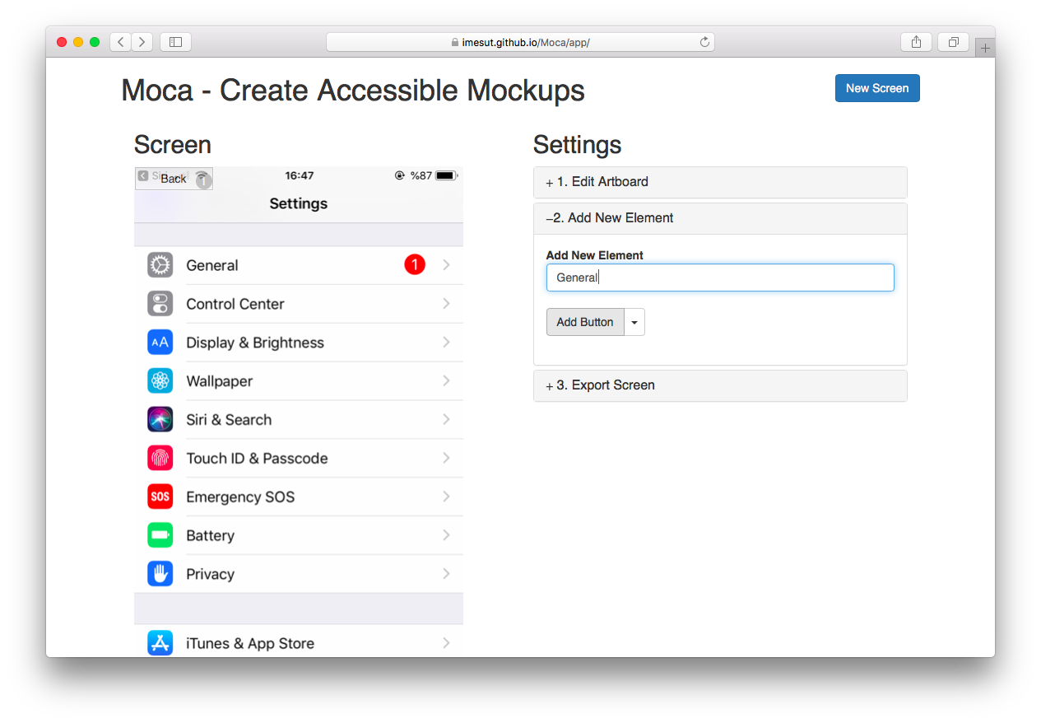
Step 3
Open «Add New Element» section at right.
Add new elements by
Writing element name and accessibility hint together
Press «App Button» button *
* You can select element kind as button, image and input area by clicking arrow at the right of button.

Slide 6
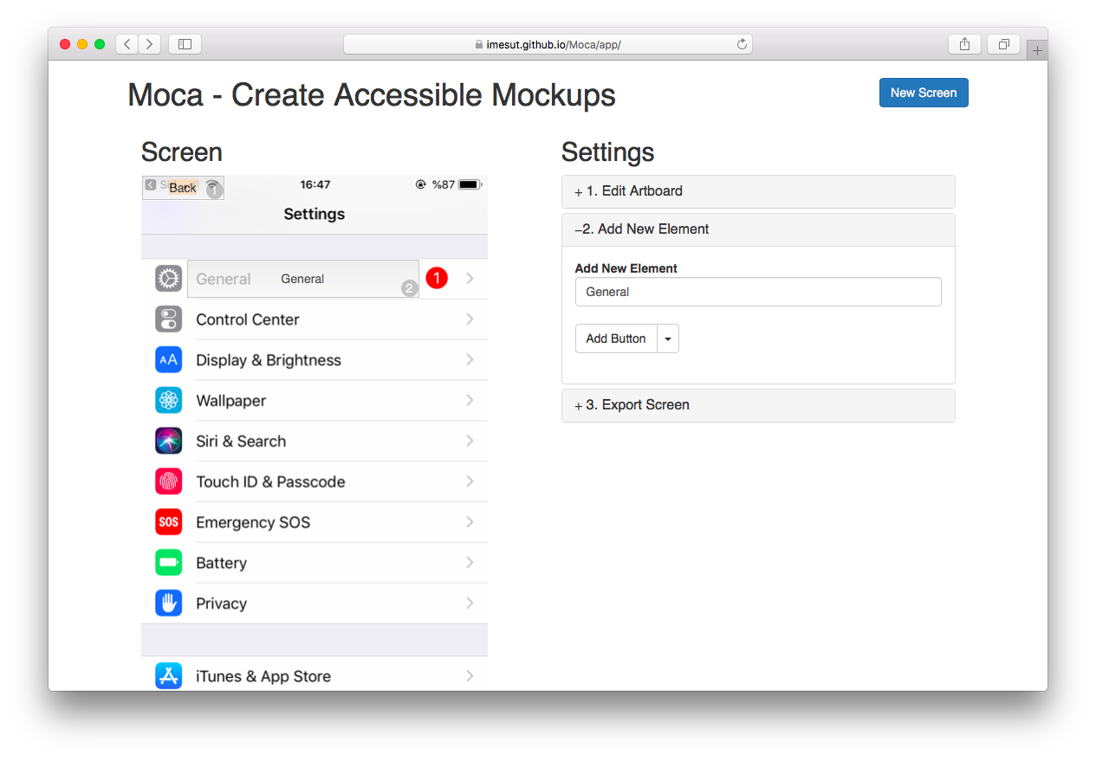
Step 4
Hold & Drag new created item to proper position.

Slide 7
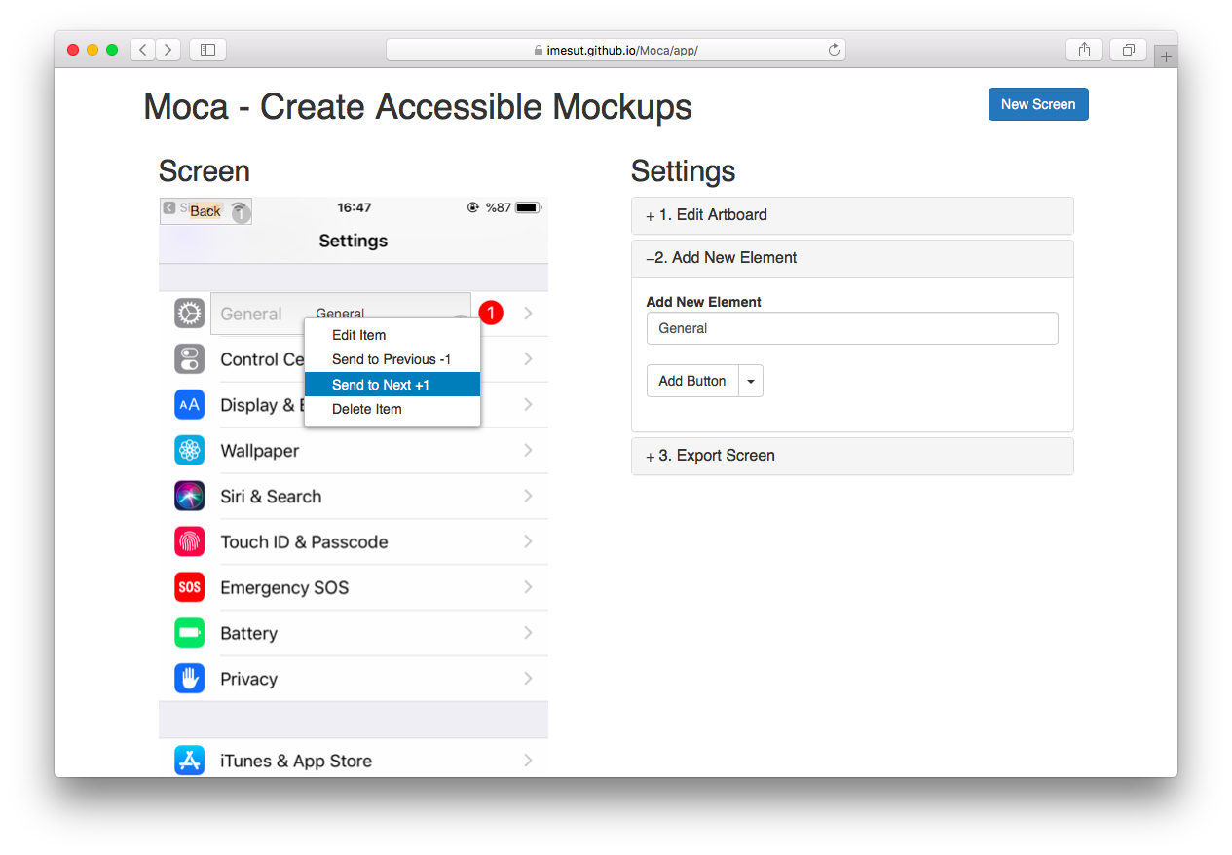
Step 5
Right click items to;
Edit item name and kind
Send to previous *
Send to next
delete
* It’s also important the order of elements for accessibility according to discoverability. Default order should be top from bottom, but it can be customized to make something easy for user.

Slide 8
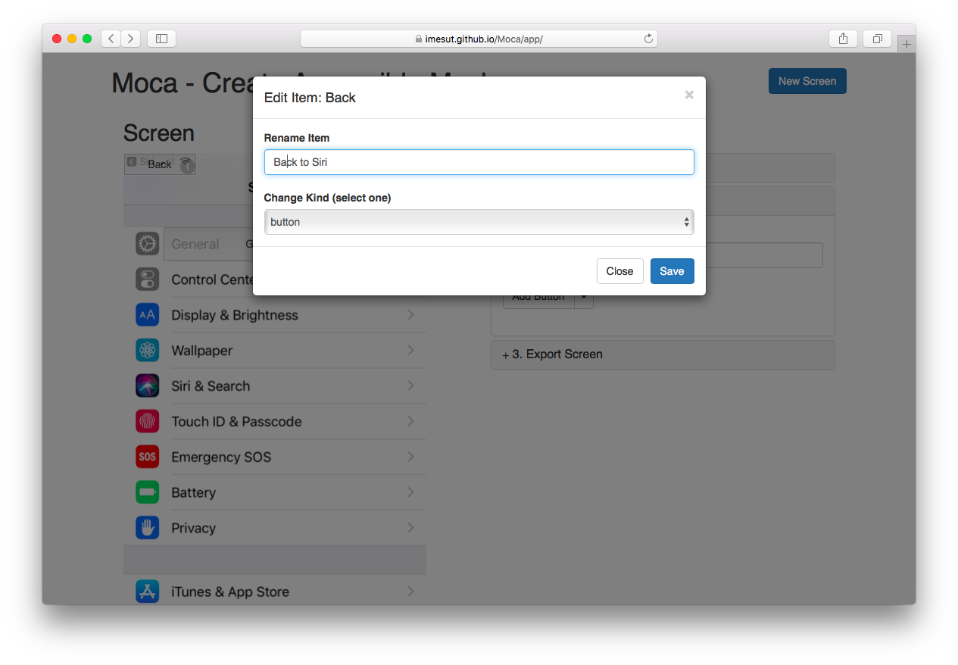
Step 5
Edit item modal

Slide 9
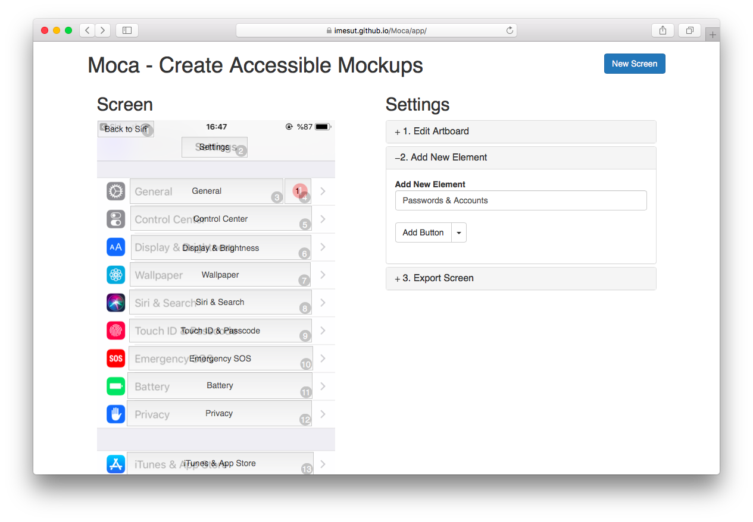
Step 6
Finish marking all elements in the screen

Slide 10
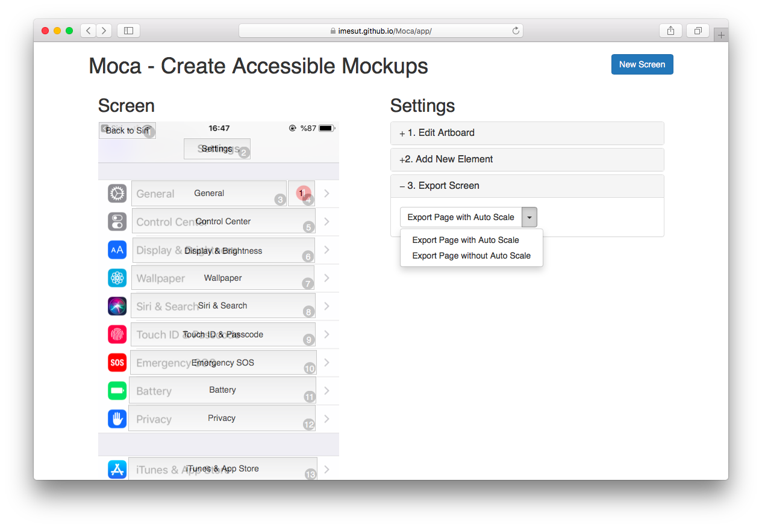
Step 7
Export screen as html page with or without auto scale feature
Auto scale, adjust sizes and positions of elements according to device width and height
Without auto scale feature, screen seem static.

Slide 11
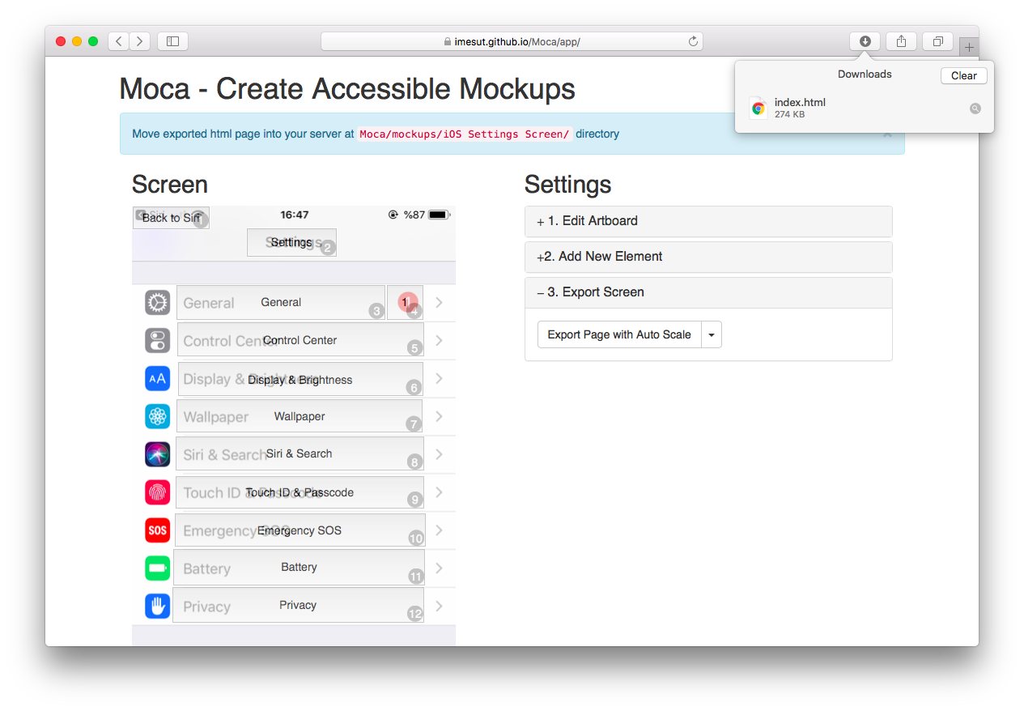
Step 8
Put html page offered or different directory
Give the page address to users

Slide 12
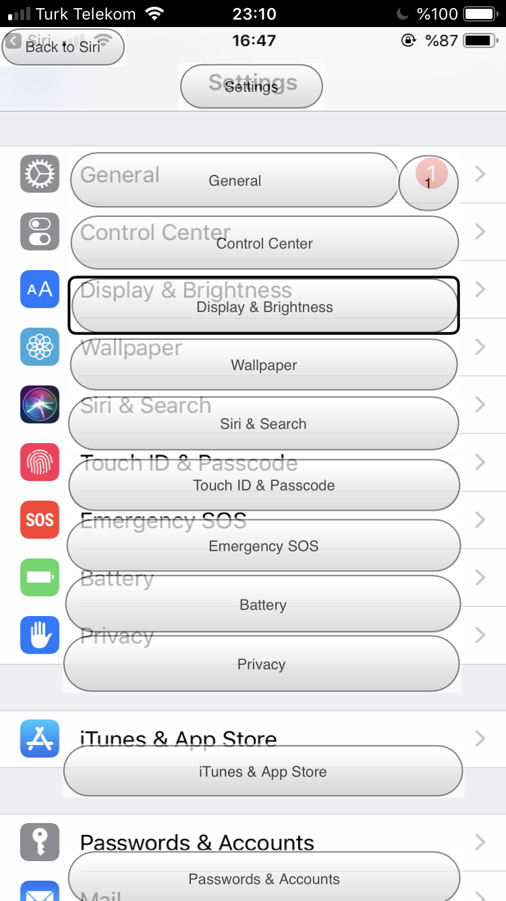
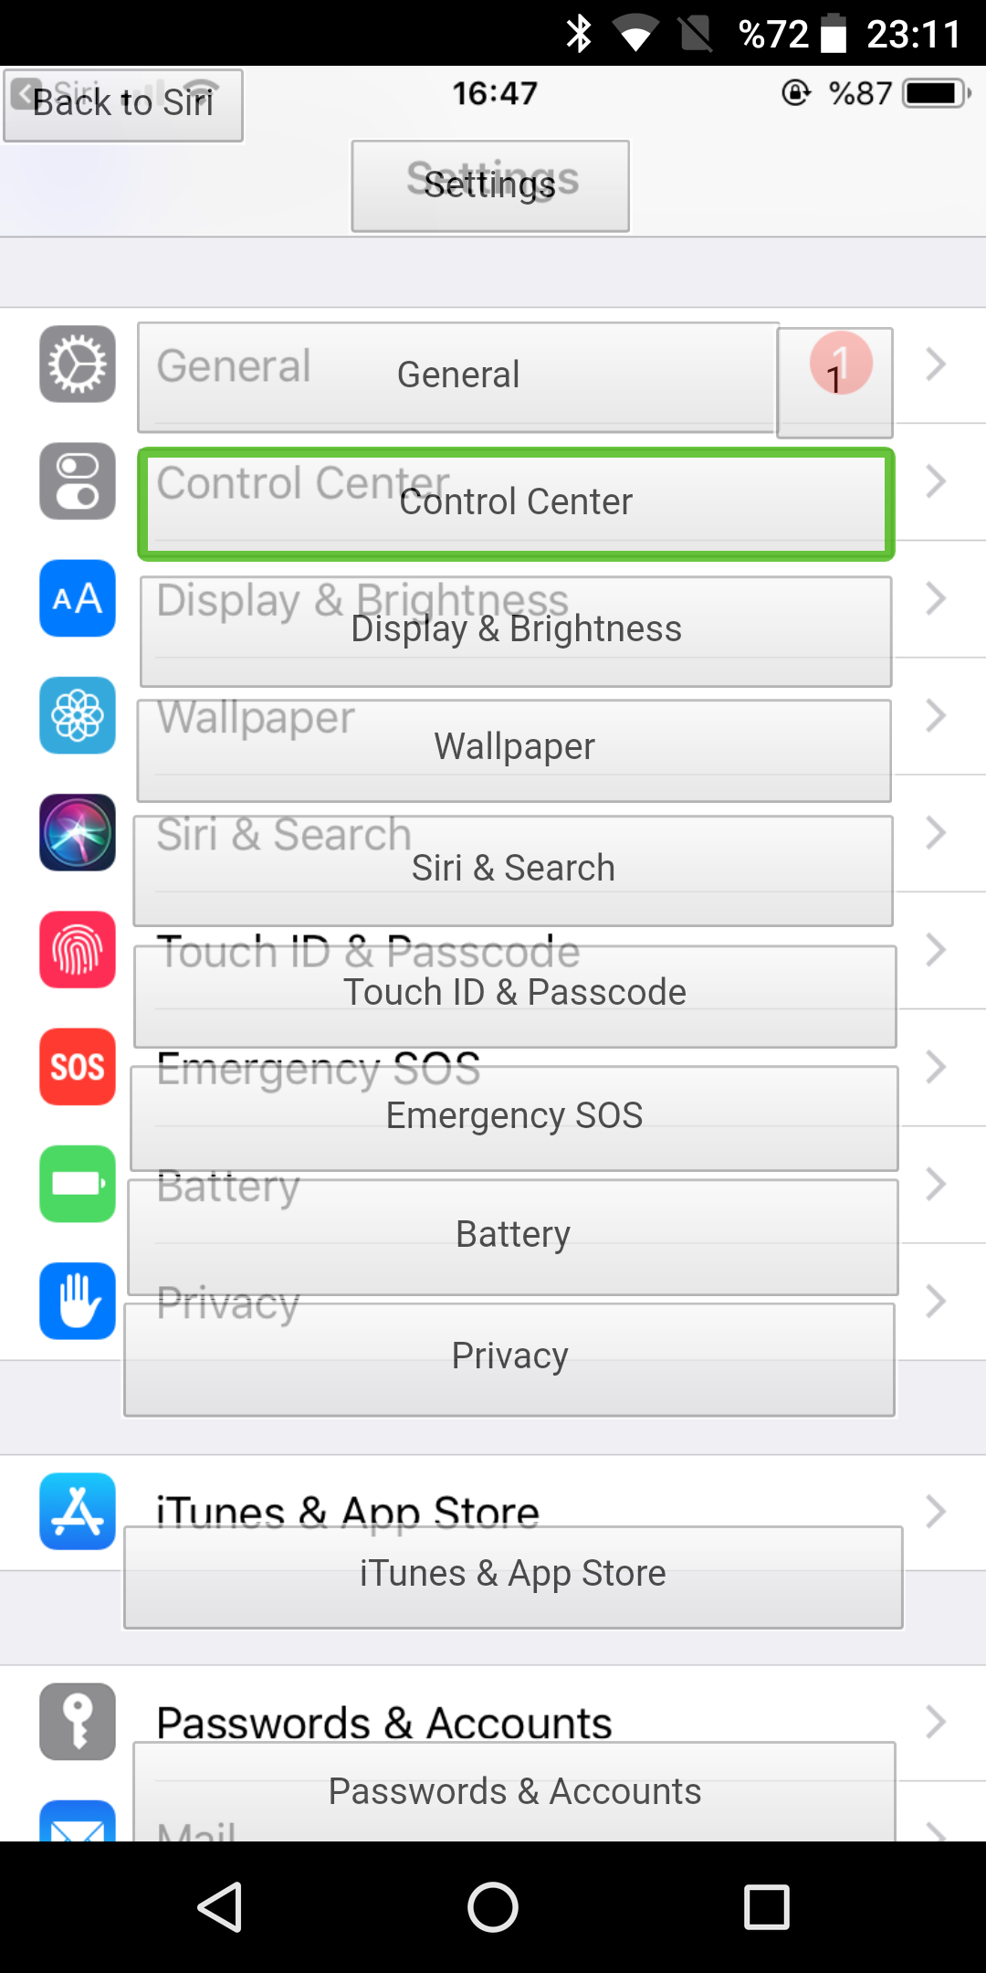
Step 9
Open page on browser or ADHS (add to home screen) *
Test and interview screen
General accessibility UX
Swipe left to right and right to left (Order of elements)
Drag over Screen **
iOS 4.7 inch
Android 5.65 inch
* ADHS makes easy to experience screen as full height than at browser. ** Select and speak each item as you touch it.

