Slide 1
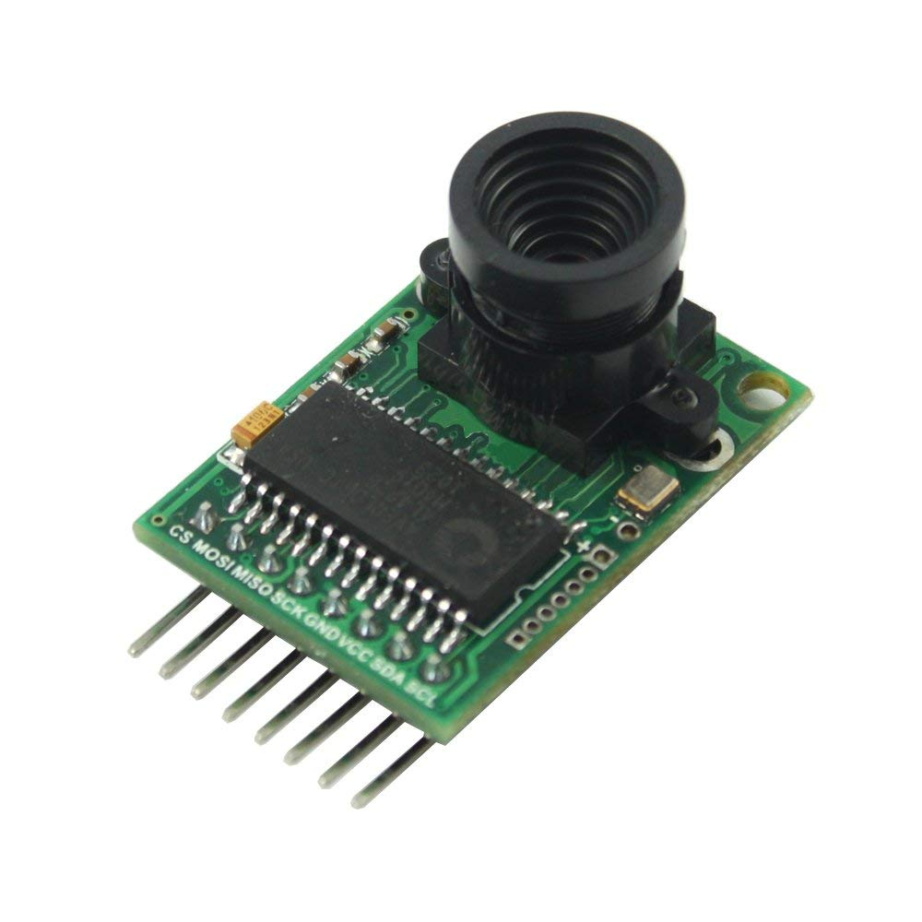

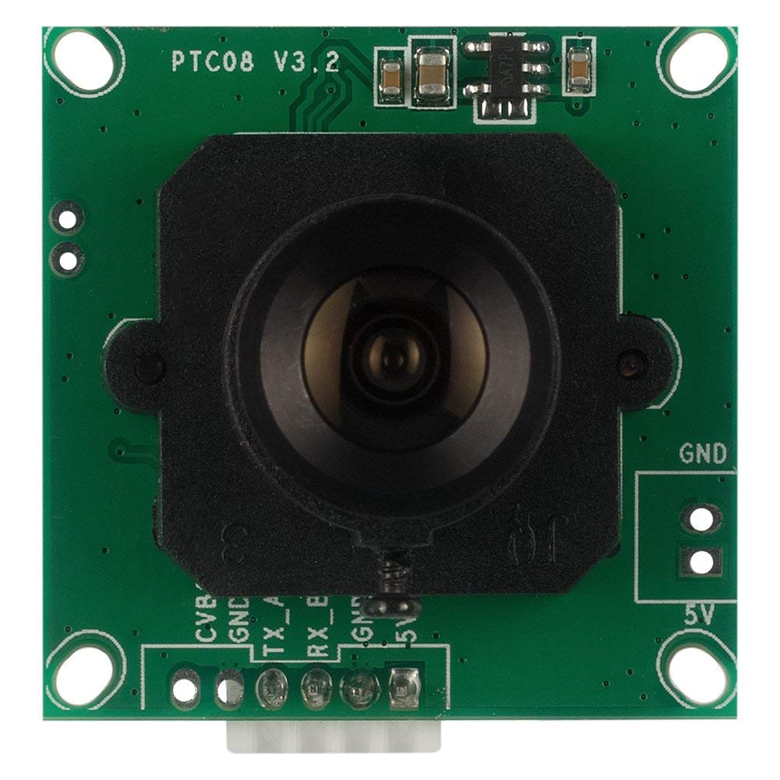
Camera module

Slide 2
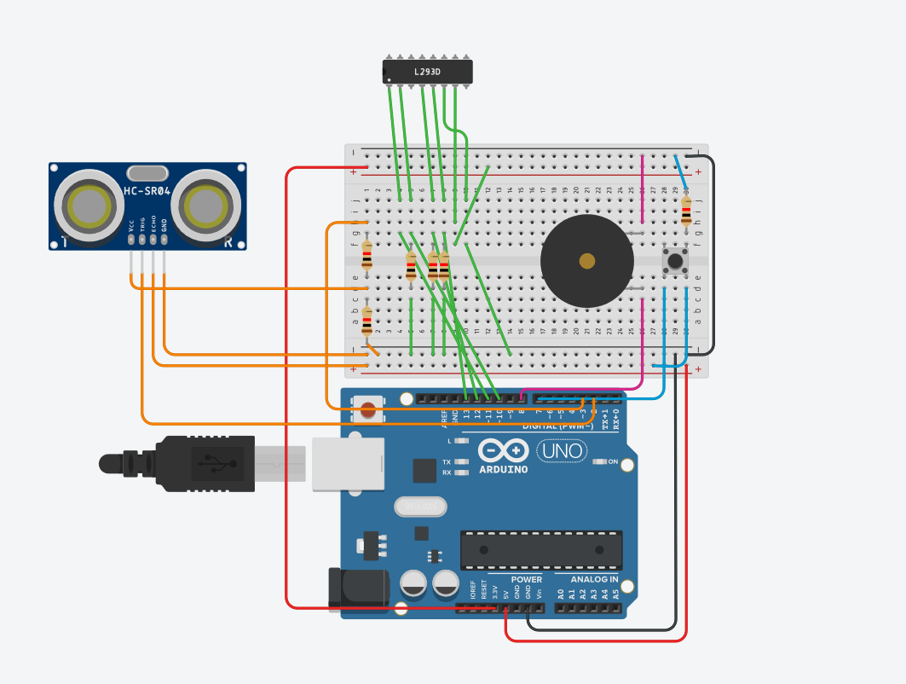
Simple Security System
SD Card Breakout Board
Camera Module

Slide 3

Videos

Slide 4
Basic Info About Camera Module
Serial Peripheral Interface (SPI)
Read File
Save image

Slide 5
Spinel 0.3MP Serial
JPEG Color Camera
ArduCam OV2640
VS

