Slide 1
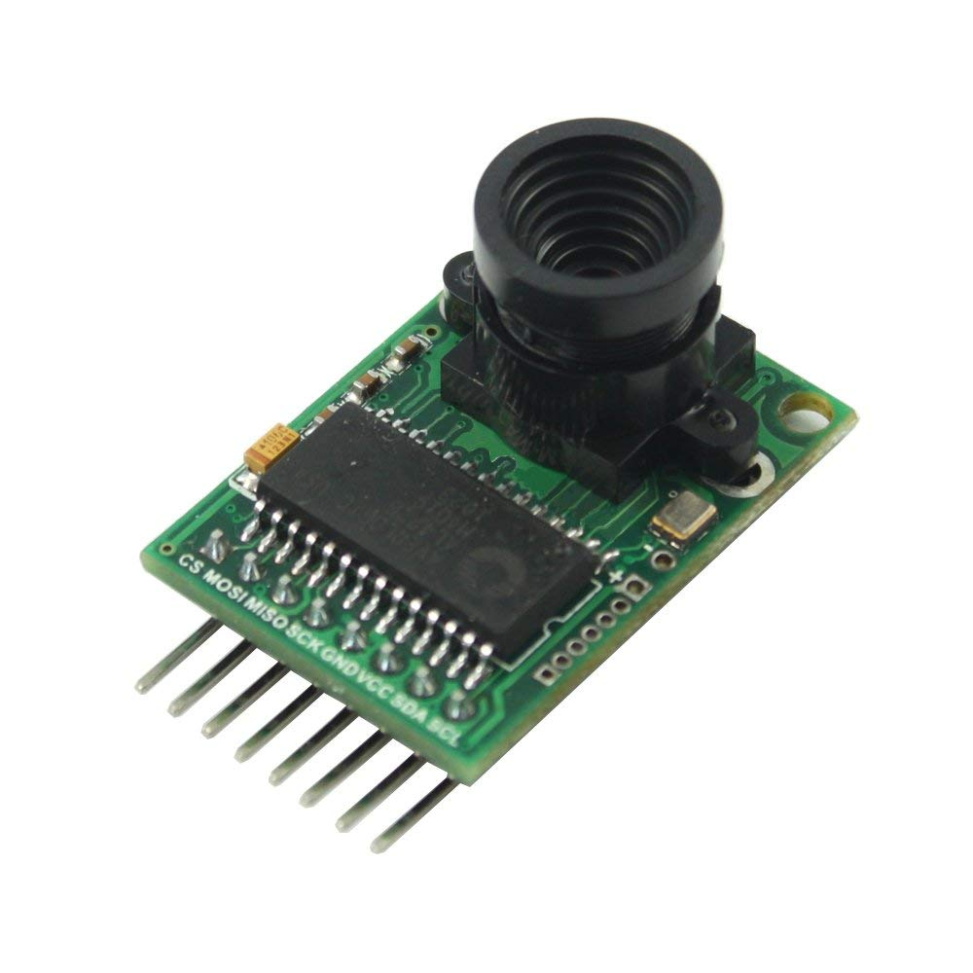

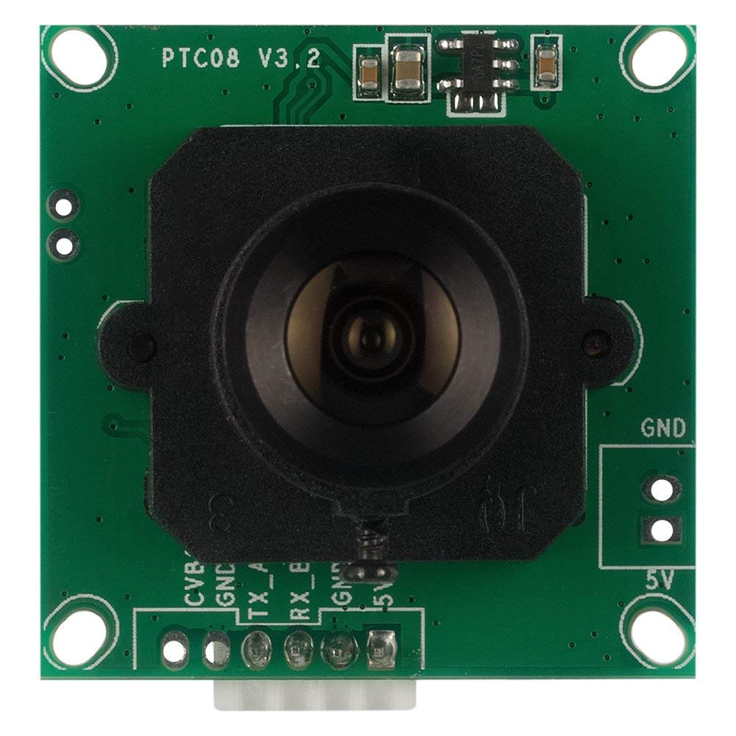
Camera module

Slide 2
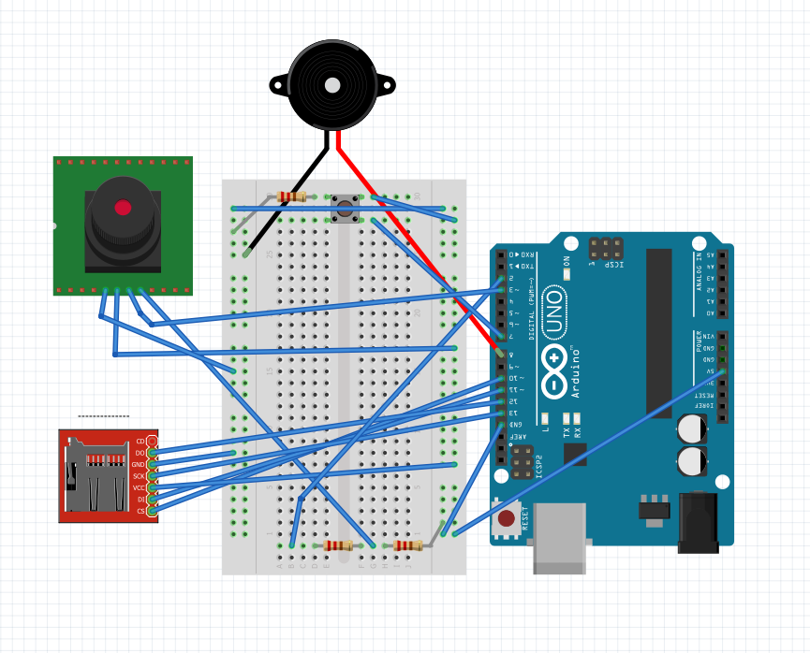
Simple Security System
Piezo Buzzer
Camera Module
SD Card Breakout Board

Slide 3

Videos
Arducam APP
JPEG in TXT File

Slide 4
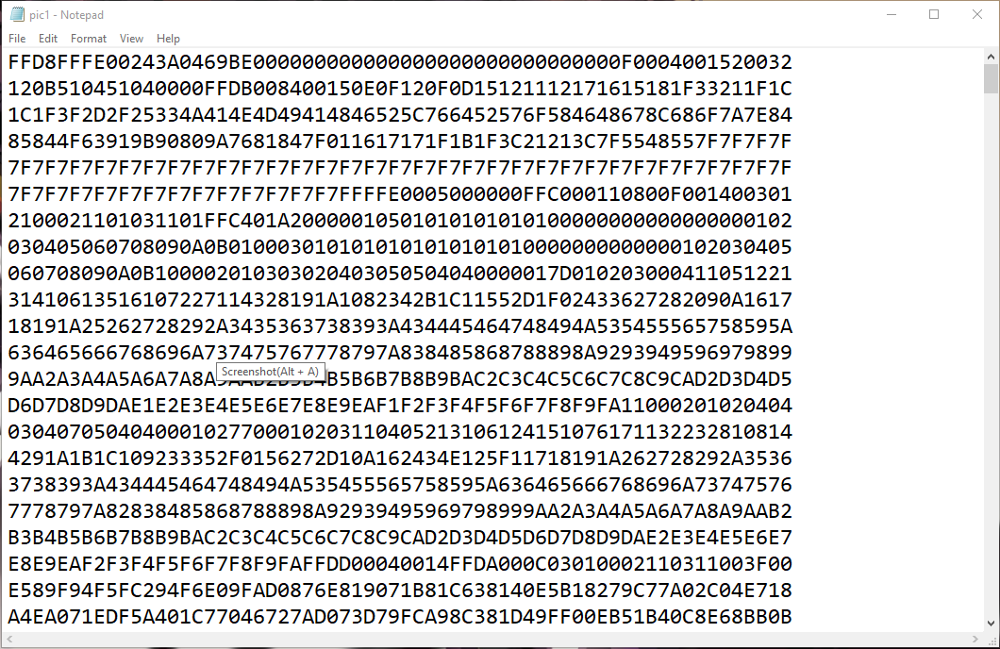

Slide 5
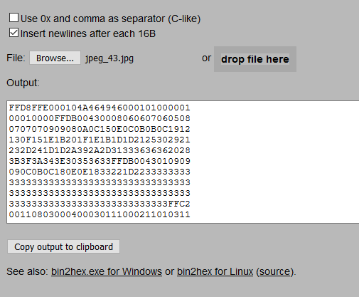


Slide 6
Spinel 0.3MP Serial
JPEG Color Camera
ArduCam OV2640
VS

Slide 7
Cost
Arduino Uno $22
SD Breakout Board $15
Spinel Camera $35
ArduCam $26
Total : $72 / $63

