Slide 1
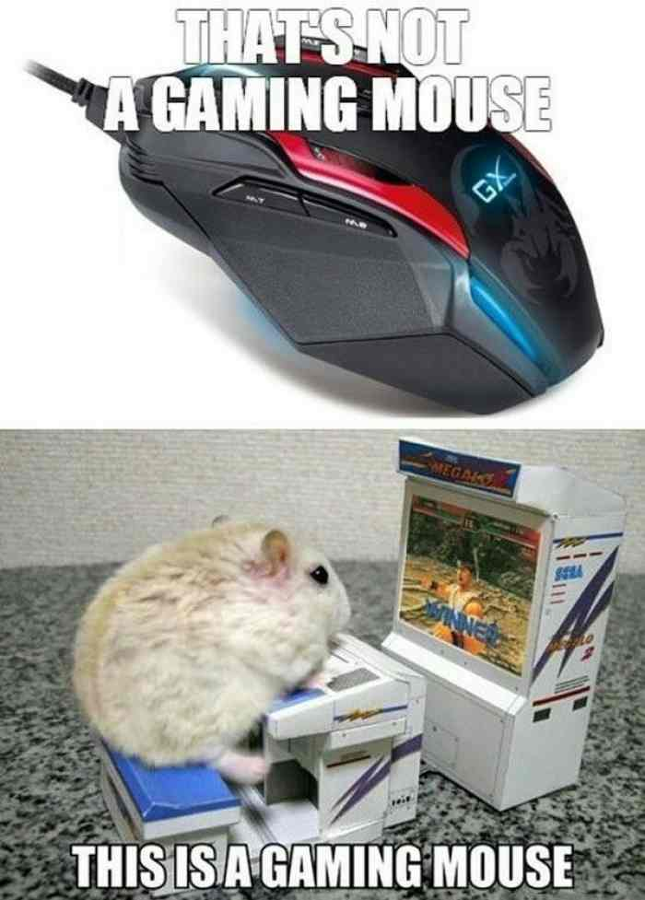
Embedded System in a Mouse

Slide 2
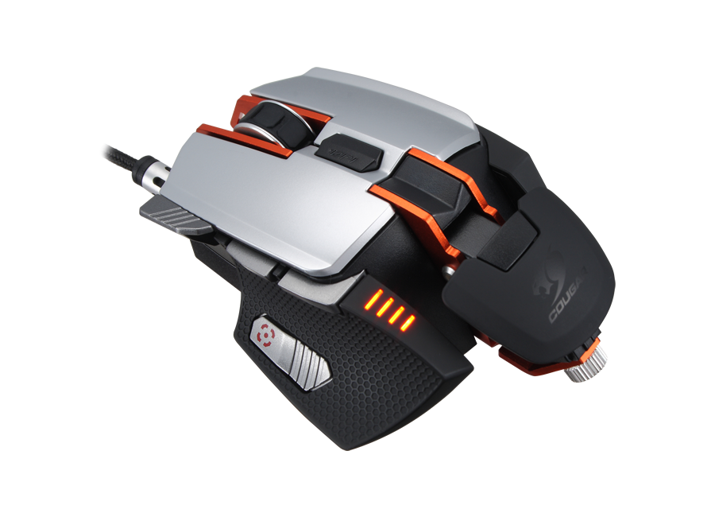
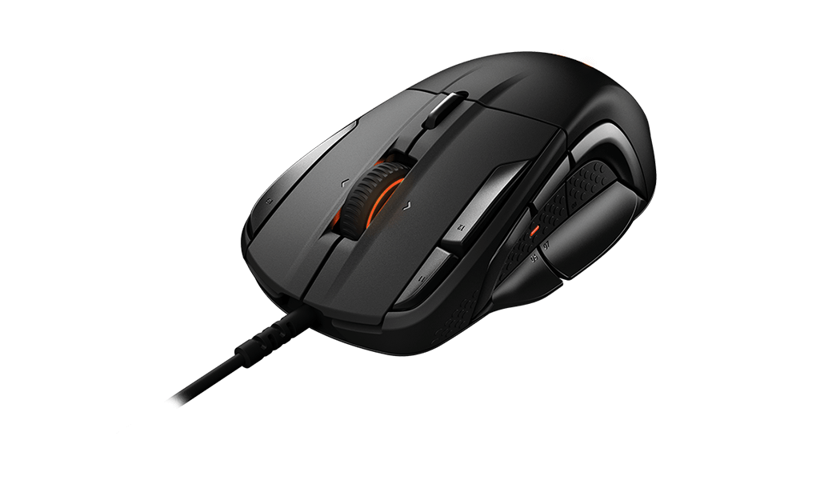
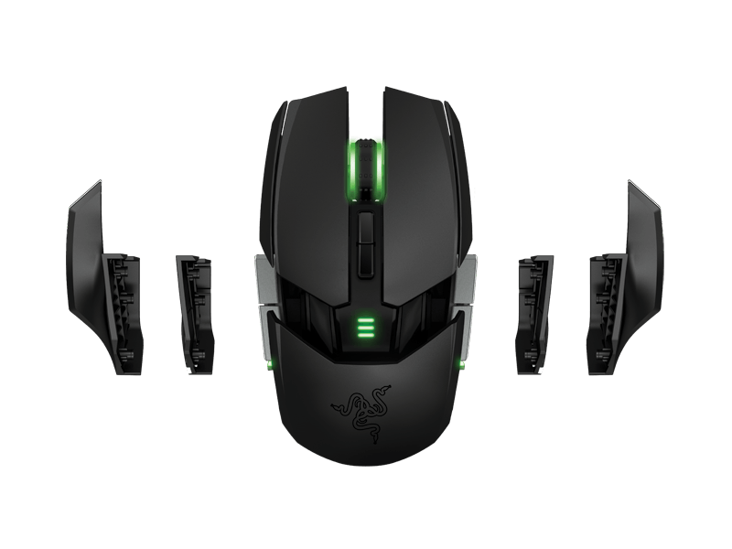
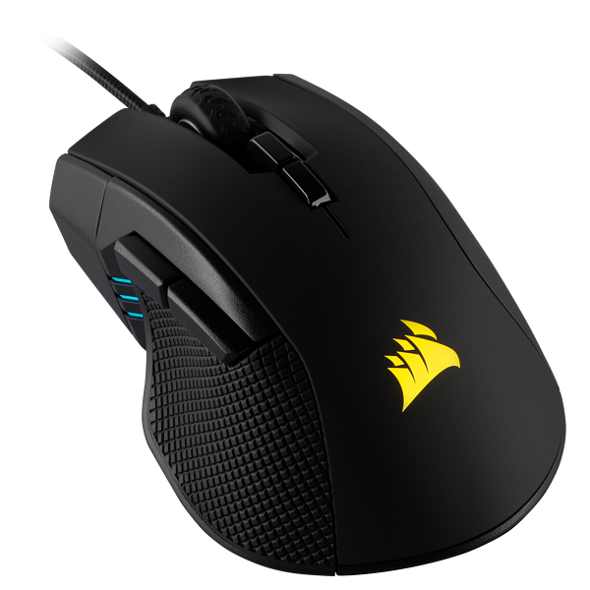
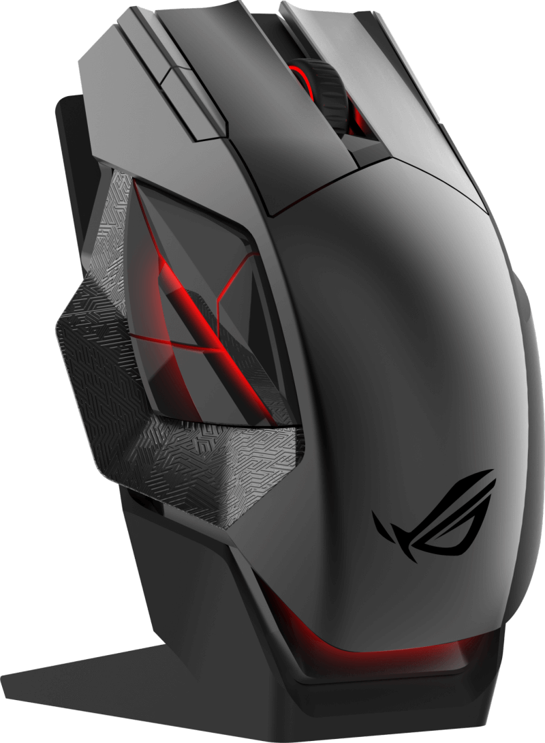

Slide 3
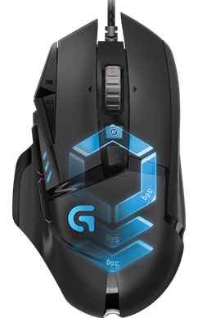
Logitech G502
Tracking
Sensor: PMW3366
Resolution: 200 – 12,000 DPI
Max. acceleration: > 40 G⁵
Max. speed: > 400 IPS⁶
Responsiveness
USB data format: 16 bits/axis
USB report rate: 1000 Hz (1ms)
Microprocessor: 32-bit ARM
Other features
Onboard memory: 3 profiles
LIGHTSYNC RGB: 1 zone
Braided cable
#1 Gaming Mouse for FPS

Slide 4
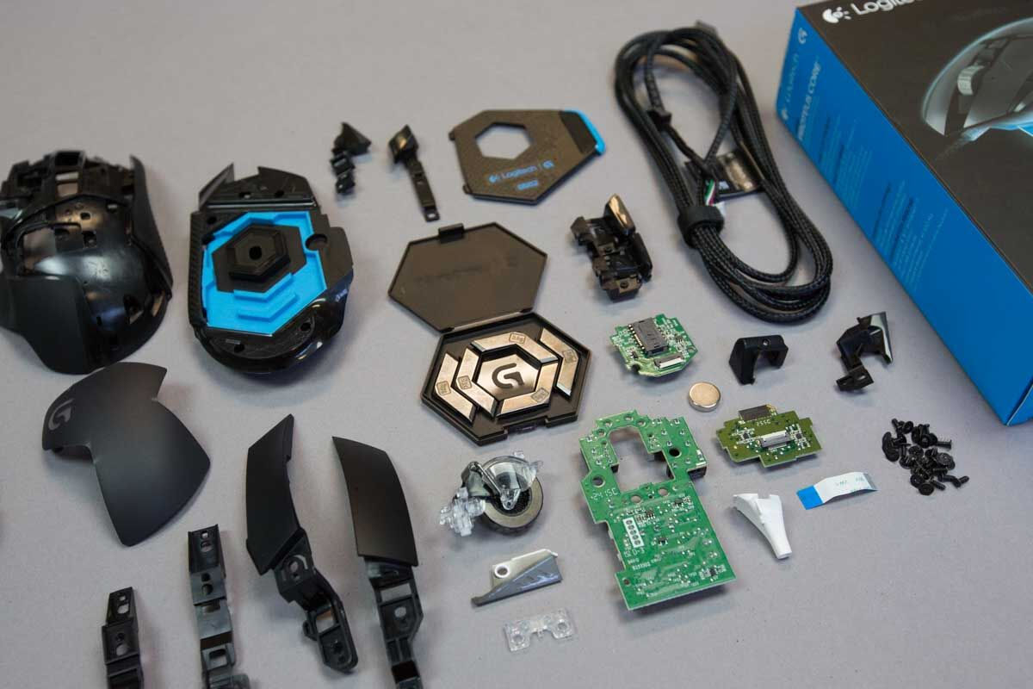
What’s inside?

Slide 5

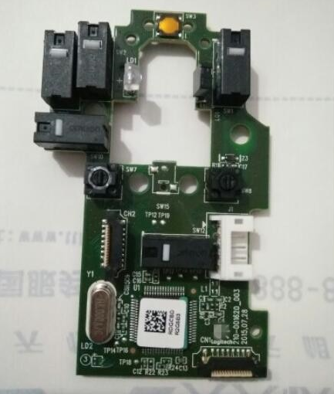
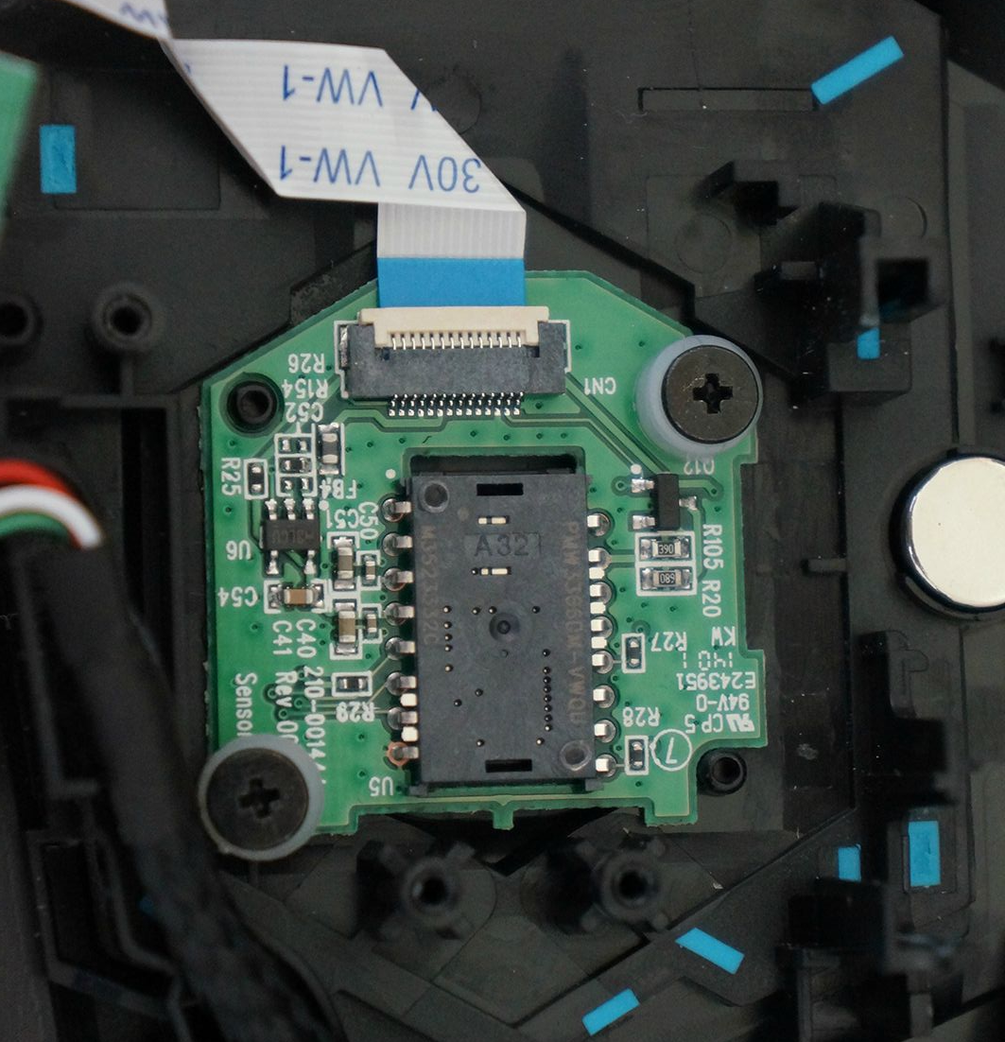
Mother Board
Optical Sensor

Slide 6
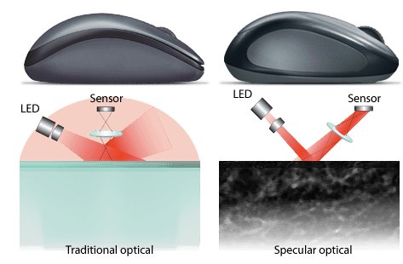
How does a Optical Sensor Function?

Slide 7
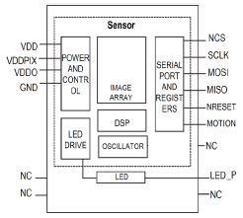
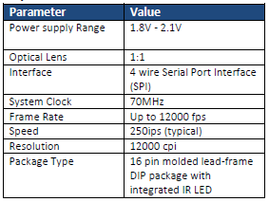
PMW3360DM-T2QU

