Slide 2
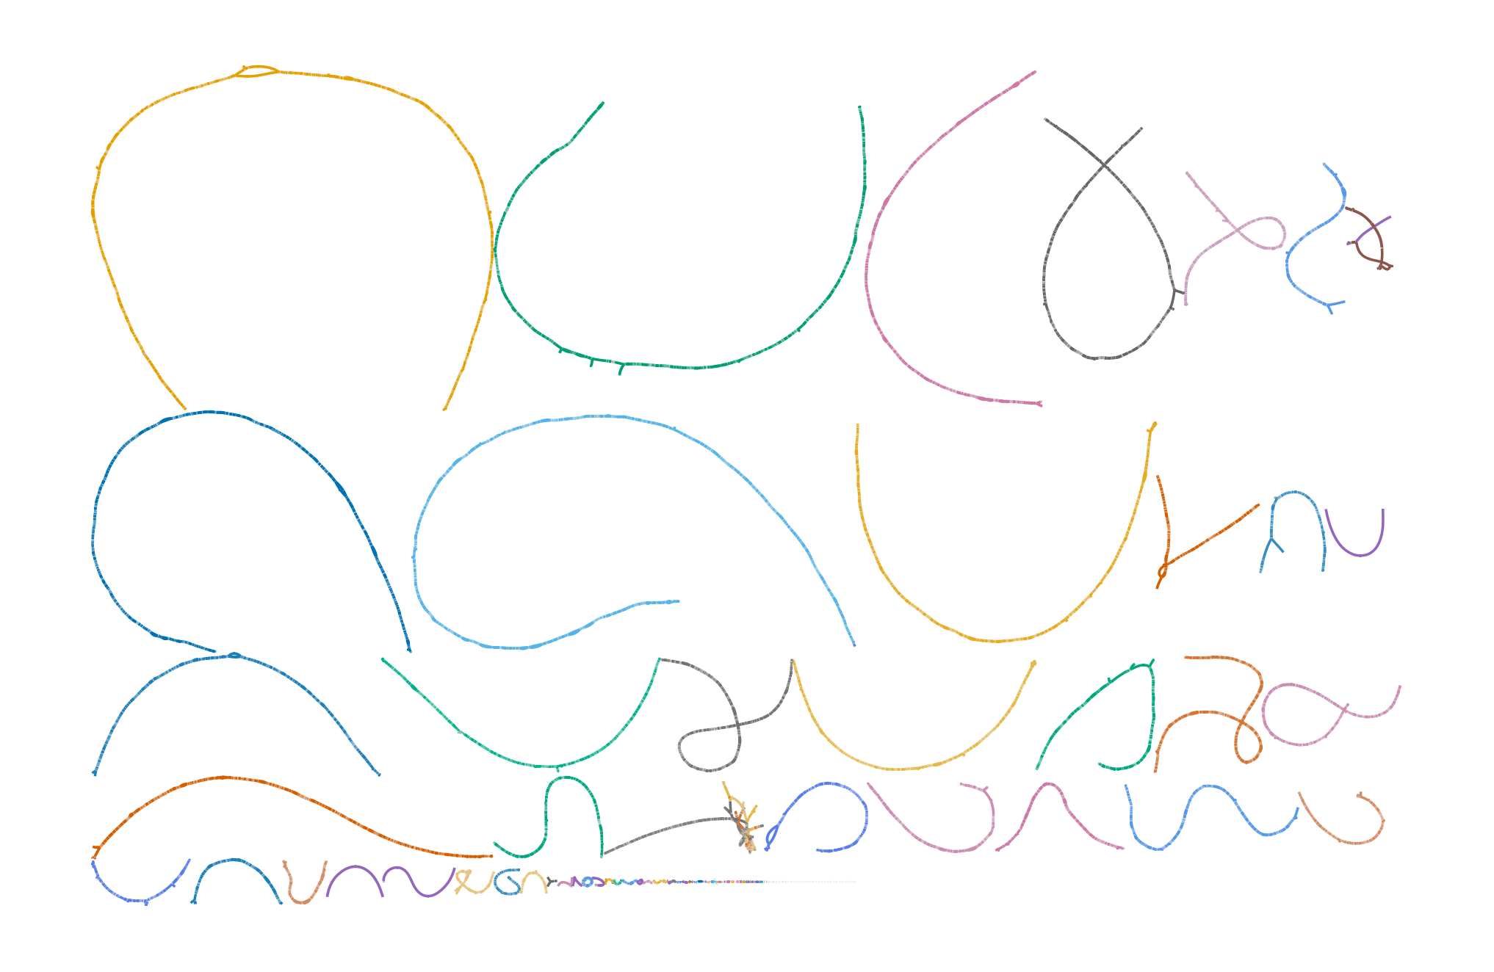
TUE_02_01UL

Slide 3
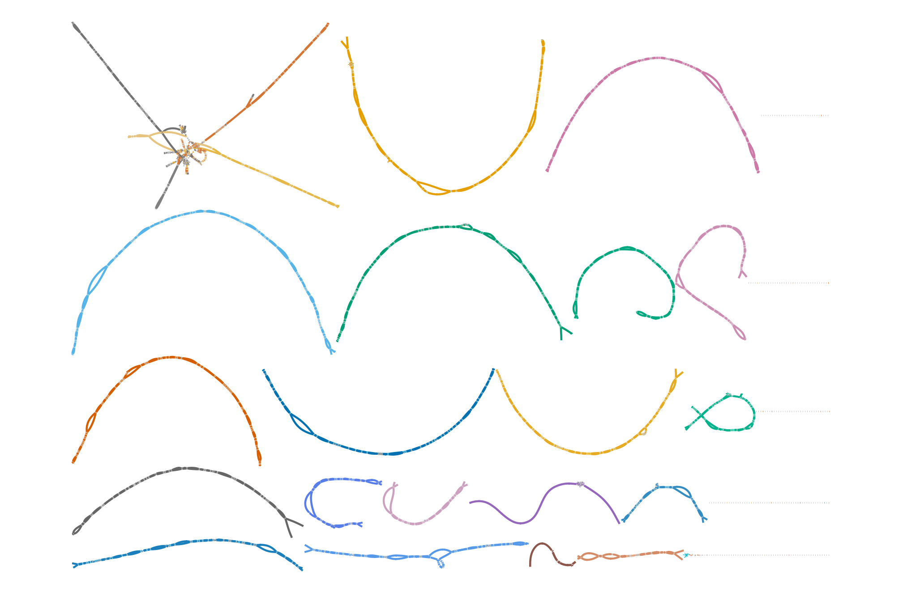
TUE_02_02UL

Slide 4
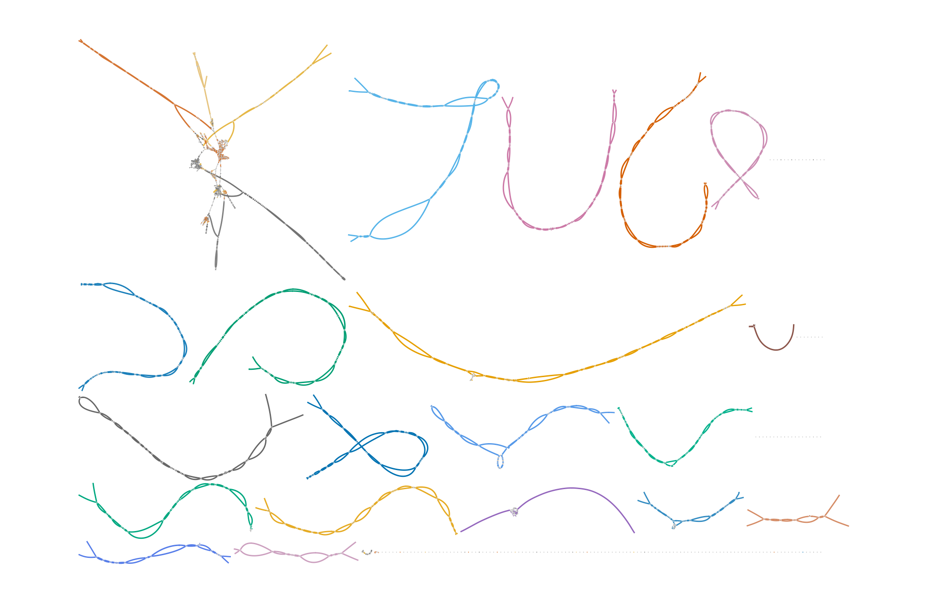
chr22
chr13
chr15
chr2
chr11
chr4
chr6
chr14
chr3
chr12
chr1
chrY
chr5
chr9
chr17
chr7
chr10
chrX
chr19
chr20
chr8
chr16
chr18
TUE_02_03UL

Slide 5
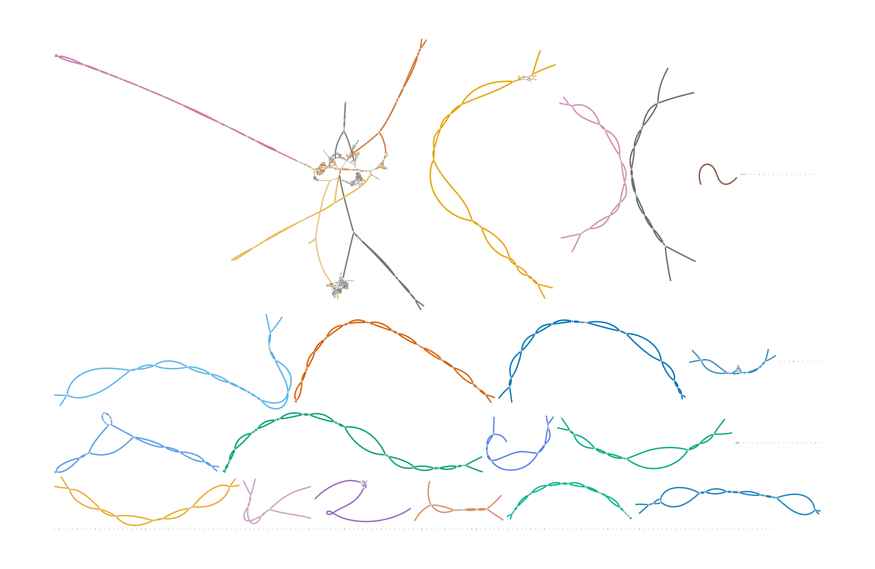
TUE_02_04UL

Slide 6
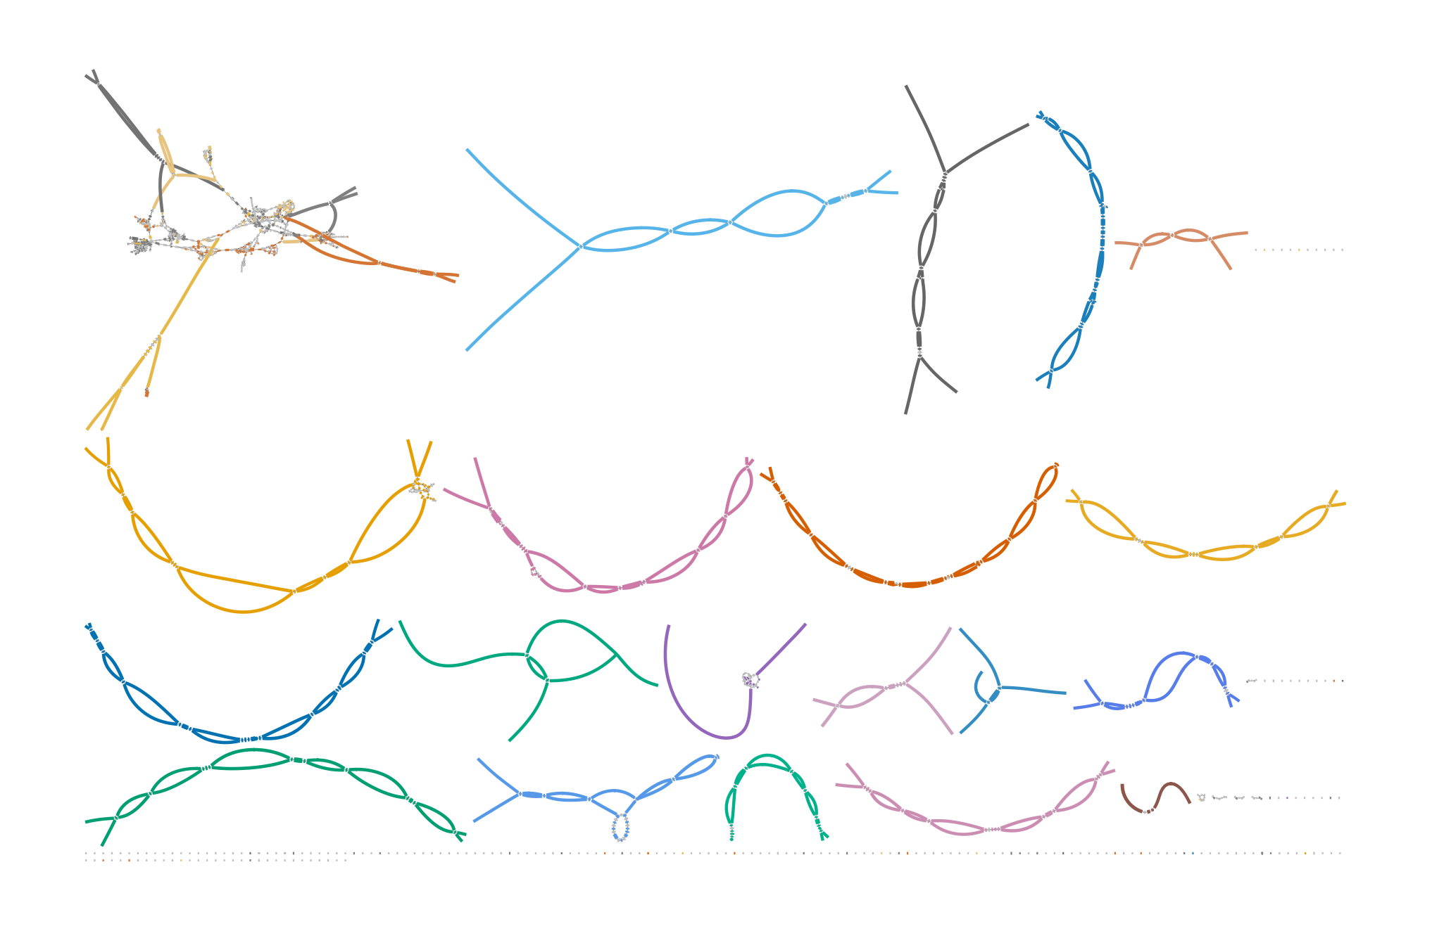
TUE_02_05UL

Slide 7
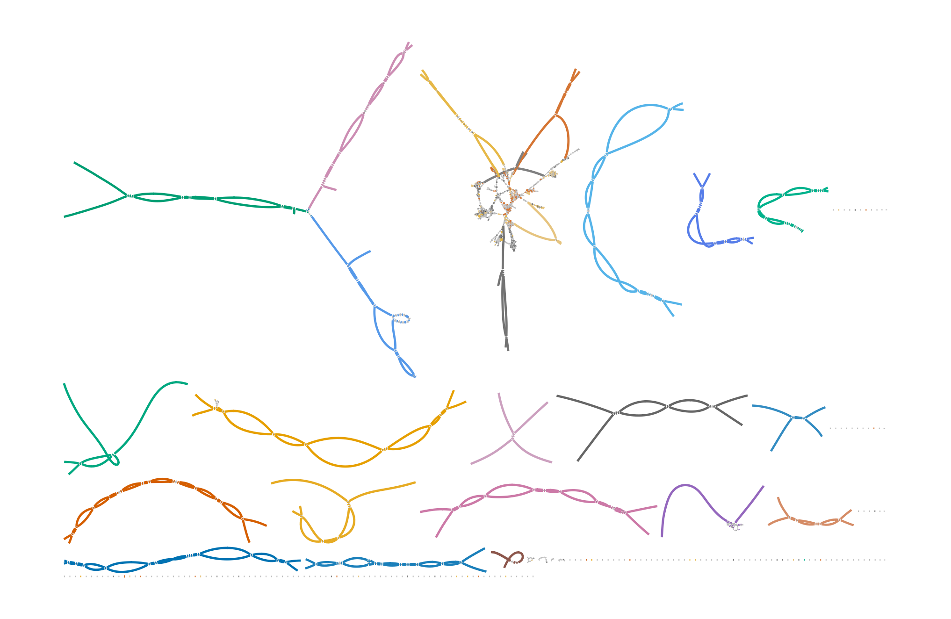
TUE_02_06UL

