Slide 1
Nanopore only T2T Assemblies
ESHG 2025, Milano Caspar Gross

Slide 2
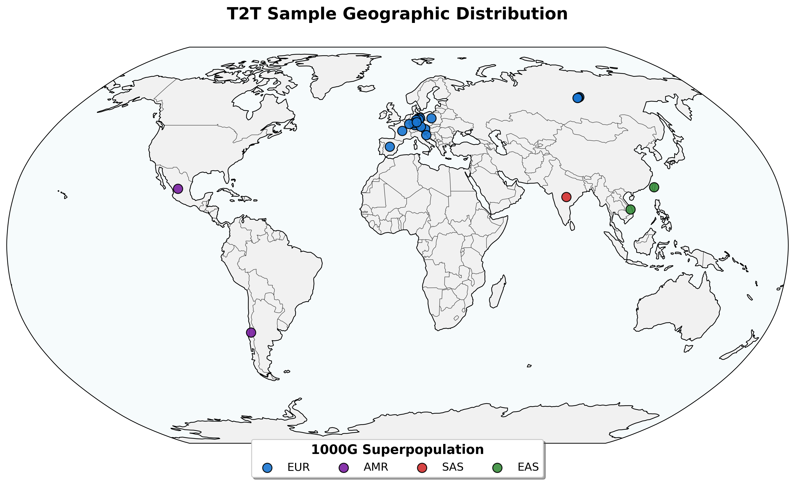

T2T Assemblies as part of Genomes of Europe
28 Institutes from Europe Sequencing goal: 500 000 genomes
At Tübingen University Hospital :
Planned 20 000 genomes
Twin Study (n = 400 pairs) WGS-LR
23 T2T Genomes
T2T genomes sampled mainly from institute members, aiming for broad ethnic background.

Slide 3

Different flavours of ONT sequencing data
High quality (HQ) Accurate sequences
Ultra Long (UL)
Span difficult regions
Pore-C
High order DNA structure
Assembly Polishing Kit
Improve base level accuracy

Slide 4
HQ Data generated from ONT reads
Looking for High accuracy reads >Q30, equivalent to PacBio Hifi
Old approach (2 years ago): Duplex
New approach: HERRO Error Correction
Benefits:
Sequence only once (~80% conversion)
Implemented in Dorado
Very long
Dorado Correct is a two step approach:
Overlap mapping (minimap2)
Inference CNN + TransformerEncoder
Runtime
Mapping: 6-28h @ 60 CPU Threads
Inference: 6-24h @ 2xH100 GPU

Slide 5
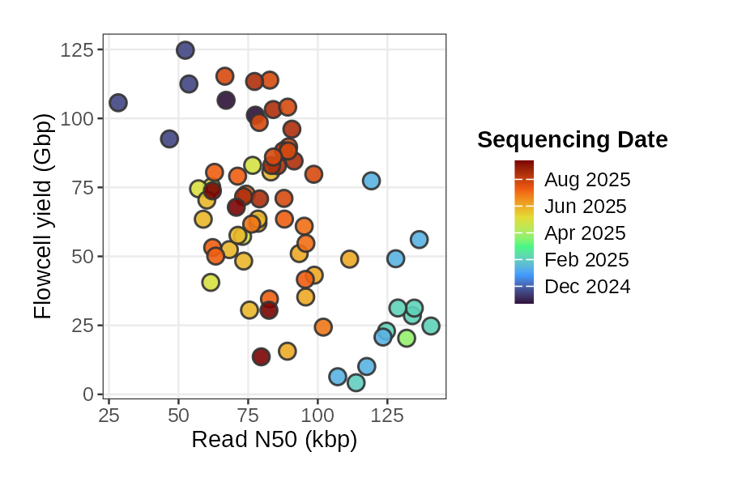
Ultralong ONT Sequencing
Ultra High Molecular Weight (UHMW) Extraction from fresh EDTA blood.
Tradeoff between N50 and Yield
Challenging handling in Lab
SUP Basecalling

Slide 6
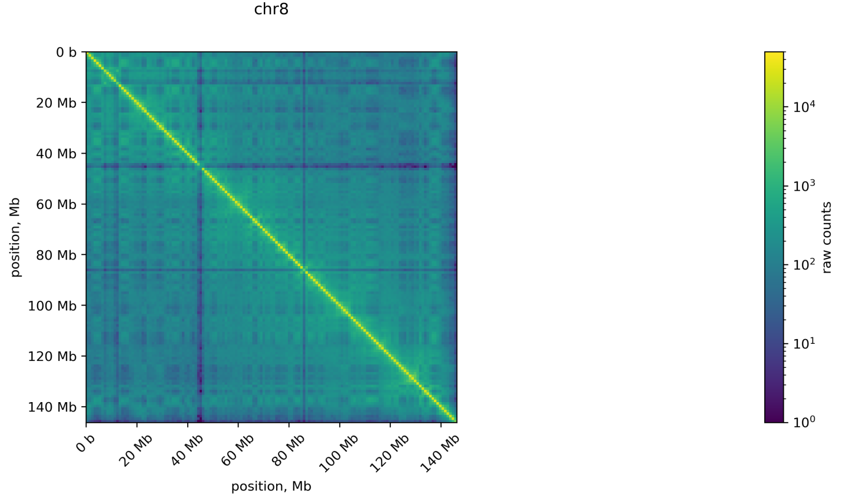
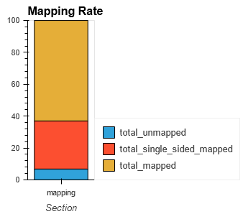
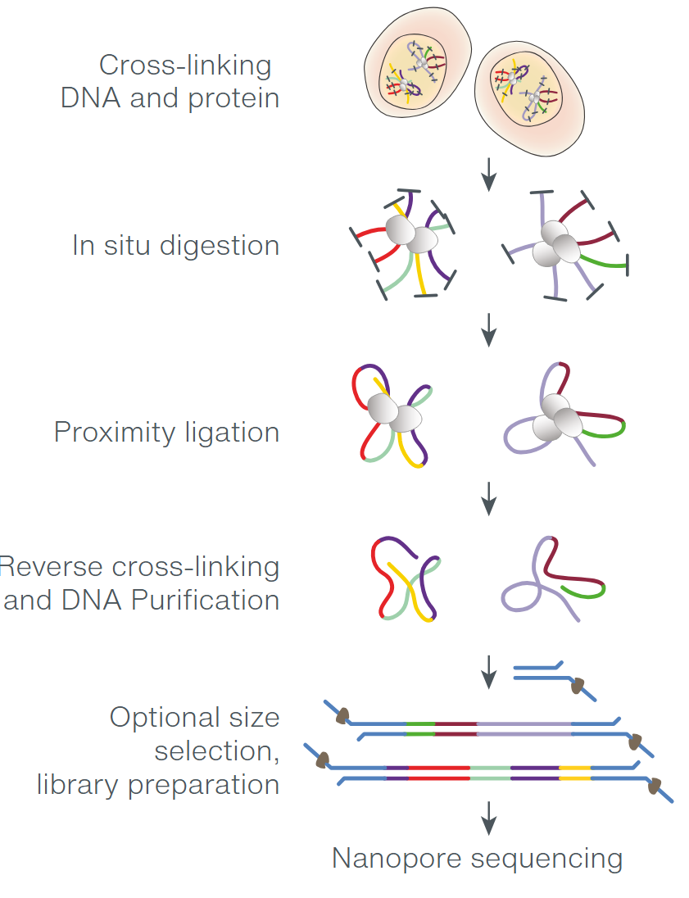
Pore-C sequencing
Chromatin Conformation Capture, equivalent Hi-C
3 Day protocol for cross-linking
"Standard" LSK library prep and sequencing
7ml EDTA Blood
SUP basecalling
https://nanoporetech.com/sites/default/files/s3/literature/plant-pore-c-workflow.pdf
Notes:
How does Pore-C work?
Chromatin is crosslinked in cells to preserve 3D structure.
DNA is fragmented and proximity-ligated, joining together DNA segments that are spatially close in the nucleus.
The resulting chimeric DNA molecules (containing multiple genomic fragments) are sequenced using Oxford Nanopore’s long-read technology.
Each read can contain information about multiple interacting genomic loci, providing high-resolution insight into chromatin organization.

Slide 7
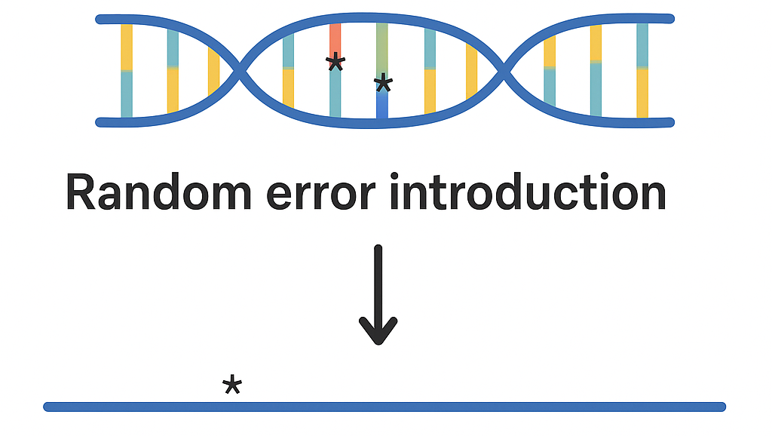
APK sequencing
Basic Idea:
1) Introduce random errors during Library Prep. Break up homopolymer stretches. 2) Normal sequencing 3) Align to assembly 4) Use special polishing model to get rid of random errors and improve homopolymers in assembly
Lab:
~5ug DNA as starting material
2-3 day process
Does not require UHMW DNA
APK Kit from ONT
*
TCTGGGGAGGGGTCTTGGAGTCGGTTG

Slide 8
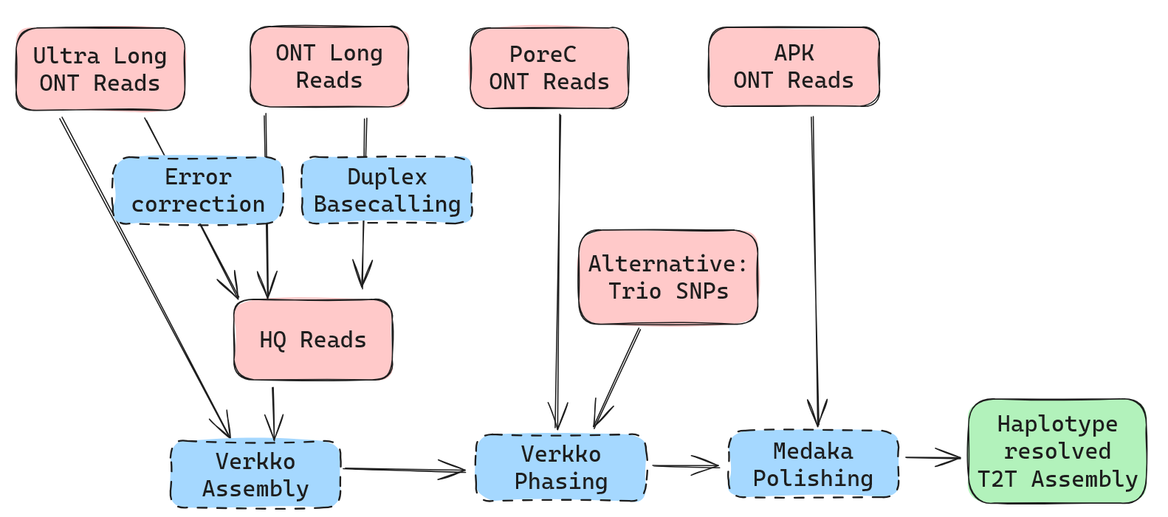
Analysis pipeline

Slide 9
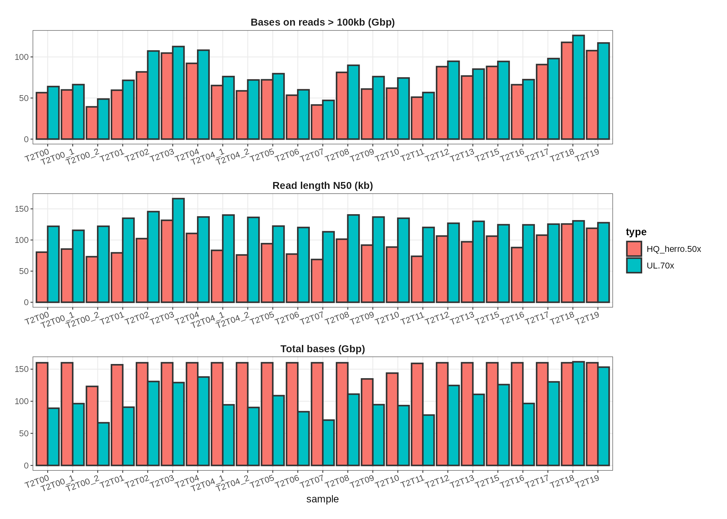
Read QC
No improvements with very high input coverages
2 Library Preps: enough DNA for 14 Loadings on 3 Flowcells
HQ:
Max 50x coverage
>Q9
Length priority in sampling
UL:
Max 70x coverage
> Q9
>80kb Length

Slide 10
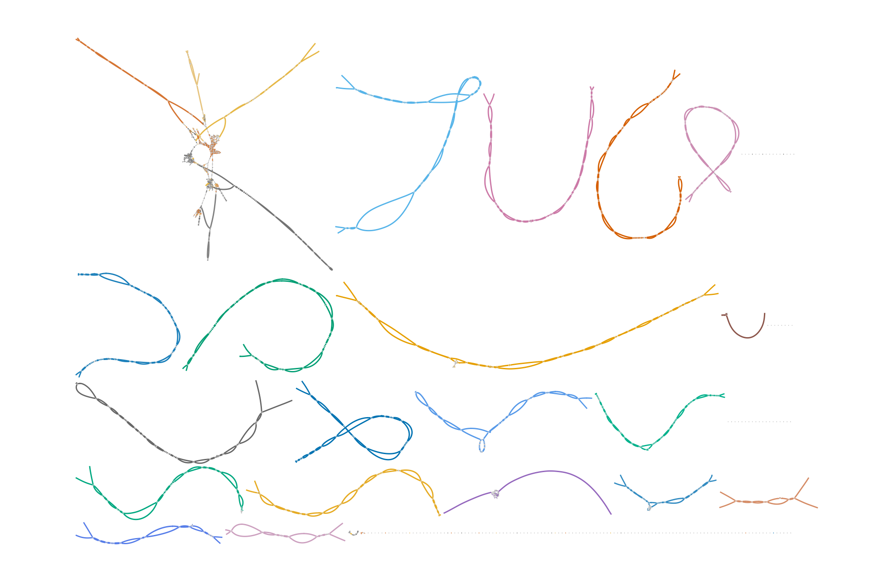
Assembly graph visualisation
GE-MED-T2T00
Generated with HQ + UL
Primary assembly, unphased, not scaffolded
Acrocentric chromosomes cluster at repetitive sequences
Sex chromosomes only single stranded (haploid)
Mapping to CHM13 reveals chromosome names
chr22
chr13
chr15
chr2
chr11
chr14
chr4
chr6
chr21
chr3
chr12
chr1
chrY
chr5
chr9
chr17
chr7
chr10
chr8
chrX
chr19
chr20
chr16
chr18

Slide 11
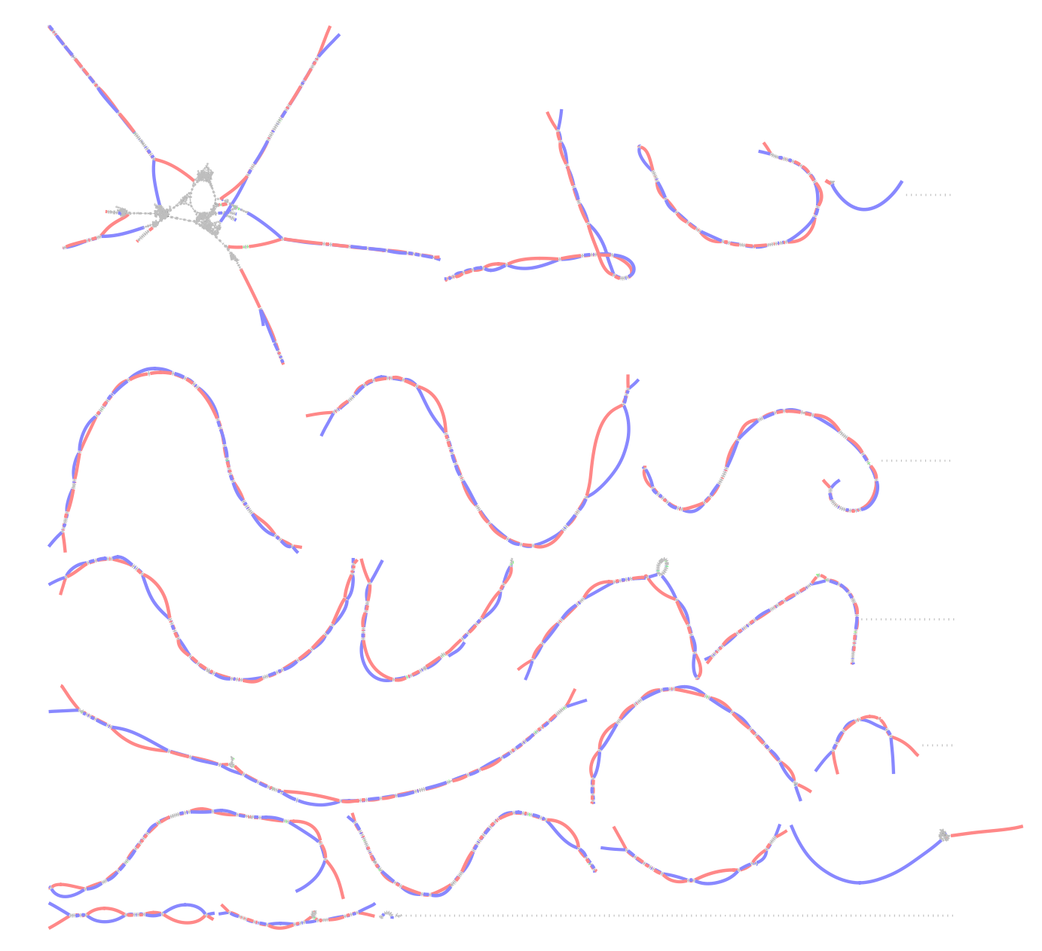
Assembly graph visualisation: Phased
Haplotype1: Red Haplotype2: Blue
Phasing selects separate paths through the graph for each haplotype
Using Pore-C or Trio information.

Slide 12
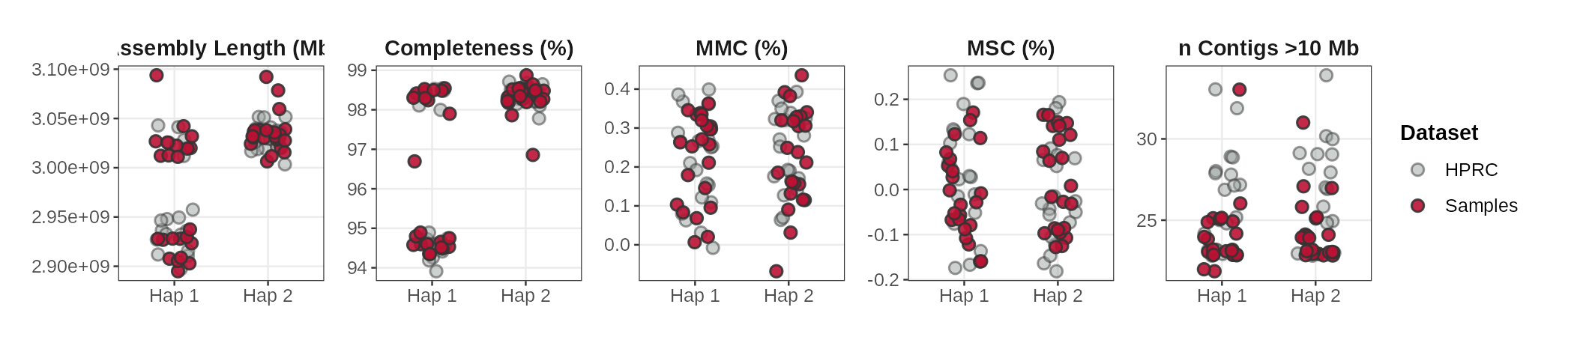
Assembly QC
On every metric at comparable with HPRC samples

Slide 13
Base Accuracy
Commonly referred as QV (Phred score)
Calculated using k-mer comparison (Merqury) with Illumina short reads
Polishing with Medaka and 1 APK Flowcells
Runtime: 2days (60threads, 2xH100 GPU)
Sample | QV | QV polished | Kmer ref used
T2T00 | 63.83 | 50.9 | Illumina reads
→ In our case: Polishing with APK reduces QV
→ Illumina seq for verification of other samples is ongoing

Slide 14
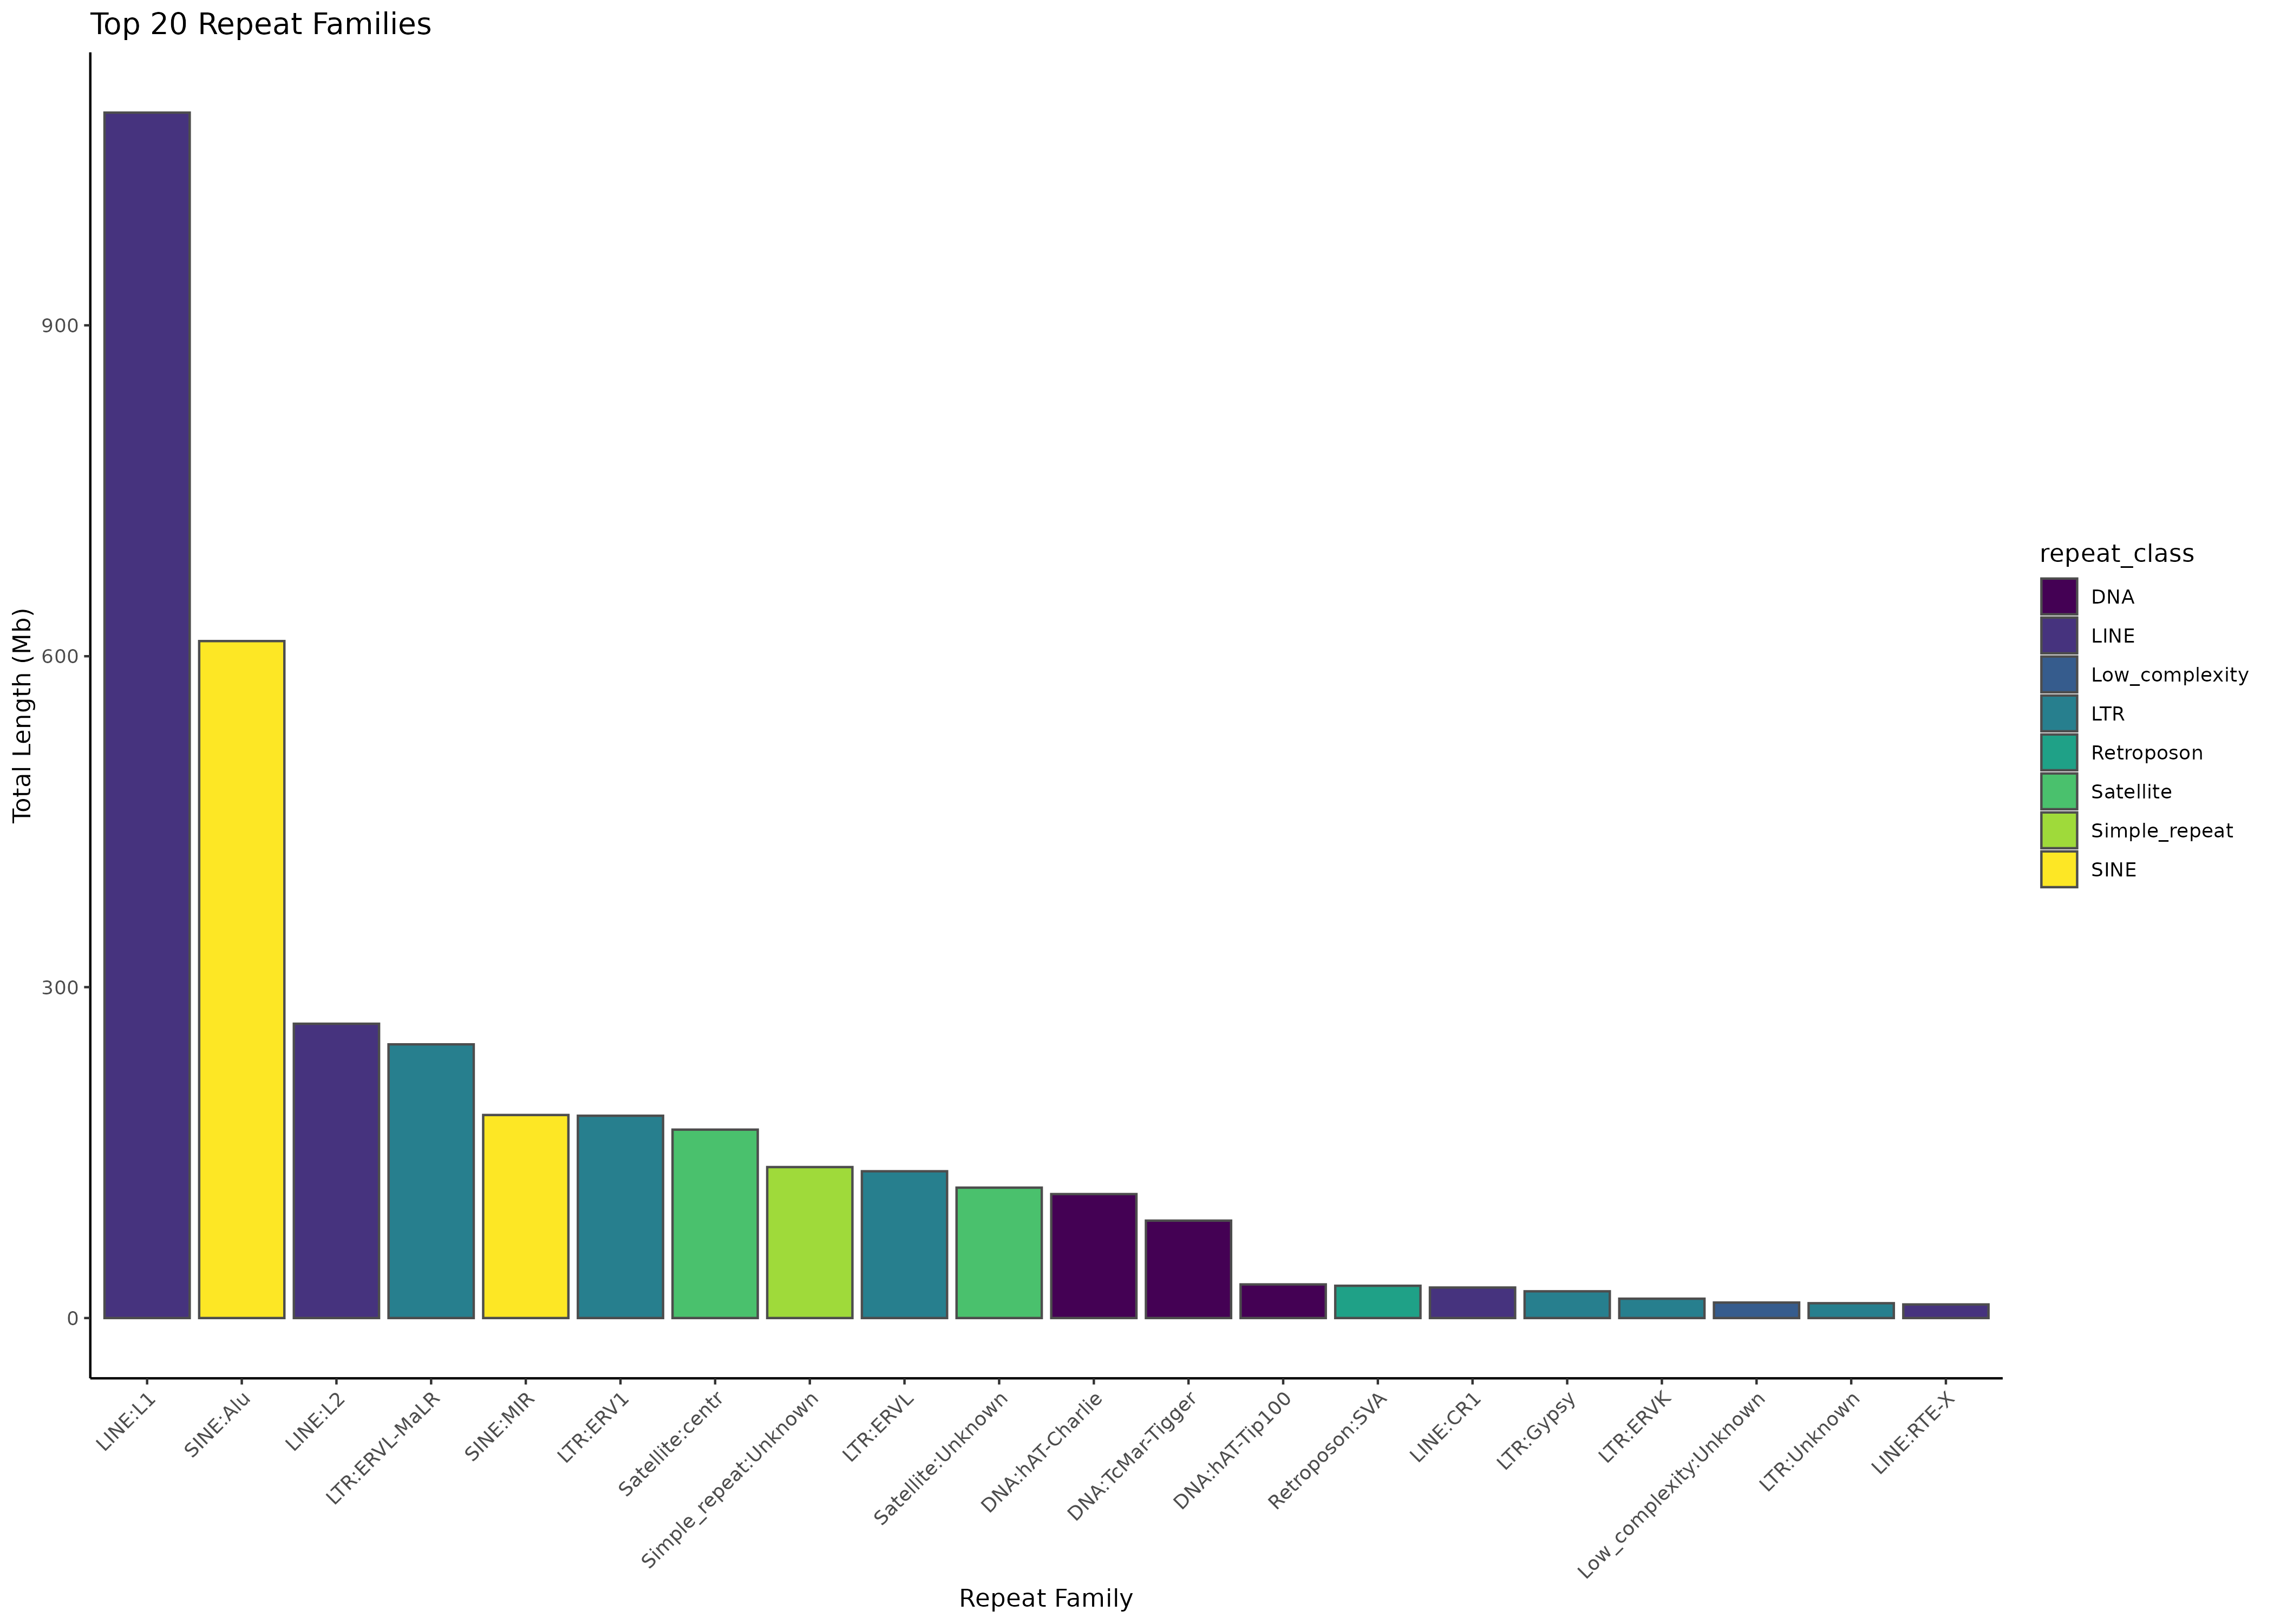
Repeatmasker analysis of assembled genomes
Required for in depth QC
Computationally expensive (1 week)

Slide 15
> For an assembly to be truly T2T, it must both cover the whole of each chromosome without gaps and be free from large-scale assembly errors. It is critical to rigorously assess the quality of the assembly before concluding it is T2T.
Li and Durbin, 2024. “Genome Assembly in the Telomere-to-Telomere Era.” Nature Reviews Genetics

Slide 16
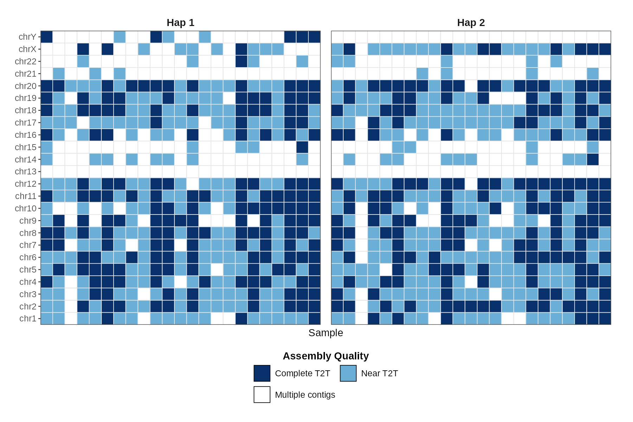
Real T2T chromosomes
Near T2T:
Single contig per chromosom
Has telomer motif on both ends
At least 95% of the contig AND at least 95% of the chromosome must participate in a single chained alignment
Complete T2T:
Near T2T
No Gaps (NNNNN)

Slide 17
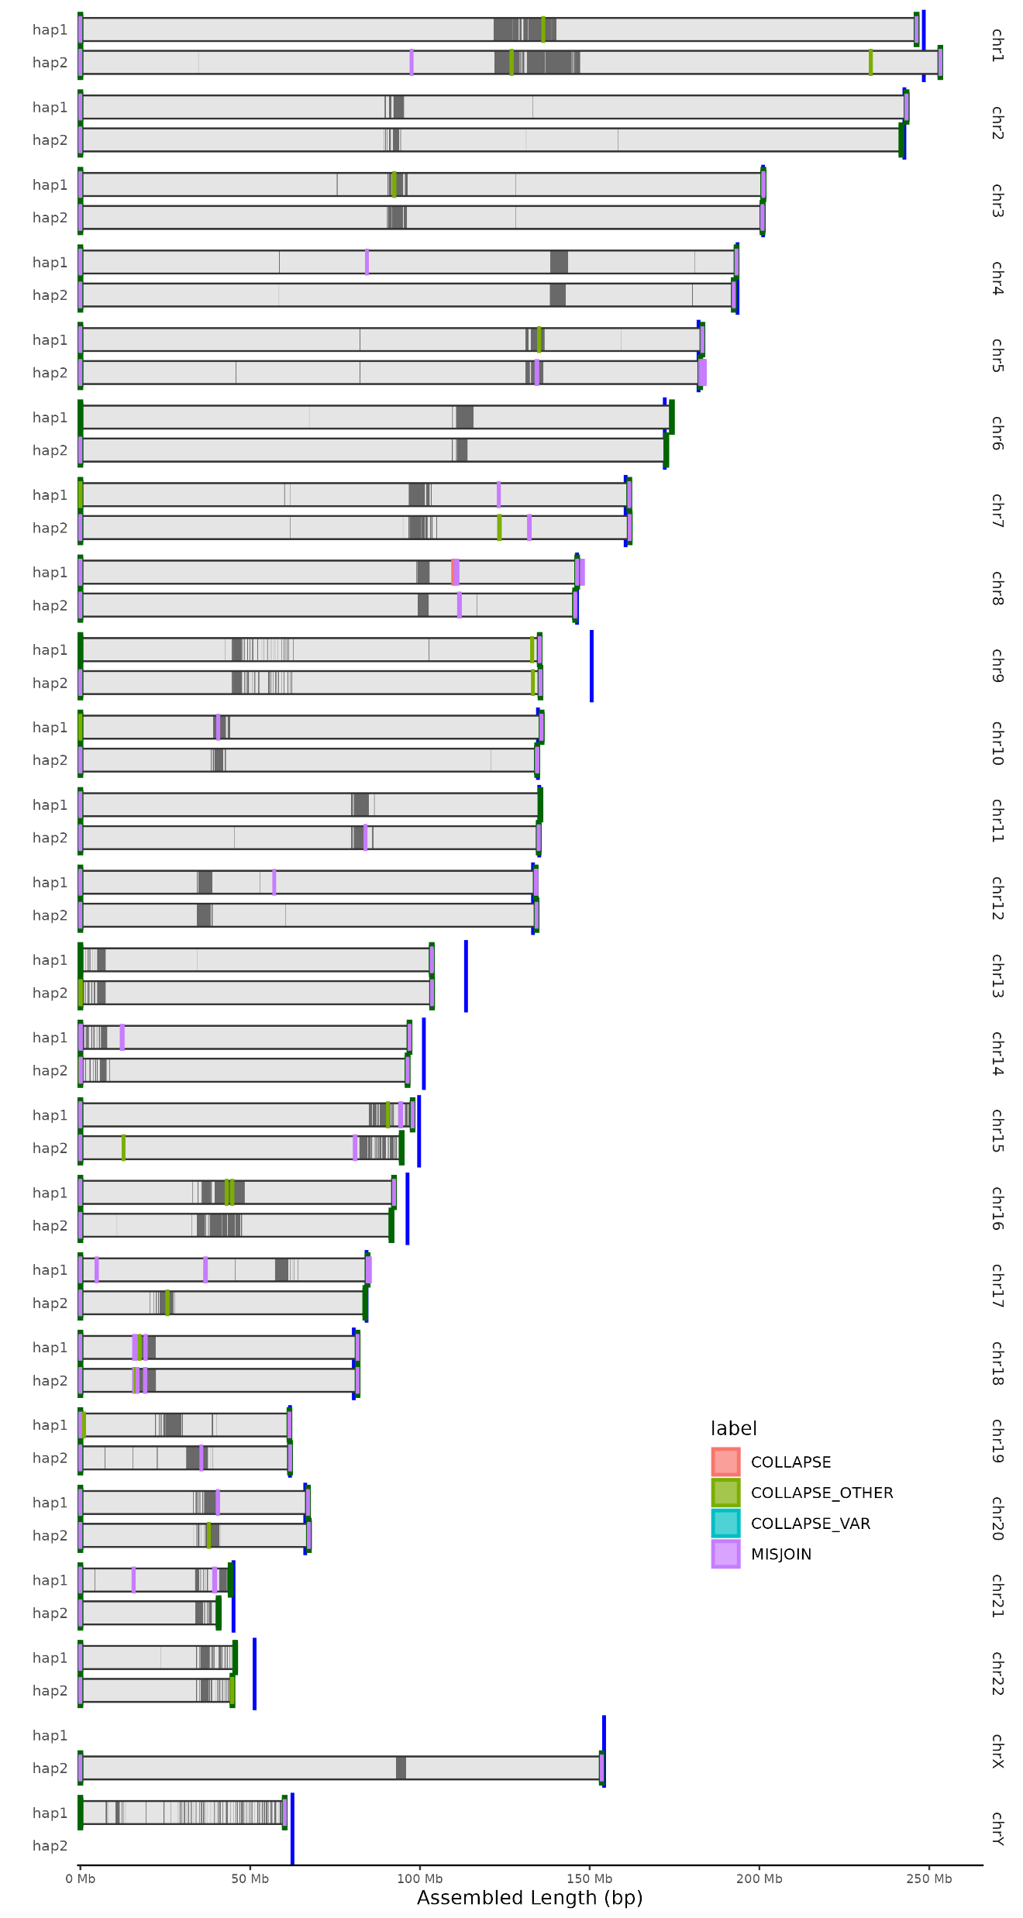
Possible misassemblies?
1
13
Detection tools: - Nucflag
- Flagger
2
14
3
15
4
16
5
17
6
18
7
19
8
20
9
21
10
22
11
X
12
Y

Slide 18
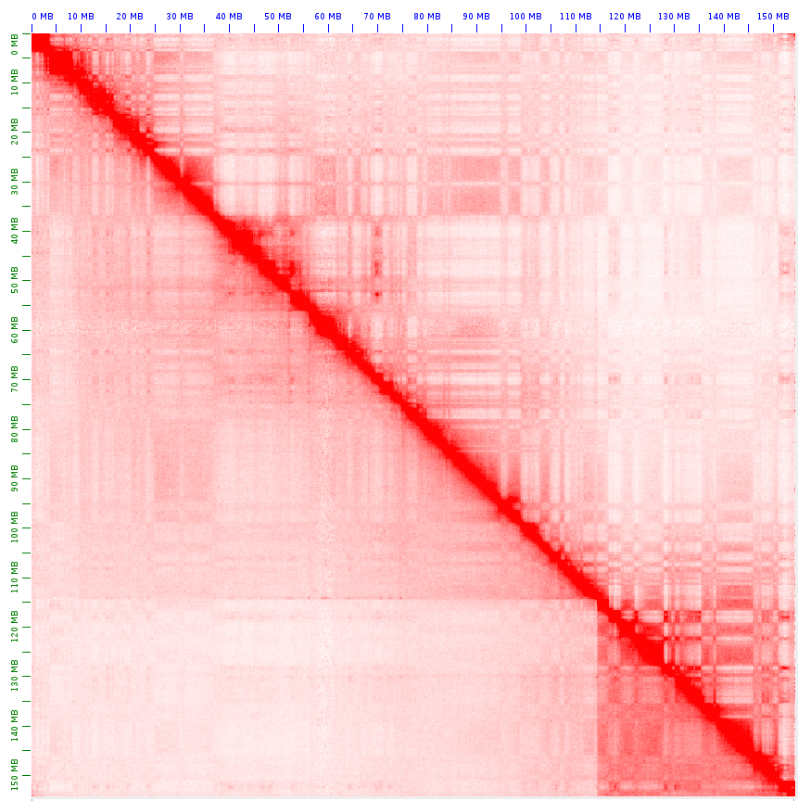
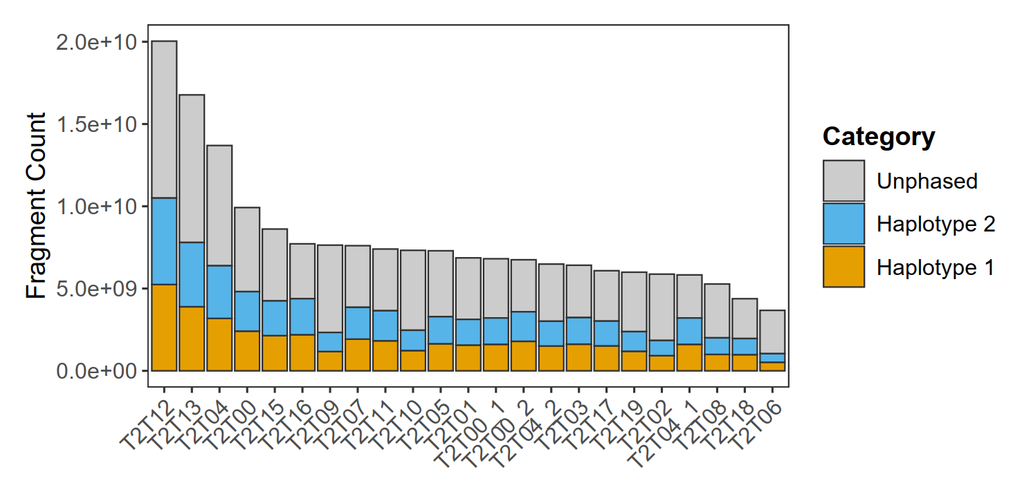
PoreC Phasing
Upper: Hap 2 (Xa)
Reference based (T2T-CHM13v2.0)
Uses phased variants from Assembly
Based on Dip3D Pipeline:
1) Map PoreC reads (Falign).
2) Tag PoreC monomers using phased variants.
3) Haplotype imputation of complete concatemers.
Lower: Hap 1 (Xi)
T2T12

Slide 19
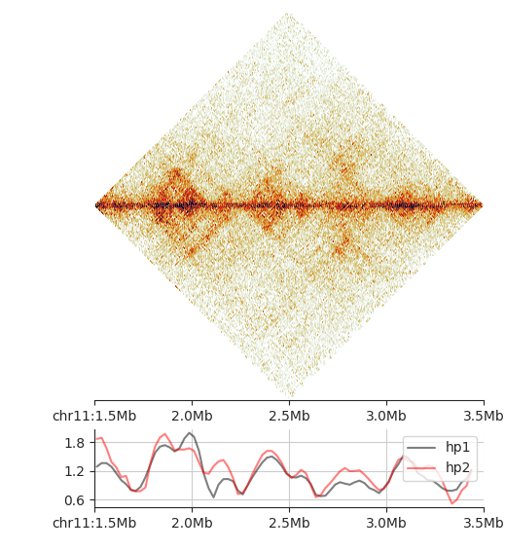
Known imprinted region IGF2-H19
T2T04.hp1, chr11
25 kb
T2T04.hp1, chr11
25 kb
H19
IGF2
T2T04.hp2, chr11
25 kb
T2T04.hp2, chr11
25 kb
Insulation score
IS calculated at 25 kb, 5x
IS calculated at 25 kb, 5x

Slide 20
Known imprinted region IGF2-H19
T2T04.hp1, chr11
25 kb
T2T04.hp2, chr11
25 kb
Insulation score
IS calculated at 25 kb, 5x

Slide 21

Centromere plot
Analysis with: logsdon-lab/CenMAP

Slide 22
Yes, we also tried the new Hifiasm!
No support for Pore-C yet
Requires a lot of memory (700Gb), is a bit faster.
Assembly | Hap | MMC | MSC | Completeness | Length | n T2T | n Contigs | n Contigs >10mb | QV | n Gaps | Gap length
T2T00_verkko | hap 1 | 0.18 | 0.05 | 94.62 | 2.93E+09 | 19 | 44 | 23 | 64.2 | 29 | 694539
T2T00_verkko | hap 2 | 0.23 | 0.02 | 98.39 | 3.04E+09 | 18 | 73 | 23 | 63.5 | 43 | 965836
T2T00_hifiasm_herro | hap 1 | 0.31 | 0.05 | 95.39 | 2.95E+09 | 10 | 67 | 30 | 64.46 | 22 | 1346442
T2T00_hifiasm_herro | hap 2 | 0.12 | 0.05 | 95.42 | 3.05E+09 | 8 | 47 | 32 | 64.88 | 43 | 2250829
T2T00_hifiasm_ont | hap 1 | 0.22 | 0.02 | 98.34 | 3.04E+09 | 14 | 56 | 24 | 61.28 | 6 | 1210904
T2T00_hifiasm_ont | hap 2 | 0.17 | 0.05 | 94.68 | 2.93E+09 | 15 | 33 | 24 | 62.96 | 12 | 85904

Slide 23
Conclusion
We used only ONT data to assemble 2 very high quality genomes containing multiple T2T chromosomes .
Even a small lab can generate these assemblies at reasonable cost.
For Genomes of Europe we will use the established methods to assemble additional genomes from a wide ethnic background. Data will be freely available.

Slide 24

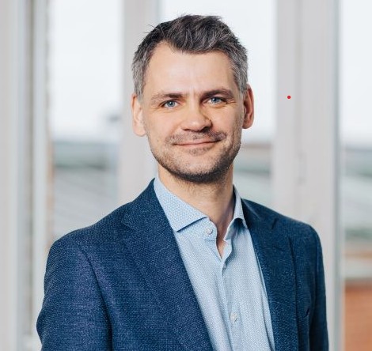



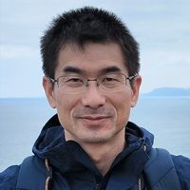



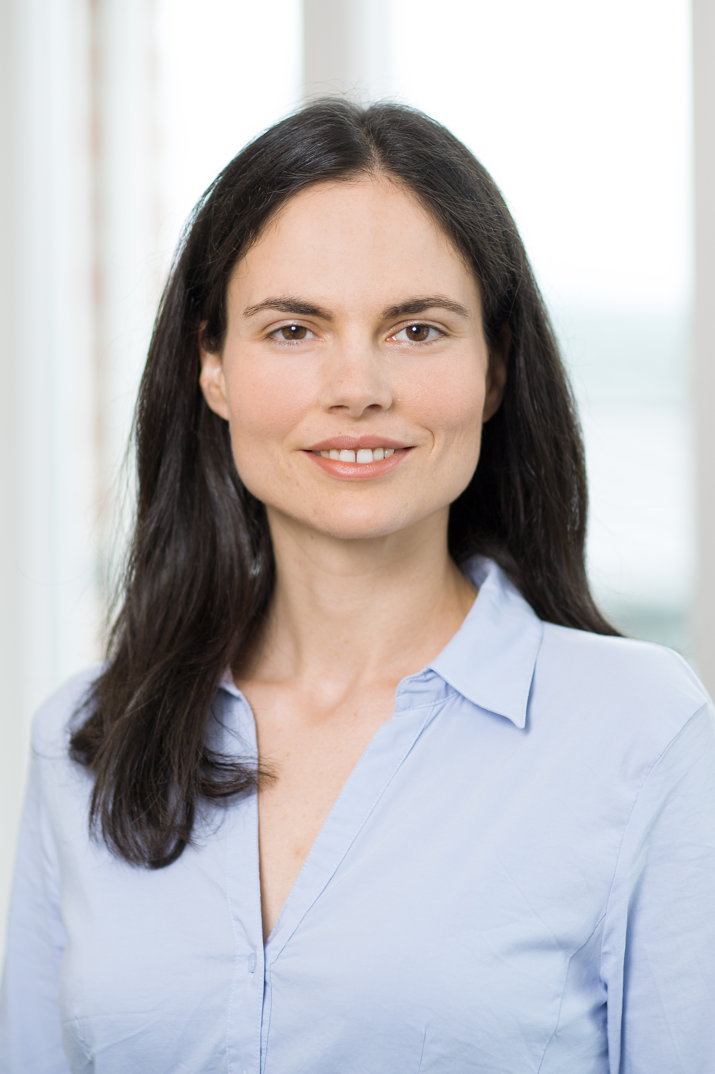
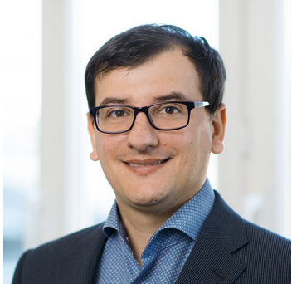

Acknowledgements
Olaf Riess
Project Lead
Stephan Ossowski
Head of Bioinformatics
Download: - Raw data - Assemblies
Ramya Potabattula
Ultra Long Reads
Beate Kristmann
Project Management
https://www.elrin-network.eu/t2t.html
Fubo Cheng
Pore-C
Prithivi Jung Thapa
Bioinformatics
Elena Buena-Atienza
Nanopore Sequencing
Hanna Sophie Hartung
Nanopore Sequencing
Funding by:
Nicolas Casadei
NCCT, Core facility
Alex DiGenova
Assembly tools

