Slide 1
11.11.2025

Slide 2
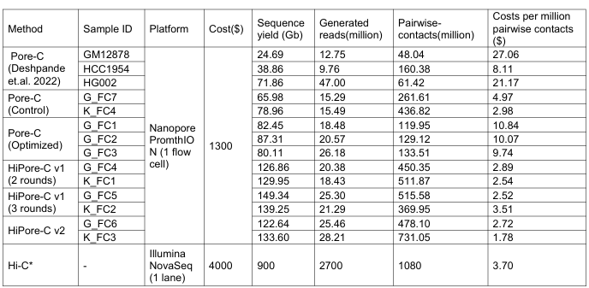
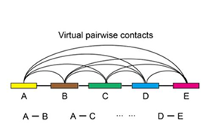
VPCs
adjacent VPCs
→ 80 M VPCs
adjacent + nonadj VPCs
→ 300 M VPCs
DOI: https://doi.org/10.1038/s41467-023-36899-x, Hi-Pore-C paper
In our experience, an adequately complex Hi-C dataset for the human genome with roughly 100 million mapped / valid junction reads, is sufficient to support a 40kb data resolution. (Lajoie 2016)
DOI: https://doi.org/10.1038/s41594-025-01512-w, Dip3D paper

Slide 3
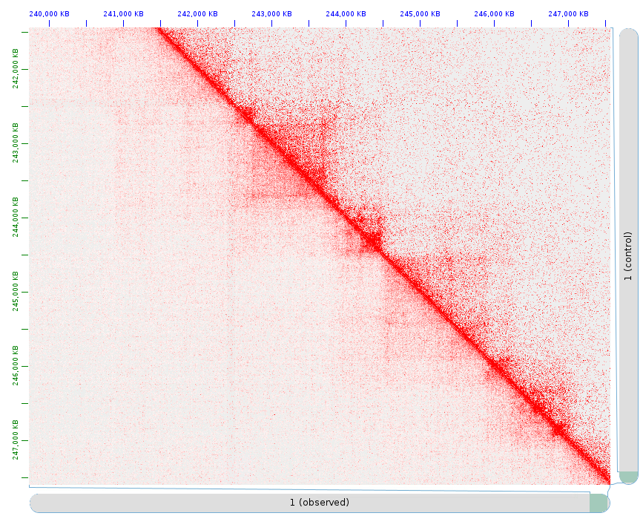
VPCs
T2T04.hp1, chr1, 10 kb
adj
adjacent VPCs
→ 80 M VPCs
adjacent + nonadj VPCs
→ 300 M VPCs
In our experience, an adequately complex Hi-C dataset for the human genome with roughly 100 million mapped / valid junction reads, is sufficient to support a 40kb data resolution. (Lajoie 2016)
adj + nonadj

Slide 4
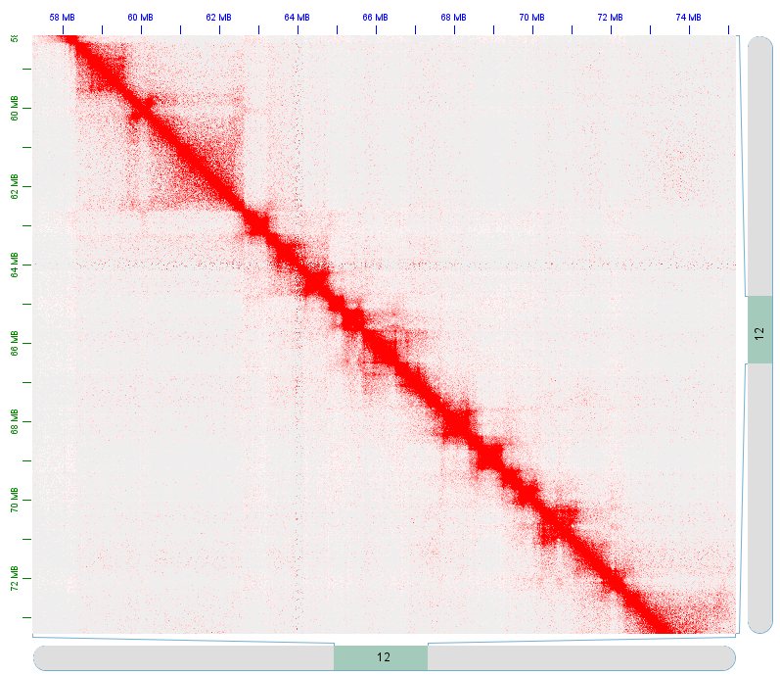
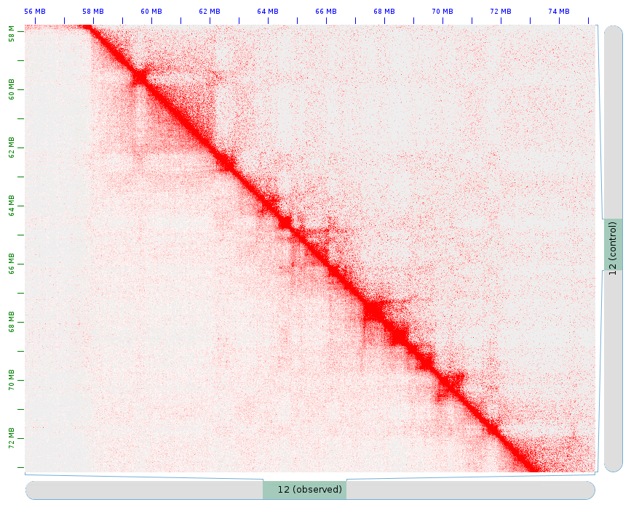
GM12878, in situ Hi-C, Rao 2014
T2T04.hp1, Chr 12, 25 kb
adj
adj + nonadj

Slide 5
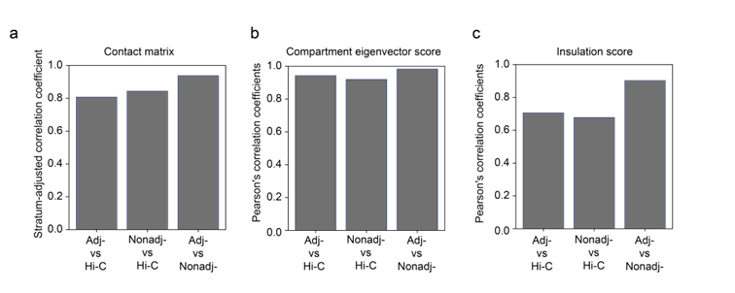
Are adjacent and nonadjcent VPCs equivalent?
0.938
0.982
0.902
DOI: https://doi.org/10.1038/s41467-023-36899-x, Hi-Pore-C paper

Slide 6
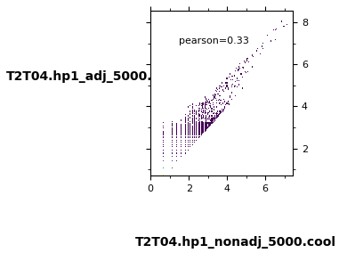
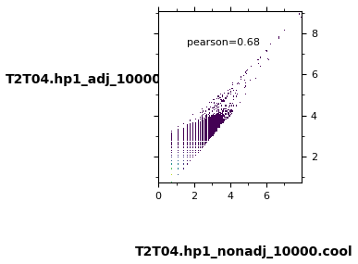
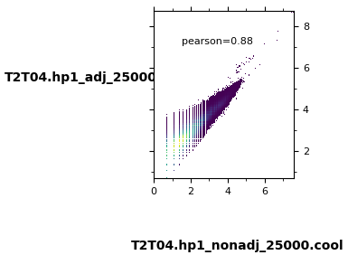
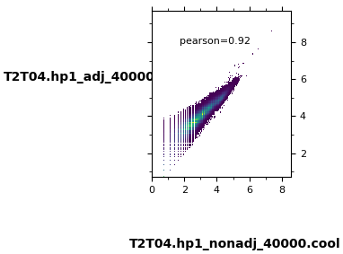
Are adjacent and nonadjcent VPCs equivalent?
T2T04.hp1
0.938
0.982
0.902
… comparing the heatmaps generated with adj- and non-adj-pairs of chromatin contacts […], overall chromatin interaction patterns were similar and resembled Hi-C contact heatmap (stratum-adjusted correlation coefficients are 0.938 […] for the heatmaps of adj-pairs and non-adj-pairs …
stratum-adjusted correlation coefficients = smoothed contact heatmaps

Slide 7
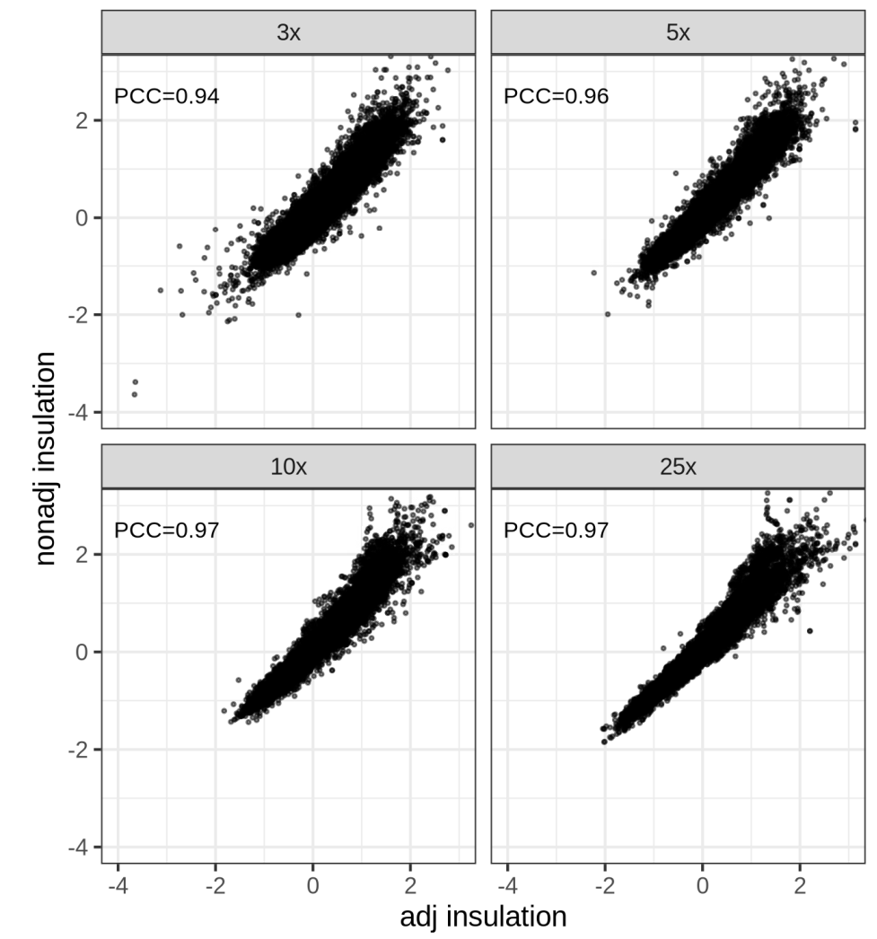
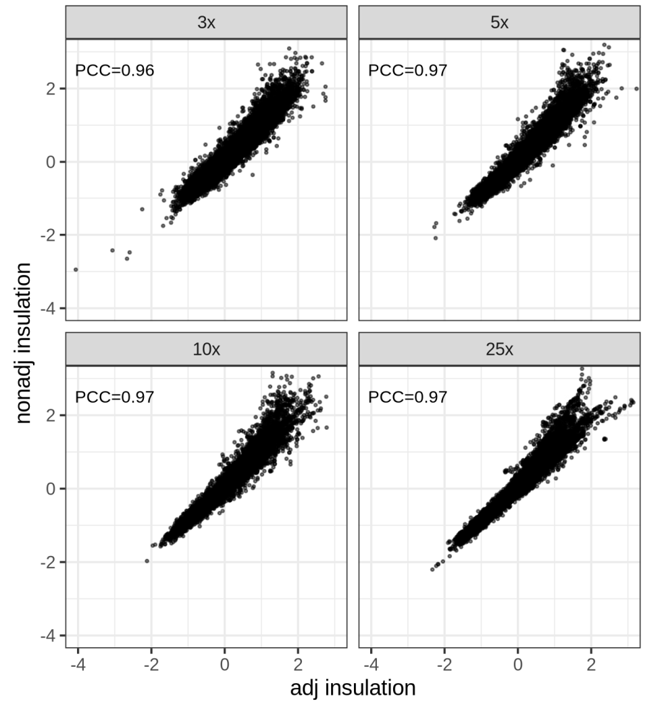
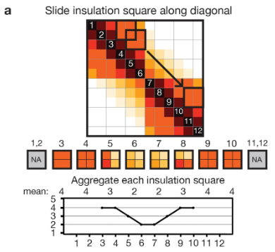
Are adjacent and nonadjcent VPCs equivalent?
T2T04.hp1
25 kb
40 kb
0.902
DOI: https://doi.org/10.1038/nature14450, Crane insulation score

Slide 8
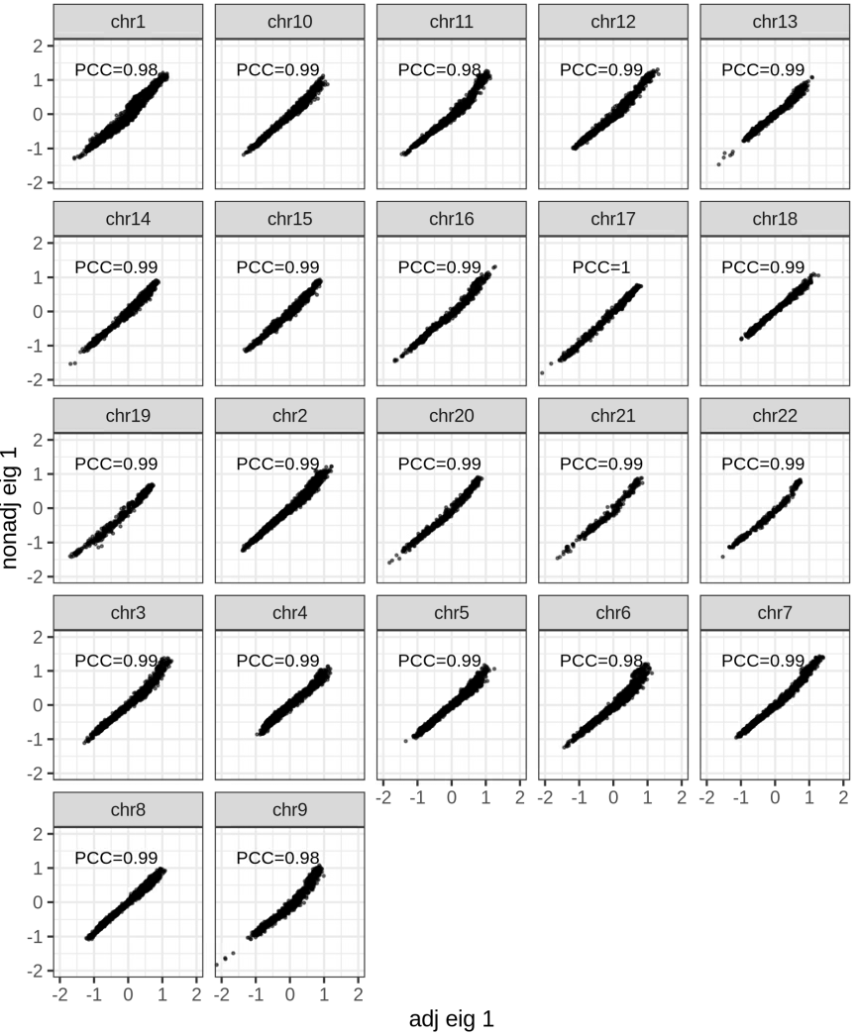
Are adjacent and nonadjcent VPCs equivalent?
T2T04.hp1
0.982

Slide 9
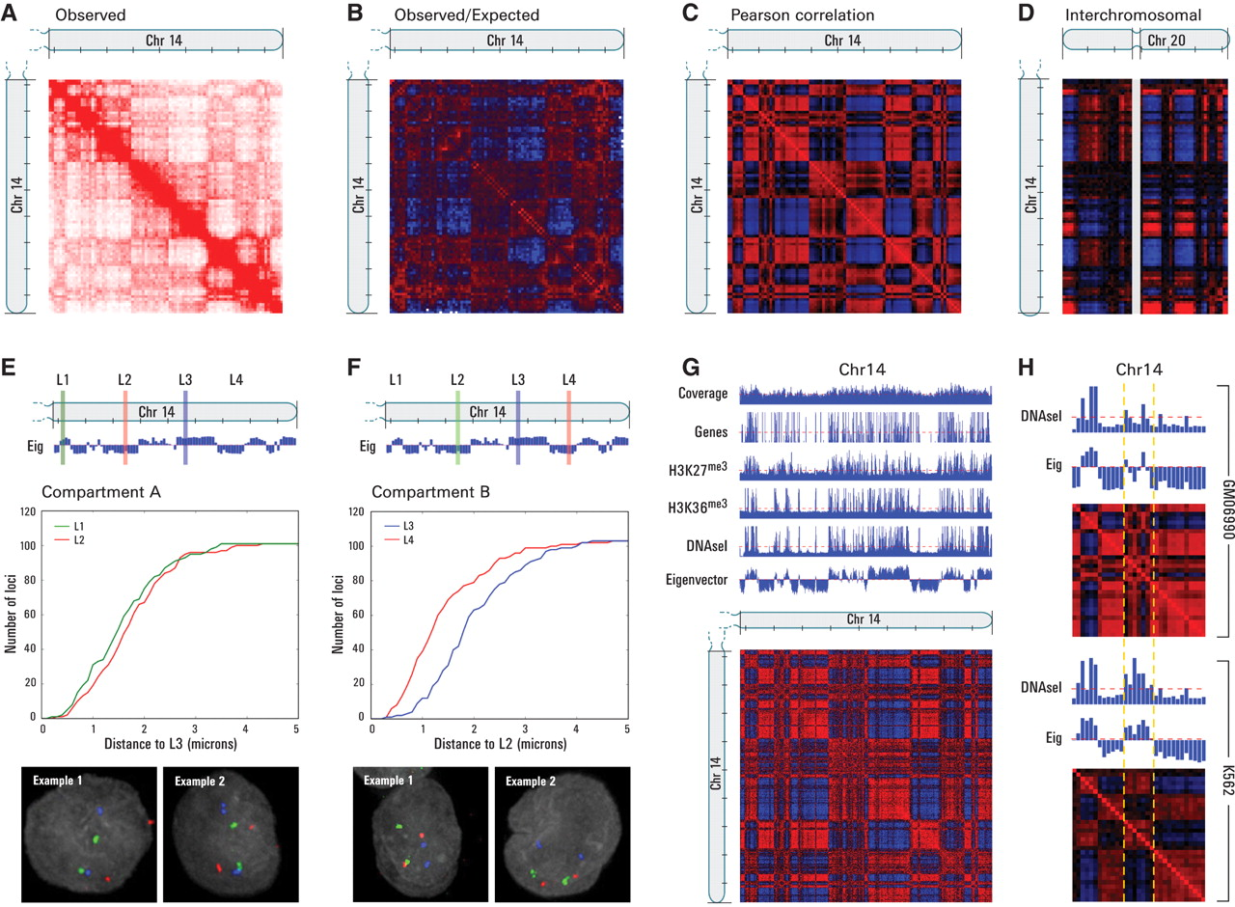
Chromatin compartments
… the entire genome can be partitioned into two spatial compartments such that greater interaction occurs within each compartment rather than across compartments …
Compartment A: positive principal component (PC) vector, correlation with presence of genes, higher expression, accessible chromatin
Compartment B: negative PC vector
DOI: 10.1126/science.1181369

Slide 10
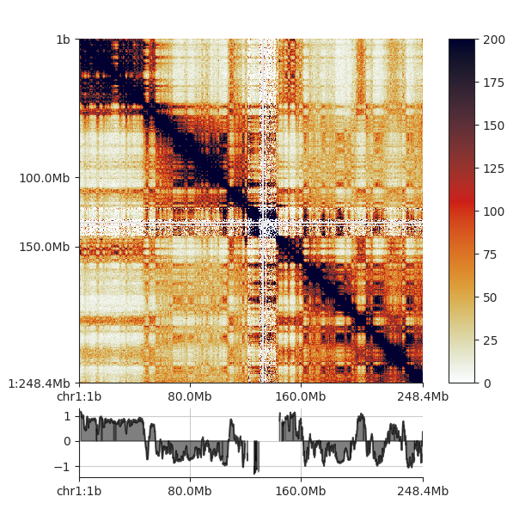
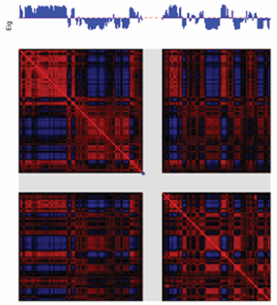
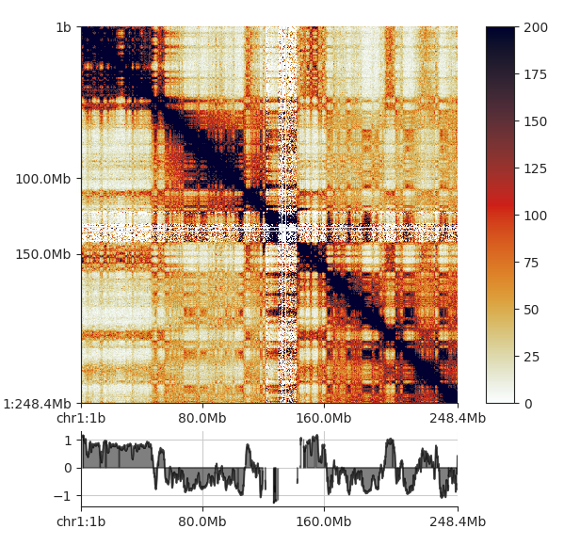
Chromatin compartments
T2T04.hp1
T2T04.hp2
DOI: 10.1126/science.1181369, Lieberman, first Hi-C

Slide 11
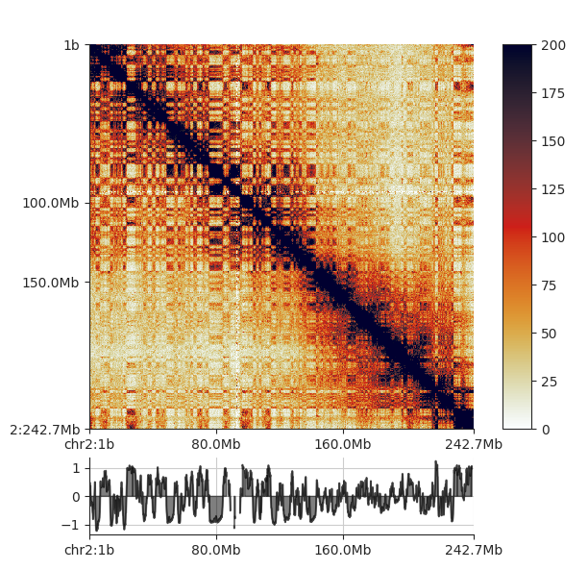
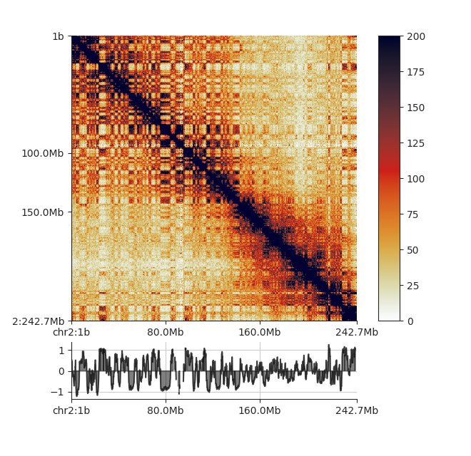
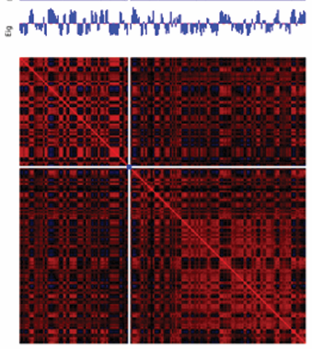
Chromatin compartments
T2T04.hp1
T2T04.hp2
DOI: 10.1126/science.1181369

Slide 12
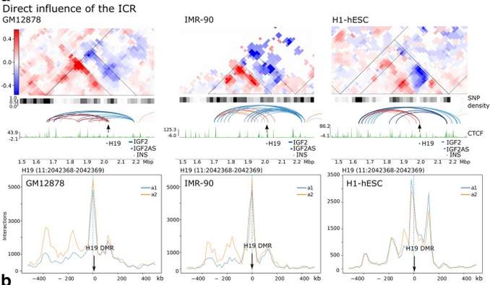
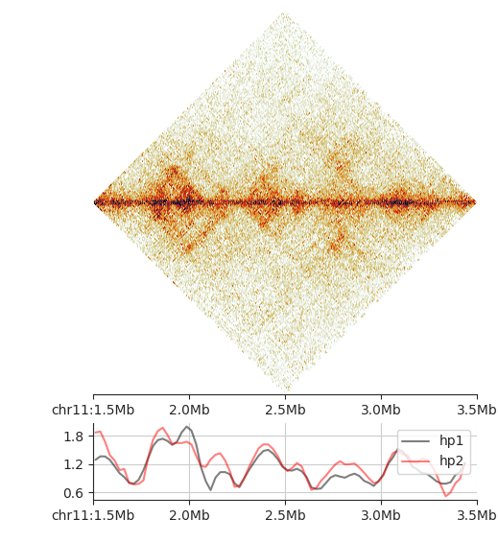
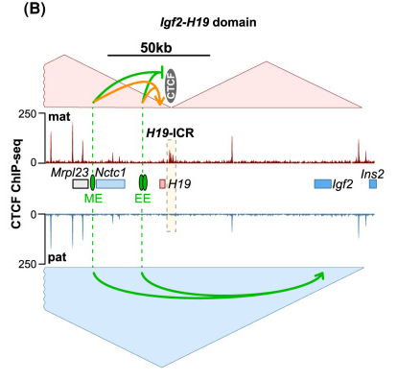
IGF2-H19
T2T04.hp1, chr11
25 kb
H19
IGF2
DOI: https://doi.org/10.1186/s13059-023-02876-2
T2T04.hp2, chr11
25 kb
Insulation score
IS calculated at 25 kb, 5x
doi: 10.1042/BST20230143

Slide 13
IGF2-H19
T2T04.hp1, chr11
25 kb
DOI: https://doi.org/10.1186/s13059-023-02876-2
T2T04.hp2, chr11
25 kb
Insulation score
IS calculated at 25 kb, 5x
doi: 10.1042/BST20230143

Slide 14
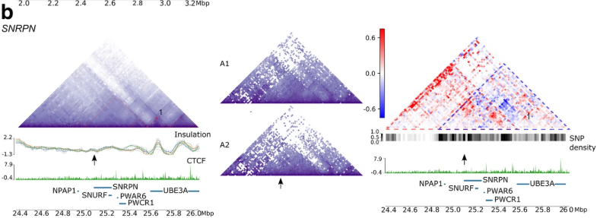
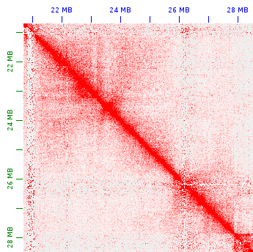
SNRPN
T2T04.hp1, chr15
25 kb
DOI: https://doi.org/10.1186/s13059-023-02876-2
T2T04.hp2, chr15
25 kb

Slide 15
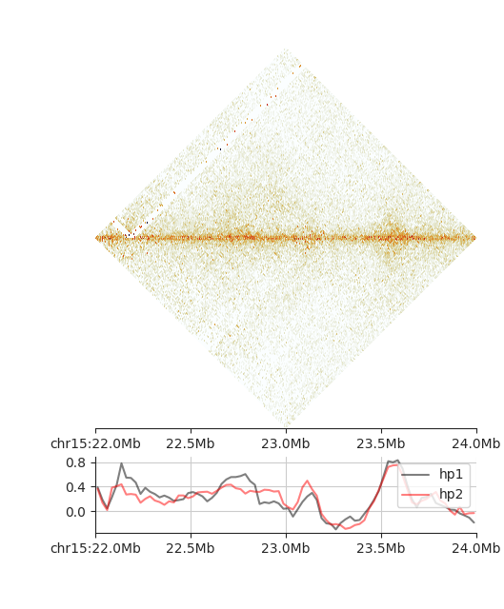
SNRPN
T2T04.hp1, chr15
25 kb
DOI: https://doi.org/10.1186/s13059-023-02876-2
T2T04.hp2, chr15
25 kb

