Slide 1
Nanopore only Telomere-2-Telomere Assemblies for Genomes of Europe
ESHG 2025, Milano Caspar Gross

Slide 2
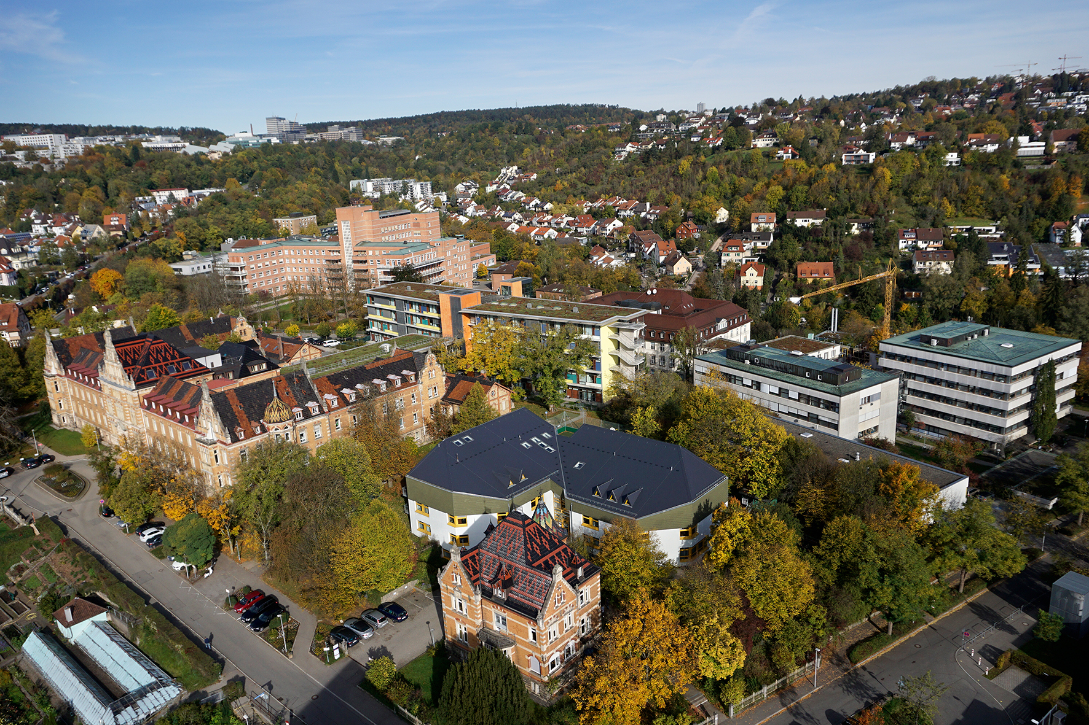
Introduction
University Hospital Tübingen
Institute of Medical Genetics and Applied Genomics

Slide 3

T2T Assemblies as part of Genomes of Europe
28 Institutes from Europe Sequencing goal: 500 000 genomes
At UKT:
Planned 20 000 genomes
Twin Study (n = 400 pairs) WGS-LR
T2T Genomes
T2T genomes sampled mainly from institute members, aiming for broad ethnic background.

Slide 4
Human reference genomes
2001 First Draft Human Genome
2011 hg19 Reference Genome
2017 hg38 Reference Genome
2022 T2T-CHM13 First T2T Genome (haploid)
2023 The Human Pangenome Project
2024 HG002v1.1 Q77.8
2022 HG002v0.7 Q60
2024 Improved Methods
Herro (Stanojevic et al.)
ONT only (Koren et al)
2025 Publications
Hifiasm (Cheng et al)
6 T2T Ape (Yoo et al)
18 T2T Human (Ghorbani et al)

Slide 5
> For an assembly to be truly T2T, it must both cover the whole of each chromosome without gaps and be free from large-scale assembly errors. It is critical to rigorously assess the quality of the assembly before concluding it is T2T.
Li and Durbin, 2024. “Genome Assembly in the Telomere-to-Telomere Era.” Nature Reviews Genetics

Slide 6
Lab
Ultra-Long DNA
Sequencing Kit
SQK-ULK114
~45X with >=100kb N50
Assembly Polishing
Kit (APK)
SQK-APK114
>=35X with ~6-8 kb N50
Pore-C protocol with
Ligation Sequencing Kit
SQK-LSK114
Chromatin conformation capture data
>=25X with ~8kb N50
Chromosome correction data
Ultra-long reads (>=100kb)
1 lib prep on 1 flow cell
1 lib prep on 1 flow cell
2 lib preps on 3/4 flow cells

Slide 7
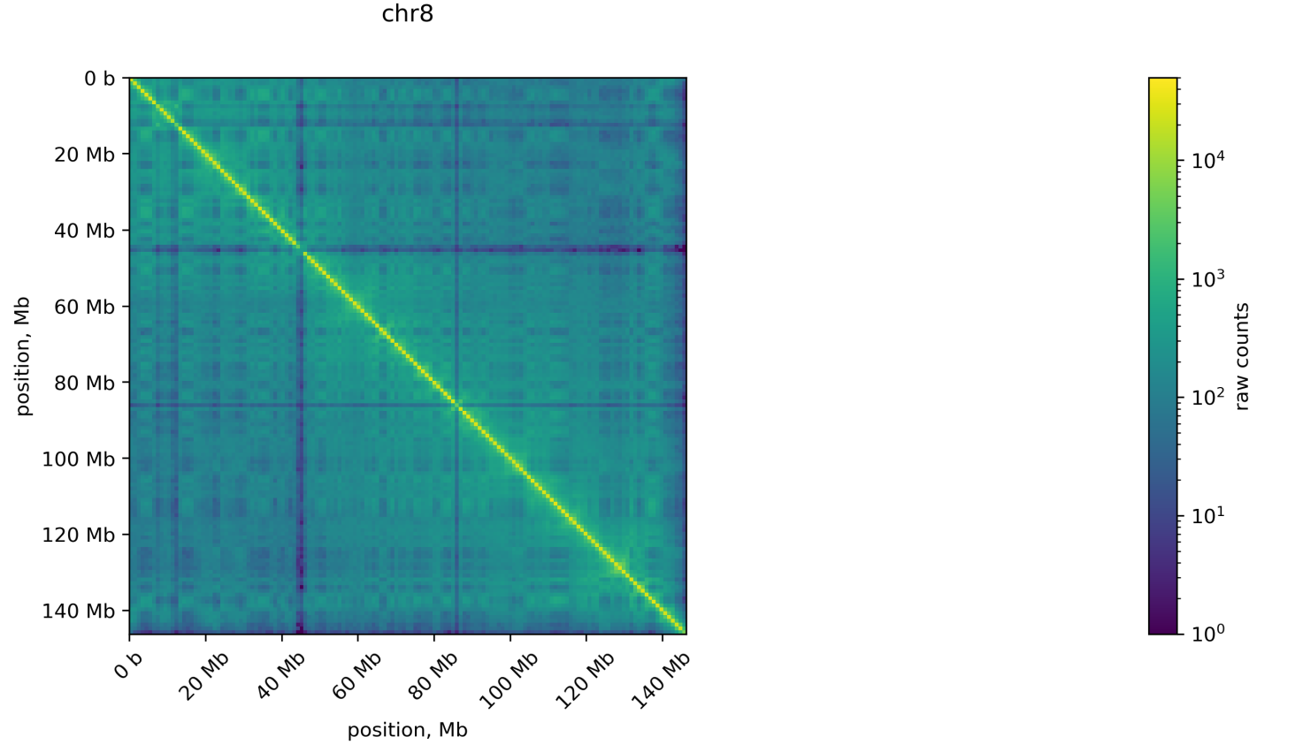
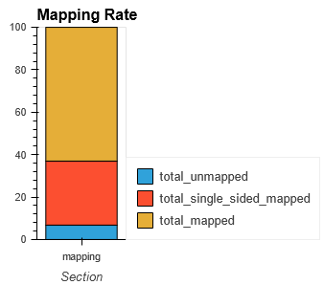
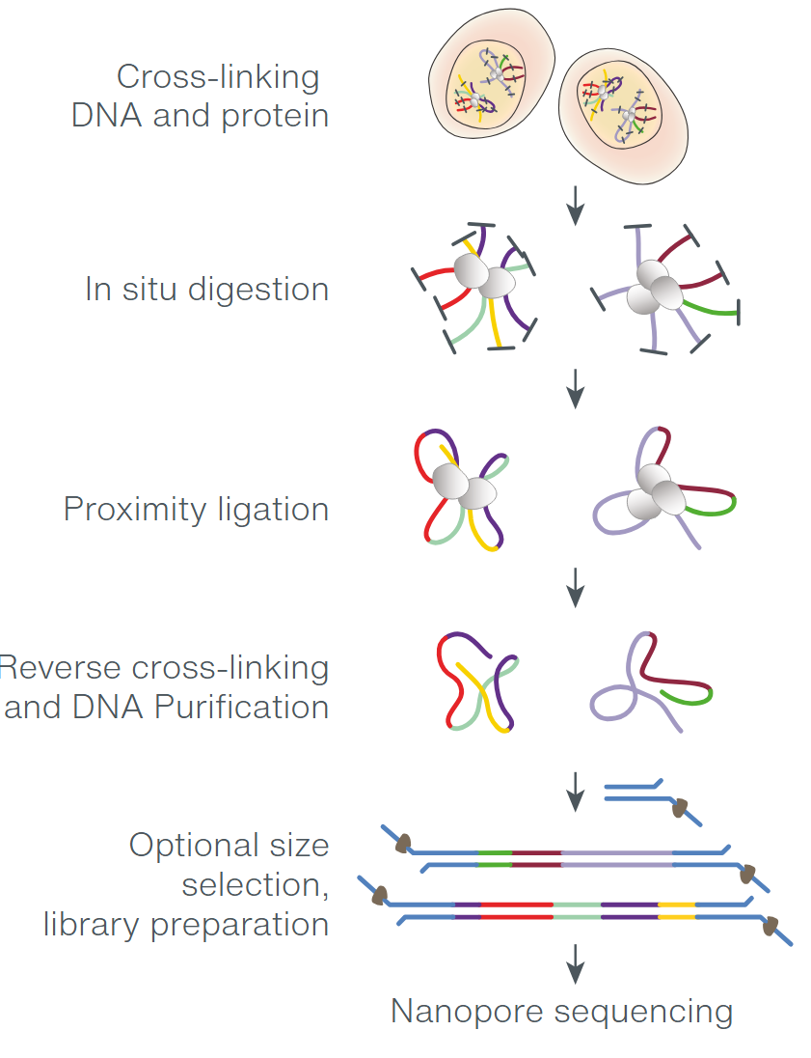
Pore-C sequencing
3 days protocol
Can be generated from UHMW DNA
https://nanoporetech.com/sites/default/files/s3/literature/plant-pore-c-workflow.pdf
Notes:
How does Pore-C work?
Chromatin is crosslinked in cells to preserve 3D structure.
DNA is fragmented and proximity-ligated, joining together DNA segments that are spatially close in the nucleus.
The resulting chimeric DNA molecules (containing multiple genomic fragments) are sequenced using Oxford Nanopore’s long-read technology.
Each read can contain information about multiple interacting genomic loci, providing high-resolution insight into chromatin organization.

Slide 8
UL sequencing

Slide 9
APK sequencing
Custom protocol

Slide 10
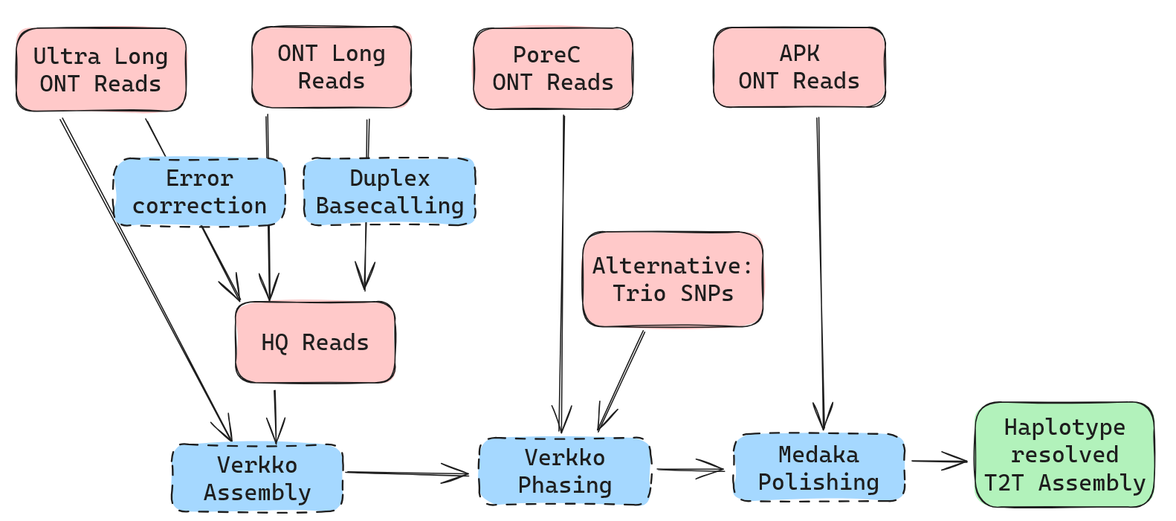
Pipeline overview
Basecalling with SUP model on GPU nodes

Slide 11
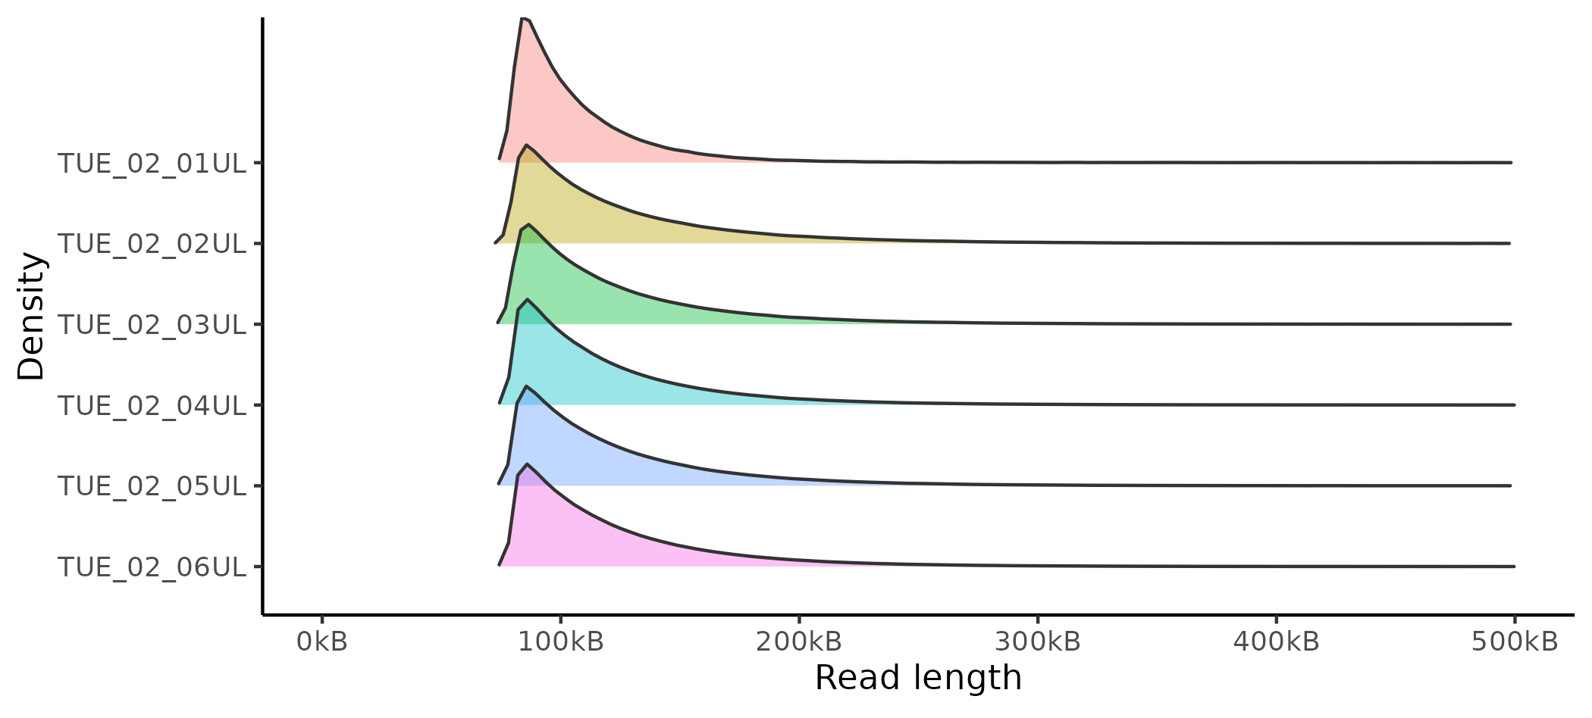
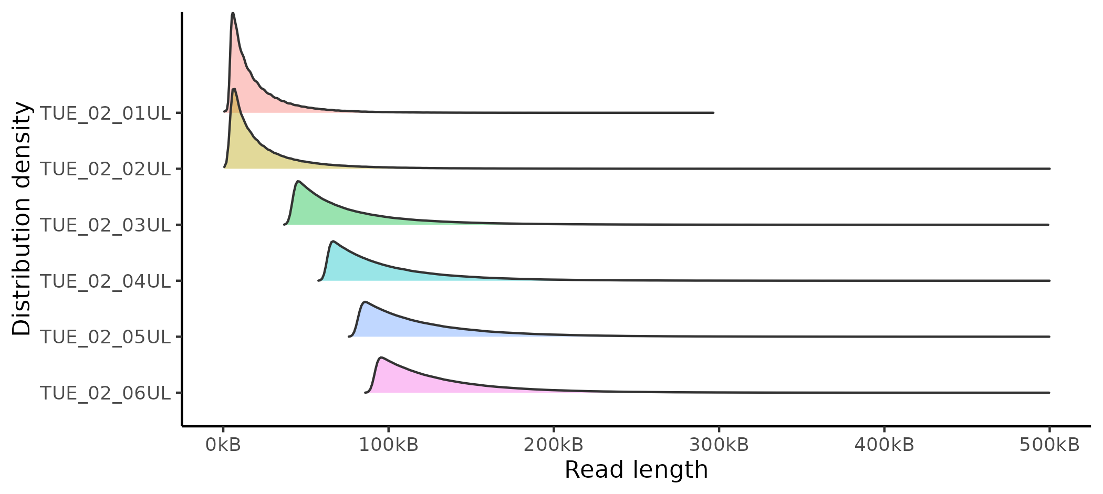
Basecalling, Error correction, Filtering
HQ:
Max 50x coverage
>Q9
Length priority
UL:
Max 70x coverage
> Q9
>80kb Length

Slide 12
Input optimizations
#TODO Figure
2 UHMW Library Preps -> Enough for 14 Flowcell loadings
3 UL Flowcells
Duplex reads do not help

Slide 13
Runtimes

Slide 14
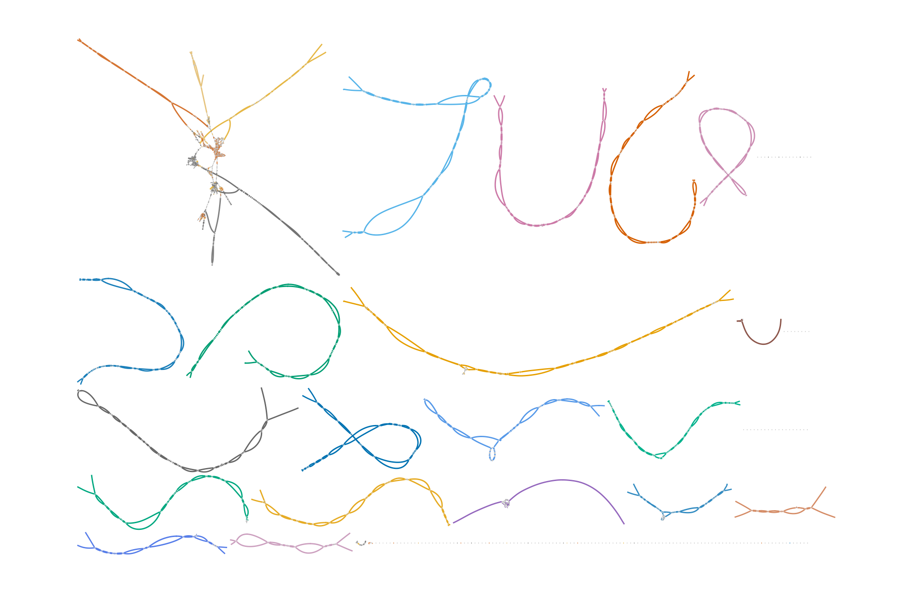
Assembly graph visualisation
GE-MED-T2T00
Primary assembly, unphased, not scaffolded
Acrocentric chromosomes cluster at repetitive sequences
Sex chromosomes only single stranded (haploid)
chr22
chr13
chr15
chr2
chr11
chr14
chr4
chr6
chr21
chr3
chr12
chr1
chrY
chr5
chr9
chr17
chr7
chr10
chr8
chrX
chr19
chr20
chr16
chr18

Slide 15
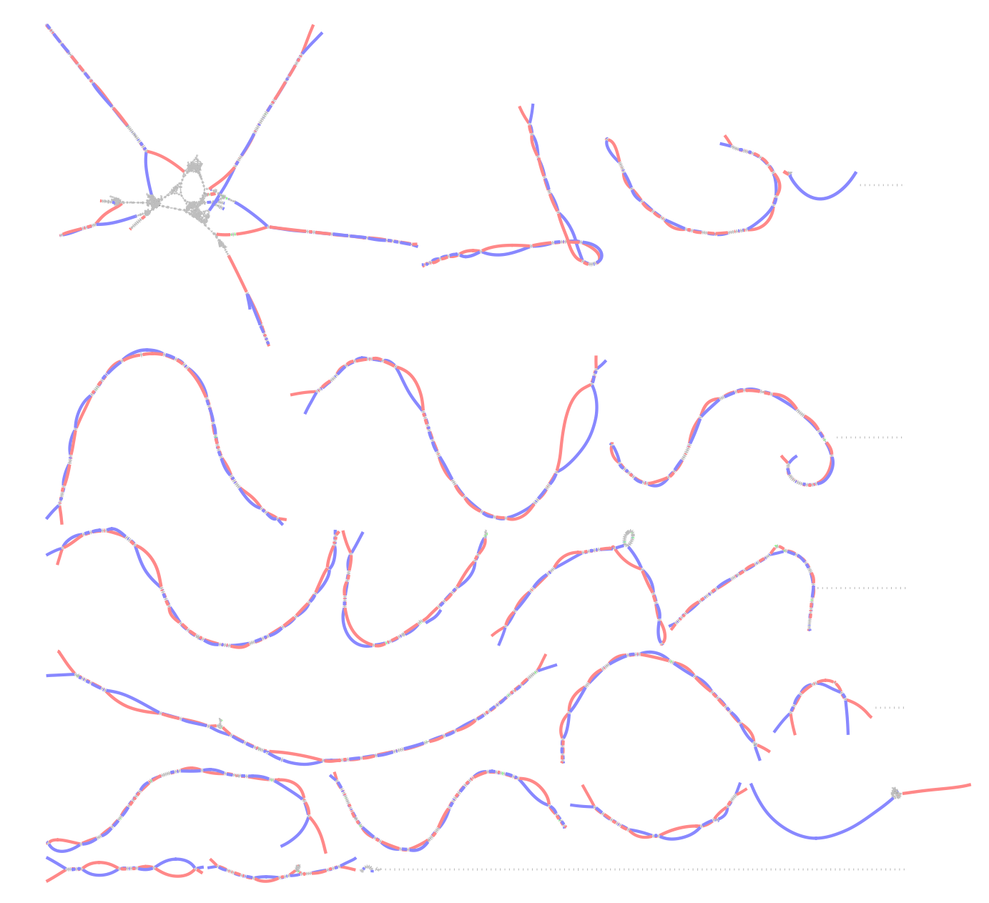
Assembly graph visualisation
Haplotype1: Red Haplotype2: Blue
Phasing selects separate paths through the graph for each haplotype
Using Pore-C or Trio information.

Slide 16
Assembly QC
Metric | haplotype1 | haplotype2
Number of T2T chromosomes | 20 | 18
% of Assembly covered by Ref | 0.97 | 0.97
% of Ref covered by Assembly | 0.9 | 0.94
% of Ref duplicated in Assembly | 0.01 | 0.01
Assembly Length | 2934985356 | 3028541959
Average Ungapped Alignment length | 4167916 | 4482112
Genome Completeness (%) | 94.61 | 98.41
Missing Multi-Copy Genes (%) | 0.19 | 0.22
NG50 | 137904320 | 145923310
NG75 | 101150053 | 103627408
 | complete assembly
Phase Blocks | 46
Switch Rate (%) | 1.23
Quality Value | 58.48
Error Rate (%) | 0.00014
Variants Phased (%) | 98.7

Slide 17
APK Polishing
#todo Add quality values

Slide 18
Alignment against reference genome
Image 2 Tracks, Methylation included
#todo

Slide 19
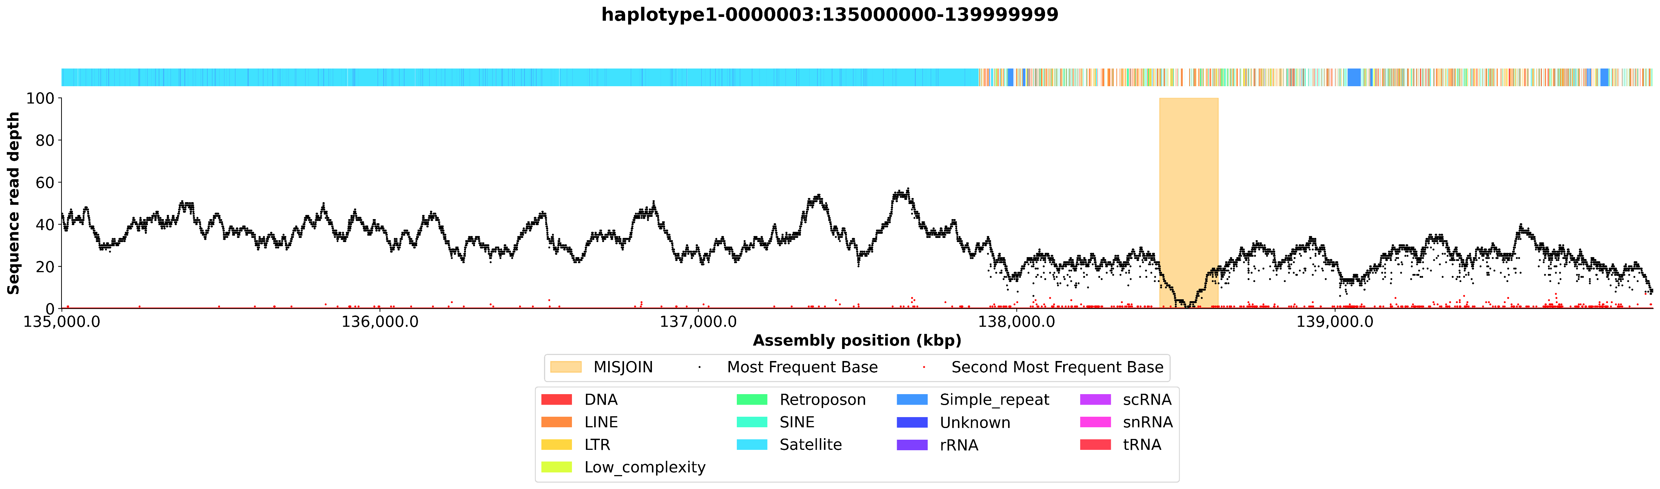
Extended QC
Nucflag
Gapstats

Slide 20
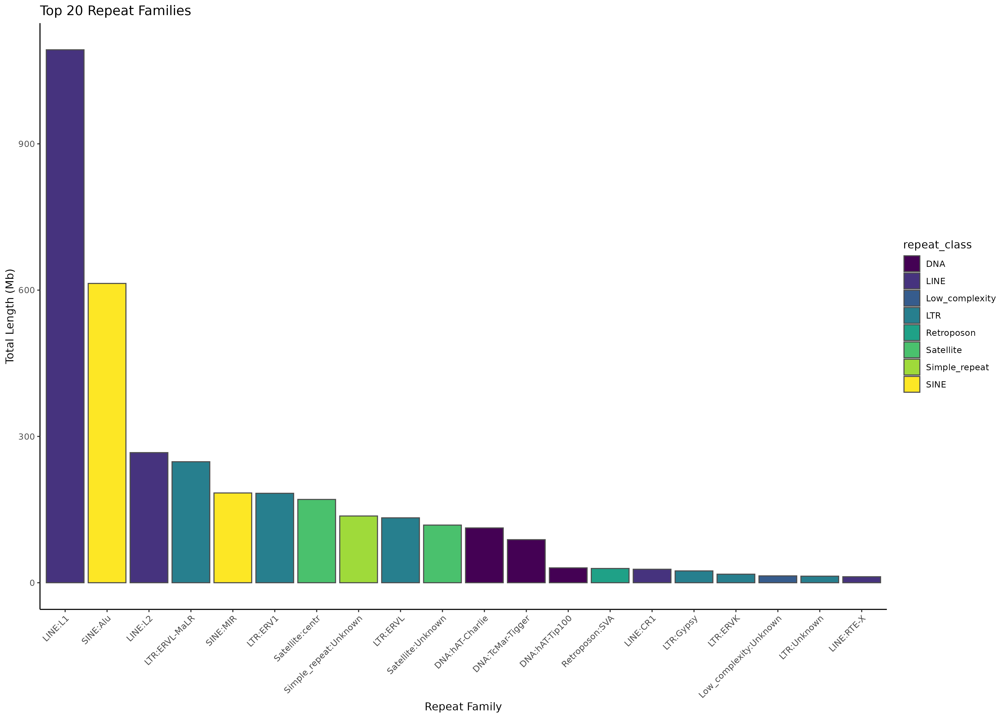
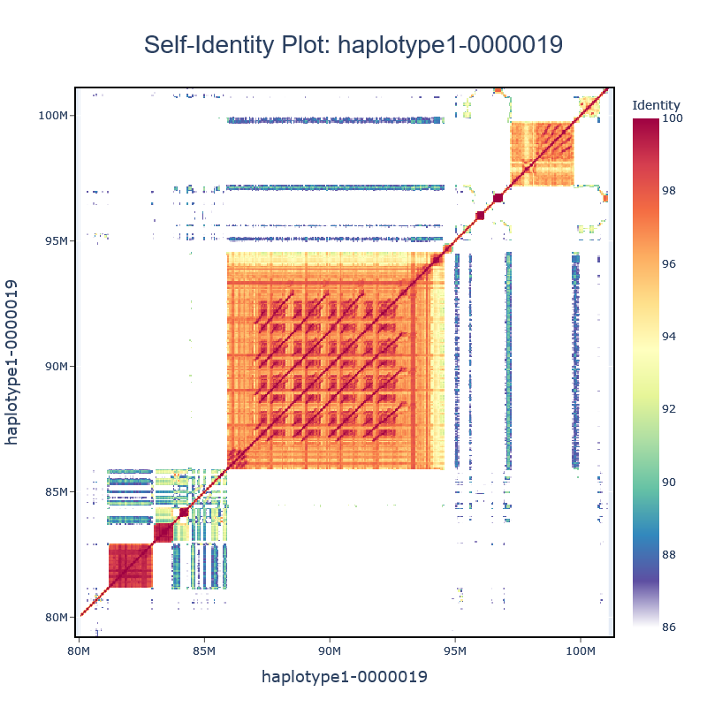
Repeat analysis
Annotation of assembled genomes with RepeatMasker

Slide 21



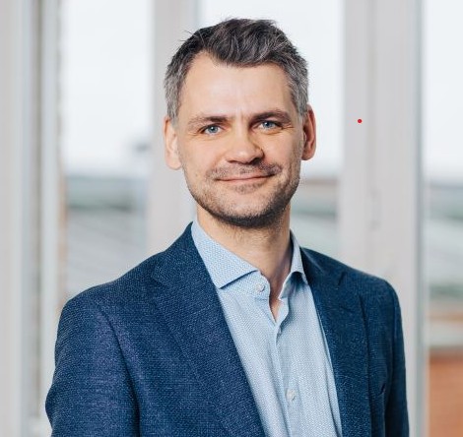






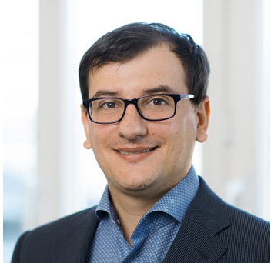
Contributors
Olaf Riess
Project Lead
Stephan Ossowski
Head of Bioinformatics
Ramya Potabattula
Ultra-Long Reads
Beate Kristmann
Project Management
Fubo Cheng
Pore-C
Prithivi Jung Thapa
Bioinformatics
Elena Buena-Atienza
Nanopore Sequencing
Hanna Sophie Hartung
Nanopore Sequencing
Download: - Raw data - Assemblies
Nicolas Casadei
NCCT, Core facility
https://www.elrin-network.eu/t2t.html

Slide 22
Hifiasm (Additional slide)
No support for Pore-C yet
#todo insert QC

Slide 23
