Slide 1
Hifiasm output comparison
T:\users\ahthapp1\real_deal\github_projects\T2T_ONT\assembly\input\hybrid_HQ_combined.15x_20x_UL.50x

Slide 2
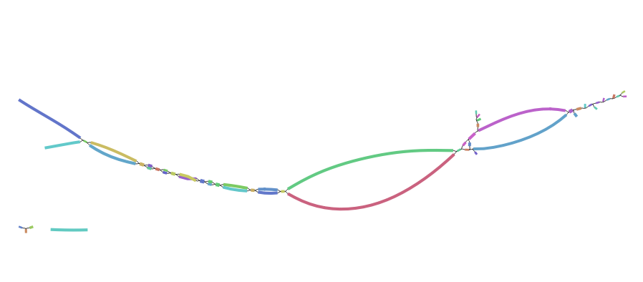
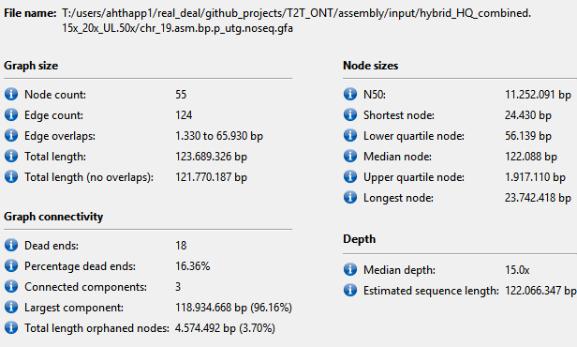
Chr19.asm.bp.p_utg.noseq.gfa

Slide 3
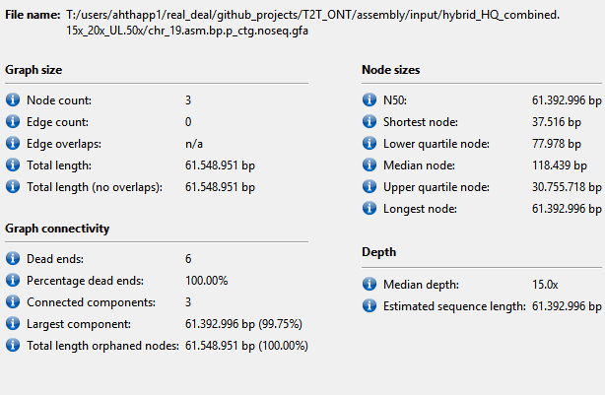
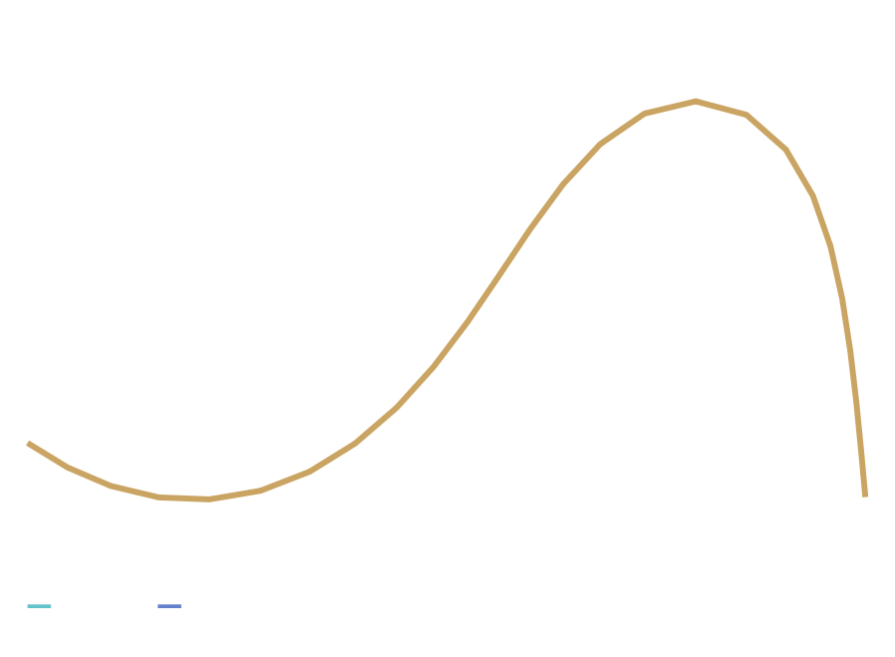

Slide 4
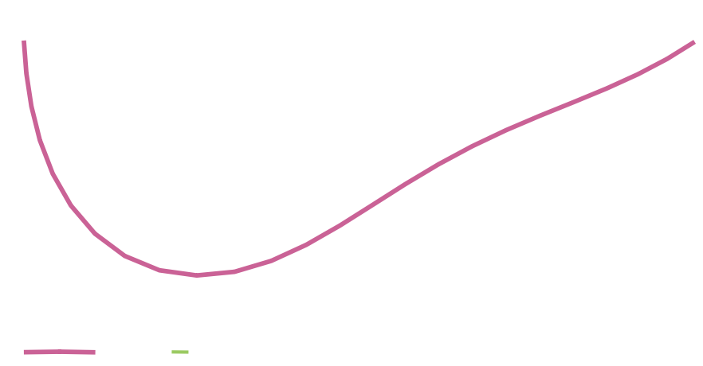
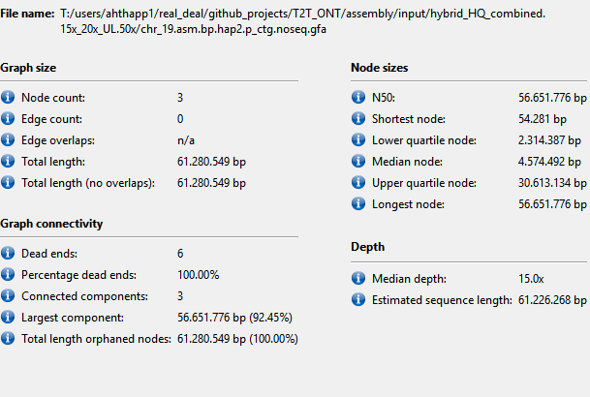
hap2.p_ctg

Slide 5
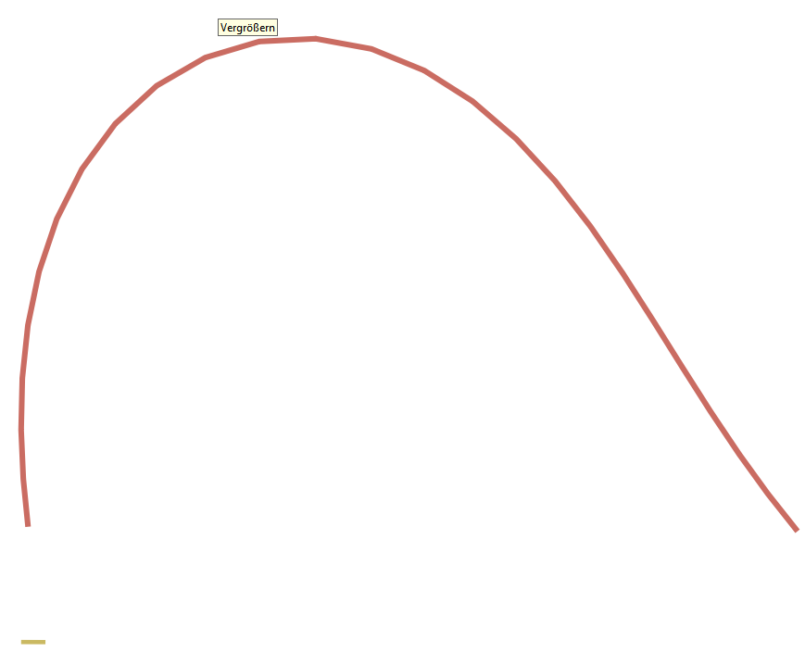
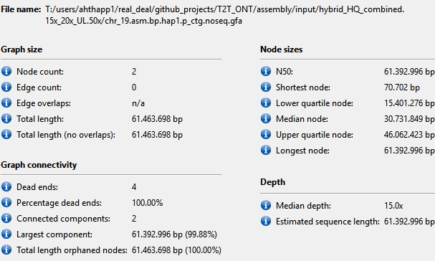
Chr_19.asm.bp.hap1.p_ctg.noseq.gfa

