Slide 1
Slides T2T

Slide 2
UL data

Slide 3
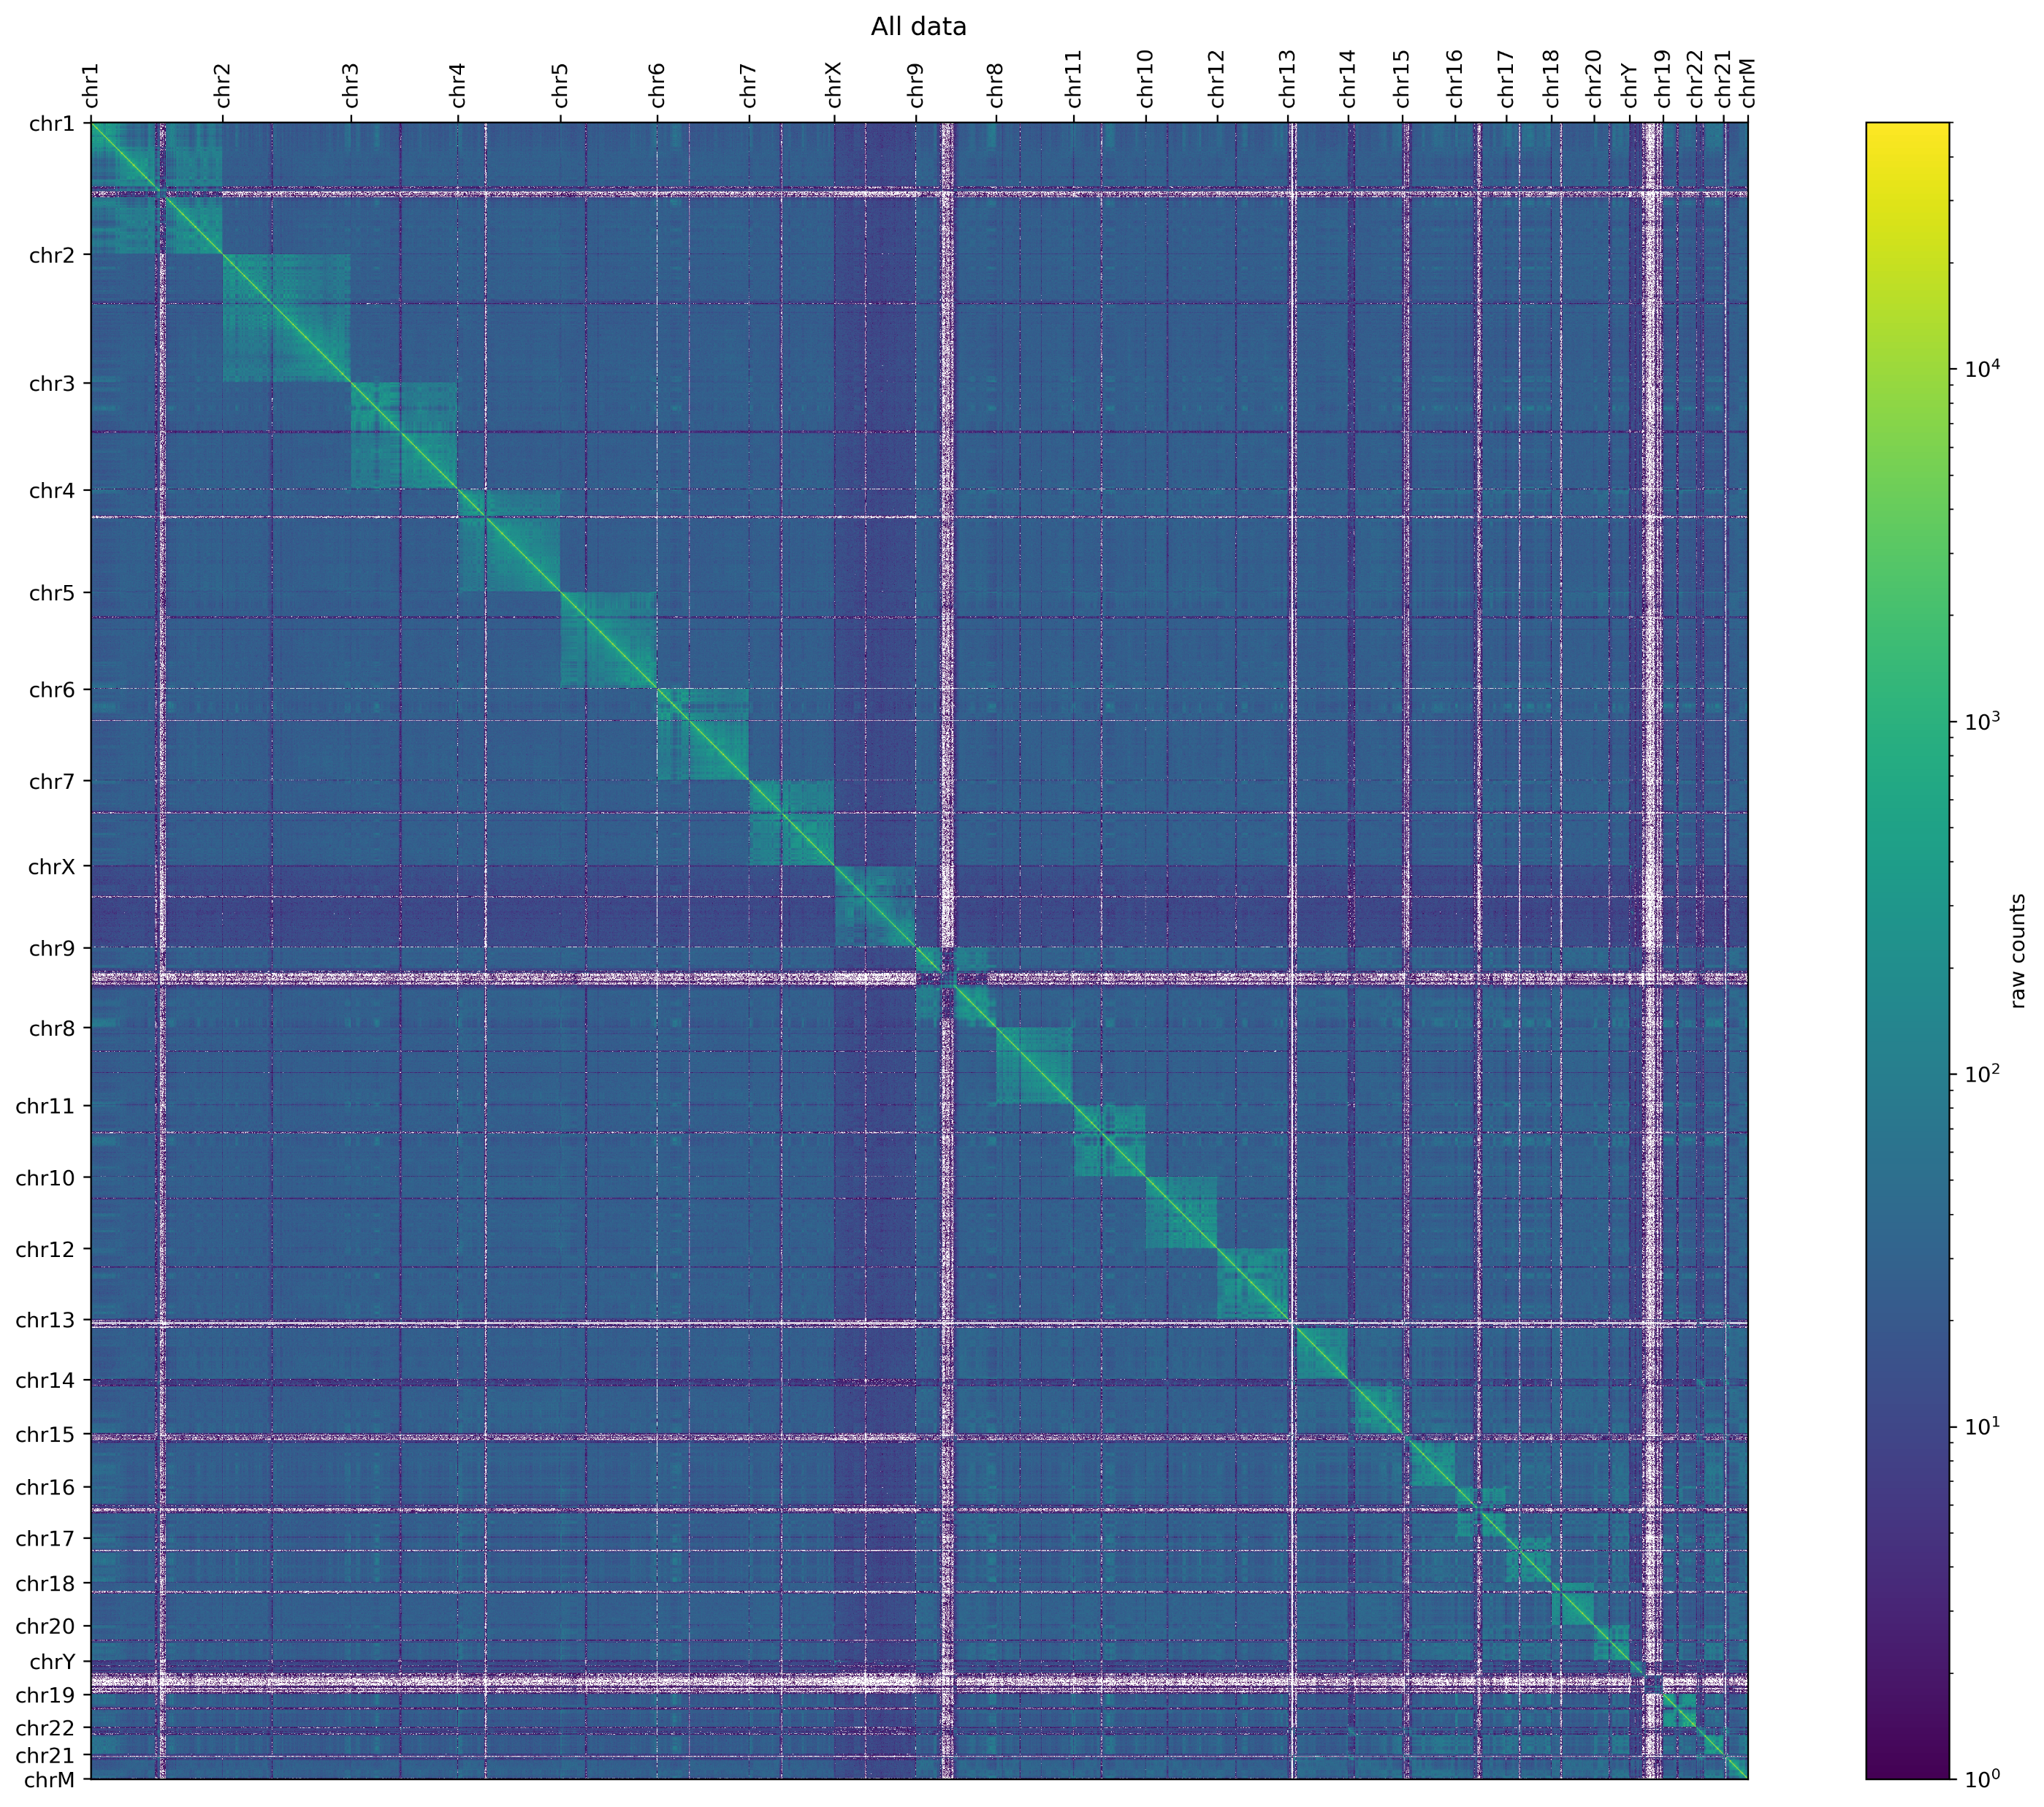
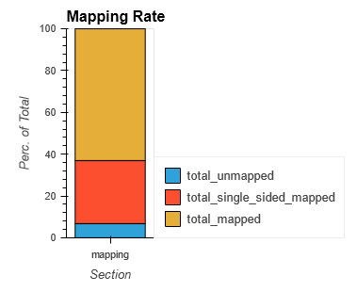
PoreC data
Qscore median: 18.0
Read length N50: 8890
Yield: 124 Gb

Slide 4
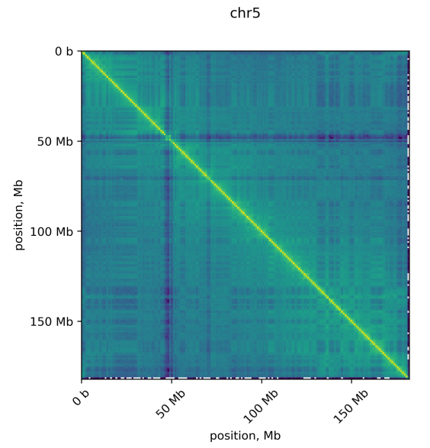
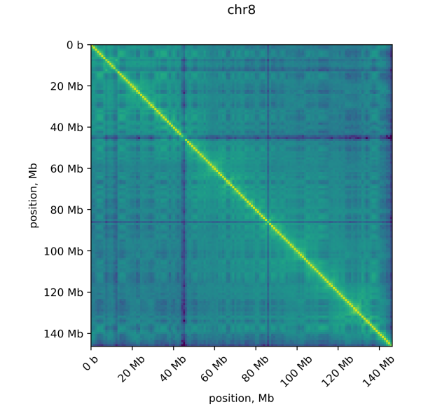
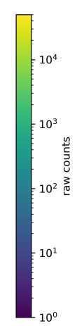
Per chromosome association plots

Slide 5
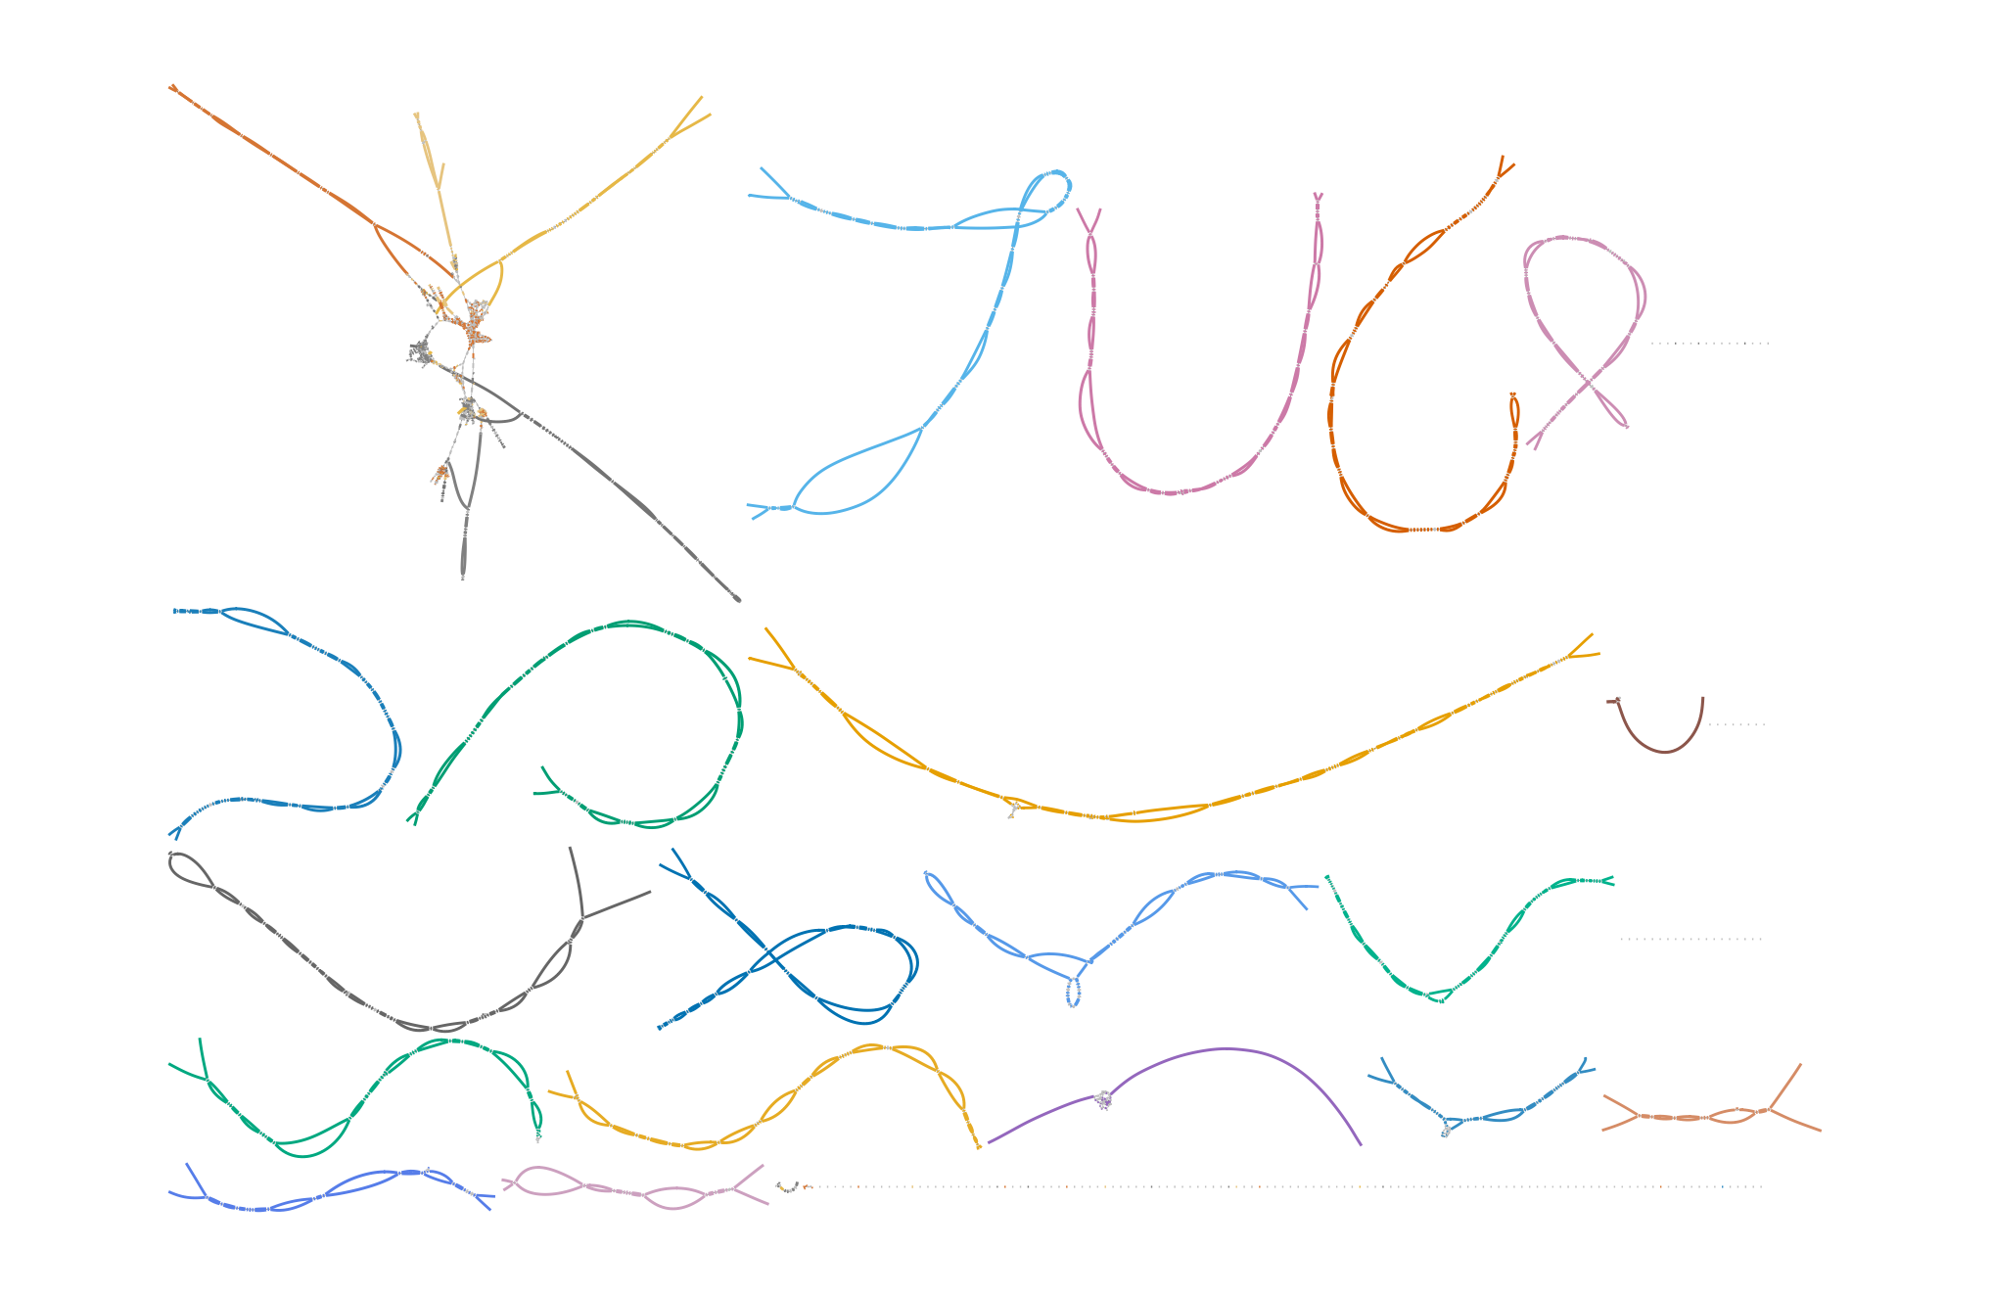
chr22
chr13
chr15
chr2
chr11
chr14
chr4
chr6
chr21
chr3
chr12
chr1
chrY
chr5
chr9
chr17
chr7
chr10
chrX
chr19
chr20
chr8
chr16
chr18
TUE_02_03UL

Slide 6
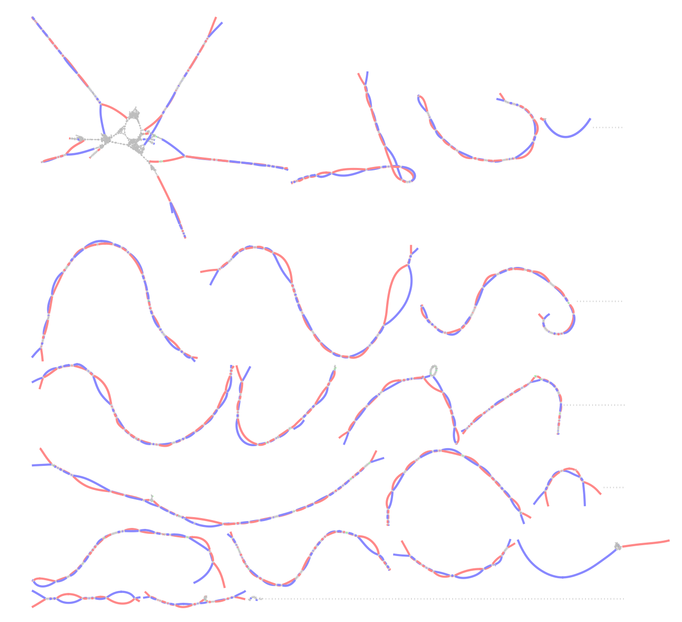
TUE_02_03UL

Slide 7
QC metrics
Metric | haplotype1 | haplotype2
Number of T2T chromosomes | 20 | 18
% of Assembly covered by Ref | 0.97 | 0.97
% of Ref covered by Assembly | 0.9 | 0.94
% of Ref duplicated in Assembly | 0.01 | 0.01
Assembly Length | 2934985356 | 3028541959
Average Ungapped Alignment length | 4167916 | 4482112
Genome Completeness (%) | 94.61 | 98.41
Missing Multi-Copy Genes (%) | 0.19 | 0.22
NG50 | 137904320 | 145923310
NG75 | 101150053 | 103627408
 | complete assembly
Phase Blocks | 46
Switch Rate (%) | 1.23
Quality Value | 58.48
Error Rate (%) | 0.00014
Variants Phased (%) | 98.7
3 UL Flowcells
1 PoreC
Assembled genome is not HG002

