Slide 1
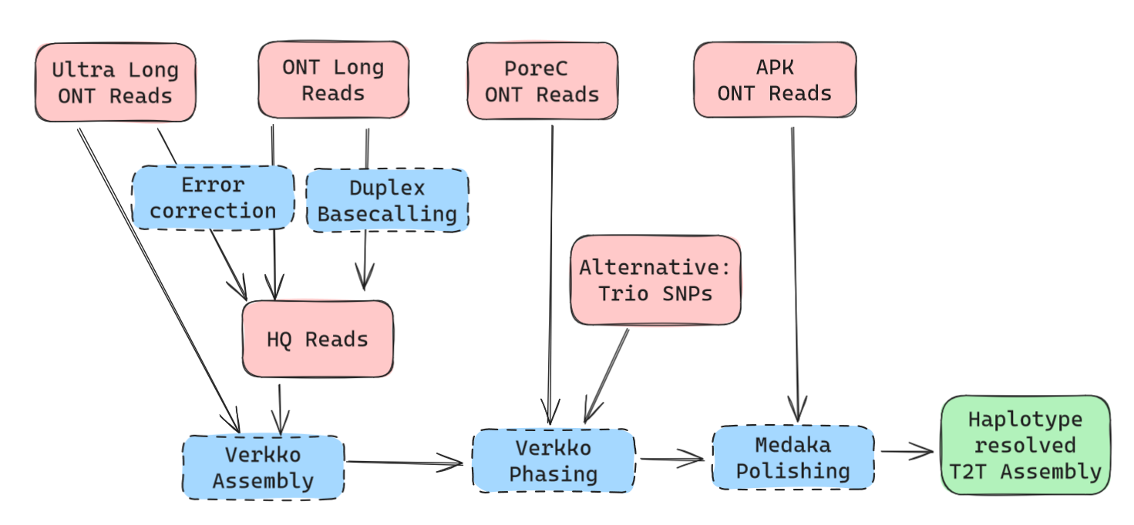
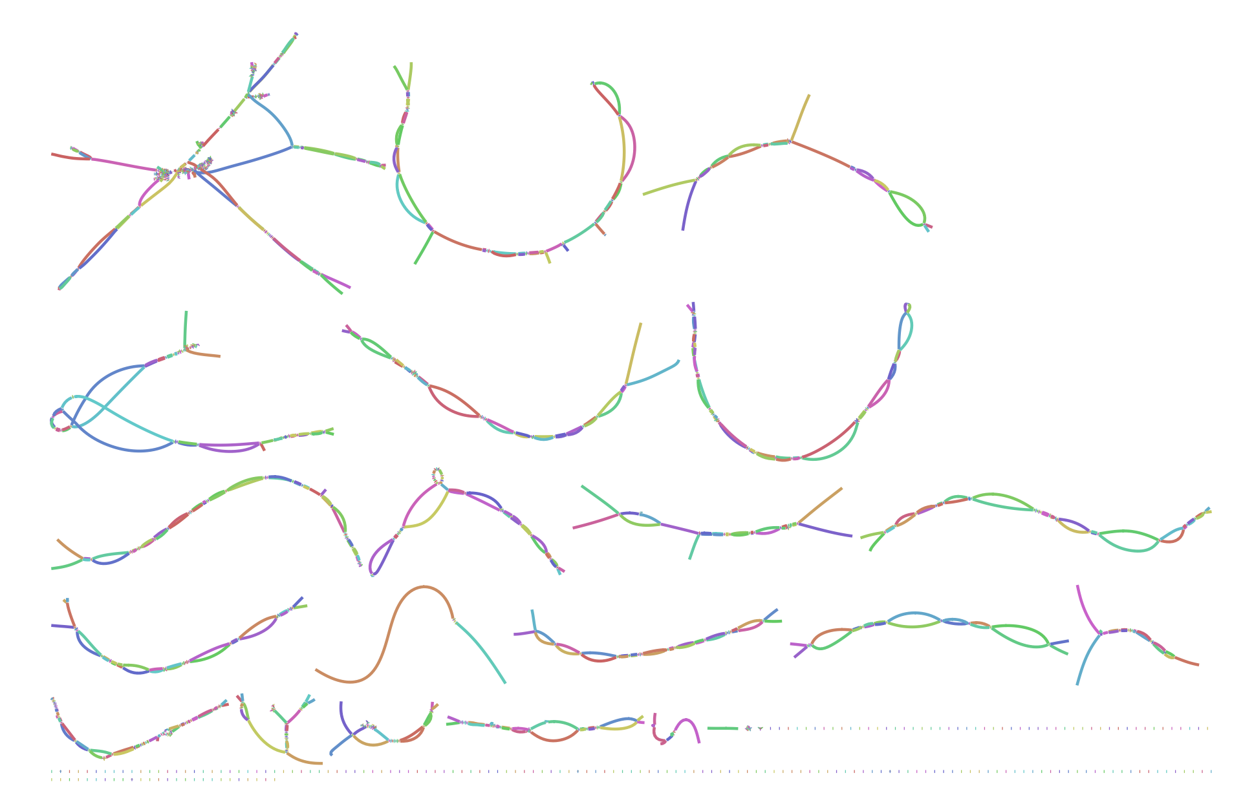
T2T-Assemblies
type | count | read_len | aligned_ref_len | match | ins | del | sub | iden | acc
duplex | 1666562 | 12050 | 11966 | 11905.0 | 6 | 8 | 8 | 99.91 | 99.76
herro | 562348 | 98595 | 98303 | 97561.5 | 43 | 49 | 87 | 99.92 | 99.81

