Slide 1
imgflo
visually programmable
server-side
image-processing
Jon Nordby @jononor

Slide 2
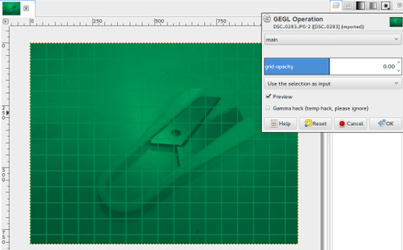
GEGL operations in GIMP 2.9+
.json operations in GEGL_PATH
Works in any GEGL app. Gnome Photos++
Notes:
Image processing library
Used in: GIMP, GNOME Photos, imgflo
- Operations: .c file (example)
Declares inputs/outputs/properties of various types
Some processing logic.
Commonly take buffer in, produce a new buffer out
Good as a primitive. But power of GEGL comes from building graphs
- Normal graph: built using
- Meta operations: typically built as .c files, similar way. But declaring “exported” inputs/outputs, so it can be used as an operation

Slide 3
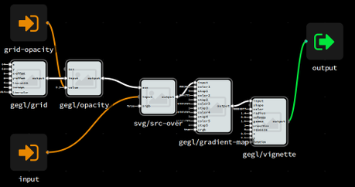
Visually programming operations
With Flowhub IDE
+
imgflo FBP runtime
Communicating over FBP runtime protocol
Notes:
Exports .json file, put into GEGL_PATH
Flowhub can be used with any system implementing FBP runtime protocol
http://noflojs.org/documentation/protocol/
Imgflo which does this for GEGL
Other tools:
.fbp DSL
fbp-spec

Slide 4
Batch processing
Shell script example
Job API coming! jonnor/imgflo-server#25

Slide 5
Use on web
Live demo app http://imgflo.herokuapp.com
Real-life example https://thegrid.io
Helper libraries
https://github.com/the-grid/rig
https://github.com/the-grid/imgflo-url
Notes:
http
The Grid
BTW, this page was autodesigned using
The Grid product
All layout built with an open source CSS replacement tool called GSS.
Talk tomorrow by Carl at 10.20

Slide 6
Recap
imgflo + Flowhub
live, node-based programming of
GEGL image processing operations/pipelines
GEGL .json metaops
allows using visual created ops in any GEGL-based app
GIMP, Gnome Photos, etc
imgflo-server
provides HTTP GET api for processing GEGL graphs
for images on web, batch jobs...

Slide 7
?
http://imgflo.org
This presentation
https://github.com/jonnor/imgflo
/tree/master/doc/lgm2015
Jon Nordby @jononor

Slide 8
Random notes
Notes:
HTTP frontend + workers
Supports horizontal scalability
One-click deploy to Heroku
HTTP GET API, params in URL
batch processing
<image src=”foo”>
http://Imgflo.herokuapp.com
Live instance we use in production
Can handle
1000+ requests/second cache
Per frontend dyno
Requires API keys
App-registration and free/demo tier coming link github

