Slide 1
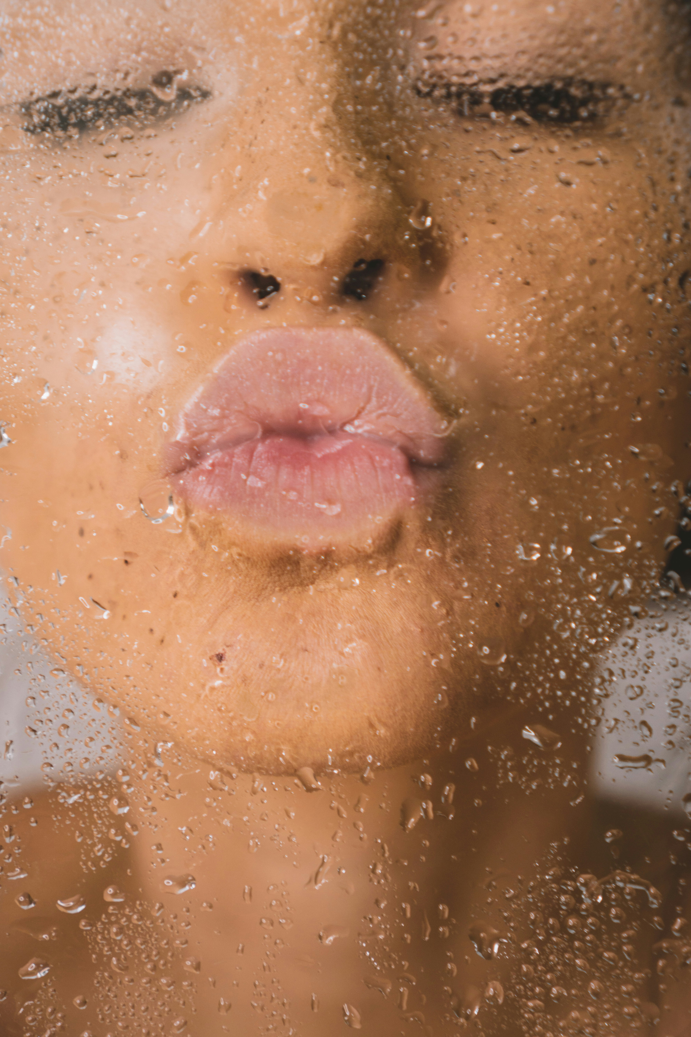
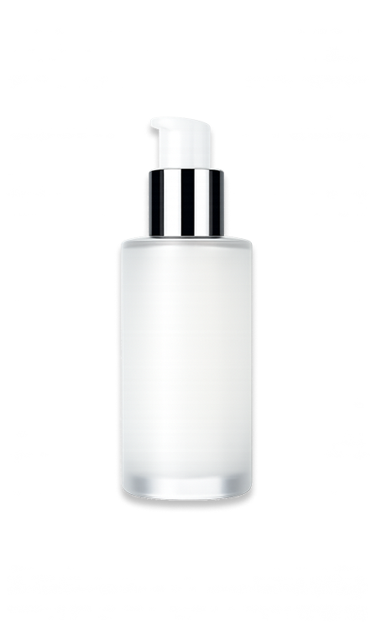
SKIIN
NATURAL SKINCARE
FOR EVERYBODY
Explore our carefully curated collection of premium skincare products, each crafted to nourish, rejuvenate, and protect your skin. From hydrating serums and rich moisturizers to revitalizing masks and gentle cleansers, every formula is designed to enhance your natural glow and support a healthy, radiant complexion.
www.reallygoodwebsite.com

