Slide 1
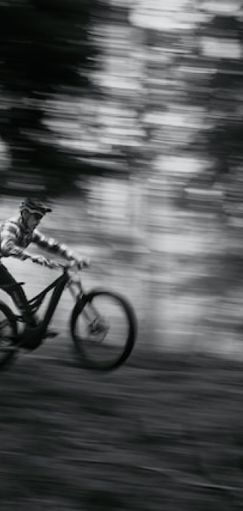
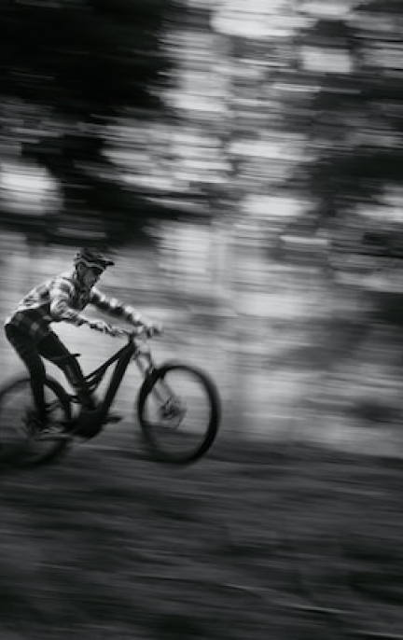


MOM WOULDN’T LIKE THIS
MOUNTAINBIKING MADEIRA — A MOVIE BY JAMES
RELEASE—
DECEMBER 25
PRESENTED BY—
JAMES
PREVIEW—
BERLIN

