Slide 1
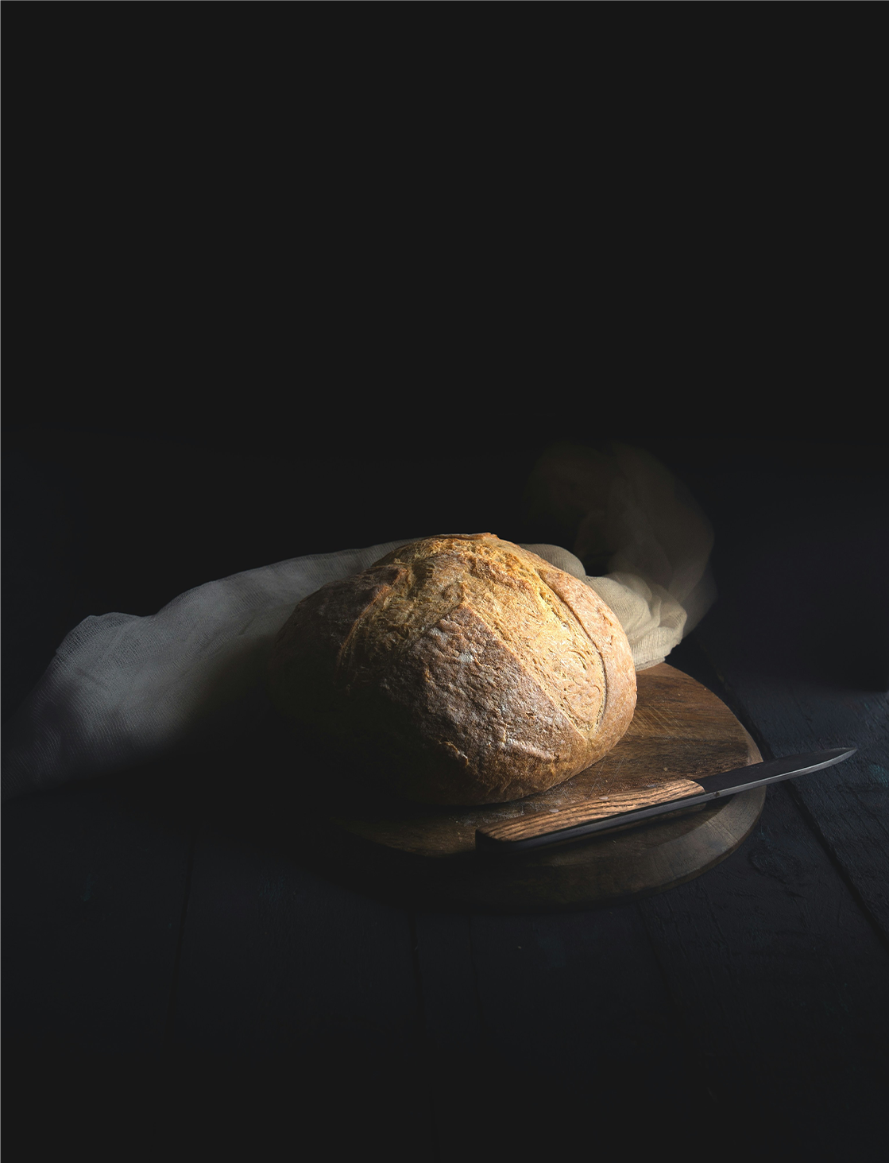


How good
is Bread?
Join our Live-Podcast about live
lessons straight from the oven.
Every sunday — 8.30 pm.

