Slide 1
Photography
Robbbb AND alkaline

Slide 2
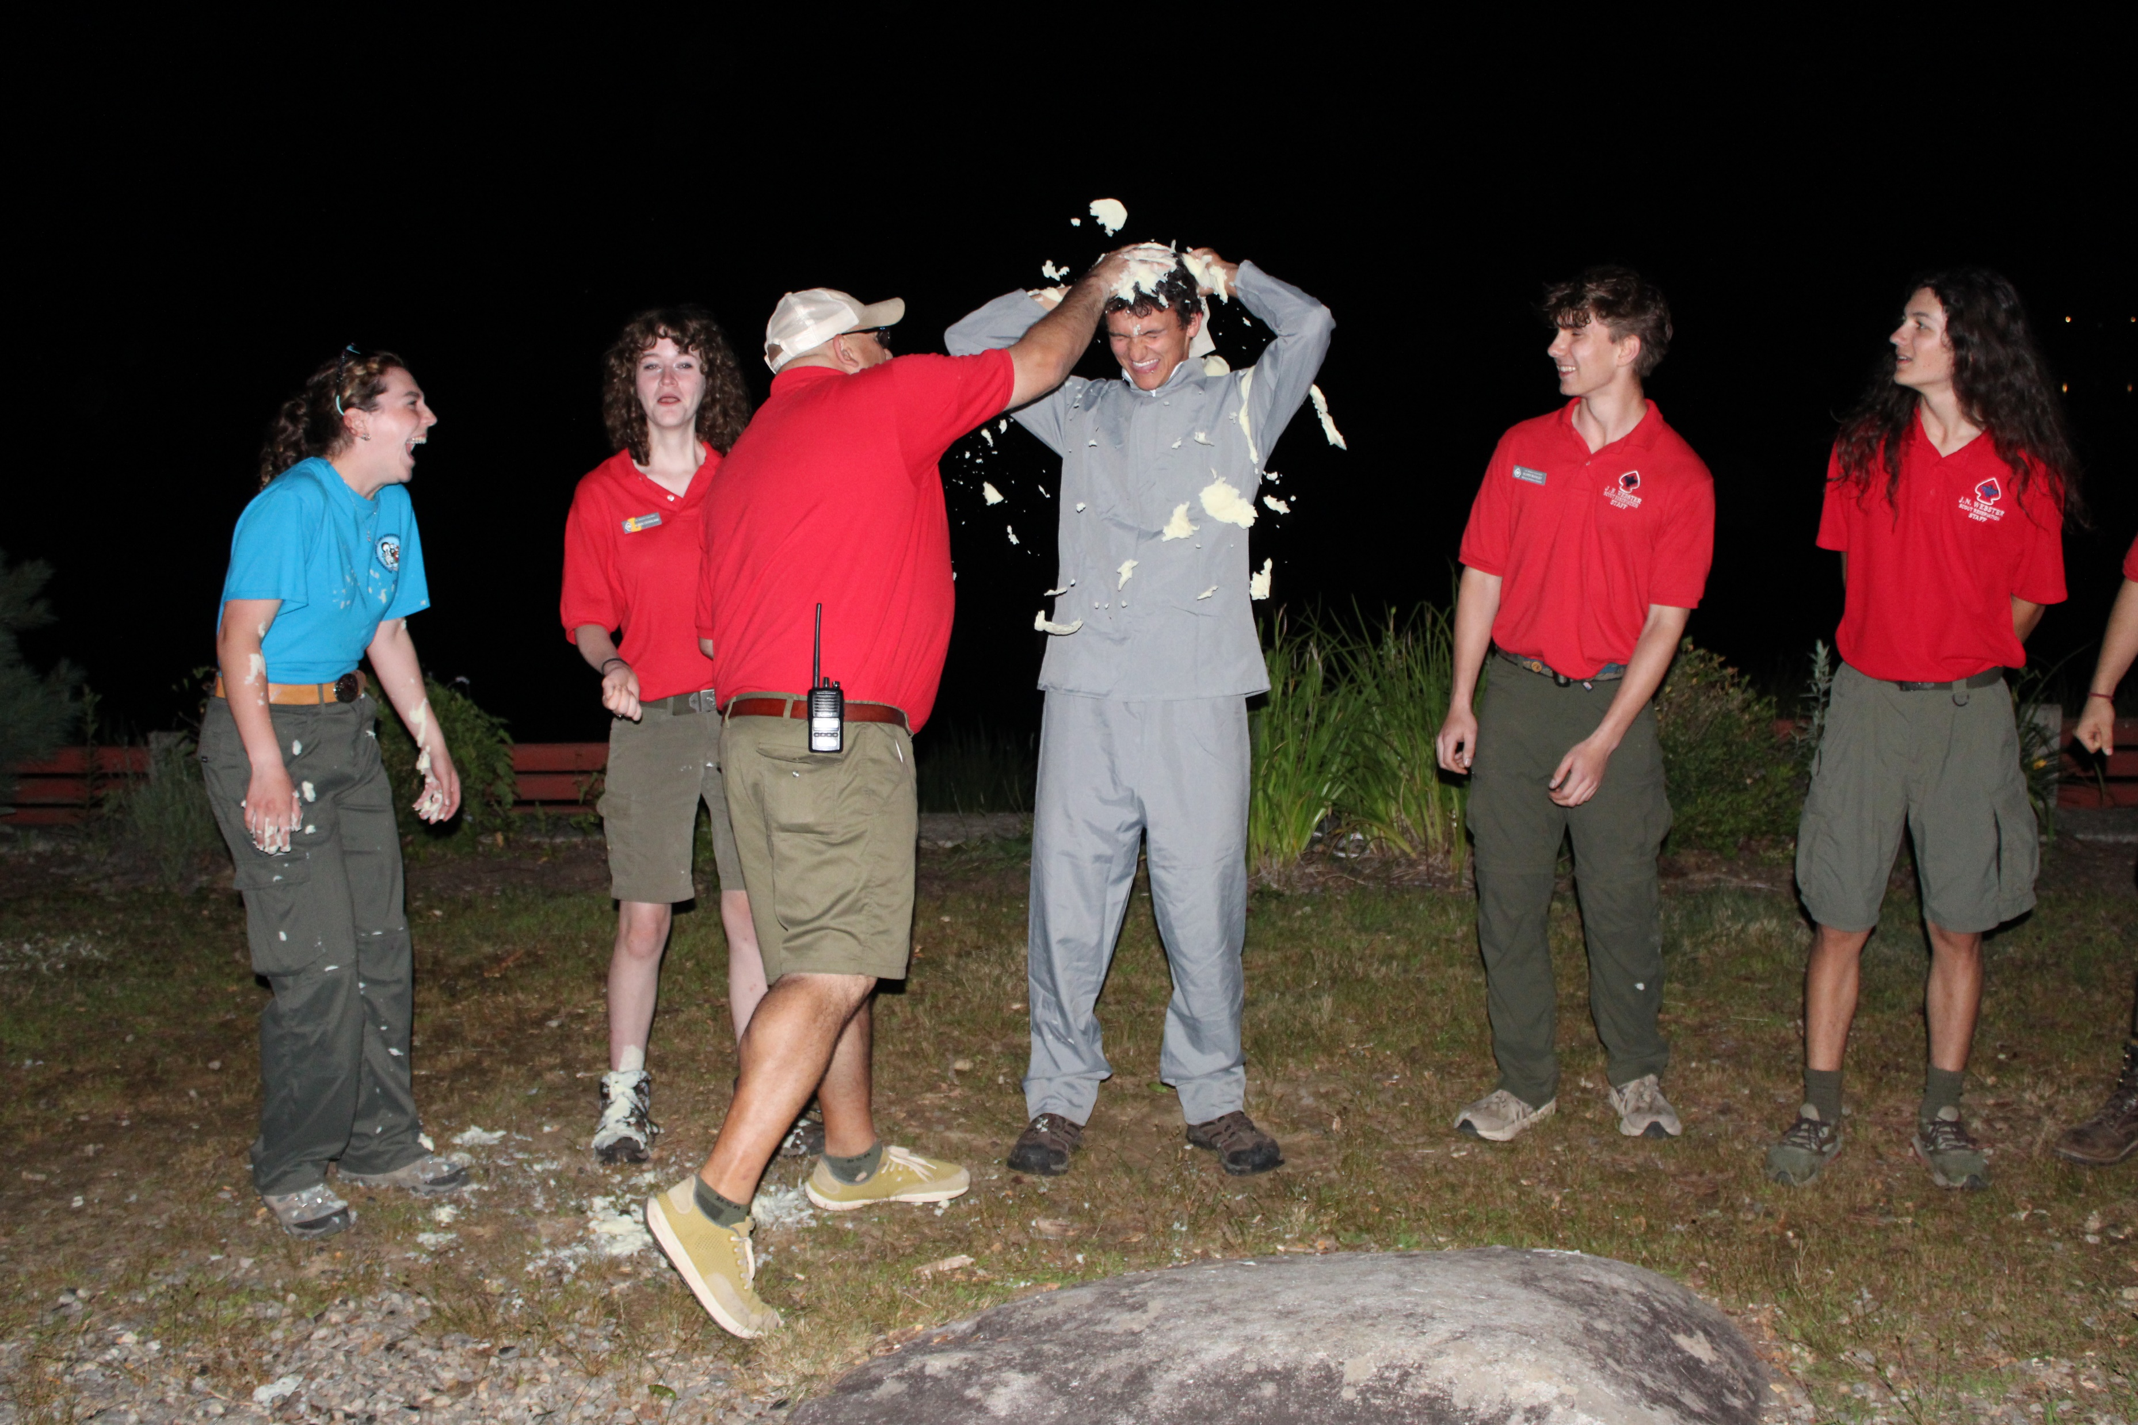
Safety
Photography is one of the most dangerous badges ever, right after fingerprinting.

Slide 3
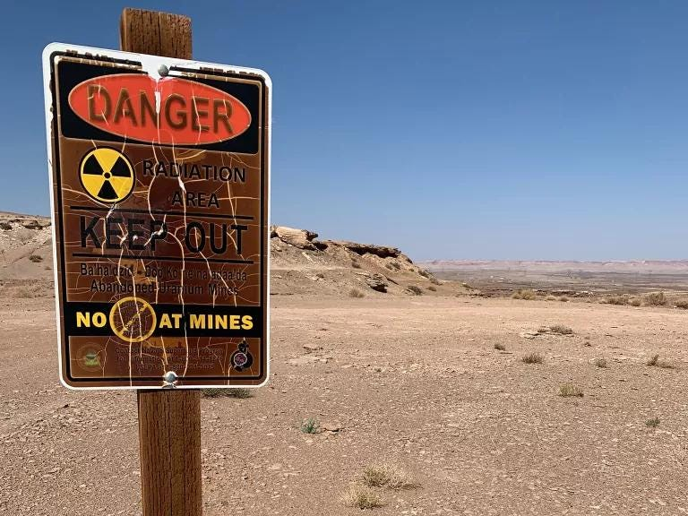
DANGERS!!!!!

Slide 4
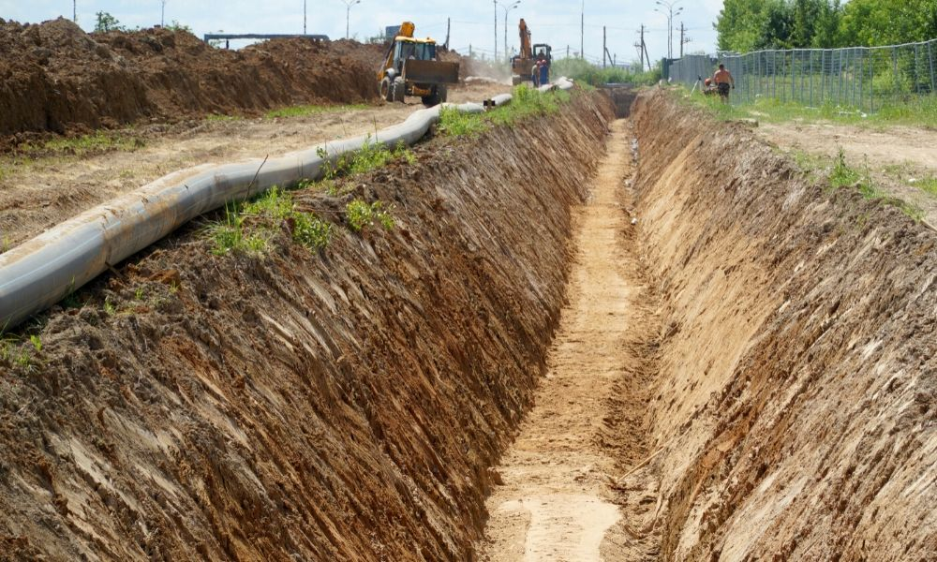
Pits

Slide 5
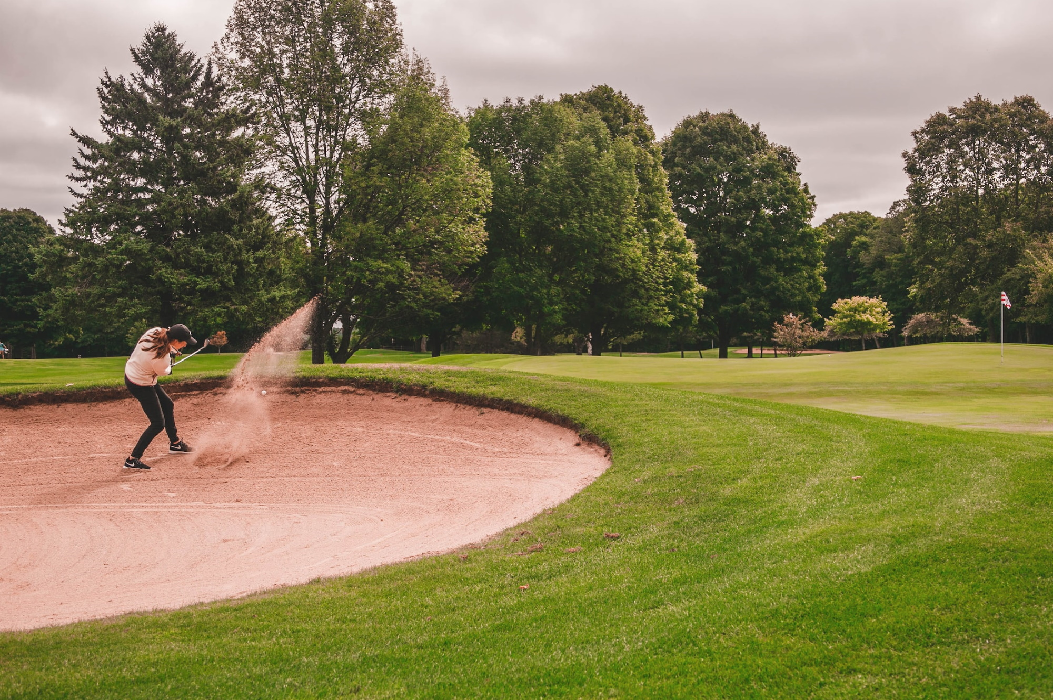
Sand Traps

Slide 6
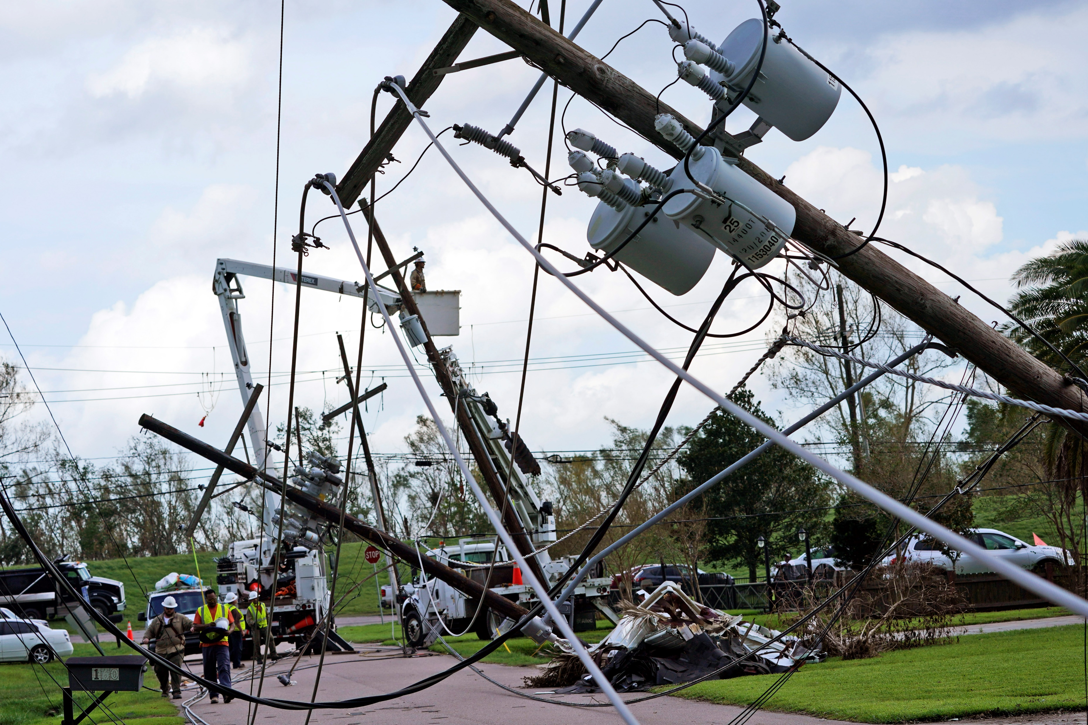
Downed Power Lines

Slide 7
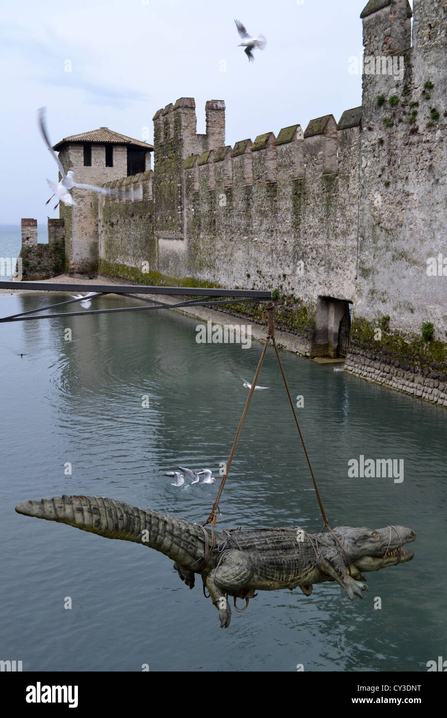
Gators

Slide 8
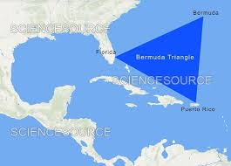
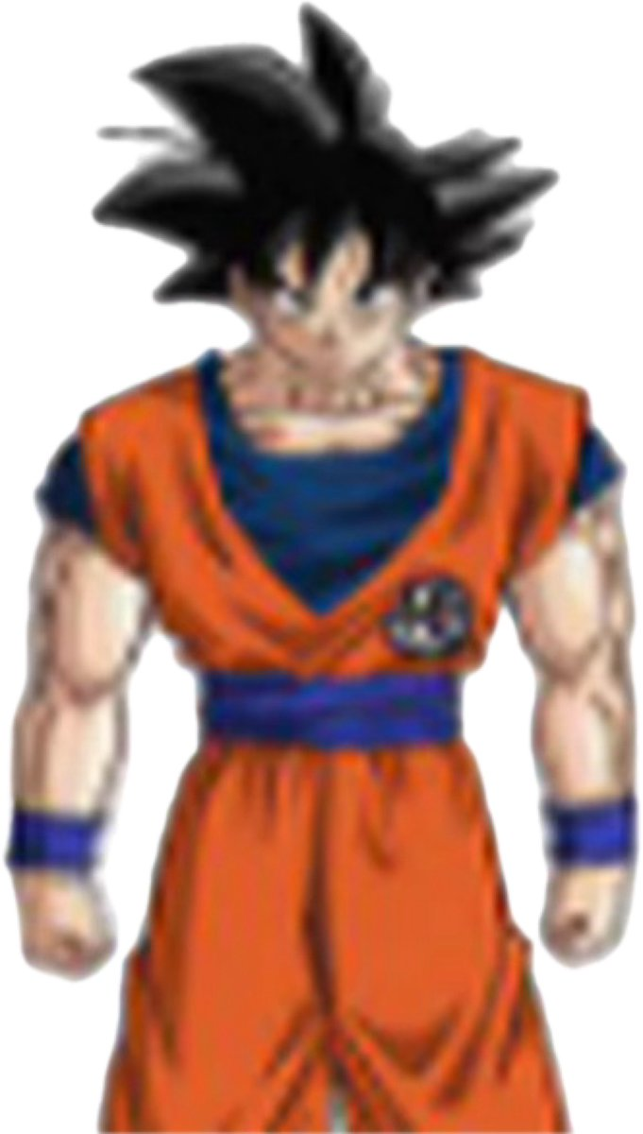
Bermuda Triangle

Slide 9
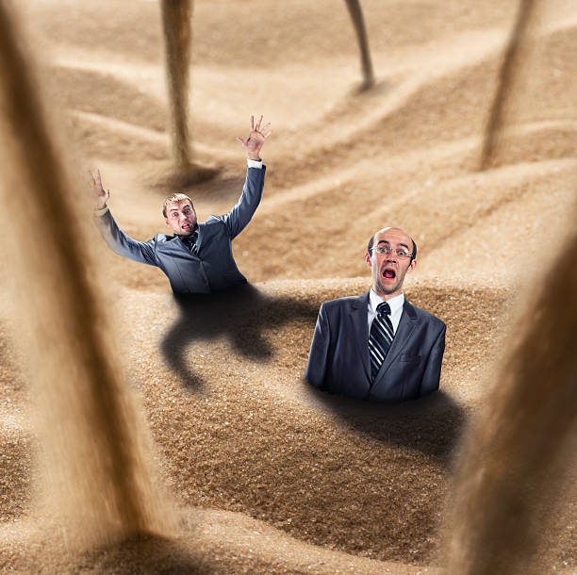
Quicksand

Slide 10
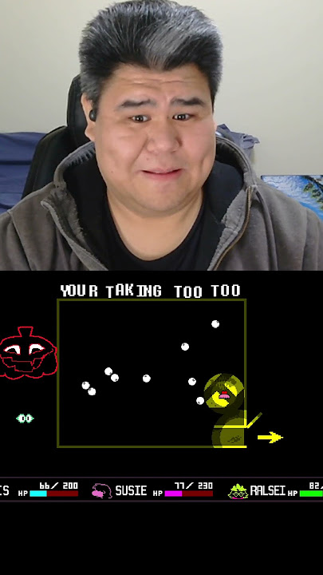
End ing timerrrrrr!!!!

