Slide 1
0
1
2
3
4
5
8
12
8
12
6
7
8
20
24
20
24
(1,2,2,1)
(1,2,2,1)
(1,3,3,1)
8
8
12
12
24
24
20
20
(1,2)
24
24
(1,2,2,2)

Slide 2
input_shape = (1,2,5)
np.arange(10).reshape(input_shape)
np.arange(10).reshape(input_shape).transpose((0,2,1))
(1,2,5)
(1,5,2)
0
1
2
3
4
5
6
7
8
9
(N,T,D)
0
5
0
1
2
3
4
1
6
5
6
7
8
9
2
7
(1,2,5)
3
8
4
9

Slide 3
x1 = layers.Conv1D(2, 3, kernel_initializer='ones')(x)
(1,5,2)
(3,2,2)
(1,3,2)
(N,T,D)
(W,C,FN)
0
5
1
6
21
21
2
7
33
33
27
27
3
8
33
33
4
9

Slide 4
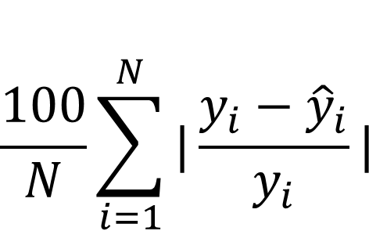
$$\frac{100}{N}\sum_{i=1}^{N}{\begin{aligned}|\frac{y_{i}−{\hat{y}}_{i}}{y_{i}}|\end{aligned}}$$
MAPE
m = tf.keras.metrics.MeanAbsolutePercentageError()
m.update_state([[1, 2],
[3, 4]],
[[4, 2],
[5, 3]])
# ((ads(4-1)/1*1+ads(2-2)/2*1+ads(5-3)/3*1+ads(3-4)/4*1)/4)*100
# 3 0 2 1
m.result().numpy()
# 97.91667

Slide 5
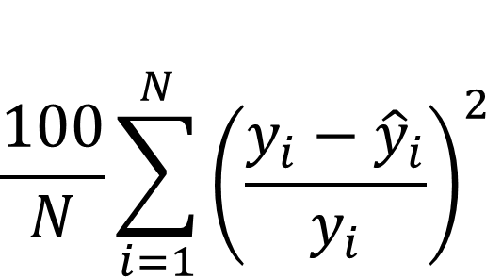
$$\frac{100}{N}\sum_{i=1}^{N}{\begin{aligned}{\left(\frac{y_{i}−{\hat{y}}_{i}}{y_{i}}\right)}^{2}\end{aligned}}$$
MSPE

Slide 6
class ST
{
public:
int kor, eng;
int total;
double aver;
void input();
void calc();
void output();
};
int main() {
ST st;
st.input();
st.calc();
st.output();
return 0;
}
main
input
Text
calc
output
0x7ffce602fe80
45
kor
st
Stack

Slide 8
1
1
2
2
2
2
4
4
4
4
.
=
1
1
2
2
2
2
4
4
4
4
(2,2)
(2,4)
(2,4)

Slide 9
tf.reduce_sum(inputs, axis=0)
1
1
1
1
(2,2)
2
2
=
0
0
+
2
2
(2,)
(2,)
(2,)
4
4
=
2
2
+
2
2
(2,)
(2,)
(2,)

Slide 10
inputs
w
1
1
1
1
1
1
1
1
1
1
1
1
1
1
1
1
.
1
1
1
1
1
1
1
1
1
1
1
1
1
1
1
1
1
1
1
1
1
1
1
(3,3)
(3,10)
3
3
3
3
3
3
3
3
3
3
3
3
3
3
3
3
3
3
3
3
3
3
3
3
3
3
3
3
3
3

Slide 11
a = np.array([1,2,3])
b = np.array([1,2])
result = tf.linalg.einsum('c,d->cd', a, b)
print(result)
1
2
[[1 2]
[2 4]
[3 6]]
1
2
3
1
2
2
4
(3,)
(2,)
3
6
(3,2)

Slide 12
a = np.array([[1,2,3],[4,5,6]])
b = np.array([[1,1],[2,2]])
result = tf.linalg.einsum('ic,id->cd', a, b)
print(result)
9
9
[[ 9 9]
[12 12]
[15 15]]
1
2
3
1
1
12
12
4
5
6
2
2
(2,2)
15
15
(2,3)
(3,2)
1
1
8
8
1
2
3
1
1
4
5
6
2
2
2
2
10
10
3
3
12
12

Slide 13
a = np.array([[[1,2,3],[4,5,6]], [[1,2,3],[4,5,6]]])
b = np.array([[[1,1],[1,1]], [[2,2],[2,2]]])
result = tf.linalg.einsum('ijc,ijd->cd', a, b)
print(result)
15
15
[[15 15]
[21 21]
[27 27]]
1
2
3
1
1
21
21
00
01
10
11
4
5
6
1
1
27
27
1
2
3
2
2
(3,2)
4
5
6
2
2
(2,2,3)
(2,2,2)
1
1
4
4
2
2
8
8
2
2
5
5
4
4
10
10
3
3
6
6
6
6
12
12

Slide 14
a = np.array([[[[1,2,3],[4,5,6]], [[1,2,3],[4,5,6]]], [[[1,2,3],[4,5,6]], [[1,2,3],[4,5,6]]]])
b = np.array([[[[1,1],[1,1]], [[2,2],[2,2]]], [[[1,1],[1,1]], [[2,2],[2,2]]]])
result = tf.linalg.einsum('bijc,bijd->bcd', a, b)
print(result)
15
15
[[15 15]
[21 21]
[27 27]]
1
2
3
1
1
21
21
00
01
10
11
4
5
6
1
1
27
27
1
2
3
2
2
4
5
6
15
15
2
2
(2,3,2)
21
21
1
2
3
1
1
27
27
4
5
6
1
1
1
2
3
2
2
4
5
6
2
2

Slide 15
a = np.array([[[[1,2], [1,2], [1,2]],
[[2,3], [2,3], [2,3]],
[[3,4], [3,4], [3,4]]]])
result = tf.linalg.einsum('bijc,bijd->bcd', a, a)
print(result)
1
2
2
4
1
2
2
4
(1,3,3,2)
(1,3,3,2)
1
2
[[[42 60]
[60 87]]]
2
4
1
2
1
2
4
6
(1,2,2)
1
2
1
2
6
9
1
2
1
2
4
6
42
60
6
9
2
3
2
3
60
87
4
6
2
3
2
3
6
9
9
12
4.6
6.6
2
3
2
3
12
16
6.6
9.6
3
4
3
4
9
12
12
[[[4.6666665 6.6666665]
[6.6666665 9.666667 ]]]
3
4
3
4
16
3
4
3
4
9
12
12
16

Slide 16
1
2
3
4
14
18
22
5
6
7
8
1
1
30
34
38
9
10
11
12
1
1
46
50
54
13
14
15
16
(2,2,1,1)
(N*OH*OW,C*FH*FW)
1
2
5
6
(9,4)(4,1)
(1*3*3,1*2*2)
(9,1)
1
1
1
1

Slide 17
1
2
3
1
1
4
5
6
1
1
1
3
5
3
7
8
9
5
12
16
9
(9,4)
11
24
28
15
1
1
1
1
7
15
17
9
1
(9,1)
(1,4)
2
2
2
2
2
3
3
3
3
3
1
1
1
1
4
4
4
4
4
[[ 1. 3. 5. 3.]
[ 5. 12. 16. 9.]
[11. 24. 28. 15.]
[ 7. 15. 17. 9.]]
5
5
5
5
5
6
6
6
6
6
7
7
7
7
7
8
8
8
8
8
9
9
9
9
9

Slide 18
1
3
2
1
2
1
1
4
10
6
3
4
1
1
3
7
4
(4,4)
(4,1)
(1,4)
1
1
1
1
1
2
2
2
2
2
1
1
1
1
3
3
3
3
3
[[ 1. 3. 5. 3.]
[ 5. 12. 16. 9.]
[11. 24. 28. 15.]
[ 7. 15. 17. 9.]]
4
4
4
4
4

Slide 19
N-F+1+2*0.5 = N
1
2
3
4
0
1
2
3
4
5
6
7
8
0
1
1
5
6
7
8
9
10
11
12
0
1
1
9
10
11
12
13
14
15
16
0
13
14
15
16
0
0
0
0
0
(2,2,1,1)
(N*OH*OW,C*FH*FW)
(16,4)(4,1)
(1*4*4,1*2*2)
(16,1)
(1,4,4,1)
1
1
1
1

Slide 20
N-F+1+2*0.5 = N
1
2
3
4
1
3
5
7
4
1
1
5
6
7
8
6
14
18
22
12
9
10
11
12
1
1
5
11
13
15
8
13
14
15
16
(2,2,1,1)
(16,4)
(N*OH*OW,C*FH*FW)
(1*4*4,1*2*2)
1
(16,1)
(1,4)
1
1
1
1
2
2
2
2
2
...
1
1
1
1
..
.
.
.
[[ 1. 3. 5. 7.]
[ 6. 14. 18. 22.]
[14. 30. 34. 38.]
[22. 46. 50. 54.]]
16
16
16
16
16

Slide 21
(N-F+1+2*0.5)/2 = Out
1
2
3
4
1
1
5
6
7
8
9
10
11
12
1
1
13
14
15
16
(2,2,1,1)
(N*OH*OW,C*FH*FW)
(1*4*4,1*2*2)
(4,4)
(4,1)
1
2
5
6
1
14
3
4
7
8
1
22
14
22
.
9
10
13
14
1
46
46
54
11
12
15
16
1
54

Slide 22
(5-2+1+2*0.5)/2 = Out
(N-F+1+2*0.5)/2 = Out
1
1
2
2
1
2
1
1
1
1
2
2
3
4
1
1
3
3
4
4
(2,2,1,1)
3
3
4
4
(N*OH*OW,C*FH*FW)
(1*4*4,1*2*2)
(4,1)
1
(1,4)
1
1
1
1
2
2
2
2
2
.
1
1
1
1
3
3
3
3
3
4
4
4
4
4

Slide 23
(N-F+2*0.5)/2+1 = Out
1
2
3
4
1
3
5
7
4
1
1
5
6
7
8
6
14
18
22
12
9
10
11
12
1
1
5
11
13
15
8
13
14
15
16
(2,2,1,1)
(16,4)
(N*OH*OW,C*FH*FW)
(1*4*4,1*2*2)
1
(16,1)
(1,4)
1
1
1
1
2
2
2
2
2
...
1
1
1
1
..
.
.
.
[[ 1. 3. 5. 7.]
[ 6. 14. 18. 22.]
[14. 30. 34. 38.]
[22. 46. 50. 54.]]
16
16
16
16
16

Slide 24
(N-F+2*0.5)/2+1 = Out
1
2
3
4
14
22
1
1
5
6
7
8
46
54
9
10
11
12
1
1
13
14
15
16
[[14. 22.]
[46. 54.]]
(2,2,1,1)
(4,4)
(4,1)
(4,1)
1
2
5
6
1
14
3
4
7
8
.
1
22
14
22
9
10
13
14
1
46
46
54
11
12
15
16
1
54

Slide 25
(N-F+2*0.5)/2+1 = Out
1
2
3
4
14
22
1
1
5
6
7
8
46
54
9
10
11
12
1
1
13
14
15
16
[[14. 22.]
[46. 54.]]
(2,2,1,1)
dout
dout
dx
dcol
(4,1)
(4,1)
1
1
2
2
1
1
1
1
1
(1,4)
1
1
1
2
2
2
2
2
2
2
.
2
1
2
1
1
1
1
3
3
4
4
3
3
3
3
3
3
3
4
3
3
4
4
4
4
4
4
4
4
[[1. 1. 2. 2.]
[1. 1. 2. 2.]
[3. 3. 4. 4.]
[3. 3. 4. 4.]]

Slide 26
Conv2D : padding=same, strides=2
(N-F)//S+1 = Out
(4-2+2*0.5)//2+1 = 2
1
2
3
4
0
14
22
1
1
5
6
7
8
0
46
54
9
10
11
12
0
1
1
13
14
15
16
0
[[14. 22.]
[46. 54.]]
(2,2,1,1)
0
0
0
0
0
(4,4)
(4,1)
(4,1)
1
2
5
6
1
14
3
4
7
8
.
1
22
14
22
9
10
13
14
1
46
46
54
11
12
15
16
1
54

Slide 27
Conv2DTranspose : padding=same, strides=2
N = (Out-1)*S+F-2*P
1
2
3
4
(2-1)*2+2-2*0.5
14
22
5
6
7
8
(2)*2
46
54
1
1
9
10
11
12
13
14
15
16
1
1
[[14. 22.]
[46. 54.]]
(2,2,1,1)
dout
dout
dx
dcol
(4,1)
(4,1)
1
1
2
2
1
1
1
1
1
(1,4)
1
1
1
2
2
2
2
2
2
2
.
2
1
2
1
1
1
1
3
3
4
4
3
3
3
3
3
3
3
4
3
3
4
4
4
4
4
4
4
4
[[1. 1. 2. 2.]
[1. 1. 2. 2.]
[3. 3. 4. 4.]
[3. 3. 4. 4.]]

Slide 28
Conv2D : padding=same, strides=2
(N-F+2*P)//S+1 = Out
(3-2+2*P)//2+1 = 2
1
2
3
0
12
9
1
1
4
5
6
0
15
9
1
1
7
8
9
0
0
0
0
0
[[12. 9.]
[15. 9.]]
(2,2,1,1)
(4,4)
(4,1)
(4,1)
1
2
4
5
1
12
3
0
6
0
.
1
9
12
9
7
8
0
0
1
15
15
9
9
0
0
0
1
9

Slide 29
Conv2DTranspose : padding=same, strides=2
N = (Out-1)*S+F-2*P
1
2
3
4
(2-1)*2+2-2*0.5
5
6
7
8
(2)*2
9
10
11
12
13
14
15
16
dout
dout
dx
dcol
(4,1)
(4,1)
1
1
2
2
1
1
1
1
1
(1,4)
1
1
1
2
2
2
2
2
2
2
.
2
1
2
1
1
1
1
3
3
4
4
3
3
3
3
3
3
3
4
3
3
4
4
4
4
4
4
4
4
[[1. 1. 2. 2.]
[1. 1. 2. 2.]
[3. 3. 4. 4.]
[3. 3. 4. 4.]]

Slide 30
Conv2DTranspose : padding=same, strides=2, output_padding=1
P = F//2
N = (Out-1)*S+F-2*P+1
if output_padding:
new_rows = ((rows - 1) * strides[0] + kernel_size[0] - 2 * padding[0] + output_padding[0])
else
new_rows = rows * strides[0]
dout
dout
dx
dcol
(4,1)
(4,1)
1
1
2
2
1
1
1
1
1
(1,4)
1
1
1
2
2
2
2
2
2
2
.
2
1
2
1
1
1
1
3
3
4
4
3
3
3
3
3
3
3
4
3
3
4
4
4
4
4
4
4
4
[[1. 1. 2.]
[1. 1. 2.]
[3. 3. 4.]]

Slide 31
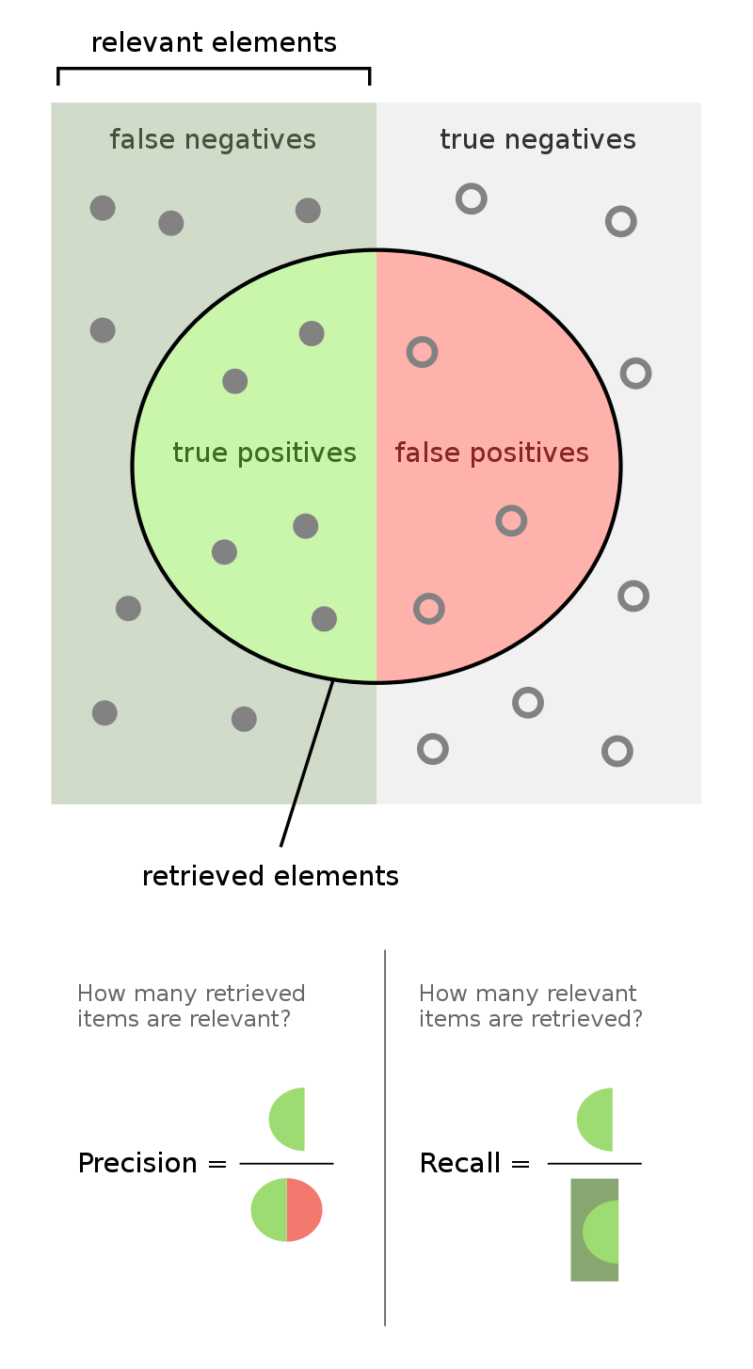
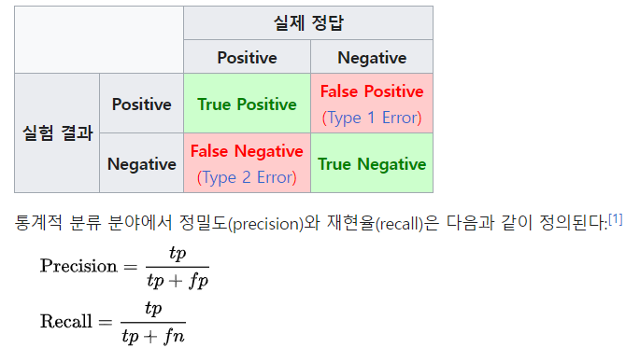


Slide 32
cls 이 ##기 ##범 한 ##두 쪽 ##을 먹 ##고 10 ##분 후 ##쯤 화 ##제 ##인 을 먹는 것이 좋다고 한다 .
logits.shape => (1,111,30) => (111,30)
0.1
0.2
0.3
0.2
0.1
labels.shape => (1,111)
[ 0 2 3 3 1 1 1 1 1 1 16 17 17 17 12 13 13 1 1 1 1 1 1 1
0 0 0 0 0 0 0 0 0 0 0 0 0 0 0 0 0 0 0 0 0 0 0 0
0 0 0 0 0 0 0 0 0 0 0 0 0 0 0 0 0 0 0 0 0 0 0 0
0 0 0 0 0 0 0 0 0 0 0 0 0 0 0 0 0 0 0 0 0 0 0 0
0 0 0 0 0 0 0 0 0 0 0 0 0 0 0]

Slide 33
def compute_loss(labels, logits):
loss_fn = tf.keras.losses.SparseCategoricalCrossentropy(
from_logits=True, reduction=tf.keras.losses.Reduction.NONE
)
# 0의 레이블 값은 손실 값을 계산할 때 제외
active_loss = tf.reshape(labels, (-1,)) != 0
# reduced_logits = tf.boolean_mask(tf.reshape(logits, (-1, shape_list(logits)[2])), active_loss)
reduced_logits = tf.boolean_mask(tf.reshape(logits, (-1, logits.shape[2])), active_loss)
labels = tf.boolean_mask(tf.reshape(labels, (-1,)), active_loss)
return loss_fn(labels, reduced_logits)

Slide 34
from seqeval.metrics import precision_score
y_true = [['O', 'O', 'B-MISC', 'I-MISC', 'B-MISC', 'O', 'O']]
y_pred = [['O', 'O', 'B-MISC', 'I-MISC', 'B-MISC', 'I-MISC', 'O']]
precision_score(y_true, y_pred, average=None)
array([0.5])
recall_score(y_true, y_pred, average=None)
array([0.5])
정밀도
1/2 => 50%

Slide 35

from seqeval.metrics import precision_score
y_true = [['O', 'O', 'B-MISC', 'I-MISC', 'B-MISC', 'B-PER', 'B-LOC']]
y_pred = [['O', 'B-PER', 'B-MISC', 'I-MISC', 'B-MISC', 'B-TIM', 'B-LOC']]
precision_score(y_true, y_pred, average=None)
array([0.6])
recall_score(y_true, y_pred, average=None)
정밀도
3/5 => 60%
$$\frac{2∗정밀도∗재현률}{정밀도+재현률}$$
F1 score=66.6%
재현율
3/4 => 75%

Slide 36
(1,56,128)=>(1,56,128) label(true)=4.5
(pred)=3.0

Slide 37
1
1
1
1
1
1
1
3
3
3
3
.
=
1
1
1
1
1
1
1
3
3
3
3
x
(2,3)
1
1
1
1
(2,4)
z
w
(3,4)
x
dz
.
z
grad_fn=<MmBackward0>
w
dw
MmBackward0

Slide 38
1
1
4
4
4
4
2
2
2
2
1
1
.
=
2
2
2
2
4
4
4
4
1
1
4
4
4
4
dz
(2,4)
x.T
(3,2)
dw
(3,4)
1
1
1
2
2
2
2
1
1
1
8
8
8
.
=
2
2
2
2
1
1
1
8
8
8
dz
(2,4)
1
1
1
dx
(2,3)
w.T
(4,3)
x
dz
.
z
grad_fn=<MmBackward0>
w
dw
MmBackward0

Slide 39
1
1
1
1
1
1
1
1
2
2
2
2
+
=
1
1
1
1
1
1
1
1
2
2
2
2
temp
(2,4)
b
(2,4)
z
(2,4)
3
3
3
3
3
3
3
3
dz
(2,4)
dz
temp
dz
+
z
b
dz
AddBackward0

Slide 40
1
1
1
1
1
1
1
1
2
2
2
2
+
=
1
1
1
1
1
1
1
1
2
2
2
2
temp
(2,4)
z
(2,4)
6
6
6
6
1
1
1
1
3
3
3
3
db
(4,)
b
(4,)
3
3
3
3
dz
dz
(2,4)
temp
dz
+
z
b
dz
repeat
b
AddBackward0
db
<RepeatBackward0>

Slide 41
dx
x
dz
.
temp
dz
+
w
z
dw
b
dz
AddBackward0
repeat
AddBackward0
b
db
<RepeatBackward0>

Slide 42

4
2
2
2
2
$$(inp+1)^2$$
1
0
0
0
0
2
4
2
2
2
2
2
4
2
2
1
1
1
1
1
0
1
0
0
0
4
2
2
2
2
2
2
2
4
2
1
1
1
1
1
0
0
1
0
0
inp.grad
2
4
2
2
2
1
1
1
1
1
1
1
1
1
0
0
0
1
0
2
2
4
2
2
1
1
1
1
inp
1
1
1
1
1
2
2
2
4
2
1
1
1
1
+
1
1
1
1
(inp+1)
^2
t()
dout
1
1
1
1
1
out
2
1
1
1
1
1
2
1
1
1
4
1
1
1
1
1
2
1
1
1
4
1
1
1
1
1
2
1
1
2
4
1
1
1
1
4
1
1
1
1

