Slide 1
def non_max_suppression(boxes, probs=None, overlapThresh=0.3):
if len(boxes) == 0:
return []
if boxes.dtype.kind == "i":
boxes = boxes.astype("float")
pick = []
x1 = boxes[:, 0] # [100,100,100,1000,1000] , (5,)
y1 = boxes[:, 1] # [200,200,200,100,100]
x2 = boxes[:, 2] # [350,400,300,1150,1200]
y2 = boxes[:, 3] # [300,500,800,600,700]
area = (x2 - x1 + 1) * (y2 - y1 + 1) # (5,)
idxs = probs
idxs = np.argsort(idxs)
boxes=np.array([
[100,200,350,300],
[100,200,400,500],
[100,200,300,800],
[1000,100,1150,600],
[1000,100,1200,700]
]) # (5,4)
probs = np.array([0.5,0.6,0.9,0.7,0.8])
idxs = np.array([0, 1, 3, 4, 2])
(1000,100)
(100,200)
0.7
0.5
(350,300)
0.6
(400,500)
(1150,600)
[ 100. 100. 100. 1000. 1000.]
[200. 200. 200. 100. 100.]
[ 350. 400. 300. 1150. 1200.]
[300. 500. 800. 600. 700.]
0.8
0.9
(1200,700)
(300,800)
(251,101)

Slide 2
while len(idxs) > 0:
last = len(idxs) - 1
i = idxs[last]
pick.append(i)
print(x1[i]) # 100
ptint(x1[idxs[:last]]) # [100,100,1000,1000]
xx1 = np.maximum(x1[i], x1[idxs[:last]])
# [100,100,100,100] [100,100,1000,1000]
# print(xx1) # [100,100,1000,1000]
yy1 = np.maximum(y1[i], y1[idxs[:last]])
# print(yy1) # [200,200,200,200]
xx2 = np.minimum(x2[i], x2[idxs[:last]])
# print(xx2) # [300,300,300,300]
yy2 = np.minimum(y2[i], y2[idxs[:last]])
# print(yy2) # [300,500,600,700]
w = np.maximum(0, xx2 - xx1 + 1)
print(w) # [0,0,0,0] [201,201,-699,-699] => [201,201,0,0]
h = np.maximum(0, yy2 - yy1 + 1)
print(w) # [0,0,0,0] [101,301,401,501] => [101,301,401,501]
print(area[idxs[:last]]) # [251*101,301*301,151*501,201*601]
overlap = (w * h) / area[idxs[:last]]
print(overlap) # [20301,60501,0,0] / [251*101,301*301,151*501,201*601]
# [0.80,0.67,0,0]
print(np.where(overlap > overlapThresh)[0]) # [0,1]
print(np.concatenate(([last],np.where(overlap > overlapThresh)[0]))
# [4,0,1]
idxs = np.delete(idxs, np.concatenate(([last],
np.where(overlap > overlapThresh)[0])))
return pick
last
idxs
0
1
3
4
2
pick
2
last
idxs
3
4
pick
2
4
(1000,100)
(100,200)
0.7
0.5
(350,300)
0.6
(400,500)
(1150,600)
0.8
0.9
(1200,700)
(300,800)

Slide 3
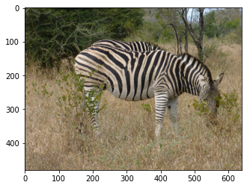
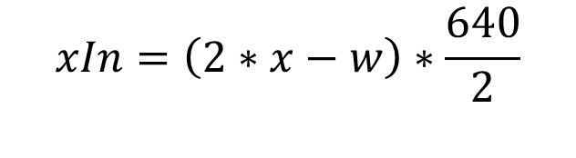
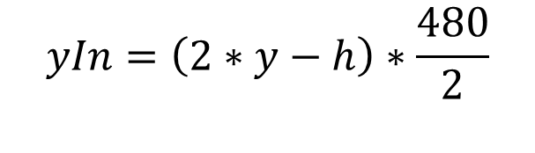
DT=(0.657031, 0.653125, 0.648438, 0.552083)
# box : (centerX, centerY, width, height)
def convertToAbsoluteValues(size, box):
xIn = round(((2 * float(box[0]) - float(box[2])) * size[0] / 2))
yIn = round(((2 * float(box[1]) - float(box[3])) * size[1] / 2))
xEnd = xIn + round(float(box[2]) * size[0])
yEnd = yIn + round(float(box[3]) * size[1])
if xIn < 0:
xIn = 0
if yIn < 0:
yIn = 0
if xEnd >= size[0]:
xEnd = size[0] - 1
if yEnd >= size[1]:
yEnd = size[1] - 1
return (xIn, yIn, xEnd, yEnd)
GT=(0.572656, 0.523958, 0.698438, 0.589583)
size=(640,480)
640
(143,110)
480
(0.572656,0.523958)
(590,393)
$$xIn=\left(2∗x−w\right)∗\frac{640}{2}$$
$$yIn=\left(2∗y−h\right)∗\frac{480}{2}$$
(143, 110, 590, 393)

Slide 4
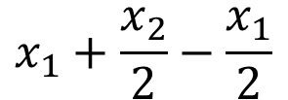

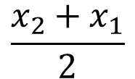
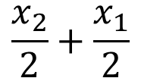
DT=(0.657031, 0.653125, 0.648438, 0.552083)
def convertToRelativeValues(size, box):
dw = 1. / (size[0])
dh = 1. / (size[1])
cx = (box[1] + box[0]) / 2.0
cy = (box[3] + box[2]) / 2.0
w = box[1] - box[0]
h = box[3] - box[2]
x = cx * dw
y = cy * dh
w = w * dw
h = h * dh
return (x, y, w, h)
GT=(0.572656, 0.523958, 0.698438, 0.589583)
size=(640,480)
(143, 110, 590, 393)
640
(143,110)
(143, 590, 110, 393)
480
(0.572656,0.523958)
(590,393)
$$x_{1}+(x_{2}−x_{1})/2$$
$$x_{1}+\frac{x_{2}}{2}−\frac{x_{1}}{2}$$
$$\frac{x_{2}}{2}+\frac{x_{1}}{2}$$
$$\frac{x_{2}+x_{1}}{2}$$

Slide 5
def AP(detections, groundtruths, classes, IOUThreshold = 0.3, method = 'AP'):
result = []
for c in classes:
dects = [d for d in detections if d[1] == c]
gts = [g for g in groundtruths if g[1] == c]
dects = sorted(dects, key = lambda conf : conf[2], reverse=True)
TP = np.zeros(len(dects))
FP = np.zeros(len(dects))
det = Counter(cc[0] for cc in gts)
for key, val in det.items():
det[key] = np.zeros(val)
dects
[['363', 0.0, 0.92, (280, 69, 696, 435)] ,
['297', 0.0, 0.77, (499, 286, 791, 455)],
['297', 0.0, 0.33, (138, 173, 335, 330)]]
gts
[['297', 0.0, 1.0, (106, 195, 303, 352)],
['297', 0.0, 1.0, (548, 250, 841, 419)],
['363', 0.0, 1.0, (207, 108, 624, 474)],
['299', 0.0, 1.0, (434, 223, 715, 386)]]
det
TP
0
0
0
0
0
'297'
det
'363'
0
FP
Counter({'297': 2, '363': 1, '299': 1})
'299'
0
0
0
0

Slide 6
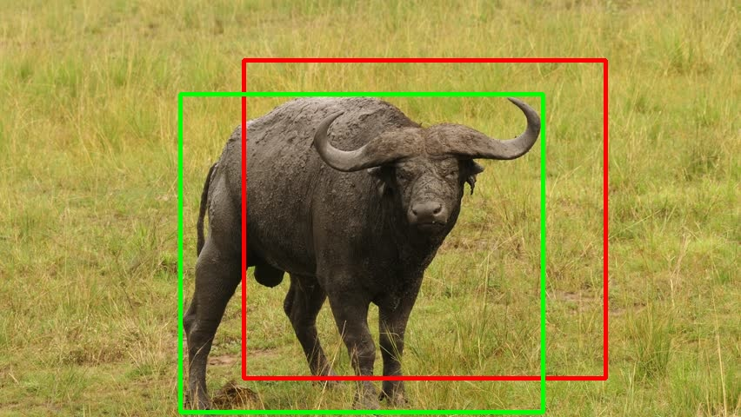
for d in range(len(dects)):
gt = [gt for gt in gts if gt[0] == dects[d][0]]
iouMax = 0
for j in range(len(gt)):
iou1 = iou(dects[d][3], gt[j][3])
if iou1 > iouMax:
iouMax = iou1
jmax = j
if iouMax >= IOUThreshold:
if det[dects[d][0]][jmax] == 0:
TP[d] = 1
det[dects[d][0]][jmax] = 1
else:
FP[d] = 1
else:
FP[d] = 1
dects
[['363', 0.0, 0.92, (280, 69, 696, 435)] ,
['297', 0.0, 0.77, (499, 286, 791, 455)],
['297', 0.0, 0.33, (138, 173, 335, 330)]]
gts
[['297', 0.0, 1.0, (106, 195, 303, 352)],
['297', 0.0, 1.0, (548, 250, 841, 419)],
['363', 0.0, 1.0, (207, 108, 624, 474)],
['299', 0.0, 1.0, (434, 223, 715, 386)]]
gt
[['363', 0.0, 1.0, (207, 108, 624, 474)]]
det
363
0
0
d
TP
iouMax
jmax
'297'
1
0
0
0.58
0
'363'
1
'299'
FP
0
0
0
0

Slide 7
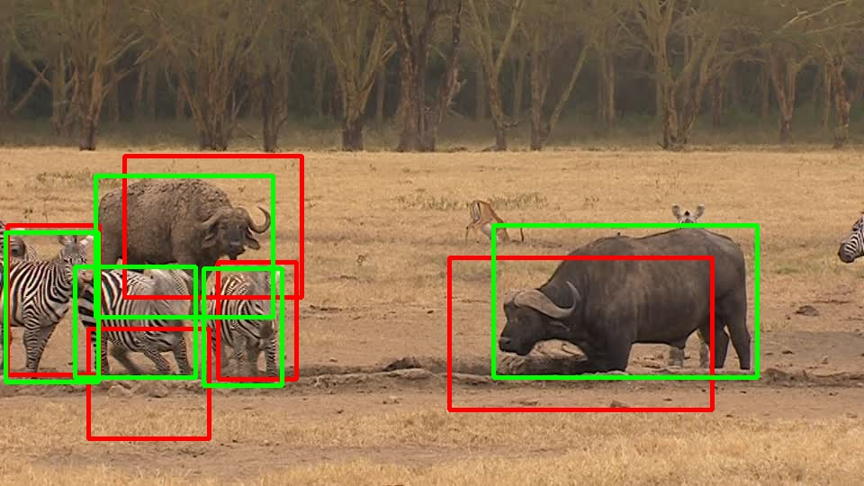
for d in range(len(dects)):
gt = [gt for gt in gts if gt[0] == dects[d][0]]
iouMax = 0
for j in range(len(gt)):
iou1 = iou(dects[d][3], gt[j][3])
if iou1 > iouMax:
iouMax = iou1
jmax = j
if iouMax >= IOUThreshold:
if det[dects[d][0]][jmax] == 0:
TP[d] = 1
det[dects[d][0]][jmax] = 1
else:
FP[d] = 1
else:
FP[d] = 1
dects
[['363', 0.0, 0.92, (280, 69, 696, 435)] ,
['297', 0.0, 0.77, (499, 286, 791, 455)],
['297', 0.0, 0.33, (138, 173, 335, 330)]]
gts
[['297', 0.0, 1.0, (106, 195, 303, 352)],
['297', 0.0, 1.0, (548, 250, 841, 419)],
['363', 0.0, 1.0, (207, 108, 624, 474)],
['299', 0.0, 1.0, (434, 223, 715, 386)]]
gt
[['297', 0.0, 1.0, (106, 195, 303, 352)],
['297', 0.0, 1.0, (548, 250, 841, 419)]]
297
det
TP
d
iouMax
jmax
1
1
'297'
1
1
1
0.51
0
'363'
1
FP
'299'
0
0
0
0

Slide 8
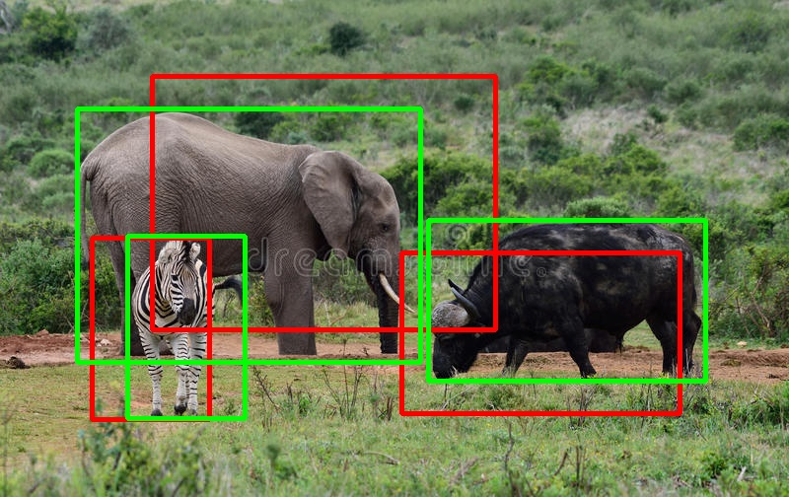
acc_FP = np.cumsum(FP)
acc_TP = np.cumsum(TP)
rec = acc_TP / npos
prec = np.divide(acc_TP, (acc_FP + acc_TP))
dects
[['363', 0.0, 0.92, (280, 69, 696, 435)],
['297', 0.0, 0.77, (499, 286, 791, 455)],
['297', 0.0, 0.33, (138, 173, 335, 330)]]
acc_FP
acc_TP
rec
prec
gts
0
0
0
1
2
3
0.25
0.50
0.75
1.0
1.0
1.0
[['297', 0.0, 1.0, (106, 195, 303, 352)],
['297', 0.0, 1.0, (548, 250, 841, 419)],
['363', 0.0, 1.0, (207, 108, 624, 474)],
['299', 0.0, 1.0, (434, 223, 715, 386)]]
d
det
TP
npos
1
1
gt
'297'
1
1
1
4
'363'
[['297', 0.0, 1.0, (106, 195, 303, 352)],
['297', 0.0, 1.0, (548, 250, 841, 419)]]
1
FP
'299'
0
0
0
0
363
297
299

Slide 9
def calculateAveragePrecision(rec, prec):
mrec = [0] + [e for e in rec] + [1]
mpre = [0] + [e for e in prec] + [0]
for i in range(len(mpre)-1, 0, -1):
mpre[i-1] = max(mpre[i-1], mpre[i])
ii = []
for i in range(len(mrec)-1):
if mrec[1:][i] != mrec[0:-1][i]:
ii.append(i+1)
ap = 0
for i in ii:
ap = ap + np.sum((mrec[i] - mrec[i-1]) * mpre[i])
return [ap, mpre[0:len(mpre)-1], mrec[0:len(mpre)-1], ii]
rec
prec
0.25
0.50
0.75
1.0
1.0
1.0
mrec
0.0
0.25
0.50
0.75
1.0
mpre
mrec= [0, 0.25, 0.5, 0.75, 1]
mpre= [1.0, 1.0, 1.0, 1.0, 0]
ii= [1, 2, 3, 4]
1.0
1.0
1.0
1.0
0.0
ii
1
2
3
4
ap
0.75
363
297
299

