Slide 1
Selective search 알고리즘을 통해 객체가 있을 법할 위치인 후보 영역(region proposal)을 2000개 추출하여, 각각을 227x227 크기로 warp시켜줍니다.
Warp된 모든 region proposal을 Fine 입력하여 2000x4096 크기의 feature vector를 추출합니다. tune된 AlexNet에
추출된 feature vector를 linear SVM 모델과 Bounding box regressor 모델에 입력하여 각각 confidence score와 조정된 bounding box 좌표를 얻습니다.
마지막으로 Non maximum suppression 알고리즘을 적용하여 최소한의, 최적의 bounding box를 출력합니다.

Slide 3
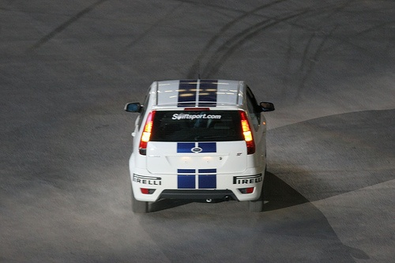
1. Fine tuning pre-trained AlexNet
Positive samples
370*1400
32
crop, resize 됨
warp
IOU>0.5
PASCAL
VOC
...
(128,227,227)
(128,2)
Pre-trained
AlexNet
96
한개의 이미지
최대 2000개
region
IOU<0.5
Mini batches(128)
Negative samples

Slide 4


$$y=wx+b$$
2. Training linear SVM using fine tuned AlexNet
$$y=w^{T}x+b$$
Positive samples
Groud truth
w.shape(4096,2)
PASCAL
VOC
...
(128,227,227)
(128,4096)
Fine-tuned
AlexNet
Linear
SVM
(128,2)
한개의 이미지
최대 2000개
region
IOU<0.3
Mini batches(128)
(128,4096)
(4096,2)
Negative samples
Hard negative Mining

Slide 5
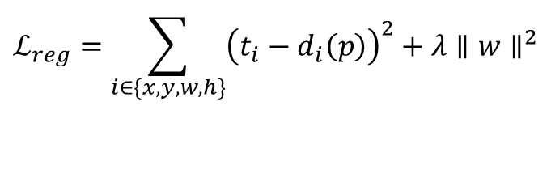
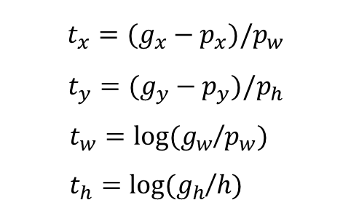
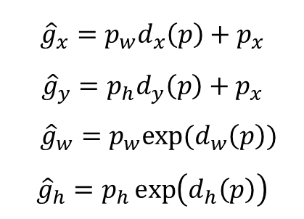
SS Predicted
수정 예측 값
Target
$${\hat{g}}_{x}=p_{w}d_{x}\left(p\right)+p_{x}$$
$${\hat{g}}_{y}=p_{h}d_{y}\left(p\right)+p_{x}$$
${\hat{g}}_{w}=p_{w}exp⁡(d_{w}\left(p\right))$
$${\hat{g}}_{h}=p_{h}\exp\left(d_{h}\left(p\right)\right)$$
Ground Truth
$$t_{x}=(g_{x}−p_{x})/p_{w}$$
$$t_{y}=(g_{y}−p_{y})/p_{h}$$
$t_{w}=log⁡(g_{w}$/$p_{w})$
$t_{h}=log⁡(g_{h}$/$h)$
손실 함수
SSE(Sum of Squared Error)
$$ℒ_{reg}=\sum_{i∈\{x,y,w,h\}}{{\left(t_{i}−d_{i}\left(p\right)\right)}^{2}+λ∥w∥^{2}}$$

Slide 6
3. Training Bounding box regressor using fine tuned AlexNet
Positive samples
w.shape(256*6*6,4)
PASCAL
VOC
(128,227,227)
(128,256*6*6)
Bounding
Box
Regressor
IOU>0.6
Fine-tuned
AlexNet
(128,4)
한개의 이미지
최대 2000개
region
Feature vector
(128,256*6*6)
(256*6*6,4)

Slide 7
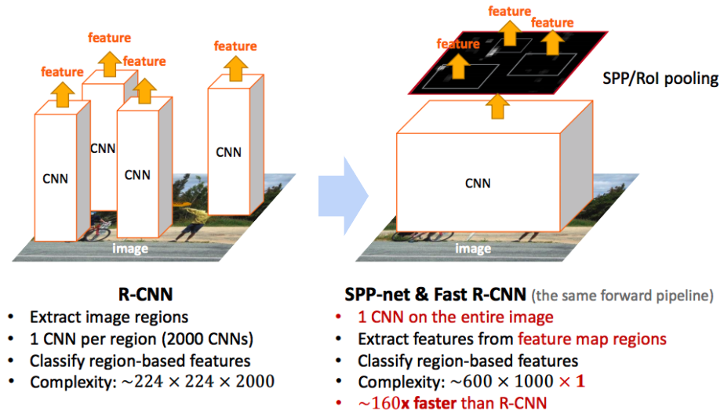
R-CNN vs Fast R-CNN

Slide 8
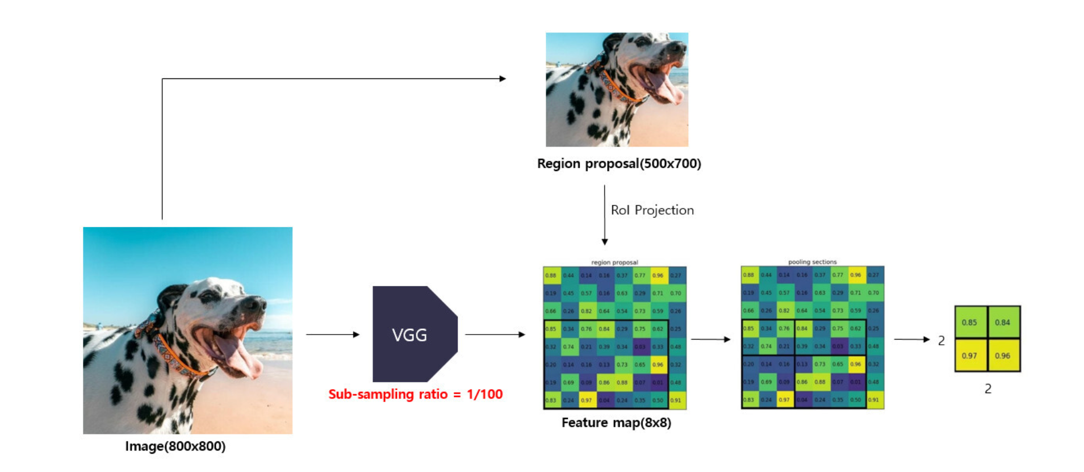
RoI pooling 개념
np.floor(2.5) => 2
np.ceil(2.5) => 3
(0,300)
(0,3)
(700,800)
(7,8)

Slide 9

224
def forward(self, images, rois, roi_idx):
n = rois.shape[0]
h = images.size(2)
w = images.size(3)
x1 = rois[:,0]
y1 = rois[:,1]
x2 = rois[:,2]
y2 = rois[:,3]
x1 = np.floor(x1 * w).astype(int)
x2 = np.ceil(x2 * w).astype(int)
y1 = np.floor(y1 * h).astype(int)
y2 = np.ceil(y2 * h).astype(int)
14
(50,50)=>(0.22,0.22)
10
224
Pre-trained
VGG
(224,224,3)
10
14
(180,180)=>(0.8,0.8)
ratio=1/16
(14,14,512)

Slide 10
R-CNN vs Fast R-CNN
K=20
K+1 (백그라운드 포함)
clasifier
((K+1)*1,)
최대 2000개
region
Truncated SVD
PASCAL
VOC
Pre-trained
VGG
(224,224,3)
(14,14,512)
(7,7,512)
Multi-task
loss
(25088)
한개의 이미지
RoI
pooling
((K+1)*4,)
Feature vector
(4096,)
Bounding box
regressor

Slide 11
Classification과 Regression를 함께 반영한 Loss 함수
Multi-task Loss 함수: $L\left(p,u,t^{u},v\right)=L_{cls}\left(p,u\right)+λ\left[u≥1\right]L_{loc}\left(t^{u},v\right),$
Classification Loss
Regression Loss
Regression Loss 함수: $L_{loc}\left(t^{u},v\right)=\sum_{iε\{x,y,w,h\}}{smooth_{L_{1}}\left(t_{i}^{u}−v_{i}\right),} smooth_{L_{1}}\left(x\right)=\left\{\begin{aligned}0.5x^{2} if\left|x\right|<1 \\ \left|x\right|−0.5 otherwise,\end{aligned}\right.$

Slide 12


[1:2, 1:1, 2:1]
[0.5, 1, 2]
91
181
128
91
128
181
$$w×h=s^{2}$$
$$128×128=s^{2}$$

Slide 13



(0): Conv2d(3, 64, kernel_size=(3, 3), stride=(1, 1), padding=(1, 1))
(1): ReLU(inplace=True)
(2): Conv2d(64, 64, kernel_size=(3, 3), stride=(1, 1), padding=(1, 1))
(3): ReLU(inplace=True)
(4): MaxPool2d(kernel_size=2, stride=2, padding=0, dilation=1, ceil_mode=False)
(1,3,800,800) (64,3,3,3) => (1,64,800,800)
(1,64,800,800) (64,64,3,3) => (1,64,800,800)
$$\frac{H−FH+2∗P}{S}+1⇒OH$$
(1,64,800,800) => (1,64,400,400)
$$\frac{800−3+2∗1}{1}+1⇒800$$
$$\frac{800−2+2∗0}{2}+1⇒400$$

Slide 15

nn.Conv2d(mid_channels, n_anchor * 4, 1, 1, 0).to(DEVICE)
nn.Conv2d(mid_channels, n_anchor * 2, 1, 1, 0).to(DEVICE)
(1,512,50,40) (9*4,512,1,1) => (1,9*4,50,40)
$$\frac{H−FH+2∗P}{S}+1⇒OH$$
(1,512,50,40) (9*2,512,1,1) => (1,9*2,50,40)
$$\frac{50−1+2∗0}{1}+1⇒50$$

Slide 16
https://github.com/imguru-mooc/AI_VISION/blob/main/3_day/4.opencv_faster_rcnn/opencv_faster_rcnn_inference.ipynb
https://colab.research.google.com/github/imguru-mooc/AI_VISION/blob/main/3_day/4.opencv_faster_rcnn/opencv_faster_rcnn_inference.ipynb

Slide 17
https://raw.githubusercontent.com/imguru-mooc/AI_VISION/main/3_day/4.opencv_faster_rcnn/data/sample1.jpg
https://colab.research.google.com/github/imguru-mooc/AI_VISION/blob/main/3_day/4.opencv_faster_rcnn/opencv_faster_rcnn_inference.ipynb

Slide 18
Anchor
generation
layer
Anchor boxes
Anchor
target
layer
index_inside = np.where(
(anchor_boxes[:, 0] >= 0) &
(anchor_boxes[:, 1] >= 0) &
(anchor_boxes[:, 2] <= 800) &
(anchor_boxes[:, 3] <= 800))[0]
print(index_inside.shape)
# only 8940 anchor boxes are inside the boundary out of 22500
valid_anchor_boxes = anchor_boxes[index_inside]
print(valid_anchor_boxes.shape)

Slide 19
2) Calculate IoUs
ious = np.empty((len(valid_anchor_boxes),4), dtype=np.float32)
ious.fill(0)
# anchor boxes
for i, anchor_box in enumerate(valid_anchor_boxes):
xa1, ya1, xa2, ya2 = anchor_box
anchor_area = (xa2 - xa1) * (ya2 - ya1)
# ground truth boxes
for j, gt_box in enumerate(bbox):
xb1, yb1, xb2, yb2 = gt_box
box_area = (xb2 - xb1) * (yb2 - yb1)
inter_x1 = max([xb1, xa1])
inter_y1 = max([yb1, ya1])
inter_x2 = min([xb2, xa2])
inter_y2 = min([yb2, ya2])
...

Slide 20
2) Calculate IoUs
ious = np.empty((len(valid_anchor_boxes),4), dtype=np.float32)
ious.fill(0)
# anchor boxes
...
if (inter_x1 < inter_x2) and (inter_y1 < inter_y2):
inter_area = (inter_x2 - inter_x1) * (inter_y2 - inter_y1)
iou = inter_area / (anchor_area + box_area - inter_area)
else:
iou = 0
ious[i, j] = iou

Slide 21
3) Sample positive/negative anchor boxes
gt_argmax_ious = ious.argmax(axis=0)
print(gt_argmax_ious)
gt_max_ious = ious[gt_argmax_ious, np.arange(ious.shape[1])]
# ious[[1008, 2862, 5935, 8699], [0,1,2,3]]
print(gt_max_ious)
gt_argmax_ious = np.where(ious == gt_max_ious)[0]
print(gt_argmax_ious)
(8940,4)
[[0.58514285 0. 0. 0. ]
[0.16435339 0.5752716 0. 0. ]
[0. 0. 0.5255493 0. ]
[0. 0. 0. 0.6325869 ]]

Slide 22
3) Sample positive/negative anchor boxes
...
label = np.empty((len(index_inside),), dtype=np.int32)
label.fill(-1)
print(label.shape)
pos_iou_threshold = 0.7
neg_iou_threshold = 0.3
label[gt_argmax_ious] = 1
label[max_ious >= pos_iou_threshold] = 1
label[max_ious < neg_iou_threshold] = 0

Slide 23
3) Sample positive/negative anchor boxes
n_sample = 256
pos_ratio = 0.5
n_pos = pos_ratio * n_sample
pos_index = np.where(label == 1)[0]
if len(pos_index) > n_pos:
disable_index = np.random.choice(pos_index,
size = (len(pos_index) - n_pos),
replace=False)
label[disable_index] = -1
n_neg = n_sample * np.sum(label == 1)
neg_index = np.where(label == 0)[0]
if len(neg_index) > n_neg:
disable_index = np.random.choice(neg_index,
size = (len(neg_index) - n_neg),
replace = False)
label[disable_index] = -1

Slide 24
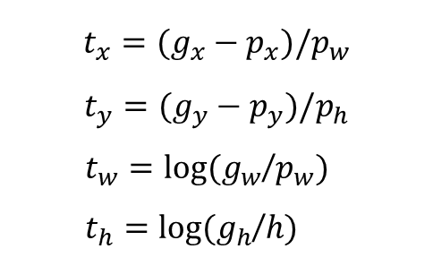
height = valid_anchor_boxes[:, 3] - valid_anchor_boxes[:, 1]
width = valid_anchor_boxes[:, 2] - valid_anchor_boxes[:, 0]
ctr_y = valid_anchor_boxes[:, 1] + 0.5 * height
ctr_x = valid_anchor_boxes[:, 0] + 0.5 * width
base_height = max_iou_bbox[:, 3] - max_iou_bbox[:, 1]
base_width = max_iou_bbox[:, 2] - max_iou_bbox[:, 0]
base_ctr_y = max_iou_bbox[:, 1] + 0.5 * base_height
base_ctr_x = max_iou_bbox[:, 0] + 0.5 * base_width
eps = np.finfo(height.dtype).eps
print(eps)
print(height.shape, width.shape)
height = np.maximum(height, eps)
width = np.maximum(width, eps)
print(height[1000:1100])
print(height.shape, width.shape)
dy = (base_ctr_y - ctr_y) / height
dx = (base_ctr_x - ctr_x) / width
dh = np.log(base_height / height)
dw = np.log(base_width / width)
$$t_{x}=(g_{x}−p_{x})/p_{w}$$
$$t_{y}=(g_{y}−p_{y})/p_{h}$$
$t_{w}=log⁡(g_{w}$/$p_{w})$
$t_{h}=log⁡(g_{h}$/$h)$
anchor_locs
[[ 1.24848541 2.49973296 0.56971714 -0.03381788]
[ 1.24848541 2.41134461 0.56971714 -0.03381788]
[ 1.24848541 2.32295626 0.56971714 -0.03381788]
...
[-0.5855728 -0.63252911 0.4917556 -0.03381788]
[-0.5855728 -0.72091746 0.4917556 -0.03381788]
[-0.5855728 -0.80930581 0.4917556 -0.03381788]]

Slide 25
RPN
(1,36,50,50)
(36,512,1,1)
Conv
(1,512,50,50)
Pre-trained
VGG
(1,3,800,800)
(1,512,50,50)
(512,512,3,3)
Conv
(1,18,50,50)
in_channels = 512
mid_channels = 512
n_anchor = 9
conv1 = nn.Conv2d(in_channels, mid_channels, 3, 1, 1).to(DEVICE)
conv1.weight.data.normal_(0, 0.01)
conv1.bias.data.zero_()
# bounding box regressor
reg_layer = nn.Conv2d(mid_channels, n_anchor * 4, 1, 1, 0).to(DEVICE)
reg_layer.weight.data.normal_(0, 0.01)
reg_layer.bias.data.zero_()
# classifier(object or not)
cls_layer = nn.Conv2d(mid_channels, n_anchor * 2, 1, 1, 0).to(DEVICE)
cls_layer.weight.data.normal_(0, 0.01)
cls_layer.bias.data.zero_()
(18,512,1,1)
Conv

Slide 26
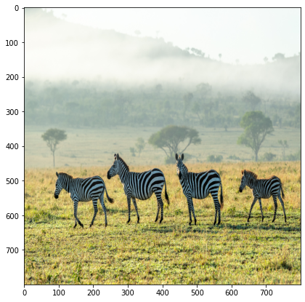
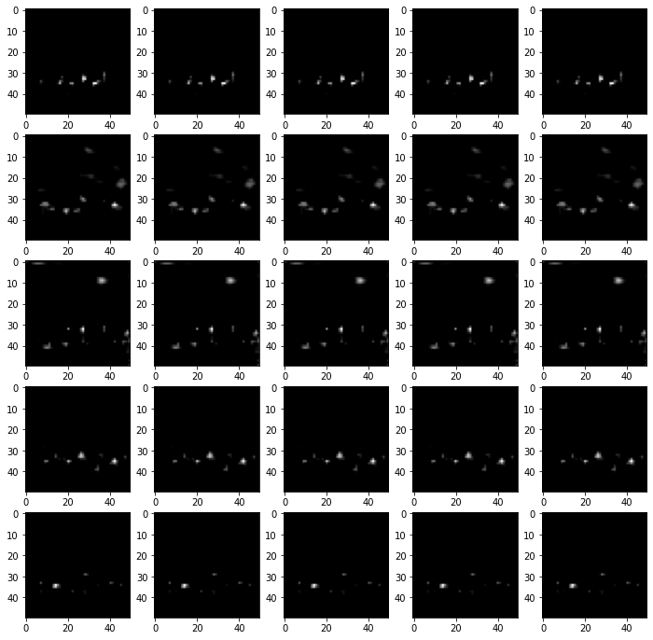
RPN
=>(1,50,50,36)=>(1,50*50*9,4)
(1,36,50,50)
pred_anchor_locs
(1,22500,4)
pred_anchor_locs
(36,512,1,1)
reg_layer
(1,512,50,50)
Pre-trained
VGG
(1,3,800,800)
(1,512,50,50)
=>(1,50,50,18)=>(1,50*50*9,2)
(512,512,3,3)
Conv1
(1,18,50,50)
pred_cls_scores
(1,22500,2)
pred_cls_scores
(18,512,1,1)
cls_layer
(1,22500)
objectness_score
x = conv1(output_map.to(DEVICE)) # output_map = faster_rcnn_feature_extractor(imgTensor)
pred_anchor_locs = reg_layer(x) # bounding box regresor output
pred_cls_scores = cls_layer(x) # classifier output
print(pred_anchor_locs.shape, pred_cls_scores.shape)

Slide 27
RPN
=>(1,50,50,36)=>(1,50*50*9,4)
(1,36,50,50)
pred_anchor_locs
(1,22500,4)
pred_anchor_locs
(36,512,1,1)
reg_layer
(1,512,50,50)
Pre-trained
VGG
(1,3,800,800)
(1,512,50,50)
=>(1,50,50,18)=>(1,50*50*9,2)
(512,512,3,3)
Conv1
(1,18,50,50)
pred_cls_scores
(1,22500,2)
pred_cls_scores
(18,512,1,1)
cls_layer
(1,22500)
objectness_score
rpn_cls_loss = F.cross_entropy(rpn_score, gt_rpn_score.long().to(DEVICE), ignore_index = -1)
x = torch.abs(mask_loc_targets.cpu() - mask_loc_preds.cpu())
rpn_loc_loss = ((x < 1).float() * 0.5 * x ** 2) + ((x >= 1).float() * (x - 0.5))
rpn_lambda = 10
N_reg = (gt_rpn_score > 0).float().sum()
rpn_loc_loss = rpn_loc_loss.sum() / N_reg
rpn_loss = rpn_cls_loss + (rpn_lambda * rpn_loc_loss)

Slide 28
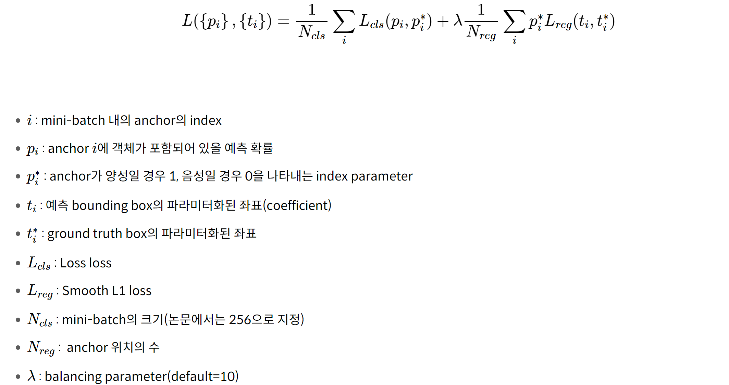
rpn_cls_loss = F.cross_entropy(rpn_score, gt_rpn_score.long().to(DEVICE), ignore_index = -1)
x = torch.abs(mask_loc_targets.cpu() - mask_loc_preds.cpu())
rpn_loc_loss = ((x < 1).float() * 0.5 * x ** 2) + ((x >= 1).float() * (x - 0.5))
rpn_lambda = 10
N_reg = (gt_rpn_score > 0).float().sum()
rpn_loc_loss = rpn_loc_loss.sum() / N_reg
rpn_loss = rpn_cls_loss + (rpn_lambda * rpn_loc_loss)

Slide 29
Resion
proposals
2000개
Proposal
layer
Proposal
target
layer
class score,
bbox regressors
RoIs
Pre-trained
VGG
RPN
(1,512,50,50)
(1,3,800,800)
Rol
pooling
Fast
RCNN
(1,512,50,50)

Slide 30
