Slide 1
# Define the window size
window_size = (64, 64)
# Define the step size
step_size = (8, 8)
# Define how many steps to take in x and y directions
x_steps = np.arange(0, image.shape[1] - window_size[1], step_size[0])
y_steps = np.arange(0, image.shape[0] - window_size[0], step_size[1])
8
image.shape[1] - window_size[1]
64
64
height
== image.shape[0]
width==image.shape[1]

Slide 2
def compute_iou(boxA, boxB):
xA = max(boxA[0], boxB[0]) # xA = 200
yA = max(boxA[1], boxB[1]) # yA = 200
xB = min(boxA[2], boxB[2]) # xB = 300
yB = min(boxA[3], boxB[3]) # yB = 300
interArea = max(0, xB - xA + 1) * max(0, yB - yA + 1)
boxAArea = (boxA[2] - boxA[0] + 1) * (boxA[3] - boxA[1] + 1)
boxBArea = (boxB[2] - boxB[0] + 1) * (boxB[3] - boxB[1] + 1)
iou = interArea / float(boxAArea + boxBArea - interArea)
return iou
(100,100)
boxA
(200,200)
boxB
(300,300)
(400,400)

Slide 3
def compute_iou(boxA, boxB):
xA = max(boxA[0], boxB[0]) # xA = 200
yA = max(boxA[1], boxB[1]) # yA = 200
xB = min(boxA[2], boxB[2]) # xB = 200
yB = min(boxA[3], boxB[3]) # yB = 200
interArea = max(0, xB - xA + 1) * max(0, yB - yA + 1)
boxAArea = (boxA[2] - boxA[0] + 1) * (boxA[3] - boxA[1] + 1)
boxBArea = (boxB[2] - boxB[0] + 1) * (boxB[3] - boxB[1] + 1)
iou = interArea / float(boxAArea + boxBArea - interArea)
return iou
(0,0)
boxB
(200,200)
iou = 0.0000123...
boxA
(400,400)

Slide 4
def compute_iou(boxA, boxB):
xA = max(boxA[0], boxB[0]) # xA = 200
yA = max(boxA[1], boxB[1]) # yA = 200
xB = min(boxA[2], boxB[2]) # xB = 200
yB = min(boxA[3], boxB[3]) # yB = 200
interArea = max(0, xB - xA + 1) * max(0, yB - yA + 1)
boxAArea = (boxA[2] - boxA[0] + 1) * (boxA[3] - boxA[1] + 1)
boxBArea = (boxB[2] - boxB[0] + 1) * (boxB[3] - boxB[1] + 1)
iou = interArea / float(boxAArea + boxBArea - interArea)
return iou
(0,0)
boxB
(200,200)
iou = 0.0000123...
boxA
(400,400)

Slide 5
def non_max_suppression(boxes, probs=None, overlapThresh=0.3):
if len(boxes) == 0:
return []
if boxes.dtype.kind == "i":
boxes = boxes.astype("float")
pick = []
x1 = boxes[:, 0] # [100,100,100,1000,1000]
y1 = boxes[:, 1] # [200,200,200,100,100]
x2 = boxes[:, 2] # [350,400,300,1150,1200]
y2 = boxes[:, 3] # [300,500,800,600,700]
area = (x2 - x1 + 1) * (y2 - y1 + 1)
idxs = probs
idxs = np.argsort(idxs)
boxes=np.array([
[100,200,350,300],
[100,200,400,500],
[100,200,300,800],
[1000,100,1150,600],
[1000,100,1200,700]
])
probs = np.array([0.6,0.7,0.9,0.7,0.8])
0.6 0.7 0.7 0.8 0.9
0 1 3 4 2
(1000,100)
(100,200)
0.7
0.6
(350,300)
0.7
(400,500)
(1150,600)
[ 100. 100. 100. 1000. 1000.]
[200. 200. 200. 100. 100.]
[ 350. 400. 300. 1150. 1200.]
[300. 500. 800. 600. 700.]
0.8
0.9
(1200,700)
(300,800)
(251,101)

Slide 6
while len(idxs) > 0:
last = len(idxs) - 1
i = idxs[last]
pick.append(i)
print(x1[i]) # 100
ptint(x1[idxs[:last]]) # [100,100,1000,1000]
xx1 = np.maximum(x1[i], x1[idxs[:last]])
# [100,100,100,100] [100,100,1000,1000]
# print(xx1) # [100,100,1000,1000]
yy1 = np.maximum(y1[i], y1[idxs[:last]])
# print(yy1) # [200,200,200,200]
xx2 = np.minimum(x2[i], x2[idxs[:last]])
# print(xx2) # [300,300,300,300]
yy2 = np.minimum(y2[i], y2[idxs[:last]])
# print(yy2) # [300,500,600,700]
w = np.maximum(0, xx2 - xx1 + 1)
print(w) # [0,0,0,0] [201,201,-699,-699] => [201,201,0,0]
h = np.maximum(0, yy2 - yy1 + 1)
print(w) # [0,0,0,0] [101,301,401,501] => [101,301,401,501]
print(area[idxs[:last]]) # [251*101,301*301,151*501,201*601]
overlap = (w * h) / area[idxs[:last]]
print(overlap) # [20301,60501,0,0] / [251*101,301*301,151*501,201*601]
# [0.80,0.67,0,0]
print(np.where(overlap > overlapThresh)[0]) # [0,1]
print(np.concatenate(([last],np.where(overlap > overlapThresh)[0]))
# [4,0,1]
idxs = np.delete(idxs, np.concatenate(([last],
np.where(overlap > overlapThresh)[0])))
return pick
boxes=np.array([
[100,200,350,300],
[100,200,400,500],
[100,200,300,800],
[1000,100,1150,600],
[1000,100,1200,700]
])
probs = np.array([0.6,0.7,0.9,0.7,0.8])
0.6 0.7 0.7 0.8 0.9
0 1 3 4 2
(1000,100)
(100,200)
0.7
0.6
(350,300)
0.7
(400,500)
(1150,600)
0.8
0.9
(1200,700)
(300,800)
last
last
idxs
0
1
3
4
2
idxs
3
4
pick
2
pick
2
4

Slide 7
DT=(0.657031, 0.653125, 0.648438, 0.552083)
# box : (centerX, centerY, width, height)
def convertToAbsoluteValues(size, box):
xIn = round(((2 * float(box[0]) - float(box[2])) * size[0] / 2))
yIn = round(((2 * float(box[1]) - float(box[3])) * size[1] / 2))
xEnd = xIn + round(float(box[2]) * size[0])
yEnd = yIn + round(float(box[3]) * size[1])
if xIn < 0:
xIn = 0
if yIn < 0:
yIn = 0
if xEnd >= size[0]:
xEnd = size[0] - 1
if yEnd >= size[1]:
yEnd = size[1] - 1
return (xIn, yIn, xEnd, yEnd)
GT=(0.572656, 0.523958, 0.698438, 0.589583)
size=(640,480)
640
w=0.698438
(143,110)
h=0.589583
(0.572656,0.523958)
480
(590,393)

Slide 8
def AP(detections, groundtruths, classes, IOUThreshold = 0.3, method = 'AP'):
result = []
for c in classes:
dects = [d for d in detections if d[1] == c]
gts = [g for g in groundtruths if g[1] == c]
dects = sorted(dects, key = lambda conf : conf[2], reverse=True)
TP = np.zeros(len(dects))
FP = np.zeros(len(dects))
det = Counter(cc[0] for cc in gts)
for key, val in det.items():
det[key] = np.zeros(val)
dects
[['363', 0.0, 0.92, (280, 69, 696, 435)] ,
['297', 0.0, 0.77, (499, 286, 791, 455)],
['297', 0.0, 0.33, (138, 173, 335, 330)]]
gts
[['297', 0.0, 1.0, (106, 195, 303, 352)],
['297', 0.0, 1.0, (548, 250, 841, 419)],
['363', 0.0, 1.0, (207, 108, 624, 474)],
['299', 0.0, 1.0, (434, 223, 715, 386)]]
TP
0
0
0
0
0
'297'
det
'363'
0
FP
Counter({'297': 2, '363': 1, '299': 1})
'299'
0
0
0
0

Slide 9
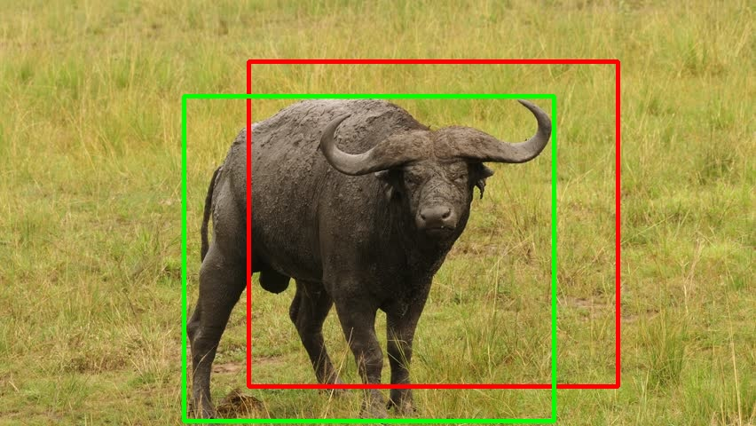
for d in range(len(dects)):
gt = [gt for gt in gts if gt[0] == dects[d][0]]
iouMax = 0
for j in range(len(gt)):
iou1 = iou(dects[d][3], gt[j][3])
if iou1 > iouMax:
iouMax = iou1
jmax = j
if iouMax >= IOUThreshold:
if det[dects[d][0]][jmax] == 0:
TP[d] = 1
det[dects[d][0]][jmax] = 1
else:
FP[d] = 1
else:
FP[d] = 1
dects
[['363', 0.0, 0.92, (280, 69, 696, 435)] ,
['297', 0.0, 0.77, (499, 286, 791, 455)],
['297', 0.0, 0.33, (138, 173, 335, 330)]]
gts
[['297', 0.0, 1.0, (106, 195, 303, 352)],
['297', 0.0, 1.0, (548, 250, 841, 419)],
['363', 0.0, 1.0, (207, 108, 624, 474)],
['299', 0.0, 1.0, (434, 223, 715, 386)]]
gt
[['363', 0.0, 1.0, (207, 108, 624, 474)]]
det
363
0
0
d
TP
iouMax
jmax
'297'
1
0
0
0.58
0
'363'
1
'299'
FP
0
0
0
0

Slide 10
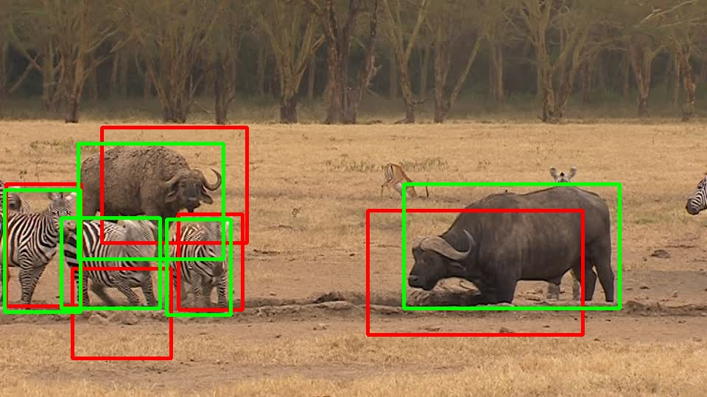
for d in range(len(dects)):
gt = [gt for gt in gts if gt[0] == dects[d][0]]
iouMax = 0
for j in range(len(gt)):
iou1 = iou(dects[d][3], gt[j][3])
if iou1 > iouMax:
iouMax = iou1
jmax = j
if iouMax >= IOUThreshold:
if det[dects[d][0]][jmax] == 0:
TP[d] = 1
det[dects[d][0]][jmax] = 1
else:
FP[d] = 1
else:
FP[d] = 1
dects
[['363', 0.0, 0.92, (280, 69, 696, 435)] ,
['297', 0.0, 0.77, (499, 286, 791, 455)],
['297', 0.0, 0.33, (138, 173, 335, 330)]]
gts
[['297', 0.0, 1.0, (106, 195, 303, 352)],
['297', 0.0, 1.0, (548, 250, 841, 419)],
['363', 0.0, 1.0, (207, 108, 624, 474)],
['299', 0.0, 1.0, (434, 223, 715, 386)]]
gt
[['297', 0.0, 1.0, (106, 195, 303, 352)],
['297', 0.0, 1.0, (548, 250, 841, 419)]]
d
297
det
TP
iouMax
jmax
1
1
'297'
1
1
1
0.53
0
'363'
1
FP
'299'
0
0
0
0

Slide 11
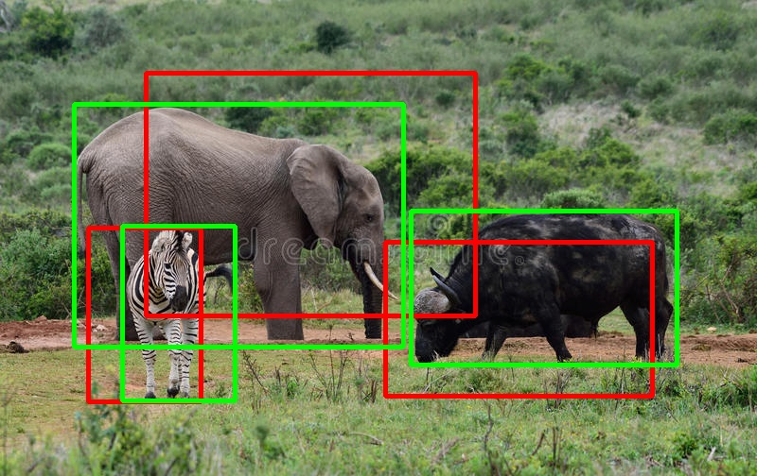
acc_FP = np.cumsum(FP)
acc_TP = np.cumsum(TP)
rec = acc_TP / npos
prec = np.divide(acc_TP, (acc_FP + acc_TP))
dects
[['363', 0.0, 0.92, (280, 69, 696, 435)],
['297', 0.0, 0.77, (499, 286, 791, 455)],
['297', 0.0, 0.33, (138, 173, 335, 330)]]
acc_FP
acc_TP
rec
prec
gts
0
0
0
1
2
3
0.25
0.50
0.75
1.0
1.0
1.0
[['297', 0.0, 1.0, (106, 195, 303, 352)],
['297', 0.0, 1.0, (548, 250, 841, 419)],
['363', 0.0, 1.0, (207, 108, 624, 474)],
['299', 0.0, 1.0, (434, 223, 715, 386)]]
d
det
TP
npos
1
1
gt
'297'
1
1
1
4
'363'
[['297', 0.0, 1.0, (106, 195, 303, 352)],
['297', 0.0, 1.0, (548, 250, 841, 419)]]
1
FP
'299'
0
0
0
0
363
297
299

Slide 12
def calculateAveragePrecision(rec, prec):
mrec = [0] + [e for e in rec] + [1]
mpre = [0] + [e for e in prec] + [0]
for i in range(len(mpre)-1, 0, -1):
mpre[i-1] = max(mpre[i-1], mpre[i])
ii = []
for i in range(len(mrec)-1):
if mrec[1:][i] != mrec[0:-1][i]:
ii.append(i+1)
ap = 0
for i in ii:
ap = ap + np.sum((mrec[i] - mrec[i-1]) * mpre[i])
return [ap, mpre[0:len(mpre)-1], mrec[0:len(mpre)-1], ii]
rec
prec
0.25
0.50
0.75
1.0
1.0
1.0
mrec
0.0
0.25
0.50
0.75
1.0
mpre
1.0
1.0
1.0
1.0
0.0
ii
1
2
3
4
ap
0.75
363
297
299

