Slide 1
강사명 : 김정인
공유사이트 : https://github.com/imguru-mooc/AI_edu
강의시간 : 40분
쉬는시간 : 20분
점심시간 : 11시 40분 ~ 13시 10분

Slide 2
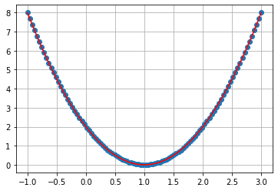

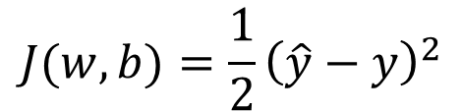








Initial Weight
$$x=2$$
$$w=3$$
Gradient=8
$$y=2$$
$$b=0$$
Increment Step
$$\hat{y}=wx+b$$
J
$$J(w,b)=\frac{1}{2}{\left(\hat{y}−y\right)}^{2}$$
$$α=0.01$$
$$\left(\hat{y}−y\right)x$$
$$w=w−α∗dw$$
w
$$2.92=3−0.01∗8$$

Slide 3


Initial Weight
$$x=2$$
$$w=2$$
Gradient=8
$$y=2$$
$$b=0$$
Increment Step
$$\hat{y}=wx+b$$
J
$$J(w,b)=\frac{1}{2}{\left(\hat{y}−y\right)}^{2}$$
Gradient=4
$$α=0.01$$
$$\left(\hat{y}−y\right)x$$
$$w=w−α∗dw$$
w
$$2.92=2−0.01∗4$$

Slide 4


Initial Weight
$$x=2$$
$$w=1$$
Gradient=8
$$y=2$$
$$b=0$$
Increment Step
$$\hat{y}=wx+b$$
J
$$J(w,b)=\frac{1}{2}{\left(\hat{y}−y\right)}^{2}$$
Gradient=4
$$α=0.01$$
$$\left(\hat{y}−y\right)x$$
$$w=w−α∗dw$$
w
$$1=1−0.01∗0$$

Slide 5

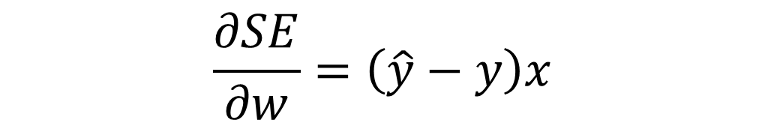
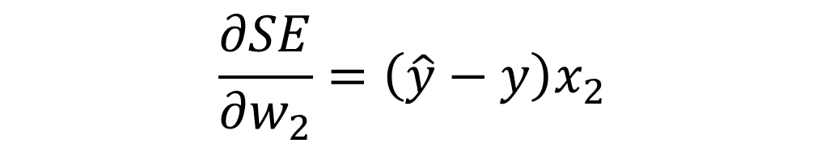
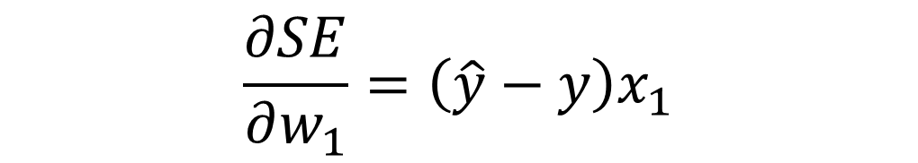
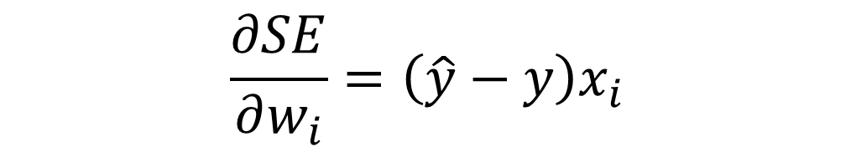


$$\frac{∂SE}{∂w}=\left(\hat{y}−y\right)x$$
$$\hat{y}=wx+b$$
$$\frac{∂SE}{∂w_{1}}=\left(\hat{y}−y\right)x_{1}$$
$$\hat{y}=w_{1}x_{1}+w_{2}x_{2}+b$$
$$\frac{∂SE}{∂w_{2}}=\left(\hat{y}−y\right)x_{2}$$
$$\hat{y}=w_{1}x_{1}+w_{2}x_{2}+b$$
$$\frac{∂SE}{∂w_{i}}=\left(\hat{y}−y\right)x_{i}$$

Slide 6
0
1
2
3
4
a
10
20
30
40
50
a.shape = (5,)
a.ndim = 1
a[0] => 10
a[0].shape = ()
a.ndim = 0

Slide 7
0
1
2
3
4
0
10
20
30
40
50
x
1
100
200
300
400
500
10
20
30
40
50
x
100
200
300
400
500
x.shape = (2,5)
x.ndim = 2
len(x) => 2
x[0].shape = (5,)
x.ndim = 1
x[0] => [10,20,30,40,50]

Slide 8
x.shape = (455,30)
x.ndim = 2
len(x) => 455
x[0] => ...
x[0].shape = (30,)
x.ndim = 1

Slide 9

(2,2)
(2,1)
(2,1)
1
2
1
5
.
=
3
4
2
11
X
W
(2,2)
(2,1)
(2,1)
1
3
2
11
.
=
2
4
3
16
$$X^{T}$$
E
dW

Slide 11













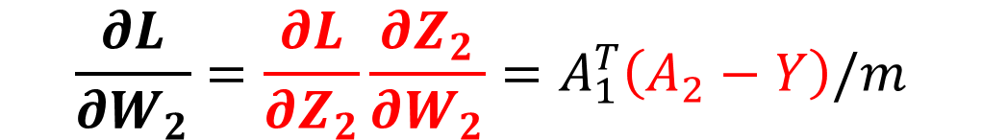


다층 신경망 backprop 이해
3. 다층 신경망의 경사 하강법 구현
2. ANN
가중치 $W_{1}$대하여 손실 함수를 미분한다.
$$\frac{∂L}{∂W_{2}}=\frac{∂L}{∂Z_{2}}\frac{∂Z_{2}}{∂W_{2}}=A_{1}^{T}\left(A_{2}−Y\right)/m$$
$$W_{2}$$
역방향 계산
X
${XW}_{1}$+ $b_{1}$
$$\frac{1}{1{+e}^{−Z_{1}}}$$
$A_{1}W_{2}$+ $b_{2}$
$$\frac{1}{1{+e}^{−Z_{2}}}$$
$$A_{2}≥0.5$$
$$A_{2}<0.5$$
$$\hat{y}$$
$$Z_{1}$$
$$A_{1}$$
$$Z_{2}$$
$$A_{2}$$
$$b_{1}$$
$$b_{2}$$
손실함수 L
$$\frac{∂L}{∂Z_{2}}=\left(A_{2}−Y\right)$$

Slide 12




다층 신경망 backprop 이해
3. 다층 신경망의 경사 하강법 구현
2. ANN
가중치 $W_{1}$대하여 손실 함수를 미분한다.
err_to_hidden
$\frac{∂L}{∂W_{1}}=\frac{∂L}{∂Z_{2}}\frac{∂Z_{2}}{∂A_{1}}\frac{∂A_{1}}{∂Z_{1}}$ $\frac{∂Z_{1}}{∂W_{1}}=X^{T}(\left(A_{2}−Y\right)$ $W_{2}^{T}⨀A_{1}⨀(\text{1− }A_{1}))/m$
$$\frac{∂Z_{1}}{∂W_{1}}=X$$
$$W_{1}$$
$$W_{2}$$
역방향 계산
X
${XW}_{1}$+ $b_{1}$
$$\frac{1}{1{+e}^{−Z_{1}}}$$
$A_{1}W_{2}$+ $b_{2}$
$$\frac{1}{1{+e}^{−Z_{2}}}$$
$$A_{2}≥0.5$$
$$A_{2}<0.5$$
$$\hat{y}$$
$$Z_{1}$$
$$A_{1}$$
$$Z_{2}$$
$$A_{2}$$
$$b_{1}$$
$$b_{2}$$
손실함수 L
$$\frac{∂A_{1}}{∂Z_{1}}=A_{1}⨀\text{(1− }A_{1}\text{)}$$
$$\frac{∂Z_{2}}{∂A_{1}}=W_{2}$$
$$\frac{∂L}{∂Z_{2}}=\left(A_{2}−Y\right)$$

Slide 13
다층 신경망 backprop 이해
3. 다층 신경망의 경사 하강법 구현
2. ANN
가중치 $W_{1}$대하여 손실 함수를 미분한다.
err_to_hidden
$\frac{∂L}{∂W_{1}}=\frac{∂L}{∂Z_{2}}\frac{∂Z_{2}}{∂A_{1}}\frac{∂A_{1}}{∂Z_{1}}$ $\frac{∂Z_{1}}{∂W_{1}}=X^{T}(\left(A_{2}−Y\right)$ $W_{2}^{T}⨀A_{1}⨀(\text{1− }A_{1}))/m$
(364,1)(1,1)
(30,364)
(364,1)
(30,1)
$$\frac{∂Z_{1}}{∂W_{1}}=X$$
$$W_{1}$$
$$W_{2}$$
(1,1)
역방향 계산
(30,1)
(364,30)
X
${XW}_{1}$+ $b_{1}$
$$\frac{1}{1{+e}^{−Z_{1}}}$$
$A_{1}W_{2}$+ $b_{2}$
$$\frac{1}{1{+e}^{−Z_{2}}}$$
$$A_{2}≥0.5$$
$$A_{2}<0.5$$
$$\hat{y}$$
$$Z_{1}$$
$$A_{1}$$
$$Z_{2}$$
$$A_{2}$$
(364,1)
(364,1)
(364,1)
(364,1)
$$b_{1}$$
(364,1)
(364,1)
(364,1)
손실함수 L
$$b_{2}$$
$$\frac{∂A_{1}}{∂Z_{1}}=A_{1}⨀\text{(1− }A_{1}\text{)}$$
$$\frac{∂Z_{2}}{∂A_{1}}=W_{2}$$
$$\frac{∂L}{∂Z_{2}}=\left(A_{2}−Y\right)$$
(364,1)
(364,1)

Slide 14
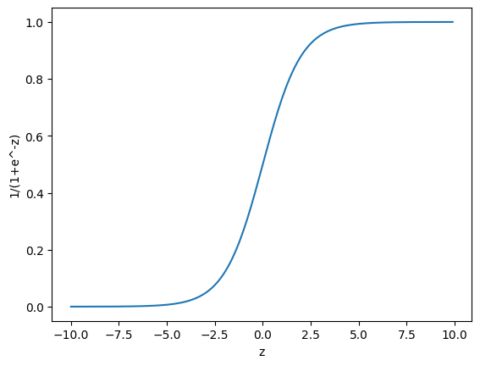

Slide 15
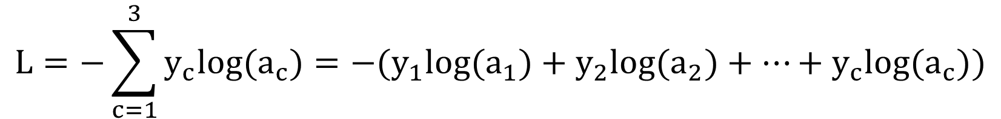
$$L=−(y∗\text{log}\text{(}a) +(1−y) log(1−a))$$
$$L=−\sum_{c=1}^{3}{y_{c}log(a_{c})=−(y_{1}log(a_{1})+y_{2}log(a_{2})+⋯+y_{c}log(a_{c}))}$$

Slide 16
def softmax(z):
z = np.clip(z, -100, None)
exp_z = np.exp(z)
print(exp_z)
print(np.sum(exp_z, axis=1))
return exp_z / np.sum(exp_z, axis=1).reshape(-1, 1)
z = np.array([[2.20,1.39,0.85],
[0.00,-1.39,-2.20]])
2.20
1.39
0.85
15
15
15
0.00
-1.39
-2.20
8
8
8
(2,3)
(2,3)

Slide 17
비선형 함수

