Slide 1
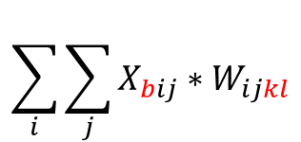
x = tf.constant(np.arange(4).reshape(1,2,2))
w = tf.constant(np.arange(16).reshape(2,2,2,2))
output = tf.einsum("bij,ijkl->bkl", x, w)
output
$$\sum_{i}{\sum_{j}{X_{bij}∗W_{ijkl}}}$$
0
1
2
3
0
1
2
3
4
5
6
7
array([[[56, 62],
[68, 74]]])>
8
9
10
11
12
13
14
15
0
1
=
0
0
4
5
=
4
5
0
*
1
*
2
3
0
0
6
7
6
7
56
62
8
9
=
16
18
12
13
=
36
39
68
74
2
*
3
*
10
11
20
22
14
15
42
45

Slide 2
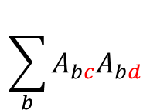
a = tf.constant([[1,2],[3,4]])
b = tf.linalg.einsum('bc,bd->cd', a, a)
a
a
1
2
1
2
$$\sum_{b}{A_{bc}A_{bd}}$$
3
4
3
4
(2,2)
(2,2)
벡터의 외적
1
2
1
2
1
2
(2,)
(2,)
2
4
(2,2)
10
14
14
20
3
4
3
4
9
12
(2,2)
(2,)
(2,)
12
16
(2,2)

Slide 3
a = tf.constant([[1,2],[3,4]])
b = tf.constant([[1,1,1],[2,2,2]])
c = tf.linalg.einsum('bc,bd->cd', a, b)
a
b
1
2
1
1
1
$$\sum_{b}{A_{bc}A_{bd}}$$
3
4
2
2
2
(2,2)
(2,3)
벡터의 외적
1
2
1
1
1
1
1
1
(2,)
(3,)
2
2
2
(2,3)
7
7
7
10
10
10
3
4
2
2
2
6
6
6
(2,3)
(2,)
(3,)
8
8
8
(2,3)

Slide 4
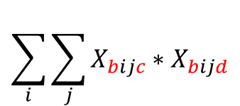
x = tf.constant(np.arange(12).reshape(1,2,2,3))
result = tf.linalg.einsum('bijc,bijd->bcd', x, x)
$$\sum_{i}{\sum_{j}{X_{bijc}∗X_{bijd}}}$$
0
1
2
3
4
5
126
144
162
6
7
8
144
166
188
9
10
11
162
188
214
(1,3,3)
0
1
2
0
1
2
0
0
0
3
4
5
3
4
5
9
12
15
0
1
2
12
16
20
0
2
4
15
20
25
6
7
8
6
7
8
36
42
48
9
10
11
9
10
11
81
90
99
42
49
56
90
100
110
48
56
64
99
110
121

Slide 5
