Slide 1
a = tf.constant([1,2])
b = tf.linalg.einsum('c,d->cd' , a, a )
print(b.numpy())
c=2
d=2
(2,)
(2,)
1
2
1
2
1
2
[[1 2]
[2 4]]
2
4
(2,2)

Slide 2
a = tf.constant([1,2])
b = tf.constant([1,2,3])
c = tf.linalg.einsum('c,d->cd' , a, b )
print(c.numpy())
c=2
d=3
(2,)
(3,)
1
2
1
2
3
1
2
3
[[1 2 3]
[2 4 6]]
2
4
6
(2,3)

Slide 3
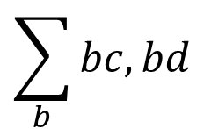
a = tf.constant([[1,2],
[3,4]])
b = tf.linalg.einsum('bc,bd->cd' , a, a )
print(b.numpy())
$$\sum_{b}{bc,bd}$$
b=2,c=2
b=2,d=2
(2,2)
(2,2)
1
2
1
2
3
4
3
4
1
2
1
2
1
2
b=0
2
4
10
14
14
20
3
4
3
4
9
12
(2,2)
b=1
12
16

Slide 4
a = tf.constant([[1,2],
[3,4]])
b = tf.constant([[1,1,1],
[2,2,2]])
c = tf.linalg.einsum('bc,bd->cd' , a, b )
print(c.numpy())
$$\sum_{b}{bc,bd}$$
b=2,c=2
b=2,d=3
(2,2)
(2,3)
1
2
1
1
1
3
4
2
2
2
1
2
1
1
1
1
1
1
b=0
2
2
2
7
7
7
10
10
10
3
4
2
2
2
6
6
6
8
8
8
(2,2)
b=1

Slide 5
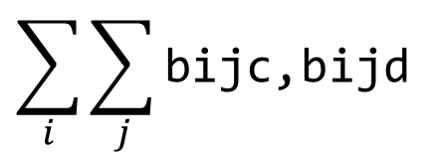
tf.linalg.einsum('bijc,bijd->bcd', input_tensor, input_tensor)
(1,2,2,2)
(1,2,2,2)
$$\sum_{i}{\sum_{j}{\text{bijc}\text{,}\text{bijd}}}$$
1
1
1
1
2
2
2
2
1
1
1
1
1
1
3
3
3
3
1
1
5
5
4
4
4
4
2
2
2
2
4
4
5
5
4
4
30
30
3
3
3
3
9
9
30
30
9
9
25
25
4
4
4
4
16
16
25
25
16
16

Slide 6
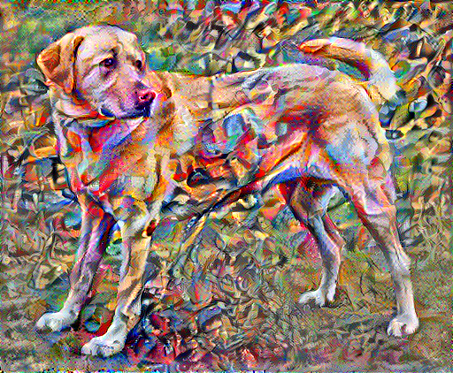
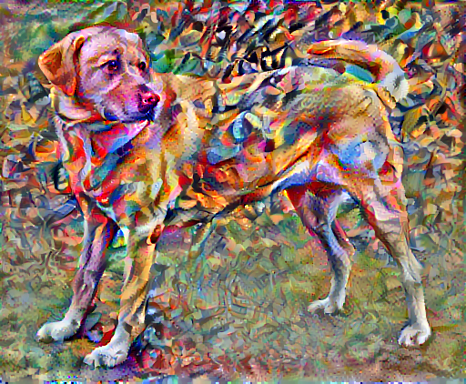

Slide 7
1
2
3
4
14
18
22
5
6
7
8
1
1
30
34
38
9
10
11
12
1
1
46
50
54
13
14
15
16
(2,2,1,1)
(1,4,4,1)
(16,1)
1
(9,16)
2
3
1
1
0
0
1
1
0
0
0
0
0
0
0
0
0
0
4
14
0
1
1
0
0
1
1
0
0
0
0
0
0
0
0
0
5
18
0
0
1
1
0
0
1
1
0
0
0
0
0
0
0
0
6
22
0
0
0
0
1
1
0
0
1
1
0
0
0
0
0
0
7
30
0
0
0
0
0
1
1
0
0
1
1
0
0
0
0
0
.
=
8
34
0
0
0
0
0
0
1
1
0
0
1
1
0
0
0
0
9
38
0
0
0
0
0
0
0
0
1
1
0
0
1
1
0
0
10
46
0
0
0
0
0
0
0
0
0
1
1
0
0
1
1
0
11
50
0
0
0
0
0
0
0
0
0
0
1
1
0
0
1
1
12
54
13
14
15
16

Slide 8
1
2
3
1
3
5
3
1
1
5
12
16
9
4
5
6
1
1
11
24
28
15
7
8
9
7
15
17
9
(1,3,3,1)
(2,2,1,1)
(1,4,4,1)
(16,9)
(16,1)
1
0
0
0
0
0
0
0
0
1
1
0
0
0
0
0
0
0
1
0
1
1
0
0
0
0
0
0
3
0
0
1
0
0
0
0
0
0
5
1
0
0
1
0
0
0
0
0
3
(9,1)
5
1
1
0
1
1
0
0
0
0
1
0
1
1
0
1
1
0
0
0
12
2
16
0
0
1
0
0
1
0
0
0
3
0
0
0
1
0
0
1
0
0
9
.
4
=
11
0
0
0
1
1
0
1
1
0
5
0
0
0
0
1
1
0
1
1
24
6
28
0
0
0
0
0
1
0
0
1
7
0
0
0
0
0
0
1
0
0
15
8
7
0
0
0
0
0
0
1
1
0
9
0
0
0
0
0
0
0
1
1
15
0
0
0
0
0
0
0
0
1
17
9

