Slide 1
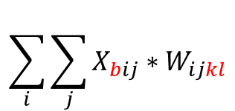
x = tf.constant(np.arange(4).reshape(1,2,2))
w = tf.constant(np.arange(16).reshape(2,2,2,2))
output = tf.einsum("bij,ijkl->bkl", x, w)
output
$$\sum_{i}{\sum_{j}{X_{bij}∗W_{ijkl}}}$$
0
1
2
3
0
1
2
3
4
5
6
7
array([[[56, 62],
[68, 74]]])>
8
9
10
11
12
13
14
15
0
1
=
0
0
4
5
=
4
5
0
*
1
*
2
3
0
0
6
7
6
7
56
62
8
9
=
16
18
12
13
=
36
39
68
74
2
*
3
*
10
11
20
22
14
15
42
45

Slide 2
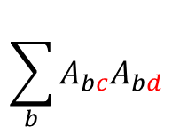
a = tf.constant([[1,2],[3,4]])
b = tf.linalg.einsum('bc,bd->cd', a, a)
a
a
1
2
1
2
$$\sum_{b}{A_{bc}A_{bd}}$$
3
4
3
4
(2,2)
(2,2)
벡터의 외적
1
2
1
2
1
2
(2,)
(2,)
2
4
(2,2)
10
14
14
20
3
4
3
4
9
12
(2,2)
(2,)
(2,)
12
16
(2,2)

Slide 3
a = tf.constant([[1,2],[3,4]])
b = tf.constant([[1,1,1],[2,2,2]])
c = tf.linalg.einsum('bc,bd->cd', a, b)
a
b
1
2
1
1
1
$$\sum_{b}{A_{bc}A_{bd}}$$
3
4
2
2
2
(2,2)
(2,3)
벡터의 외적
1
2
1
1
1
1
1
1
(2,)
(3,)
2
2
2
(2,3)
7
7
7
10
10
10
3
4
2
2
2
6
6
6
(2,3)
(2,)
(3,)
8
8
8
(2,3)

Slide 4
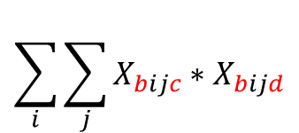
x = tf.constant(np.arange(12).reshape(1,2,2,3))
result = tf.linalg.einsum('bijc,bijd->bcd', x, x)
$$\sum_{i}{\sum_{j}{X_{bijc}∗X_{bijd}}}$$
0
1
2
3
4
5
126
144
162
6
7
8
144
166
188
9
10
11
162
188
214
(1,3,3)
0
1
2
0
1
2
0
0
0
3
4
5
3
4
5
9
12
15
0
1
2
12
16
20
0
2
4
15
20
25
6
7
8
6
7
8
36
42
48
9
10
11
9
10
11
81
90
99
42
49
56
90
100
110
48
56
64
99
110
121

Slide 5
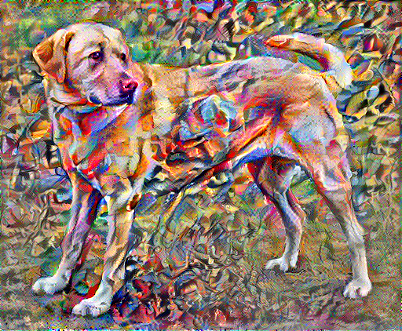
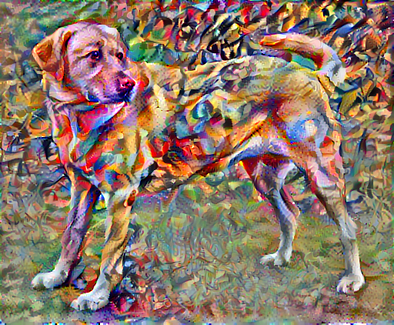

Slide 6
(1,3,3,1)
(2,2,1,1)
1
2
3
1
1
12
16
4
5
6
1
1
24
28
7
8
9
image
weight
1
2
4
5
1
12
2
3
5
6
.
1
16
4
5
7
8
1
24
5
6
8
9
1
28
(4,4)
(4,1)
(4,1)

Slide 7
(1,3,3,1)
(2,2,1,1)
1
2
3
1
1
12
16
4
5
6
1
1
24
28
7
8
9
image
1
weight
2
1
1
0
1
1
0
0
0
0
3
12
0
1
1
0
1
1
0
0
0
.
4
16
0
0
0
1
1
0
1
1
0
5
24
0
0
0
0
1
1
0
1
1
6
28
(4,9)
7
(4,1)
8
9
(9,1)

Slide 8
(1,3,3,1)
Conv2DTranspose
(1,2,2,1)
(2,2,1,1)
1
2
1
1
1
3
2
3
4
1
1
4
10
6
3
7
4
weight.T
1
0
0
0
1
1
1
0
0
image
3
0
1
0
0
1
2
1
0
1
0
.
2
4
1
1
1
1
3
10
0
1
0
1
4
6
0
0
1
0
(4,1)
3
0
0
1
1
7
0
0
0
1
4
(9,4)
(9,1)

Slide 9
(1,3,3,1)
(N+P-F)/S +1 = N
(2,2,1,1)
(5-2)/2 + 1 = N
1
2
3
4
0
5
6
7
8
0
1
1
14
22
1
9
10
11
12
0
1
1
46
54
2
image
13
14
15
16
0
3
0
0
0
0
0
4
5
weight
6
7
1
1
0
0
1
1
0
0
0
0
0
0
0
0
0
0
8
14
0
0
1
1
0
0
1
1
0
0
0
0
0
0
0
0
.
9
22
0
0
0
0
0
0
0
0
1
1
0
0
1
1
0
0
10
46
0
0
0
0
0
0
0
0
0
0
1
1
0
0
1
1
11
54
(4,16)
12
(4,1)
13
14
15
16
(16,1)

Slide 10
(1,2,2,1)
(2,2,1,1)
(1,4,4,1)
1
2
1
1
1
1
2
2
3
4
1
1
1
1
2
2
3
3
4
4
image
weight
3
3
4
4
1
1
2
2
1
1
1
0
0
1
1
0
0
0
0
0
0
0
1
1
.
0
0
0
2
2
0
0
1
1
0
0
1
1
0
0
0
0
0
0
0
0
3
2
0
0
0
0
0
0
0
0
1
1
0
0
1
1
0
0
3
4
0
0
0
0
0
0
0
0
0
0
1
1
0
0
1
1
3
(4,1)
4
4
3
3
(4,16)
4
(16,1)
4

Slide 11
Conv2D
Conv2DTranspose
다운 샘플링
업 샘플링

Slide 12
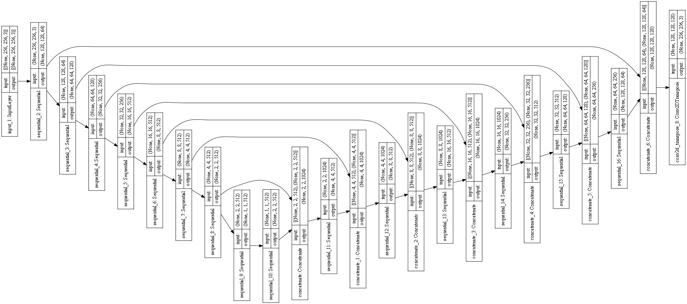
U Net 구조

