Slide 1
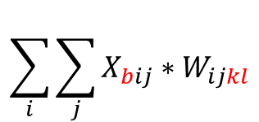
x = tf.constant(np.arange(4).reshape(1,2,2))
w = tf.constant(np.arange(16).reshape(2,2,2,2))
output = tf.einsum("bij,ijkl->bkl", x, w)
output
$$\sum_{i}{\sum_{j}{X_{bij}∗W_{ijkl}}}$$
0
1
2
3
0
1
2
3
4
5
6
7
array([[[56, 62],
[68, 74]]])>
8
9
10
11
12
13
14
15
0
1
=
0
0
4
5
=
4
5
0
*
1
*
2
3
0
0
6
7
6
7
56
62
8
9
=
16
18
12
13
=
36
39
68
74
2
*
3
*
10
11
20
22
14
15
42
45

