Slide 1
RTOS programming
강사명 : 김정인

Slide 2
https://github.com/imguru-mooc/RTOS_uCOSII

Slide 3
virtual box : 가상 머신 virtualbox.org site
ubuntu 18.04 : http://mirror.kakao.com/
micro OS II 포팅

Slide 4
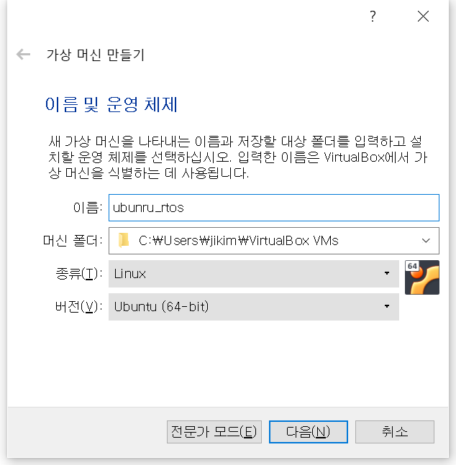
virtual box 설치 : 최신 버전
virtualbox.org 사이트에서 다운로드 후 설치
새로만들기

Slide 5
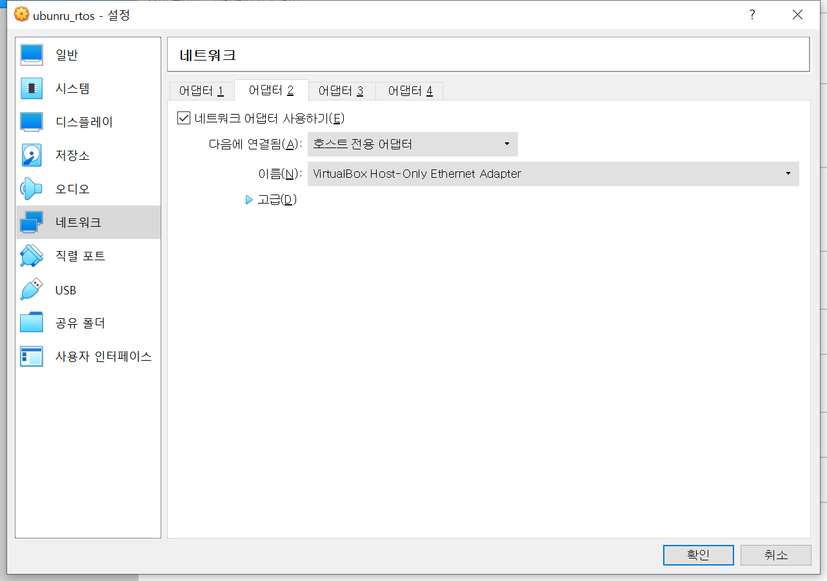
설정 >>

Slide 6
리눅스에서 터미널 실행 : ctrl+alt+t
루트 계정 활성화
$ sudo passwd
$ su -
# ifconfig
# apt install net-tools
# ifconfig
enp0s8 : inet 192.168.56.112
# apt install ssh
# netstat -ant
0.0.0.0:22
root 계정으로 접속하기
# vi /etc/ssh/sshd_config
#PermitRootLogin prohibit-password => PermitRootLogin yes
# service ssh restart

Slide 7
시작 >>
id: root
passwd : linux
windows
ubuntu
filezilla
putty
sshd
sftp
3
22
ipconfig
192.168.56.1
ifconfig
enp0s8 : 192.168.56.112
netstat -ant
0:22

Slide 8
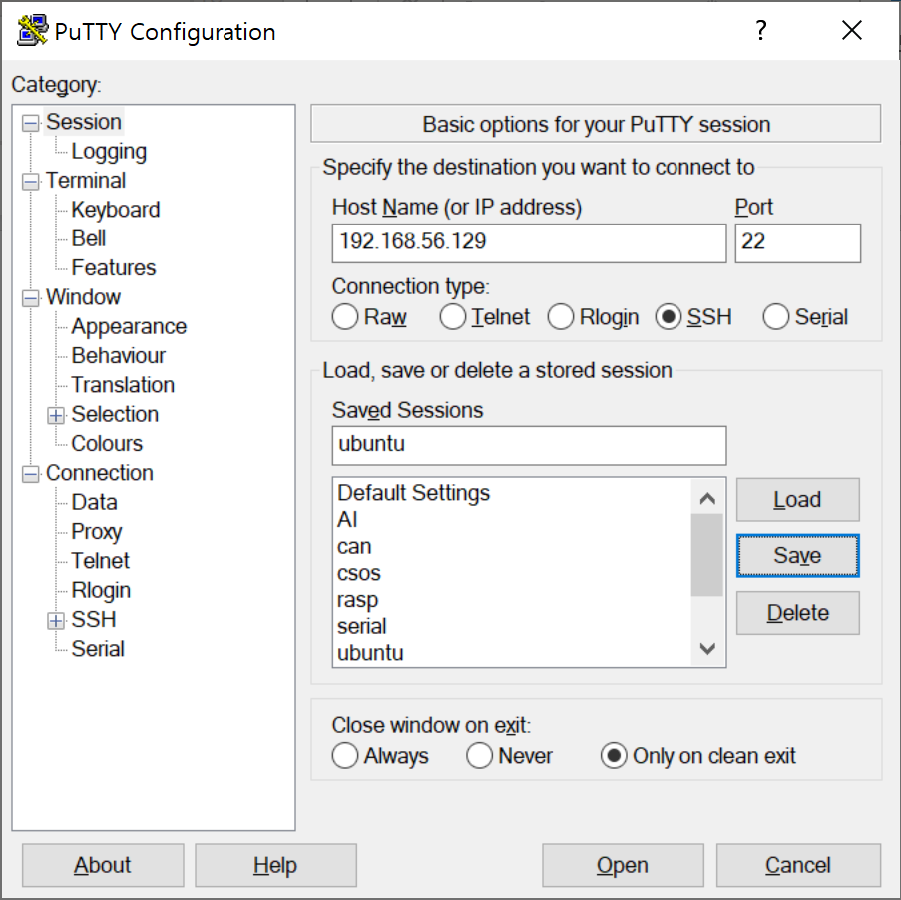
putty 설정
login as : root
passwd : linux
putty => https://www.chiark.greenend.org.uk/~sgtatham/putty/
filezilla => https://filezilla-project.org/

Slide 9
강사 PC : 192.168.0.183
id : linux
passwd : 없음

Slide 10
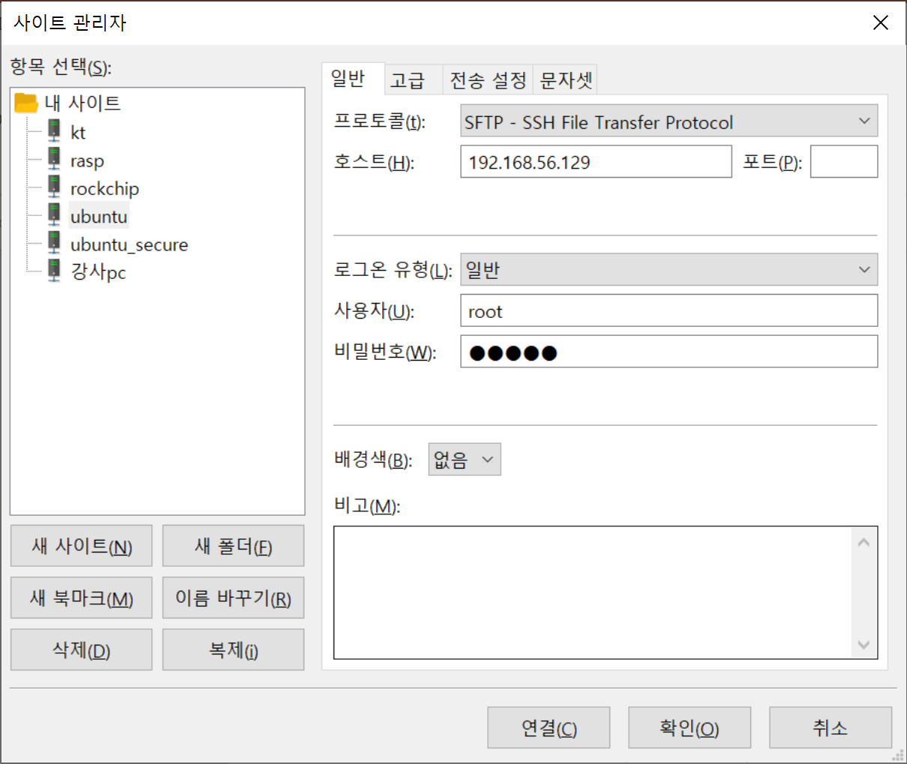
file zilla 설정
사이트 관리자 : ctrl+s

Slide 11
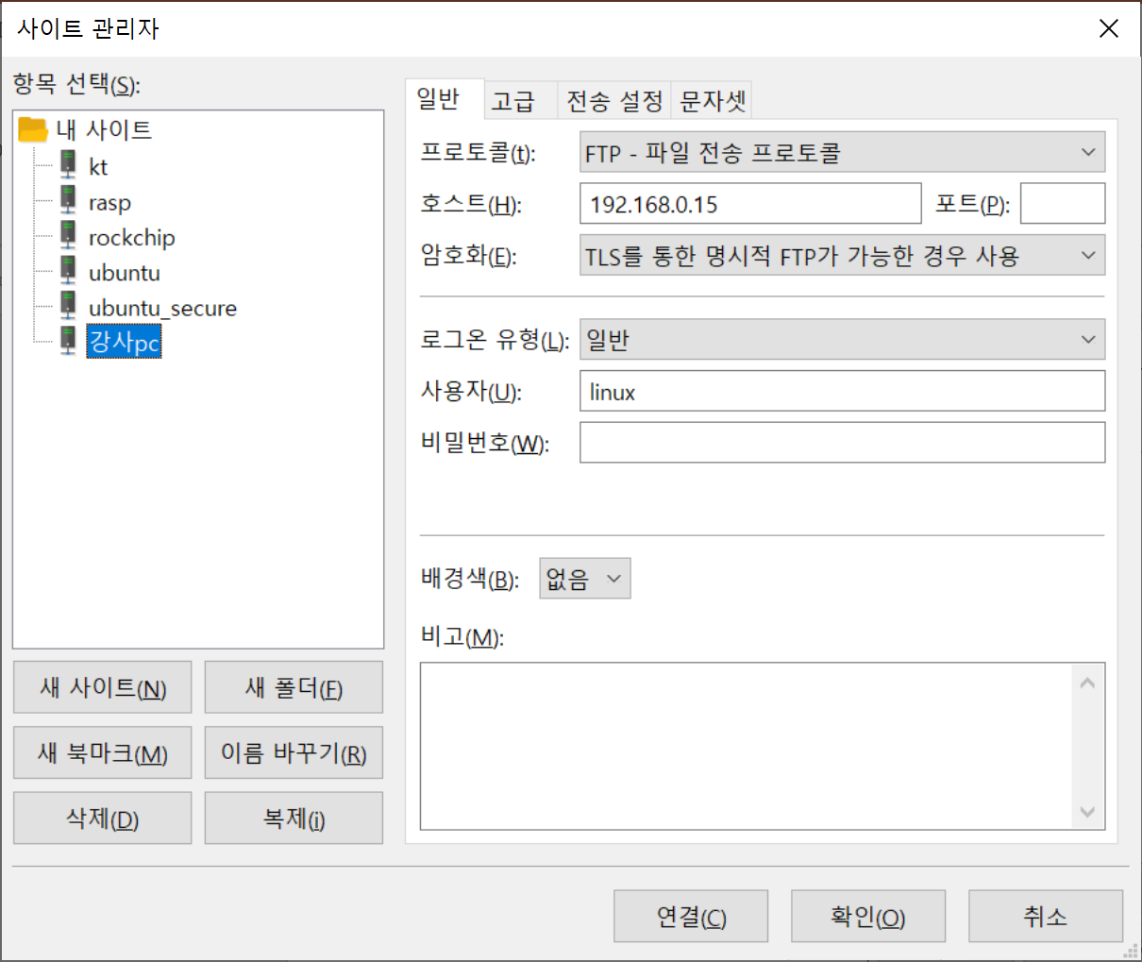
file zilla 설정
사이트 관리자 : ctrl+s
강사PC에 접속 시
192.168.0.200

Slide 12
# cd uCOS-II
# apt install exuberant-ctags
# ctags -R *
# vi ~/.vimrc
set tags += /root/uCOS-II/tags
# vi a.c
OSStart
반드시 저장후 이동
ESC >> :w
vi 종료
:q
정의로 이동 : g ]
돌아오기 : ctrl + t

Slide 13
태그 패스 설정
# apt install vim
# vi ~/.vimrc
set ts=4
set sw=4
set cindent
set autoindent
set tags+=/root/uCOS-II/tags

Slide 14
최신 vim 설치
# apt update
# apt remove vim
# apt install vim
최신 빌드 환경 설치
# apt install build-essential

Slide 15
첫번째 예제 실행
# cd uCOS-II/Ports/examples/1_day/
# cd 1.test_first
# ls
# make
# ./test
OSCPUUsage 0%
OSCPUUsage 0%
...
ESC는 프로그램의 종료
^M 특수기호 지우기
OSInit(void) ^M
:%s/^M//g
ctrl+C enter

Slide 16
확장 bitmap
#include <stdio.h>
int main()
{
int item[4]={0,};
int i;
item[0] = 1;
item[3] = 1;
for(i=0; i<4; i++ )
if( item[i] != 0 )
printf("%d\n", i );
printf("-------\n");
item[3] = 0;
문제점 :
메모리를 심하게 낭비한다.
0
1
2
3
item
0
0
0
0
item
1
0
0
0
item
1
0
0
1
item
1
0
0
0

Slide 17
확장 bitmap
#include <stdio.h>
int main()
{
int item=0;
int i;
item = item | 1;
item = item | 8;
for(i=0; i<4; i++ )
if( item & (1<<i) )
printf("%d\n", i );
printf("-------\n");
item = item & ~8;
문제점 :
메모리를 심하게 낭비한다.
3
2
1
0
item
0
0
0
0
|
0
0
0
1
0
0
0
1
|
1
0
0
0
1
0
0
1
&
0
1
1
1
0
0
0
1

Slide 18
확장 bitmap
#include <stdio.h>
int main()
{
int item=0;
int i;
item = item | 1;
item = item | 8;
for(i=0; i<4; i++ )
if( item & (1<<i) )
printf("%d\n", i );
printf("-------\n");
item = item & ~8;
문제점 :
메모리를 심하게 낭비한다.
3
2
1
0
item
1
0
0
1
&
0
0
0
1
0
0
0
1

Slide 19
확장 bitmap
#include <stdio.h>
int main()
{
int item=0;
int i;
item = item | 1;
item = item | 8;
for(i=0; i<4; i++ )
if( item & (1<<i) )
printf("%d\n", i );
printf("-------\n");
item = item & ~8;
문제점 :
메모리를 심하게 낭비한다.
개수의 제한이 있다.
3
2
1
0
item
1
0
0
1
&
0
1
1
1
0
0
0
1

Slide 20
확장 bitmap
prio = 100;
item[0]
item[1]
item[2]
item[3]
1
100-32 => 68-32 => 36-32 => 4
몫 : 3 , 나머지 : 4
int item[4] = {0,}
item[index/32] |= (1<<(index%32));

Slide 21
확장 bitmap
문제점 :
메모리를 심하게 낭비한다.
개수의 제한이 있다.
가독성이 없다.
int item[32]={0,};
int i;
item[700/32] |= 1<<(700%32);
item[800/32] |= 1<<(800%32);
for(i=0; i<1024; i++ )
if( item[i/32] & (1<<(i%32)) )
printf("%d\n", i );
printf("-------\n");
item[800/32] &= ~(1<<(800%32));

Slide 22
확장 bitmap
문제점 :
메모리를 심하게 낭비한다.
개수의 제한이 있다.
가독성이 없다.
나누기 연산은 느리다.
#define BIT_SET(index,x) (x[index/32] |= 1<<(index%32))
#define BIT_ISSET(index,x) ( x[index/32] & (1<<(index%32)) )
#define BIT_CLR(index,x) (x[index/32] &= ~(1<<(index%32)))

Slide 23
확장 bitmap
문제점 :
메모리를 심하게 낭비한다.
개수의 제한이 있다.
가독성이 없다.
나누기 연산은 느리다.
0
1
1
0
1
0
1
1
#define BIT_SET(index,x) (x[index>>5] |= 1<<(index&31))
#define BIT_ISSET(index,x) ( x[index>>5] & (1<<(index&31)) )
#define BIT_CLR(index,x) (x[index>>5] &= ~(1<<(index&31)))

Slide 24
확장 bitmap
usigned char OSRdyTbl[8];
task_create(1);
prio_tbl[prio/8] |= 1<<(prio%8);
OSRdyTbl
1

Slide 25
정수의 내부구조
char ch=200;
printf("%d\n", ch ); -56
S
1
1
0
0
1
0
0
0
1
1
0
0
1
0
0
0
MSB
0
0
1
1
0
1
1
1
S
0
0
1
1
1
0
0
0
(-1) * ~ch+1

Slide 26
정수의 내부구조
char a=5, b=3;
a-b
2
0
0
0
0
0
0
0
1
5
-
0
0
0
0
0
0
1
1
3
0
0
0
0
0
0
1
0
2

Slide 27
정수의 내부구조
n-1의 보수
a=5, b=3
9 = b+x
a+x
5+6=1+1=2
char a=5, b=3;
a-b
0
0
0
0
0
1
0
1
5
+
1
1
1
1
1
1
0
0
-3
1
1
1
1
1
1
1
1
1
0
0
0
0
0
0
0
1
7
-
0
0
0
0
0
0
1
1
carry
sum
+
1
1
1
1
1
1
1
0
0
0
0
0
0
0
0
1
0

Slide 28
정수의 내부구조
char a=5, b=3;
a-b
0
0
0
0
0
0
0
0
0
+
0
1
1
1
1
1
1
1
127
1
0
0
0
0
0
0
0
-127
-
1
1
1
1
1
1
1
1
-0

Slide 29
정수의 내부구조
n의 보수
a=5, b=3
10 = b+x
a+x
5+7=12
char a=5, b=3;
a-b
0
0
0
0
0
1
0
1
5
+
1
1
1
1
1
1
0
1
-3
1
1
1
1
1
1
1
1
1
0
0
0
0
0
0
1
0
2
0
0
0
0
1
0
0
0
carry
1
1
1
1
1
0
0
0

Slide 30
정수의 내부구조
char a=5, b=3;
a-b
0
0
0
0
0
0
0
0
0
+
0
1
1
1
1
1
1
1
127
1
0
0
0
0
0
0
0
-128
-
1
1
1
1
1
1
1
1
-1

Slide 31
정수의 내부구조
char ch = 255
1
1
1
1
1
1
1
1
0
0
0
0
0
0
0
1
-1

Slide 32
정수의 내부구조
short ch = 0xfffe
1
1
1
1
1
1
1
1
1
1
1
1
1
1
1
0
-2

Slide 33
정수의 내부구조
int ch = 0xfffffffc
1
1
1
1
1
1
1
..
1
1
1
1
1
1
0
0
-4

Slide 34
정수의 내부구조
typedef struct
{
char b:2;
} BIT;
BIT a;
a.b=3;
1
1
-1

Slide 35
정수의 내부구조
typedef struct
{
char b:1;
} BIT;
BIT a;
a.b=1;
if( a.b == 1 )
...
typedef struct
{
unsigned char b:1;
} BIT;
BIT a;
a.b=1;
if( a.b == 1 )
...
1
-1
1
1

Slide 36
실수의 내부구조
float f = 10.25f;
0
1
0
1
0
.
0
1
32767
1/65536
고정 소수점 방식

Slide 37
실수의 내부구조
float f = 10.25f;
1010.01 = 0.101001*2^4
s
e
m
0
1
0
0
1
0
1
0
0
1
부동(浮動) 소수점 방식

Slide 38
실수의 내부구조
0.000001 => 1.02^-6
float f = 10.25f;
1010.01 = 1.01001*2^3
s
e
m
0
1
0
0
0
0
0
1
0
0
1
0
0
1
부동(浮動) 소수점 방식
s
(-1)*1.m*2^(e-127) => 10.25

Slide 39
실수의 내부구조
0.000001 => 1.02^-6
float f = 10.25f;
1010.01 = 1.01001*2^3
s
e
m
0
1
0
0
0
0
0
1
0
0
1
0
0
1
0
1
0
0
0
0
0
1
0
0
1
0
0
1
0
0
4
1
2
4
0 0 0 0 4 2 1 4

Slide 40
정수의 내부구조
char ch=200;
printf("%d\n", ch ); -56

Slide 41
함수 포인터
int i=10;
int *p = &i;
void foo(void)
{
}
void (void) *p = &foo;
void (*p)(void) = foo;
...
p();
void (*p)(void) = &foo;
...
(*p)();

Slide 42
void foo (void)
{
}
void (*p)(void) = &foo;
...
(*p)();
함수 포인터
*p++;
*++p;
int i=10;
int *p = &i;
void foo(void)
{
}
void (void) *p = &foo;
void *p(void) = &foo;
void (*p)(void) = &foo;
void foo (void)
{
}
void (*p)(void) = foo;
...
p();

Slide 43
함수 포인터
void aaa(void)
{
printf("aaa()\n");
}
void ccc(void)
{
printf("ccc()\n");
}
void bbb( void (*p)(void) )
{
p();
printf("bbb()\n");
}

Slide 44
함수 타입
void aaa(void);
// function(void) returning void
void aaa(int);
// function(int) returning void
int aaa(int);
// function(int) returning int

Slide 45
배열 타입
1000
p
1000
int a[5] = {1,2,3,4,5};
int *p = a;
sizeof(a) = sizeof(int [5])=20
sizeof(p) = sizeof(int *) = 8
1
a[0]
2
3
4
5
a[4]

Slide 46
배열 타입
decay : 배열의 이름은 일반적으로
배열의 첫번재 원소의 주소로 해석된다.
예외) sizeof , &
int a[5] = {1,2,3,4,5};
int *p = a; // &a[0];
sizeof(a) = sizeof(int [5])=20
sizeof(p) = sizeof(int *) = 8
1000
p
1000
1
a[0]
2
3
4
5
a[4]

Slide 47
배열 타입
decay : 배열의 이름은 일반적으로
배열의 첫번재 원소의 주소로 해석된다.
예외) sizeof , &
int a[5] = {1,2,3,4,5};
//int *p = &a;
//int [5] *p = &a;
//int *p[5] = &a;
int (*p)[5] = &a;
(*p)[4] = 10;
1000
p
1000
1
a[0]
2
3
4
5
a[4]

Slide 48
배열 타입
decay : 배열의 이름은 일반적으로
배열의 첫번재 원소의 주소로 해석된다.
예외) sizeof , &
int a[2][2] = {1,2,3,4};
int *p = a;
p[1][1] = 10;
(*(p+1))[1]
*(*(p+1)+1)
*(*(1000+1)+1)
*(*1004+1)
*(2+1)
*3 compile error
pointer+1=pointer+sizeof(*pointer)*1
1000
p
1000
1
a[0][0]
1004
2
a[0][1]
3
a[1][0]
4
a[1][1]

Slide 49
배열 타입
decay : 배열의 이름은 일반적으로
배열의 첫번재 원소의 주소로 해석된다.
예외) sizeof , &
int a[2][2] = {1,2,3,4};
int * *p = a;
p[1][1] = 10;
(*(p+1))[1]
*(*(p+1)+1)
*(*(1000+1)+1)
*(*1008+1)
*(0x0304+1)
*0x0308 runtime error
p+1=p+sizeof(*p)*1
1000
p
1000
1
a[0][0]
1004
2
a[0][1]
1008
3
a[1][0]
4
a[1][1]

Slide 50
배열 타입
decay : 배열의 이름은 일반적으로
배열의 첫번재 원소의 주소로 해석된다.
예외) sizeof , &
int a[2][2] = {{1,2},{3,4}};
int (*p)[2] = a;
p[1][1] = 10;
(*(p+1))[1]
*(*(p+1)+1)
*(*(1000+1)+1)
*(*1008+1)
*(1008+1)
*1012 = 10
p+1=p+sizeof(int[2])*1
1000
p
1000
1
a[0][0]
__a
1004
2
a[0][1]
1008
1008
3
a[1][0]
__b
1012
10
a[1][1]

Slide 51
함수 타입
void foo(void);
// function(void) retuning
// void
void foo(int);
// function(int) retuning
// void
int foo(int);
// function(int) retuning
// int

Slide 52
함수 타입
int *a[2];
// array of 2
// pointer to
// int
sizeof(a)=8
a+1 => 4
a
*
1
int i;
// int
int **p;
// pointer to
// pointer to
// int
*
2
int *p;
// pointer to
// int
p
int a[2];
// array of 2
// int
int (*p)[2];
// pointer to
// array of 2
// int
sizeof(p)=4
p+1 => 8
*
1
2

Slide 53
함수 타입
void foo(void);
// function(void) retuning
// void
void (*(*p)(void))(void);
// pointer to
// function(void) returning
// pointer to
// function(void) returning
// void
void (*p)(void);
// pointer to
// function(void) retuning
// void
void (*foo(void))(void);
//function(void) returning
//pointer to
//function(void) returning
// void

Slide 54
배열 타입
int (*(*(*(*q)[2])(void))(void))[2]

Slide 55
배열 타입
int (*(*(*(*q)[2])(void))(void))[2]
pointer to
array of 2
pointer to
function(void) returning
pointer to
function(void) returning
pointer to
array of 2
int

Slide 56
uC/OS-II : 분석
CPU
PC
SP
CPU의 양보 시점
I/O 요청시 CPU를 양보함
Ready Queue
Task 1
Task 2
Task 3
Wait Queue
PC
PC
PC
SP
SP
SP
schedule();
context_switch();

Slide 57
uC/OS-II : 분석
OSInit();
OS_InitRdyList();
OSPrioCur
OSRdyTbl
0
OSPrioHighRdy
0
OSTCBHighRdy
0
OSTCBCur
0
OSRdyGrp
0
0
0
0
0
0
0
0

Slide 58
uC/OS-II : 분석
OSTCBTbl
[0]
[1]
[...]
[63]
OSInit();
OS_InitTCBList();
OSTCBPrio
OSTCBX
OSTCBY
OSTCBPrioTbl
OSTCBBitX
0
OSTCBBitY
0
0
OSTCBNext
0
...
OSTCBList
0
ptcb1
ptcb2
0
OSTCBPrio
OSTCBX
OSTCBFreeList
OSTCBY
OSTCBBitX
OSTCBBitY
OSTCBNext
...
0

Slide 59
NODE *head;
void insert_data(int data)
{
NODE *temp;
temp = (NODE*)malloc(sizeof(NODE));
temp->data = data;
temp->next = head;
head = temp;
}
insert_data(1);
list 의 장점
: 삽입/삭제가 빠른다.
head
temp
3
2
1
0

Slide 60
typedef struct _node
{
int data;
struct _node *next;
} NODE;
NODE *head;
void insert_data(NODE *temp)
{
temp->next = head;
head = temp;
}
list 의 장점
: 삽입/삭제가 빠른다.
head
temp
3
2
1
0

Slide 61
void __list_add( NODE *prev, NODE *next, NODE *temp )
{
temp->prev = prev;
prev->next = temp;
temp->next = next;
next->prev = temp;
}
void list_add( NODE *head, NODE *temp )
{
__list_add( head, head->next, temp );
}
head
head->next
prev
next
1
temp

Slide 62
OSTaskCreate(prio);
OS_TCBInit(prio);
OSTCBPrioTbl
0
0
0
0
OSTCBList
63
...
0
ptcb
OSTCBPrio
OSTCBX
OSTCBFreeList
OSTCBY
OSTCBBitX
OSTCBBitY
OSTCBNext
...
0

Slide 63
OS_InitTaskIdle();
OSTaskCreate(prio=0);
OSRdyTbl
OSTCBPrioTbl
OSPrioCur
[0]
1
[0]
0
0
0
0
OSPrioHighRdy
...
0
0
OSTCBList
OSTCBPrio
OSTCBX
0
OSTCBHighRdy
[7]
OSTCBY
0
0
OSTCBBitX
1
OSTCBCur
OSTCBBitY
1
1
0
OSRdyGrp
OSTCBNext

Slide 64
OSTaskCreate(prio=10);
OS_TCBInit(prio);
OSRdyTbl
OSTCBPrioTbl
OSPrioCur
[1]
0
0
1
[10]
0
0
OSPrioHighRdy
OSTCBList
...
0
0
OSTCBPrio
10
OSTCBX
2
OSTCBHighRdy
OSTCBY
1
0
OSTCBBitX
4
OSTCBCur
OSTCBBitY
2
1
0
OSRdyGrp
OSTCBNext
0

Slide 65
stack
push(1)
push(2)
push(3)
pop()
pop()
pop()
3
2
1

Slide 66
stack
int main()
{
int a=10;
int b=20;
return 0;
}
STACK
20
b
movl $0x14,-0xc(%ebp)
movl $0xa,-0x10(%ebp)
10
a

Slide 67
stack
STACK
esp
0xffa08b04
10
a
movl $0xa,-0x10(%ebp)
movl $0x14,-0xc(%ebp)
sub $0x4,%esp
pushl -0xc(%ebp)
pushl -0x10(%ebp)
0xffa08b08
20
b
10
20
ebp

Slide 68
stack
STACK
563: call 51d <foo>
568: mov $0x0,%eax
PC
568
esp
568
ebp

Slide 69
stack - cdecl 규약
void foo(int a, int b)
{
}
int main()
{
foo(10,20);
return 0;
}
foo
10
a
20
b
main

Slide 70
64bit 리눅스에서 32bit로 컴파일 하려면
# apt-get install gcc-multilib
# gcc stack.c -m32

Slide 71
000004ed <foo>:
4ed: push %ebp
4ee: mov %esp,%ebp
4f0: sub $0x10,%esp
4f3: call 52d <__x86.get_pc_thunk.ax>
4f8: add $0x1ae4,%eax
4fd: mov 0x8(%ebp),%edx
500: mov 0xc(%ebp),%eax
503: add %edx,%eax
505: mov %eax,-0x4(%ebp)
508: mov -0x4(%ebp),%eax
50b: leave
50c: ret
0000050d <main>:
...
51a: push $0x14
51c: push $0xa
51e: call 4ed <foo>
add $0x8,%esp
int foo(int a, int b)
{
int result;
result = a+b;
return result;
}
int main()
{
foo(10,20);
return 0;
}
esp
30
result
EBP
RET
10
a
20
b
ebp

Slide 72
int foo(int a, int b)
{
int result;
result = a+b;
return result;
}
int main()
{
foo(10,20);
return 0;
}
0x565554ed <+0>: push %ebp
0x565554ee <+1>: mov %esp,%ebp
0x565554f0 <+3>: sub $0x10,%esp
...
0x5655550b <+30>: leave
0x5655550c <+31>: ret
0x5655551a <+13>: push $0x14
0x5655551c <+15>: push $0xa
0x5655551e <+17>: call 0x565554ed <foo>
0x56555523 <+22>: add $0x8,%esp
ebp-4
30
result
0xffffd528
EBP
0x56555523
RET
ebp+8
10
a
ebp+c
20
b
esp
30
eax
ebp

Slide 73
OSTaskCreate(TaskStart, ,&TaskStartStk[TASK_STK_SIZE-1],10);
psp = (OS_STK *)OSTaskStkInit(task, pdata, ptos, 0);
OS_TCBInit(prio);
(*OSCurTsk->OSTCBStkPtr)()
OSTCBList
OSTCBPrio
10
TaskStartStk
OSTCBX
2
OSTCBY
1
OSTCBBitX
4
TaskStart
OSTCBBitY
2
OSTCBStkPtr
...
OSTCBStat
OS_STAT_RDY
OSTCBNext
0
pbos=0
0
511
task

Slide 74
OSTaskCreate(TaskStart, ,&TaskStartStk[TASK_STK_SIZE-1],10);
psp = (OS_STK *)OSTaskStkInit(task, pdata, ptos, 0);
OS_TCBInit(prio);
OSTCBList
OSTCBPrio
10
TaskStartStk
OSTCBX
2
OSTCBY
1
OSTCBBitX
4
TaskStart
OSTCBBitY
2
OSTCBStkPtr
...
OSTCBStat
OS_STAT_RDY
ptos
pdata
OSTCBNext
0
0

Slide 75
int my_ffs(int word){
int num = 0;
if ((word & 0xffff) == 0) {
num += 16;
word >>= 16;
}
if ((word & 0xff) == 0) {
num += 8;
word >>= 8;
}
if ((word & 0xf) == 0) {
num += 4;
word >>= 4;
}
if ((word & 0x3) == 0) {
num += 2;
word >>= 2;
}
if ((word & 0x1) == 0)
num += 1;
return num;
}
int num = 0x8000;
0000000000000000 1000000000000000
10000000 00000000
8
1000 0000
12
10 00
14
1 0
15

Slide 76
int popcount64d(uint64_t x)
{
int count;
for (count=0; x; count++)
x &= x - 1;
return count;
}
int num = 0x1234;
0001001000110100
0001001000110011 &
0001001000110000
0001001000101111 &
0001001000100000
0001001000011111 &
5
count

Slide 77
OSTaskCreate(prio);
OS_TCBInit(prio);
OSRdyTbl
OSTCBPrioTbl
OSPrioCur
[1]
0
10
1
[10]
0
0
OSPrioHighRdy
1
OSTCBList
...
0
1
OSTCBPrio
10
OSTCBX
2
OSTCBHighRdy
1
OSTCBY
1
10
OSTCBBitX
4
OSTCBCur
OSTCBBitY
2
1
1
1
1
OSTCBNext
0
OSRdyGrp
0x58 => 1

Slide 78
OS_InitTaskIdle()
OSIdleCtr
OS_TaskIdle
0
OSRdyTbl
OSTCBPrioTbl
OSPrioCur
0
0
0
0
0
OSPrioHighRdy
[63]
...
0
OSTCBList
OSTCBPrio
63
OSTCBX
7
OSTCBHighRdy
[7]
OSTCBY
1
7
0
OSTCBBitX
128
OSTCBCur
OSTCBBitY
128
1
0
OSRdyGrp
OSTCBNext
0

Slide 79
OS_InitTaskStat();
OSIdleCtr
OS_TaskIdle
0
OSRdyTbl
OSTCBPrioTbl
0
OS_TaskStat
0
0
[62]
0
[63]
OSTCBList
OSTCBPrio
63
62
OSTCBX
[7]
1
1
OSTCBY
OSTCBBitX
OSTCBBitY
1
OSTCBNext
0
0
OSRdyGrp

Slide 80
TaskStart()
{
OSStatInit()
OSTimeDly(2);
OSIdleCtr=0L;
OSTimeDly(200);
for();
printf("%d%%\n",
OSCPUUsage);
}

Slide 81
OSIdleCtr
OSCPUUsage = 100 * (1 - ------------) (units are in %)
OSIdleCtrMax
OSIdleCtr
OSCPUUsage = (100 - --------------- ) (units are in %)
OSIdleCtrMax/100
run = OSIdleCtr;
max = OSIdleCtrMax / 100L;
usage = (INT8S)(100L - run / max);

Slide 82
OSTaskCreateExt(Task1, (void *)0,
&TaskStartStk1[TASK_STK_SIZE - 1],
1,
1000,
&TaskStartStk1[0],
TASK_STK_SIZE=512,
0,
OS_TASK_OPT_STK_CHK|OS_TASK_OPT_STK_CHK);
OSTCBList
OSTCBPrio
1
TaskStartStk1
OSTCBX
pbos
OSTCBY
OSTCBBitX
Task1
OSTCBStkBottom
OSTCBStkPtr
...
OSTCBStat
OS_STAT_RDY
OSTCBNext
0
ptos
0

Slide 83
OSTaskSuspend(1);
OSRdyTbl
OSTCBPrioTbl
OSPrioCur
[1]
[1]
0
1
0
OSPrioHighRdy
[62]
...
0
ptcb
ptcb
62
OSTCBList
OSTCBPrio
1
62
OSTCBHighRdy
OSTCBX
0
6
1
1
OSTCBY
1
7
OSTCBBitX
2
2
OSTCBCur
1
OSTCBBitY
1
1
OSRdyGrp
OSTCBStat
OS_STAT_SUSPEND
OS_STAT_RDY
OSTCBNext
0
0

Slide 84
OSTaskResume(1);
OSRdyTbl
OSTCBPrioTbl
OSPrioCur
1
[1]
[1]
0
1
0
OSPrioHighRdy
[62]
...
0
ptcb
1
OSTCBList
OSTCBPrio
1
62
OSTCBHighRdy
OSTCBX
0
6
1
1
OSTCBY
1
7
OSTCBBitX
2
2
OSTCBCur
1
1
OSTCBBitY
1
1
OSRdyGrp
OSTCBStat
OS_STAT_RDY
OS_STAT_RDY
OSTCBNext
0
0

Slide 85
OSTaskChangePrio(1,3);
OSTaskChangePrio(3,1);
OSRdyTbl
OSTCBPrioTbl
OSPrioCur
1
1
[1]
[1]
0
1
[3]
[62]
...
OSPrioHighRdy
0
ptcb
2
OSTCBList
OSTCBPrio
3
2
OSTCBHighRdy
OSTCBX
0
6
1
1
OSTCBY
1
7
OSTCBBitX
2
2
OSTCBCur
1
1
OSTCBBitY
1
1
OSRdyGrp
OSTCBStat
OS_STAT_RDY
OS_STAT_RDY
OSTCBNext
0
0

Slide 86
irq=1
CPU
PIC
ISR
IVT
timer_interrupt_handler()
[0]
[1]
key_interrupt_handler()

Slide 87
OSTimeDly(10);
irq=0
CPU
PIC
interruptTable[]
OSTCBPrio
0
ISR
IVT
OSTCBDly
0
OSTimeTick()
[0]
OSTCBStat
OS_STAT_RDY
OSInit()
OSInitHookBegin()
interruptTable[0] = OSTimeTick;

Slide 88
Task prio=0
ISR

Slide 89
OSTimeDlyHMSM (INT8U hours, INT8U minutes, INT8U seconds, INT16U milli)
OSTimeDlyHMSM (0, 0, 3, 500);
ticks = ((INT32U)hours * 3600L + (INT32U)minutes * 60L +
(INT32U)seconds) * OS_TICKS_PER_SEC
+ OS_TICKS_PER_SEC * ((INT32U)milli + 500L
/ OS_TICKS_PER_SEC) / 1000L;
(59+5)/10 => 6.4 => 6
OSTCBPrio
(105+5)/10 => 11 Tick
0
OSTCBDly
350
OSTCBStat
OS_STAT_RDY

Slide 90
OS_ENTER_CRITICAL();
OSTCBPrioTbl[prio] = (OS_TCB *)1;
OS_EXIT_CRITICAL();
count
local
1
local
1
1
local = count;
local = local+1;
count = local;
local = count;
local = local+1;
count = local;

Slide 91
count++;
count
eax
1
eax
1
1
eax = count;
eax = eax+1;
count = eax;
eax = count;
eax = eax+1;
count = eax;

Slide 92
count++;
count
0
lock
1
local
local
0
1
while(lock);
lock = 1;
local = count;
local = local+1;
count = local;
lock = 0;
while(lock);
lock = 1;
local = count;
local = local+1;
count = local;
lock = 0;

Slide 93
count++;
count
0
lock
0
local
local
0
0
while(lock);
lock = 1;
local = count;
local = local+1;
count = local;
lock = 0;
while(lock);
lock = 1;
local = count;
local = local+1;
count = local;
lock = 0;

Slide 94
CAS ( Compare And Set ) 연산
count++;
count
0
lock
1
local
local
0
0
while(CAS(&lock));
local = count;
local = local+1;
count = local;
lock = 0;
while(CAS(&lock));
local = count;
local = local+1;
count = local;
lock = 0;

Slide 95
Sleep Lock 연산
count++;
count
0
value
1
local
local
0
0
lock(&value);
local = count;
local = local+1;
count = local;
unlock(&value);
lock(&value);
local = count;
local = local+1;
count = local;
unlock(&value);

Slide 96
OS_ENTER_CRITICAL();
OSTCBPrioTbl[prio] = (OS_TCB *)1;
OS_EXIT_CRITICAL();
count
local
1
local
1
0
OS_ENTER_CRITICAL();
local = count;
local = local+1;
count = local;
OS_EXIT_CRITICAL();
OS_ENTER_CRITICAL();
local = count;
local = local+1;
count = local;
OS_EXIT_CRITICAL();

Slide 97
semaphore(세마포어)
다익스트라 :
Resource(자원)
세마포어
공용변수:1
Toilet
Task
p 연산
v 연산
CriticalSection

Slide 98
semaphore(세마포어)
다익스트라 :
Resource(자원)
세마포어
공용변수:0
Toilet
Toilet
Toilet
Task
p 연산
v 연산
CriticalSection

Slide 99
OS_InitEventList();
OSSemCreate ( 1 )
pevent
OSEventType
OS_EVENT_TYPE_SEM
OSEventGrp
OSEventCnt
1
OSEventPtr
0
OSEventTbl

Slide 100
OS_InitEventList();
OSEventTbl
[0]
[1]
[2]
[3]
OSEventFreeList
...
0

Slide 101
pevent = OSSemCreate ( 1 );
pevent
OSEventType
OS_EVENT_TYPE_SEM
OSEventGrp
OSEventCnt
1
OSEventPtr
0
OSEventTbl

Slide 102
1
OSTCBPrio
pevent
0
OSTCBX
OSEventType
OS_EVENT_TYPE_SEM
1
OSTCBY
OSEventGrp
2
OSTCBBitX
1
1
OSTCBBitY
OSEventCnt
0
OS_STAT_SEM
OSTCBStat
OSEventPtr
0
OSTCBEventPtr
OSEventTbl
1

Slide 103
void Task1 (void *pdata)
{
OSSemPend (pevent, 0, &err);
temp = count;
temp = temp + 1;
OSTimeDly(200*5);
OSSemPost()
}
pevent
OSEventType
OS_EVENT_TYPE_SEM
OSEventGrp
OSEventCnt
0
OSEventPtr
0
OSEventTbl
1
1
OSTCBPrio
1
[1]
OSTCBDly
800
OSTCBStat
OS_STAT_RDY
1
1
1
1

Slide 104
void Task2 (void *pdata)
{
OSSemPend(pevent, 200*10,&err);
temp = count;
temp = temp + 1;
OSTimeDly(200*5);
}
pevent
OSEventType
OS_EVENT_TYPE_SEM
OSEventGrp
OSEventCnt
0
OSEventPtr
0
OSEventTbl
1
1
OSTCBPrio
1
[1]
OSTCBDly
0
OSTCBStat
OS_STAT_RDY
1
1
1
1

Slide 105
OSSemPost (pevent)
1
pevent
[1]
OSEventType
OS_EVENT_TYPE_SEM
OSEventGrp
1
OSEventCnt
0
OSEventPtr
0
OSEventTbl
1
1
1
1
1
OSRdyGrp
OSTCBPrio
2
OSTCBDly
0
OSTCBStat
OS_STAT_SEM

Slide 106
Task1
OSTimeTick()
Save Context
ISR 코드 수행
schedule();
Restore Context

Slide 107
Task1
Task2
OSTimeTick()
Save Context
ISR 코드 수행
schedule();
Restore Context
OSTimeDly(200);

Slide 108
Task1
중첩 인터럽트를 허용
OSTimeTick()
OSKeyBoard()
Save Context
ISR 코드 수행
schedule();
Restore Context
Save Context
ISR 코드 수행

Slide 109
he
Task1
중첩 인터럽트를 허용
OSKeyBoard()
OSKeyBoard()
Save Context
ISR 코드 수행
schedule();
Restore Context
ISR 코드 수행

Slide 110
세마포어의 문제
0
Task1 : 2
Task3 : 4

Slide 111
세마포어의 문제
0
Task1 : 2
Task2 : 3
Task3 : 4

Slide 112
세마포어의 문제
0
Task1 : 2
Task2 : 3
Task3 : 4

Slide 113
뮤텍스
Task1 : 2
Task2 : 3
Task3 : 1

Slide 114
pevent = OSMutexCreate ( 1, &err );
1
pevent
[1]
OSEventType
OS_EVENT_TYPE_MUTEX
OSEventGrp
OSEventCnt
1
ff
OSEventPtr
OSEventTbl
1
1
OSRdyGrp
1
2
OSTCBPrio
0
OSTCBDly
OS_STAT_SEM
OSTCBStat
OSTCBEventPtr

Slide 115
OSMutexPend (pevent, 0, &err);
pevent->OSEventCnt = 0x1ff & 0xff00;
pevent
[1]
OSEventType
OS_EVENT_TYPE_MUTEX
OSEventGrp
OSEventCnt
1
4
OSEventPtr
OSEventTbl
1
1
OSRdyGrp
1
4
OSTCBPrio
0
OSTCBDly
OS_STAT_RDY
OSTCBStat
pip
mprio
OSTCBEventPtr
rdy
ptcb

Slide 116
OSMutexPend (pevent, 0, &err);
pevent->OSEventCnt = 0x1ff & 0xff00;
1
pevent
[1]
OSEventType
OS_EVENT_TYPE_MUTEX
OSEventGrp
1
OSEventCnt
1
4
OSEventPtr
OSEventTbl
1
1
1
OSRdyGrp
1
1
2
OSTCBPrio
0
OSTCBDly
OS_STAT_MUTEX
OSTCBStat
pip
1
mprio
4
OSTCBEventPtr
rdy
ptcb

Slide 117
OSMutexPend (pevent, 0, &err);
[0]
1
1
pevent
OSEventType
OS_EVENT_TYPE_MUTEX
OSEventGrp
1
OSEventCnt
1
4
OSEventPtr
OSEventTbl
1
1
1
OSRdyGrp
1
1
ptcb
OSTCBCur
OSTCBPrio
1
OSTCBPrio
2
pip
1
mprio
4
OSTCBDly
0
OSTCBDly
0
rdy
OSTCBStat
OS_STAT_RDY
OSTCBStat
OS_STAT_MUTEX
TRUE

Slide 118
생각하는 철학자 - Dead Lock

Slide 119
1.lock은 순서대로 잡는다.
mutex1
mutex2
lock(&mutex1)
lock(&mutex2)
unlock(&mutex2)
unlock(&mutex1)
lock(&mutex1)
lock(&mutex2)

Slide 120
lock 모두를 획득하고
모두를 동시에 해제해야 한다.
1.lock은 순서대로 잡는다.
2.lock은 역순으로 푼다.
mutex1
mutex2
lock(&mutex1)
lock(&mutex2)
unlock(&mutex2)
unlock(&mutex1)
lock(&mutex1)
lock(&mutex2)
unlock(&mutex2)
unlock(&mutex1)

Slide 121
self dead lock
1
0
4
mutex
lock(&mutex)
lock(&mutex)
lock(&mutex)
lock(&mutex)
lock(&mutex)
unlock(&mutex)
unlock(&mutex)
unlock(&mutex)
unlock(&mutex)
unlock(&mutex)
lock(&mutex)
unlock(&mutex)
int count=0;
int count_recur(int n)
{
if( n==0 )
return 0;
return count += count_recur(n-1);
}

Slide 122
재진입 가능 함수

Slide 123
생산자와 소비자의 문제
sem
0
Task1
Task2
lock(&mutex)
temp
lock(&mutex)
생산한다.
21
p()
v()
소비한다.
unlock(&mutex)
unlock(&mutex)

Slide 124
rear
count
0
1
2
3
4
5
6
7
8
0
queue
1
2
3
4
5
6
7
8
9
front
put(1)
put(2)
put(3)
get() => 1
get() => 2
get() => 3

Slide 125
front
0
1
2
3
4
5
6
7
8
9
queue
8
9
1
2
3
4
5
6
7
rear
put(1)
put(2)
put(3)
get() => 1
get() => 2
get() => 3

Slide 126
rear
0
1
2
3
4
5
6
7
8
9
queue
4
2
3
4
5
6
7
1
2
3
front
front
|
1 2 3
|
rear

Slide 127
pgrp = OSFlagCreate(0, &err);
OS_FLAG_GRP
pgrp
OSFlagType
OS_EVENT_TYPE_FLAG
OSFlagWaitList
0
OSFlagFlags
0
0
0
0
0
0
0
0

Slide 128
OSFlagPend (pgrp, 0x3, OS_FLAG_WAIT_SET_ALL, 0, &err);
pgrp
OSFlagType
OS_EVENT_TYPE_FLAG
node
OSFlagWaitList
0
OSFlagNodeNext
OSFlagFlags
0
0
0
0
0
0
0
0
0
OSFlagNodePrev
OSFlagNodeTCB
flags_cur
0
0
0
0
0
0
0
0
OSFlagNodeFlagGrp
0
0
0
0
0
0
1
1
OSFlagNodeFlags
flags_rdy
0
0
0
0
0
0
0
0
OS_FLAG_WAIT_SET_ALL
OSFlagNodeWaitType
consume
FALSE
OSTCBPrio
1
OSTCBDly
0
OSTCBStat
OS_STAT_FLAG
OSTCBFlagNode

Slide 129
'a' => 97, 'A'=>65, '0' => 48 '3'-'0' => 3
OSFlagPend (pgrp, 0xc, OS_FLAG_WAIT_SET_ANY, 0, &err);
pgrp
pnode
OSFlagType
OS_EVENT_TYPE_FLAG
0
OSFlagWaitList
0
OSFlagFlags
0
0
0
0
0
0
0
0
flags_cur
0
0
0
0
0
0
0
0
0
0
0
0
1
1
0
0
0
0
0
0
0
0
1
1
flags_rdy
0
0
0
0
0
0
1
1
OS_FLAG_WAIT_SET_ANY
OS_FLAG_WAIT_SET_ALL
consume
FALSE
OSTCBPrio
2
OSTCBPrio
1
OSTCBDly
0
OSTCBDly
0
OSTCBStat
OS_STAT_FLAG
OSTCBStat
OS_STAT_FLAG
OSTCBFlagNode
OSTCBFlagNode

Slide 130
'a' => 97, 'A'=>65, '0' => 48 '3'-'0' => 3
OSFlagPost(pgrp, flag=0x3, OS_FLAG_SET, &err );
pgrp
pnode
OSFlagType
OS_EVENT_TYPE_FLAG
0
OSFlagWaitList
0
OSFlagFlags
0
0
0
0
0
0
1
1
flags_cur
0
0
0
0
0
0
0
0
0
0
0
0
1
1
0
0
0
0
0
0
0
0
1
1
flags_rdy
0
0
0
0
0
0
1
1
OS_FLAG_WAIT_SET_ANY
OS_FLAG_WAIT_SET_ALL
consume
FALSE
OSTCBPrio
2
OSTCBPrio
1
OSTCBDly
0
OSTCBDly
0
OSTCBStat
OS_STAT_FLAG
OSTCBStat
OS_STAT_RDY
OSTCBFlagNode
OSTCBFlagNode

Slide 131
pevent = OSMboxCreate ( 0 );
pevent
OSEventType
OS_EVENT_TYPE_MBOX
OSEventGrp
OSEventCnt
0
OSEventPtr
0
OSEventTbl

Slide 132
msg = OSMboxPend(pevent, 0, &err);
pevent
OSEventType
OS_EVENT_TYPE_MBOX
OSEventGrp
1
OSEventCnt
0
OSEventPtr
0
OSEventTbl
1

Slide 133
msg = OSMboxPend(pevent, 0, &err);
pevent
OSEventType
OS_EVENT_TYPE_MBOX
OSEventGrp
0
OSEventCnt
0
OSEventPtr
0
OSEventTbl
0
0

Slide 134
OSMboxPostOpt(pevent,"hello",OS_POST_OPT_BROADCAST);
pevent
OSEventType
OS_EVENT_TYPE_MBOX
1
OSEventGrp
OSEventCnt
0
1
1
1
OSEventPtr
0
OSEventTbl
1
1
OSTCBPrio
1
2
"Hello"
OSTCBMsg
0
0
OSTCBStat
OS_STAT_RDY
OS_STAT_RDY

Slide 135
#include <stdio.h>
int main()
{
int i=10;
int *p1 = &i;
int **p2 = &p1;
int** *p3 = &p2;
***p3 = 20;
printf("%p,%p,%p,%p\n",
&i,&p1,&p2,&p3);
printf("%d\n", i );
return 0;
}
0xffa69edc
10
i
0xffa69ee0
0xffa69edc
p1
0xffa69ee4
0xffa69ee0
p2
0xffa69ee8
0xffa69ee4
p3

Slide 136
pevent = OSQCreate ( (void**)my_queue , 8 );
KEY_EVENT *my_queue[8];
KEY_EVENT *(*p)[8] = &my_queue;
KEY_EVENT **p = my_queue;
pevent
pq
OSEventType
OS_EVENT_TYPE_Q
OSQPtr
void * *p ;
0
OSEventGrp
OSQStart
**
OSEventCnt
0
OSQEnd
**
OSQIn
**
OSEventPtr
OSQOut
0
1
2
3
4
5
6
7
**
OSEventTbl
OSQSize
8
*
*
*
*
*
*
*
*
OSQEntries
0
my_queue
start

Slide 137
pevent = OSQCreate ( (void**)my_queue , 8 );
KEY_EVENT *my_queue[8];
KEY_EVENT *(*p)[8] = &my_queue;
KEY_EVENT **p = my_queue;
pevent
pq
OSEventType
OS_EVENT_TYPE_Q
OSQPtr
void * *p ;
0
OSEventGrp
OSQStart
**
OSEventCnt
0
OSQEnd
**
OSQIn
**
OSEventPtr
OSQOut
0
1
2
3
4
5
6
7
**
OSEventTbl
OSQSize
8
100
200
*
*
*
*
*
*
OSQEntries
1
my_queue
start
temp
key
'a'
'b'
key
'a'
100
cur
123
134
cur
123
msg
100

Slide 138
pmem=OSMemCreate( my_mem, 8, sizeof(KEY_EVENT), &err );
plink = (void **)addr;
pblk = (INT8U *)addr + blksize;
for (i = 0; i < (nblks - 1); i++) {
*plink = (void *)pblk;
plink = (void **)pblk;
pblk = pblk + blksize;
}
* plink = (void *)0;
blksize
8
plink
pblk
**
*
nblks
8
addr
*
pmem
1
2
3
4
5
6
7
0
OSMemAddr
key
OSMemFreeList
cur
OSMemBlkSize
8
OSMemNBlks
8
my_mem
OSMemNFree
8

Slide 139
temp = OSMemGet( pmem, &err );
pblk = pmem->OSMemFreeList;
pmem->OSMemFreeList = *(void **)pblk;
pmem->OSMemNFree--;
pblk
temp
*
pmem
1
2
3
4
5
6
7
0
OSMemAddr
key
'a'
OSMemFreeList
cur
123
OSMemBlkSize
8
OSMemNBlks
8
my_mem
OSMemNFree
7

Slide 140
OSQPost( pevent, temp );
temp
pevent
pq
OSEventType
OS_EVENT_TYPE_Q
OSQPtr
0
OSEventGrp
1
OSQStart
void**
OSEventCnt
0
OSQEnd
OSQIn
OSEventPtr
OSQOut
0
1
2
3
4
5
6
7
OSEventTbl
1
OSQSize
8
*
*
*
*
*
*
*
*
OSQEntries
0
my_queue
start
key
'a'
cur
123
temp

Slide 141
p1 = OSMemGet( pmem, &err );
nblks
8
pblk
blksize
6
pmem
p1
OSMemAddr
OSMemFreeList
0
1
2
3
4
5
6
7
OSMemBlkSize
key
'a'
0
OSMemNBlks
8
cur
100
OSMemNFree
7
addr

Slide 142
p2 = OSMemGet( pmem, &err );
p2
nblks
8
p1
blksize
6
pmem
OSMemAddr
OSMemFreeList
0
1
2
3
4
5
6
7
OSMemBlkSize
key
'a'
'b'
0
OSMemNBlks
8
cur
100
110
OSMemNFree
7
addr

Slide 143
p3 = OSMemGet( pmem, &err );
p2
p1
p3
pmem
OSMemAddr
OSMemFreeList
0
1
2
3
4
5
6
7
OSMemBlkSize
key
'a'
'b'
'c'
0
OSMemNBlks
8
cur
100
110
120
OSMemNFree
5
addr

Slide 144
OSMemPut( pmem, pblk = p2);
*(void **)pblk = pmem->OSMemFreeList;
pmem->OSMemFreeList = pblk;
pmem->OSMemNFree++;
p2
p1
p3
pmem
OSMemAddr
OSMemFreeList
0
1
2
3
4
5
6
7
OSMemBlkSize
key
'a'
'c'
0
OSMemNBlks
8
cur
100
120
OSMemNFree
5
addr

Slide 145
p4 = OSMemGet( pmem, &err );
pblk = pmem->OSMemFreeList;
pmem->OSMemFreeList = *(void **)pblk;
nblks
8
blksize
6
pmem
p4
OSMemAddr
OSMemFreeList
0
1
2
3
4
5
6
7
OSMemBlkSize
key
'a'
'd'
'c'
0
OSMemNBlks
8
cur
100
130
120
OSMemNFree
5
addr

Slide 146
OSMemPut( pmem, p2 );
nblks
8
p3
blksize
6
pmem
p1
OSMemAddr
OSMemFreeList
0
1
2
3
4
5
6
7
OSMemBlkSize
key
'a'
'c'
0
OSMemNBlks
8
cur
100
120
OSMemNFree
5
addr

Slide 147
OSMemPut( pmem, pblk = p3 );
*(void **)pblk = pmem->OSMemFreeList;
pmem->OSMemFreeList = pblk;
nblks
8
p3
blksize
6
pmem
p1
OSMemAddr
OSMemFreeList
0
1
2
3
4
5
6
7
OSMemBlkSize
key
'a'
0
OSMemNBlks
8
cur
100
OSMemNFree
5
addr

Slide 148
OSMemPut( pmem, p1 );
nblks
8
blksize
6
pmem
p1
OSMemAddr
OSMemFreeList
0
1
2
3
4
5
6
7
OSMemBlkSize
key
0
OSMemNBlks
8
cur
OSMemNFree
5
addr

Slide 149
100
heap 영역
1004
score
init frame
1000
n
1000
3
main frame
n
1004
100
score

Slide 150
char *name[3];
"홍길동"
*
"한자"
*
*
"김수한무거북이와두루미"

Slide 151
char **name;
"홍길동"
**
*
"한자"
*
*
"김수한무거북이와두루미"

Slide 152
char ***name;
***
"홍길동"
**
*
"한자"
char **name;
*
*
"김수한무거북이와두루미"

Slide 153
typedef struct _node
{
int data;
struct _node *next;
} NODE;
NODE *head;
head
0

Slide 154
void insert_data( int data )
{
NODE *temp;
temp = malloc(sizeof(NODE));
temp->data = data;
temp->next = head;
head = temp;
}
//----------------------------
int main()
{
insert_data(1);
return 0;
}
프로세스 내에 리스트가 두개 이상
존재 할 수 없다.
head를 인자로 처리 하자.
head
1
0

Slide 155
void insert_data( int data )
{
NODE *temp;
temp = malloc(sizeof(NODE));
temp->data = data;
temp->next = head;
head = temp;
}
//----------------------------
int main()
{
insert_data(1);
return 0;
}
head
1
0

Slide 156
void insert_data( int data , NODE **head)
{
NODE *temp;
temp = malloc(sizeof(NODE));
temp->data = data;
temp->next = *head;
*head = temp;
}
//----------------------------
int main()
{
NODE *head = 0;
insert_data(1, &head);
return 0;
}
메모리 할당을 라이브러리가 강제하면
안된다.
메모리 할당을 유저에게 위임해야
한다.
head
1
0

Slide 157
void insert_data( NODE *temp , NODE **head)
{
temp->next = *head;
*head = temp;
}
//----------------------------
int main()
{
NODE *head = 0;
NODE nodes[7];
nodes[0].data = 1;
insert_data( &nodes[0], &head1);
return 0;
}
노드의 삽입이 위치에 의존적이다.
head 를 노드로 선언하자.
head
new
*
1
0
head
temp
new
*
1
2
0

Slide 158
void insert_data( NODE *temp , NODE *head)
{
temp->next = head->next;
head->next = temp;
}
//----------------------------
int main()
{
NODE head = {0,};
NODE nodes[7];
nodes[0].data = 1;
insert_data( &nodes[0], &head1);
return 0;
}
노드의 삽입이 위치에 의존적이다.
head 를 노드로 선언하자.
head
2
1
0
temp

Slide 159
void insert_data( NODE *temp , NODE *head)
{
temp->next = head->next;
head->next = temp;
}
//----------------------------
int main()
{
NODE tail = {0,&tail};
NODE head = {0,&tail};
NODE nodes[7];
nodes[0].data = 1;
insert_data( &nodes[0], &head1);
return 0;
}
list가 null로 끝나면 null 참조의
문제가 있다.
null 끝나지 말고 tail로 끝나게 하자.
head
tail

Slide 160
void insert_data( NODE *temp , NODE *head)
{
temp->next = head->next;
head->next = temp;
}
//----------------------------
int main()
{
NODE head = {0,&head};
NODE nodes[7];
nodes[0].data = 1;
insert_data( &nodes[0], &head1);
return 0;
}
과연 tail이 필요한가?
head가 tail역할을 하게 하자.
head
1
temp
2

Slide 161
head
prev
4
3
2
1
next
void reverse(NODE *head)
{
NODE *prev=head;
NODE *curr=prev->next;
NODE *next;
while( curr != head )
{
next = curr->next;
curr->next = prev;
prev = curr;
curr = next;
}
curr->next = prev;
}
curr

Slide 162
typedef struct _node
{
int data;
struct _node *next;
struct _node *prev;
} NODE;
NODE head = {0,&head,&head};

Slide 163
void insert_data( NODE *temp , NODE *head)
{
temp->next = head->next;
head->next = temp;
temp->prev = head;
temp->next->prev = temp;
}
head
2
1
temp

Slide 164
void __list_add( NODE *temp , NODE *prev, NODE *next)
{
temp->next = next;
prev->next = temp;
temp->prev = prev;
next->prev = temp;
}
void list_add( NODE *temp , NODE *head)
{
__list_add( temp , head, head->next)
}
void list_add_tail( NODE *temp , NODE *head)
{
__list_add( temp , head->prev, head)
}
head
head->prev
2
1
temp

Slide 165
리스트가 data type에 의존적이다.
void __insert_data( NODE *temp , NODE *prev, NODE *next)
{
temp->next = next;
prev->next = temp;
temp->prev = prev;
next->prev = temp;
}
void insert_add_tail( NODE *temp , NODE *head)
{
__insert_data(temp, head->prev, head );
}

Slide 166
typedef struct _node
{
void* data;
struct _node *next;
struct _node *prev;
} NODE;
리스트가 data type에 의존적이다.
void *를 도입하자.
head
*
1

Slide 167
typedef struct _node
{
void* data;
struct _node *next;
struct _node *prev;
} NODE;
NODE와 data의 동기화의 문제가 발생할 수 있다.
void *를 도입하자.
head
*
1

Slide 168
typedef struct _node
{
struct _node *next;
struct _node *prev;
} NODE;
typedef struct
{
int id;
NODE list;
} SAWON;
SAWON s;
NODE에 data를 넣지 말고,
data에 NODE를 넣어라.
"임"
*
*
12
1000
s
*
"홍"
"임"
1004
temp
*
*
*
*
*
1004 - 4*(sizeof(char))
s = (SAWON*)((char*)temp - (sizeof(SAWON)-sizeof(NODE)));

Slide 169
typedef struct _node
{
struct _node *next;
struct _node *prev;
} NODE;
typedef struct
{
int id;
NODE list;
} SAWON;
SAWON s;
SAWON구조체가 하나의 리스트에만
포함될 수 있다.
0
s
1
2
4
temp1
*
*
node1
*
*
12
temp2
*
*
node2
*
*
1004 - 4*(sizeof(char))
s = (SAWON*)((char*)temp - (unsigned long)&((SAWON*)0)->node1);

Slide 170
typedef struct _node
{
struct _node *next;
struct _node *prev;
} NODE;
typedef struct
{
int id;
NODE list;
} SAWON;
SAWON s;
SAWON구조체가 하나의 리스트에만
포함될 수 있다.
0
1000
s
1
4
1004
temp1
*
list1
*
12
1012
temp2
*
list2
*
s = (SAWON*)((char*)temp1 - (long)&((SAWON*)0)->list1 );

Slide 171
#define H_MAX 8
NODE heads[H_MAX];
for(i=0; i<H_MAX; i++ )
{
heads[i].next = &heads[i];
heads[i].prev = &heads[i];
}
[0]
*
*
[1]
*
*
[2]
*
*
[3]
*
*
[4]
*
*
[5]
*
*
[6]
*
*
[7]
*
*

Slide 172
#define H_MAX 8
NODE heads[H_MAX];
for(i=0; i<H_MAX; i++ )
{
heads[i].next = &heads[i];
heads[i].prev = &heads[i];
}
int hash_fn( int id )
{
return id%H_MAX;
}
[0]
*
200
id
*
*
[1]
*
*
*
[2]
*
*
[3]
*
*
100
id
[4]
*
*
*
*
[5]
*
*
[6]
*
*
[7]
*
*

Slide 173
LRU 알고리즘
lru_head
*
100
200
*
*
*
[0]
*
200
*
*
*
*
[1]
*
*
*
[2]
*
*
[3]
*
Tree
이진 탐색 트리
AVL 트리
RB Tree
*
100
[4]
*
*
*
*
[5]
*
*
[6]
*
*
[7]
*
*

Slide 174
RB Tree
1. 루트노드는 언제나 검정이다.
2. 새로운 노드는 빨강이다.
1

Slide 175
RB Tree
1. 루트노드는 언제나 검정이다.
2. 새로운 노드는 빨강이다.
1
2

Slide 176
RB Tree
1. 루트노드는 언제나 검정이다.
2. 새로운 노드는 빨강이다.
3. 부모노드가 빨강이면 회전한다.
R-R : rotate_left(gparent)
color flip : gparent : red
parent : black
1
2
3
2
1
3

Slide 177
RB Tree
1. 루트노드는 언제나 검정이다.
2. 새로운 노드는 빨강이다.
3. 부모노드가 빨강이면 회전한다.
R-R : rotate_left(gparent)
L-L : rotate_right(gparent)
color flip : gparent : red
parent : black
2
1
3
4
3
2
4
1
2
1
3
4

Slide 178
gparent
RB Tree
1. 루트노드는 언제나 검정이다.
2. 새로운 노드는 빨강이다.
3. 부모와 삼촌이 빨강이면
color flip : parent : black
uncle : black
4. 부모노드가 빨강이면 회전한다.
R-R : rotate_left(gparent)
L-L : rotate_right(gparent)
color flip : gparent : red
parent : black
2
uncle
parent
1
3
node
4
gparent
2
uncle
parent
1
3
node
4

Slide 179
RB Tree
1. 루트노드는 언제나 검정이다.
2. 새로운 노드는 빨강이다.
3. 부모와 삼촌이 빨강이면
color flip : parent : black
uncle : black
4. 부모노드가 빨강이면 회전한다.
R-R : rotate_left(gparent)
L-L : rotate_right(gparent)
color flip : gparent : red
parent : black
2
1
3
4
2
5
1
4
3
5

Slide 180
RB Tree
1. 루트노드는 언제나 검정이다.
2. 새로운 노드는 빨강이다.
3. 부모와 삼촌이 빨강이면
color flip : parent : black
uncle : black
gparent : red
4. 부모노드가 빨강이면 회전한다.
R-R : rotate_left(gparent)
L-L : rotate_right(gparent)
color flip : gparent : red
parent : black
2
1
4
3
5
6
2
1
4
3
5
6

Slide 181
RB Tree
1. 루트노드는 언제나 검정이다.
2. 새로운 노드는 빨강이다.
3. 부모와 삼촌이 빨강이면
color flip : parent : black
uncle : black
gparent : red
4. 부모노드가 빨강이면 회전한다.
R-R : rotate_left(gparent)
L-L : rotate_right(gparent)
color flip : gparent : red
parent : black
2
1
4
3
5
6
2
7
1
4
3
6
5
7

Slide 182
2
1
4
RB Tree
1. 루트노드는 언제나 검정이다.
2. 새로운 노드는 빨강이다.
3. 부모와 삼촌이 빨강이면
color flip : parent : black
uncle : black
gparent : red
4. 부모노드가 빨강이면 회전한다.
R-R : rotate_left(gparent)
L-L : rotate_right(gparent)
color flip : gparent : red
parent : black
3
6
2
5
7
1
4
8
3
6
5
7
4
8
2
6
1
3
5
7
8

Slide 183
RB Tree
1. 루트노드는 언제나 검정이다.
2. 새로운 노드는 빨강이다.
3. 부모와 삼촌이 빨강이면
color flip : parent : black
uncle : black
gparent : red
4. 부모노드가 빨강이면 회전한다.
R-R : rotate_left(gparent)
L-L : rotate_right(gparent)
R-L : rotate_right(parent)
rotate_left(gparent)
color flip : gparent : red
parent : black
2
4
4
3
2
3
2
3
3
4
2
4

